Slide 1
Democracydollars (working title)
Barak Krakauer
Galvanize
February, 2017

Slide 2
Money in politics!

Slide 3
The data

Slide 4
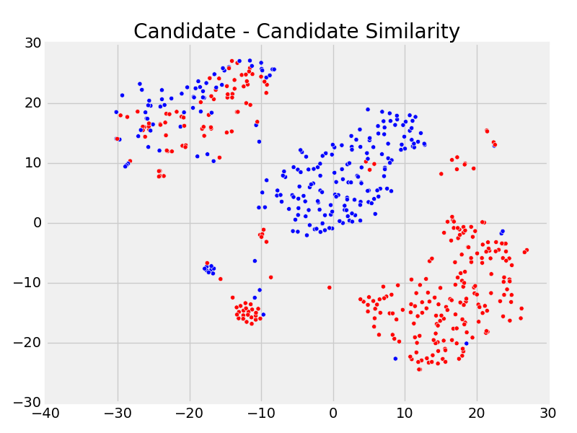
Part 1: Cluster by Ideology

Slide 5
Part 1: Cluster by Ideology
Politicians vote within their cluster about 81% of the time.
In the more homogenous clusters, they vote with their cluster 90% of the time.

Slide 6
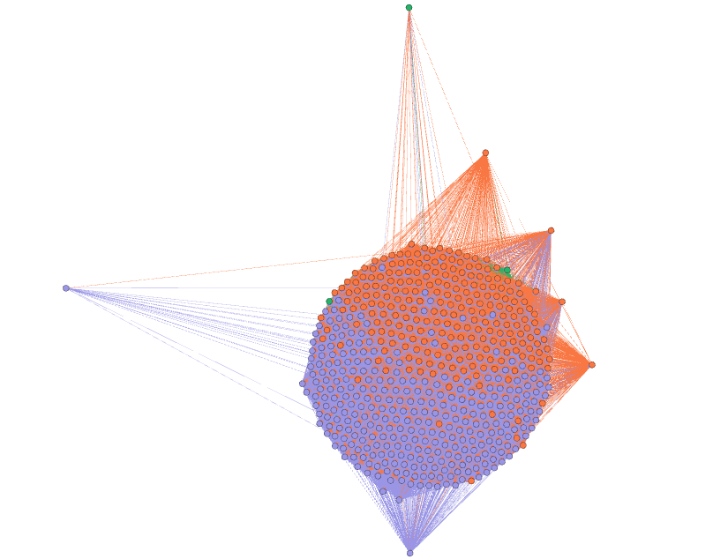
Part 2: Network Analysis by Party
Democrats and Republicans cluster themselves in force-directed graphs

Slide 7
Part 2: Network Analysis by Party
Democrats and Republicans cluster themselves in force-directed graphs
Even still, there’s not as much separation between the two parties as we might expect…

Slide 8
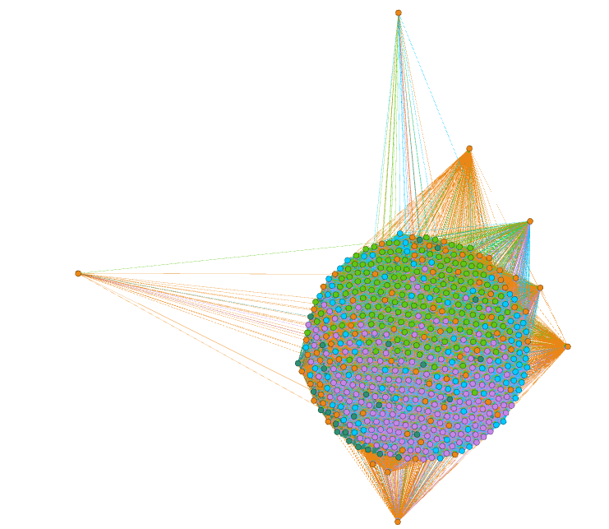
Step 3: Network Analysis by Cluster
Our clusters also appear somewhat homogeneous in this graph

Slide 9
Step 3: Network Analysis by Cluster
Our clusters also appear somewhat homogeneous in this graph
These clusters give us a more fine-grained view of communities of candidates.

Slide 10
Graphs and Centrality Measures
Eigenvector centrality is a good measure of the degree to which a politician votes with her party.

Slide 11
Graphs and Maximum Flow
We can also use these graphs to chart the influence of donors and committees on legislation.

Slide 12
Graphs and Maximum Flow
We can also use these graphs to chart the influence of donors and committees on legislation.
Proof TBD!!

Slide 13
Conclusion
We can cluster candidates by ideology based on campaign contribution, and use these clusters to make predictions about voting behavior.

Slide 14
Conclusion
We can cluster candidates by ideology based on campaign contribution, and use these clusters to make predictions about voting behavior.
We can also use this data to build graphs that help us visualize the relationships between candidates.

Slide 15
Conclusion
We can cluster candidates by ideology based on campaign contribution, and use these clusters to make predictions about voting behavior.
We can also use this data to build graphs that help us visualize the relationships between candidates.
This graph can also be used to generate further features to predict voting behavior, and to analyze how particular votes may be influenced by donors.

