Slide 1
Two Ways to Achieve a Highly Available SaltStack Implementation
William Cannon, hospitalityPulse, Infrastructure Architect
#SaltConf15
Notes:
Hello
My name is ...
Welcome to my presentation…
Before we start…How many have:
Used the salt reactor?
Written a salt runner?
Run a multi-master configuration?
Use AWS?
We’re starting at a high conceptual level…and with time remaining will end looking at code.

Slide 2
Who am I?
Co-founder of hospitalityPulse
Studied chemistry, computer science
Python is my language of choice
SaltStack is my platform of choice for all things DevOps
SSCE – certified at SaltConf14
Enjoying the weather here in Salt Lake…really.
Notes:
SSCE = salt stack certified engineer
I live in Minneapolis. This forecasted low today is -5.

Slide 3


Background with SaltStack
First “real” project: Minion Testing Army for Gaming Company
Objective:
Spin up / configure up to 1000 servers across all Amazon AWS regions “instantly”
Monitor all servers – standard linux metrics
Shut down all servers “instantly”
This was before cloud formation was available – boto + saltstack
Notes:
Wanted to share a few projects where I've used SaltStack
MachineZone wanted an "army" of testing servers
Big selling point – very quick iteration of custom modules – did it during a conference call

Slide 4


Background with SaltStack (cont’d)
Project: Hadoop on “real” racks of servers for Supply Chain Mgmt Co.
Objective:
Validate environment and necessary resources
Install / configure a set of servers with Cloudera Hadoop
Validate everything working correctly after installation:
Every server can communicate to all other servers / ports
MapReduce jobs run correctly with expected solutions
Notes:
Jabil
Long term real hardware clusters sold in groups of racks
Success depended on flexibility, overstate system, and remote execution
One input csv file

Slide 5

Background (cont’d)
Work full-time for hospitalityPulse, Infrastructure Architect
First SaltStack Project at Company:
Deploy Custom Lamp Stack Application
Uses Salt FileServer, Salt Client and Custom Modules
Parallel Deployment of Application in ~ 6 seconds
http://devopslogic.blogspot.com/2013/09/deploying-typical-lamp-application.html
Notes:
Currently ... hPulse First project was parallel deployment of lamp stack application
Previous deployment took 60 - 70 seconds (fabric)
After several updates ..
service restarts
custom module to locally check web apps

Slide 6
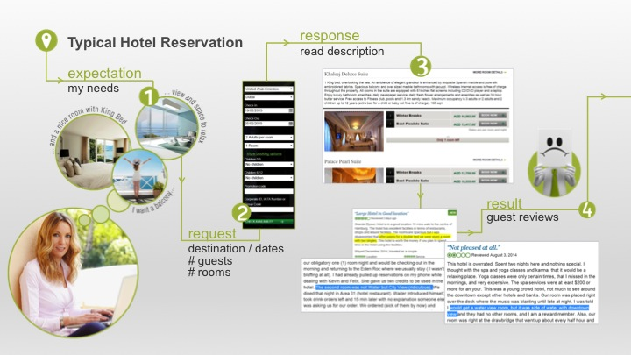
What roomPulse does…
Notes:
"A word from my sponsor" -- generous, open source
A little bit about hospitalityPulse's main product
When you make a hotel reservation you are making an abstract agreement. You are not reserving a room.
The time a room is assigned to you is when you check in, not when you book a room.

Slide 7
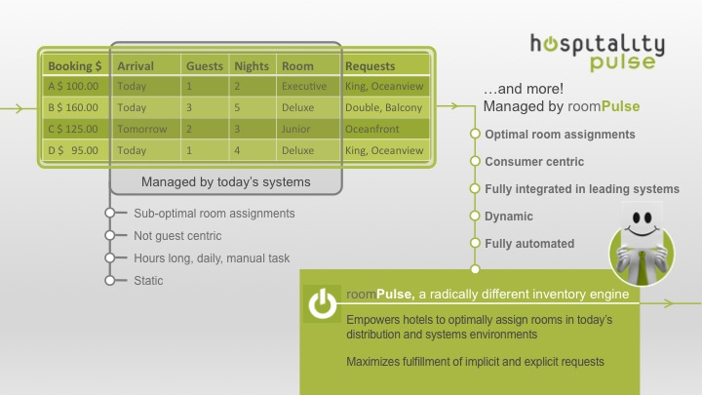
Room assignments…not easy.
Notes:
Believe it or not hotel room assignment is a difficult optimization problem
- bed types, number of beds
- amenities of room - like ocean view
- upgrades / downgrades
- cancellations, room status
- look into the future (2 weeks)
- maximize profit
Finding a fit for all rooms at the same time

Slide 8
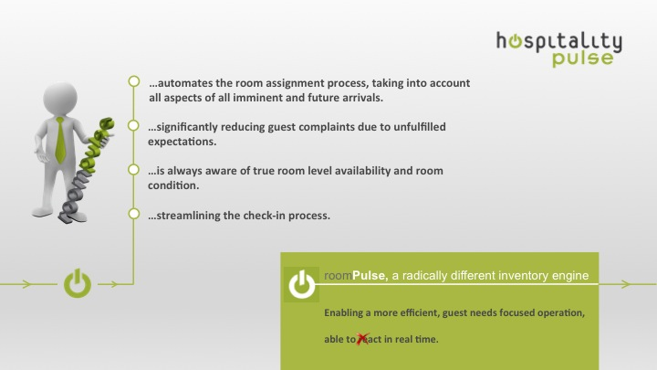
The end result
Notes:
In the end, we consider all guests requests, hotel reservations, and optimize the room assignment for :
- guest satisfaction
- hotel profitability

Slide 9
Motivation for SaltStack HA
Currently Use SaltStack for:
Configuration management
Deployment
Verification of custom application performance
Ad-hoc command execution
We want the infrastructure to be:
Highly Available
Self-healing
Entirely automated
Notes:
We are an open source, cloud company.
We love SaltStack. We use pillars, states, custom modules, the salt client (api)...
We want to make sure that what we count on is always available. And, we want to avoid manual labor whenever possible.
Our challenge is to have an environment that fixes itself.

Slide 10
Caveats
Our environment is entirely AWS based
OS is Ubuntu 14.04 LTS
SaltStack version in use is Helium (2014.7.0)
Any automation will be done with AWS and Python
** Principles applied here should translate to other environments
Notes:
The work done so far is focused on specific technologies.
- aws
- ubuntu linux
- saltstack (helium)
- python

Slide 11
What is a highly available system?
No single point of failure
System should recover from problems / failures without human action
Auto-provisioning of resources when needed
** Implicit assumption of either eliminated or minimized disruption of service
Sounds easy, right?
Notes:
Many definitions of highly available system.
Some people set up two systems and consider it HA, and it is, until one of them fails.
Some deal with acceptable downtime or unavailability.
Some deal with automation.
We’ll expand, and iterate on this definition, eventually creating our HA system

Slide 12
How does this apply to SaltStack?
No single point of failure →
Recovers without human action →
Should provide additional resources when necessary →
Master that reincarnates as itself, or perhaps 2+ Salt Masters
System software detects failures and takes corrective action
Detect a need for additional Salt Masters, and launch more
Notes:
Let’s start by translating this definition of “highly available” to SaltStack
- Review the points

Slide 13
SaltStack Multi-Master Requirements
Master Requirement
Must use the same master.pub and master.pem files
/etc/salt/pki/master/{master.pem,master.pub}
* no limit to number of redundant masters
Minion Requirement
Minion configuration file entry for ‘master’ should be converted to yaml list with items being salt master ip addresses or dns names
http://docs.saltstack.com/en/latest/topics/tutorials/multimaster.html
Notes:
What does the SaltStack documentation say is required to run a multi-master environment?
Fairly simple and straight-forward.
Note: there is not a built-in way for masters to share data for administration. In short, we have to find a solution.

Slide 14
What do we need to deal with?
Masters share nothing:
Minion keys must be managed by each Master
** or we could ‘share’ the /etc/salt/pki/master/{minions*} directories directly
States are not shared (file_roots) [gitfs, salt.fileserver.s3fs]
Pillars are not shared (pillar_roots) [gitfs, salt.pillar.s3]
Notes:
Masters are not team players
Each master runs completely independently from the others.
It is recommended that we keep the states / pillars in sync between servers.
Let’s update our requirements

Slide 15
Our requirements are…
Service that monitors a master, replacing failed master
Method to share master pub/priv key between masters
Process to handle key management of new / terminated minions
Minions must be aware of the master dns names or ip addresses
A way to keep the state tree / pillars and etc. in sync between masters
Notes:
Further translating our goal to specific requirements we now have...

Slide 16
Solution One: Big List of Components
CloudFormation
Auto-Scaling
S3
IAM roles / profiles
Route53
SNS
SQS
Custom code: minion key management
Salt reactors
Salt runners
Notes:
And now we have come to solution number one.
This list combines Amazon aws services with SaltStack services to provide a highly available SaltStack.
--- go over each item in list ---

Slide 17
Is this the ec2-autoscale-reactor?
Short answer: No.
Long answer: Very nice project. Heavily inspired by it. But, no.
The ec2-autoscale reactor reacts to auto scaling messages sent by SNS directly to a salt master. It then uses salt-cloud to install salt via ssh, and continue with state management, and etc.
https://github.com/saltstack-formulas/ec2-autoscale-reactor
Notes:
To the keen observer a number of the services in the solution sound like the ec2-autoscale-reactor.
In fact, I evaluated that solution. It did not fit all the requirements. But, it is a very nice project
I recommend you check it out - github link below

Slide 18
That sounded great. Why shouldn’t we use the ec2-autoscale reactor?
Minion key management is an issue with pre-seeded keys
Requires running a webserver on the salt master
The webserver cannot be easily secured to allow traffic only from SNS
Messages from SNS may be lost if the salt master is interrupted
We may not want the salt-minion to be installed this way (pre-built ami)
Doesn’t address replacing a salt-master
Notes:
Designed to be run as the only master
Preseeds minion keys
Requires ssh keys
Installs salt-minion - to speed up launch time we will likely pre-bake fully cooked machine images (amis)
The project is meant to solve key management for minions in aws autoscaled groups, not HA

Slide 19
What is the solution?
Make use of AWS services wherever sensible
Add custom software to meet SaltStack HA requirements, and our overall design goal

Slide 20
AWS Components of Solution One
CloudFormation – declarative syntax for infrastructure services (aws)
Auto Scaling Groups – replace failed servers automatically
S3 – bootstrap scripts, storage of files to share between salt masters
IAM – roles/profiles assigned to servers in place of credentials file
SNS – Auto Scaling events notifications (minion keys to accept/delete)
SQS – Subscribe to SNS Auto Scaling events (master gets a queue to pull from)
Route53 – using cnames for salt masters, statically set on minions
Notes:
CloudFormation can be thought of like salt states using salt orchestrate but for amazon resources
And a picture is worth a thousand words….

Slide 21
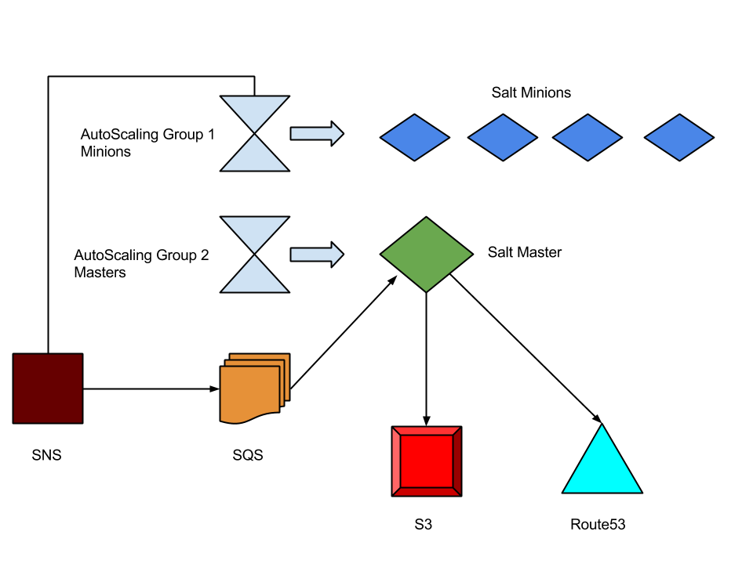
AWS Components
Notes:
An AutoScaling group provides a way to ....
- pass data
- run scripts
- define number and type of servers
SQS - no message loss, polling, not open to world
S3 - master keys, minions db, boot scripts
Route53 - cnames for salt master names

Slide 22
Custom Components of Solution
saltmaster_bootstrap.sh
dns_update.py
aws_im.py
salt reactors
salt runners
Notes:
And because everyone likes pictures…

Slide 23
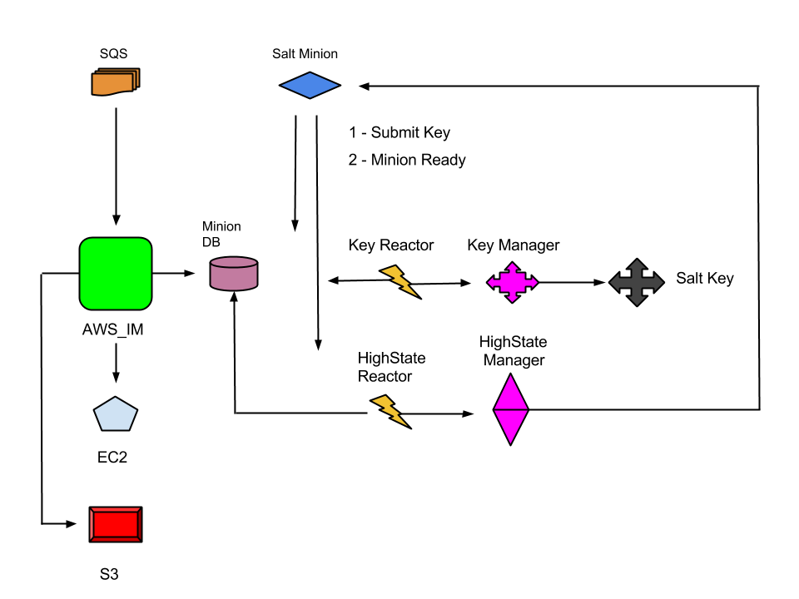
Custom Components
Notes:
aws_im manages the minion db file by polling sqs for messages about minions at termination or launch
the key reactor simply calls the key manager when a minion submits its key to be accepted
(scroll down)
a key manager looks up the minion key in the minion db, accepting the key if found by using the salt.Key
the highstate reactor simply calls the highstate manager when a minion sends its "ready" event.
the highstate manager uses the salt client to connect to the minion and determine if a highstate has been run before, is not currently running a highstate, runs the highstate
Note: the minion db is a simple yaml file on the salt master. when updated a copy of it is pushed up to s3....
** for startup of a new salt master

Slide 24
saltmaster_bootstrap.sh
On a new master, script runs on first boot only
Takes parameters from AWS Auto Scaling (region, queue, dns name…)
Creates and populates /etc/salt/ha directories and ha-config
Installs salt-master, local salt-minion, grains and configs
Accepts minion key on salt-master, runs highstate (salting itself)
Updates dns cname for salt-master
Syncs minions db file from S3 bucket
Syncs master pub/priv key pair in S3 bucket – first in “wins”
Notes:
This is how a salt master is born.
Data is passed into the master at launch, and it sets up what it needs to be a productive salt master.

Slide 25
dns_update.py
Reads in ha-config file (region, cname to set)
Determines the aws ec2 assigned dns name of server
Updates cname value in route53
E.g. sol1-salt1.devopslogic.com → ec2-54-87-187-54.compute-1.amazonaws.com
** DNS resolution in AWS gives private ip of server (e.g. 10.0.10.5)
Notes:
Minions need to find the masters
I created a little script for a master to determine its amazon aws dns name, and update a cname in route53
Effectively the salt minions use the same dns names even when we replace salt masters

Slide 26
aws_im.py
Uses info in ha-config file (region, queue name)
Maintains the minion db file (a simple yaml file)
Manages messages in SQS queue
Uploads minion db file to S3 bucket when updates occur (for new salt masters)
Deletes minion keys from Salt Key
Notes:
This script runs via startup, handling the minion key database file.
There is a delay between an instance launch with sns notification, and the time an instance is booted up and ready to do something. Usually this is around 5 minutes.
I named the script for aws instance management. But, it’s been pointed out to me that you could call it awesome.

Slide 27
Salt Reactors
Key_manager.sls
- Catches salt/auth messages
Highstate_manager.sls
- Catches salt/key messages

Slide 28
Salt Runners
Key Manager (key_manager.py)
If minion id in minion db, accept key
Highstate Manager (highstate_manager.py)
Run highstate on minion….
Only if not already run once
Only if not currently running highstate
After highstate, set file to show highstate ran once

Slide 29
So, how did we do?
(AutoScaling) Service that monitors a master, replacing failed master
(bootstrap script) Method to share master pub/priv key between masters
(aws_im.py) Process to handle key management of new / terminated
minions
(dns) Minions must be aware of the master dns names or ip addresses
(gitfs) A way to keep the state tree / pillars and etc. in sync between masters
Notes:
A master can fail, but is replaced. Not exactly a single point of failure…but spin up of a saltmaster could take several minutes.
SaltStack requirement fulfilled

Slide 30
Solution Two: Let’s improve it a little – 2 salt masters
1 salt master in aws availability zone 1
1 salt master in aws availability zone 2
Benefits:
Geographically separate – can tolerate a zone force majeure
Either salt master can control all minions – less downtime of Salt platform
Notes:
Solution One was a good start.
But, what if we want to use two availability zones in aws? Or what if we can not tolerate the salt master being unavailable for 5 minutes?

Slide 31
What changes do we have to make to support two salt masters?
New Auto Scaling Group - CloudFormation
Additional SQS queue - CloudFormation
Handle race conditions for the highstate_manager (Update logic)
Update minion configs to two masters
Notes:
Solution One was pretty good. Let's add onto it and handle the issues that arise.
- new auto scaling group - easy parameter passing
- new sqs queue - easy way to have auto scaling notifications go to both masters
- need a way to handle the situation that both masters want to run a high state on a new minion

Slide 32
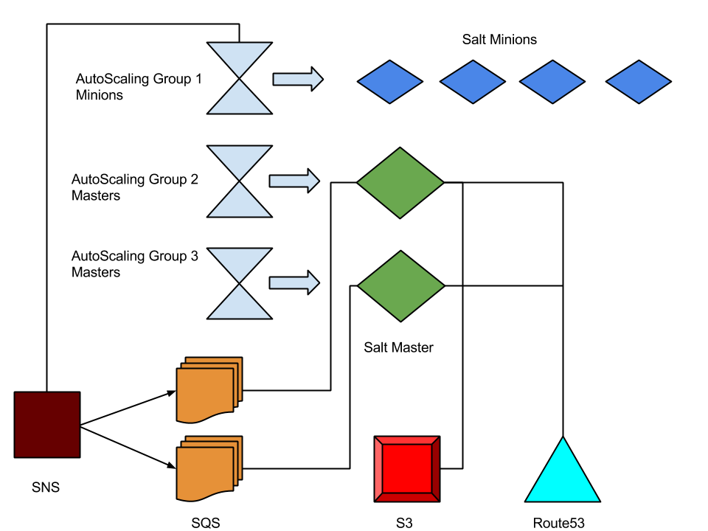
Solution Two Aws Components
Notes:
Here's the updated diagram
we also need another dns name to

Slide 33
Code for solutions one and two
Open Source
git@github.com:wcannon/saltconf2015.git
Instructions on how to set up solution one and solution two are in repository
Some changes necessary in Cloud Formation
These are prototypes – but a great start
Notes:
Here's the good news.
All of the work done is open source. It is real, and ready for use. And, I am really happy that my company is supporting the open source community by sharing this with everyone.

Slide 34
Lessons learned
Sometimes cloud formation does not work
Use separate Cloud Formation templates for long-term services (e.g. S3, SQS) versus ephemeral uses (e.g. vpc + servers – special demo / test group)
Pre-baked AMIs would save significant time and reduce possible bootstrap errors
Auto Scaling groups make it difficult to use static IP addresses – DNS cname update driven by salt master
Keep components self-contained and as simple as possible

Slide 35
Considered but not chosen
S3FS-FUSE – user space mountable file system using S3 bucket [latency, race conditions]
GlusterFS – really nice clustered file system software [added complexity for initial setup and recovery scenarios]
DRBD + Pacemaker – (distributed replicated block device) and heartbeat / failover [split brain scenarios, complexity]
Re-use of EBS storage between ec2 instances [complexity of tracking and etc – tags?, not enough benefit]
Notes:
So, what is next….
Solution Three – starting next week

Slide 36
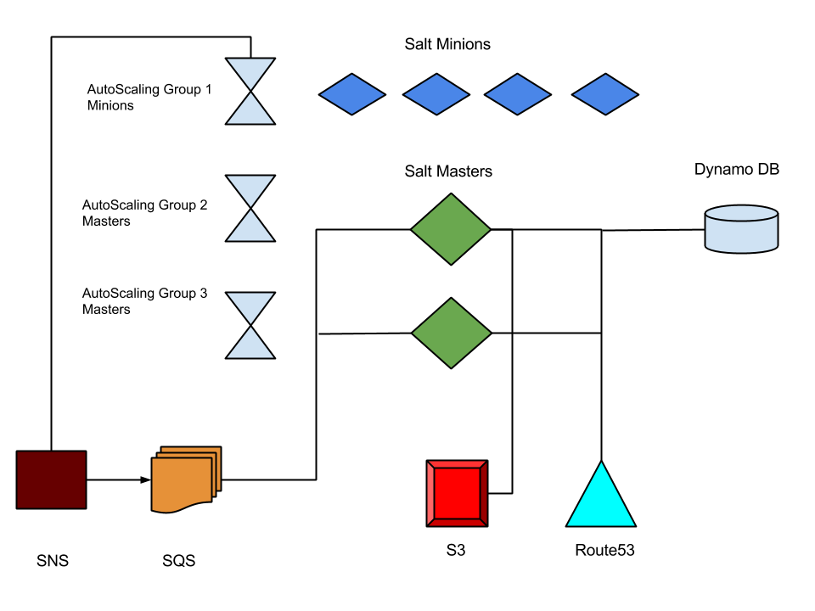
Will likely move minion db file into DynamoDB aka Solution Three
Notes:
Solution Three will likely add the use of dynamo db.
The minion db info, and highstate race conditions can be easily handled there.
I might even make the master assignment for minions dynamic.

Slide 37
Questions?
Now is the time to ask…
Notes:
No questions…or done with questions…
Ask if anyone would like to go over the code for the reactors/runners.

Slide 38
Thank you
Please provide session feedback in the SaltConf15 mobile app
#SaltConf15

