Slide 1
NEWS ARTICLE TOPIC
CLASSIFICATION
Using BiLSTM and BERT
Comparative study of recurrent and transformer-based text classification on the AG News dataset
B.Tech (Artificial Intelligence & Machine Learning) • 5th Semester
Presented by:
Tanmay patil
Bibhukrupa Samal
Swayam Sampurna Sahu
Nandini Gupta
Guide: Mr. Yugansh Varshney
Academic Year 2026–2027

Slide 2
Problem Statement & Objectives
Problem Statement
Objectives
Automatically classify news articles into four topics—World, Sports, Business, and Sci/Tech—and compare a BiLSTM baseline with a fine-tuned BERT classifier.
Build an exactly 20,000-sample balanced AG News dataset.
Train a BiLSTM baseline and fine-tune BERT.
Compare accuracy, Macro F1 and training time.
Evaluate BERT data efficiency at multiple training sizes.
Visualize BERT multi-head attention weights.
4
20K
7,600
Classes
Selected articles
Official test
2

Slide 3
Dataset & Data Preparation
AG News — fancyzhx/ag_news
Dataset portion | Samples | Purpose
Selected project dataset | 20,000 | Balanced subset
Training | 16,000 | Model training
Validation | 4,000 | Development
Official test | 7,600 | Final evaluation
Class distribution
World — 5,000
Sports — 5,000
Business — 5,000
Sci/Tech — 5,000
Preparation
Sampled 5,000 examples per class.
Shuffled with a fixed random seed.
Stratified 80/20 train-validation split.
Official 7,600-example test set kept separate.
3

Slide 4
Overall Methodology
AG News
Preprocess
BiLSTM
BERT
Evaluate
→
→
→
→
20K balanced
Two pipelines
Embedding → BiLSTM
WordPiece → Transformer
Accuracy • F1 • Time
Additional BERT analysis
Data efficiency: 2K, 5K, 10K, 15K and 16K training samples.
Attention visualization: selected heads from the final BERT layer.
4

Slide 5
BiLSTM Baseline
Lowercase whitespace tokenization.
Training-set vocabulary with <PAD> and <UNK>.
Maximum sequence length: 60 tokens.
Embedding → bidirectional LSTM → dropout → linear classifier.
Loss: CrossEntropyLoss; Adam optimizer; learning rate 0.001.
Training: 5 epochs; batch size 64.
84.00%
83.94%
Test Accuracy
Macro F1
15.44 s
Training Time
Role
Provides the recurrent neural baseline for comparison with the pretrained Transformer.
5

Slide 6
BERT Classifier
Model: bert-base-uncased.
Pretrained WordPiece tokenizer; maximum length 128.
Attention masks preserve valid token positions.
BERT encoder + task-specific four-class classification head.
AdamW; learning rate 2×10⁻⁵; weight decay 0.01.
Fine-tuning: 2 epochs; train batch 16; eval batch 32.
92.93%
92.91%
Test Accuracy
Macro F1
800.37 s
Training Time
[CLS] representation
The final [CLS] representation is used by the classification head to predict one of four topics.
6

Slide 7
Experimental Setup & Evaluation
Item | Configuration
Dataset | 20,000 selected + 7,600 official test
Classes | World, Sports, Business, Sci/Tech
BiLSTM | 5 epochs; batch 64; Adam; LR 0.001
BERT | 2 epochs; batch 16; AdamW; LR 2e-5
BERT sequence length | 128 tokens
Metrics | Accuracy, Macro F1, Training Time
Data efficiency | 2K, 5K, 10K, 15K, 16K
Final model comparison uses the same official 7,600-sample test set.
7

Slide 8
Final Model Results
Model | Accuracy | Macro F1 | Training Time
BiLSTM | 84.00% | 83.94% | 15.44 s
BERT | 92.93% | 92.91% | 800.37 s
Observed result
BERT achieved 8.93 percentage points higher test accuracy than BiLSTM.
BERT achieved 8.97 percentage points higher Macro F1 than BiLSTM.
BERT required substantially more training time in this experiment.
8

Slide 9
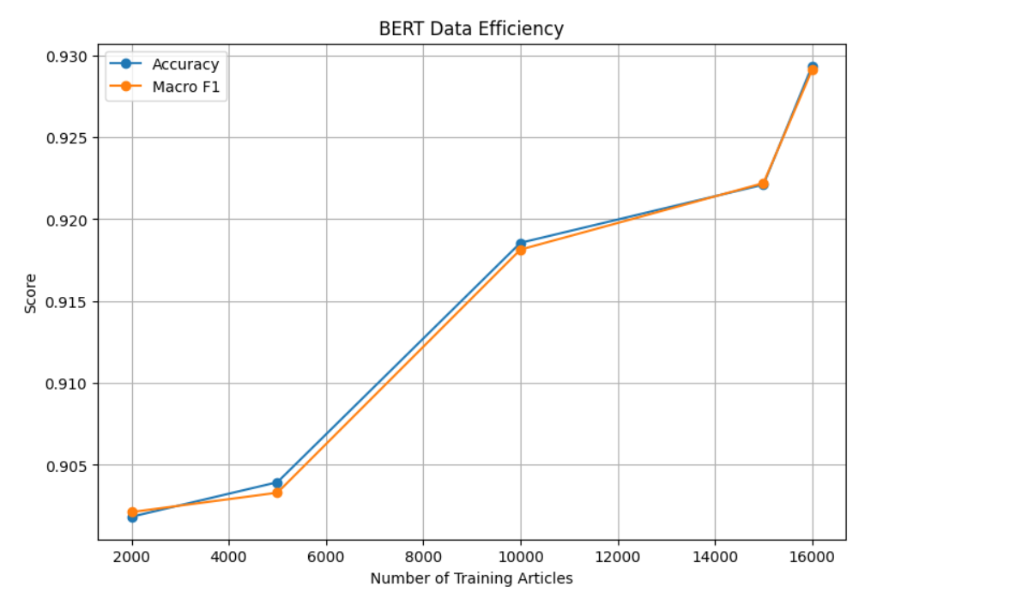
BERT Data Efficiency
Results
Size | Accuracy | Macro F1 | Time (s)
2,000 | 90.18% | 90.21% | 94.01
5,000 | 90.39% | 90.33% | 231.65
10,000 | 91.86% | 91.81% | 462.91
15,000 | 92.21% | 92.22% | 691.81
16,000 | 92.93% | 92.91% | 800.37
Accuracy and Macro F1 increased with more training data, while training time also increased.
9

Slide 10
Confusion Matrix Analysis
BiLSTM
BERT
Actual\Pred. | World | Sports | Business | Sci/Tech
World | 1601 | 95 | 121 | 83
Sports | 83 | 1763 | 21 | 33
Business | 112 | 58 | 1496 | 234
Sci/Tech | 98 | 76 | 202 | 1524
Actual\Pred. | World | Sports | Business | Sci/Tech
World | 1792 | 27 | 35 | 46
Sports | 9 | 1877 | 8 | 6
Business | 68 | 11 | 1647 | 174
Sci/Tech | 43 | 13 | 97 | 1747
The most noticeable confusion for both models is between Business and Sci/Tech. BERT shows fewer cross-category errors overall.
10

Slide 11
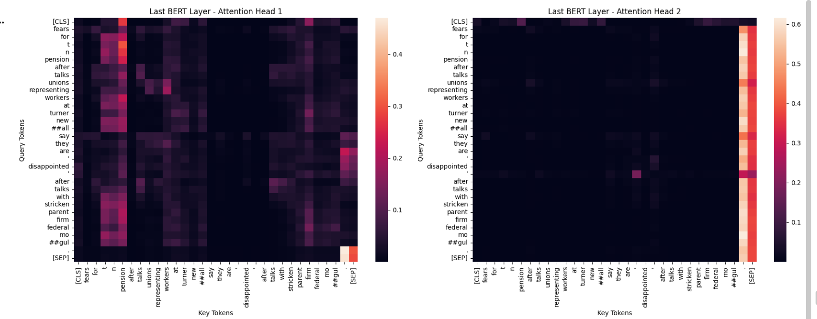
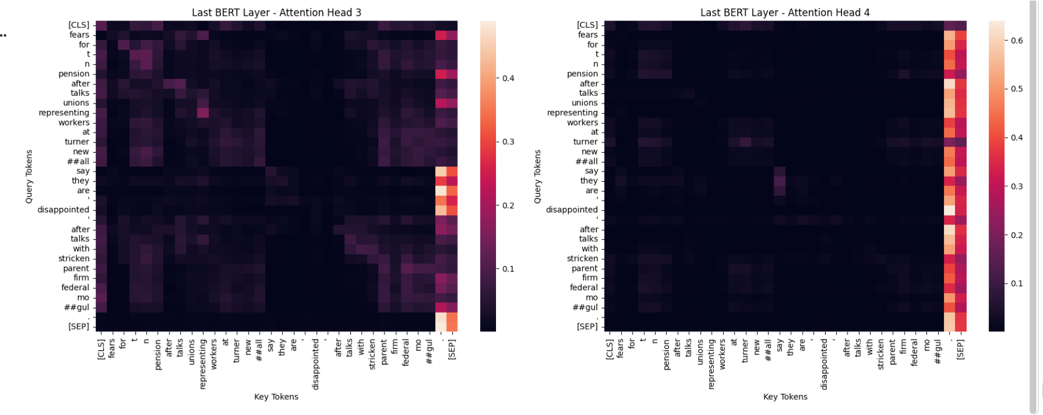
BERT Attention Visualization
What was visualized?
Attention weights from the final BERT layer.
Four selected attention heads were displayed as heatmaps.
Rows represent query tokens; columns represent key tokens.
Brighter regions indicate higher attention weights.
Different heads show different token-to-token patterns.
Attention weights provide a qualitative visualization, not a complete causal explanation of model decisions.
11

Slide 12
Conclusion & Future Scope
Conclusion
Future Scope
An end-to-end four-class news topic classification system was implemented.
BiLSTM provided the recurrent baseline; BERT was fine-tuned as the Transformer model.
BERT achieved 92.93% accuracy and 92.91% Macro F1 on the official test set.
BERT accuracy increased from 90.18% to 92.93% as training data increased from 2K to 16K.
Compare additional Transformers such as RoBERTa, DistilBERT or DeBERTa.
Evaluate data efficiency for both model families.
Experiment with sequence lengths, learning rates, batch sizes and epochs.
Extend to more categories or multilingual datasets.
Deploy through a web API or interactive application.
12

Slide 13
References
1. Devlin, J. et al. (2019). BERT: Pre-training of Deep Bidirectional Transformers for Language Understanding.
2. Hochreiter, S. & Schmidhuber, J. (1997). Long Short-Term Memory. Neural Computation.
3. Vaswani, A. et al. (2017). Attention Is All You Need. NeurIPS.
4. Zhang, X., Zhao, J. J. & LeCun, Y. (2015). Character-level Convolutional Networks for Text Classification. NeurIPS.
5. Hugging Face Datasets — AG News dataset: fancyzhx/ag_news.
6. Hugging Face Transformers documentation — BERT / AutoModelForSequenceClassification.
7. PyTorch documentation — PyTorch machine learning framework.
Thank You
13

