Slide 1
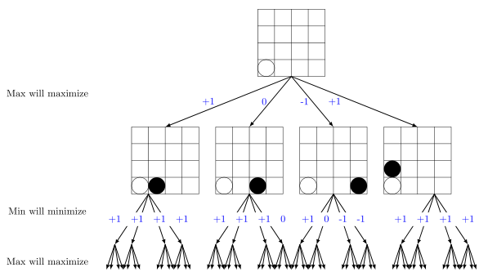
Typical 2-player perfect information game algorithm: Minimax tree

Slide 2
Motivation
Connect five has 225 states, so a search to depth p would be 225^p
Parallelize!

Slide 4
Processor 1
Processor 2

Slide 5
Improvements
Evaluation of game state:
Efficiently calculates number of 1-in-a-row, 2-in-a-rows, …, 5-in-a-rows for each player and uses weighted combination of these values for both player
Smart move ordering:
To allow for maximum pruning we want to evaluate the moves with most potential first – we evaluate starting from the last move played
Load balancing:
Split the potential best moves among processors so each can prune a lot on their respective branch of the tree
Pass alpha values at the top level to each other

