Slide 1

Coding Models Access To Developers
Coding Models Access
IDE & Coding Assistants
Coding Models Finalized
OATILLM Gateway
OATILLM Gateway Architecture
Kimi K2.6
Qwen3-Coder-30B
Gemma 4 27B
OATILLM Gateway Implementation
OATI Code – Coding Assistant
OATI LLM Gateway
OATI Code
Open Access Technology International · May 2026

Slide 2
IDE & CODING ASSISTANTS
Two IDEs, two plugins and our own plugin and coding assistant – OATI Code.
VS Code + Continue
VS Code + Cline
VS Code Visual Studio + OATI Code
Free, MIT-based IDE
Same IDE, autonomous agent flavour
Same IDE, autonomous agent flavour
Continue: inline chat + autocomplete
Multi-step file edits, tool use
Multi-step file edits, tool use
Talks to /v1/chat/completions
Talks to /v1/chat/completions
Same OpenAI-compatible base URL
Best for: refactors, codebase Q&A
Best for: autocomplete- workflows
Best for: refactors, codebase Q&A
Enhanced functionality like Claud Code, Cursor etc.
Common config: Base URL = your gateway; API Key = SSO-issued virtual key.
PROPRIETARY AND CONFIDENTIAL | Open Access Technology International | 2026

Slide 3
CODING MODELS ACCESS - GOAL
CONTROLLED ACCESS
AUTO MODEL SELECTION
CONTINUOUS MONITORING
Per-team tiers L0-L3 · JIT elevation · per-project virtual keys. Every IDE → same gateway → same policy chain.
Smart router picks the cheapest acceptable model. Operator override always allowed; rule chain is YAML-editable.
UEBA scores 10 signals per user with rolling baselines. Auto-quarantine on misuse · full audit trail with reveal flow.
Companion documents: docs/LLMGateway-Implementation.docx · docs/ARCHITECTURE.md · docs/architecture.svg
PROPRIETARY AND CONFIDENTIAL | Open Access Technology International | 2026

Slide 4
LLM GATEWAY COMPARISON AND SELECTION
Dimension
OATILLMGateway (A)
LiteLLM-backed (B)
Winner
Cold import
~700 ms · 406 modules
~6,150 ms · 2,148 modules
A (8.4–8.9×)
Per-call overhead (p50)
0.48 ms
12 ms (published)
A (~25×)
Per-call overhead (p99)
0.87 ms
43 ms (published)
A (~50×)
Throughput (RPS, 1 worker)
2,004
1,036 (2 instances, 8 cores)
A
Core dependencies
3
4
A
SDK LOC (completion.py)
323
487
A (leaner)
Total LOC (src/llmgateway)
10,162
10,326
≈ tie
Test suite
452 tests
452 tests
tie
Provider coverage
31 routes
31 routes (via LiteLLM)
tie
License model
MIT throughout
MIT (Limited features) + LiteLLM (MIT core, paid tier)
A (clean)
PROPRIETARY AND CONFIDENTIAL | Open Access Technology International | 2026

Slide 5
LLM GATEWAY ARCHITECTURE
DEVELOPER IDEs
POLICY-ORIENTED LLM GATEWAY
MODEL BACKENDS
OATILLMGateway · Policy & Routing Pipeline
VS Code + Continue + Cline
Kimi K2.6
1 AuthN
vLLM @ shared GPU box
Resolve API Key → User
2 AuthZ
VS Code + OATI Code
L1, L2, L3, L4 · Model ACL · Quota
Qwen3-Coder-30B
3 DLP
Presidio PII · regex · guardrail patterns
vLLM @ shared GPU box
4 Smart Router
Auto-pick model by length, intent, budget
Gemma 4 27B
Visual Studio IDE + OATI Code
vLLM @ shared GPU box
5 Inference
Forward to vLLM model & stream back
6 Post-call
Output secret scan · tokens track · audit
OBSERVABILITY BUS
Postgres audit · SIEM (Splunk / ELK) · Prometheus + Grafana · UEBA baselines · 4-eyes raw access
PROPRIETARY AND CONFIDENTIAL | Open Access Technology International | 2026

Slide 6
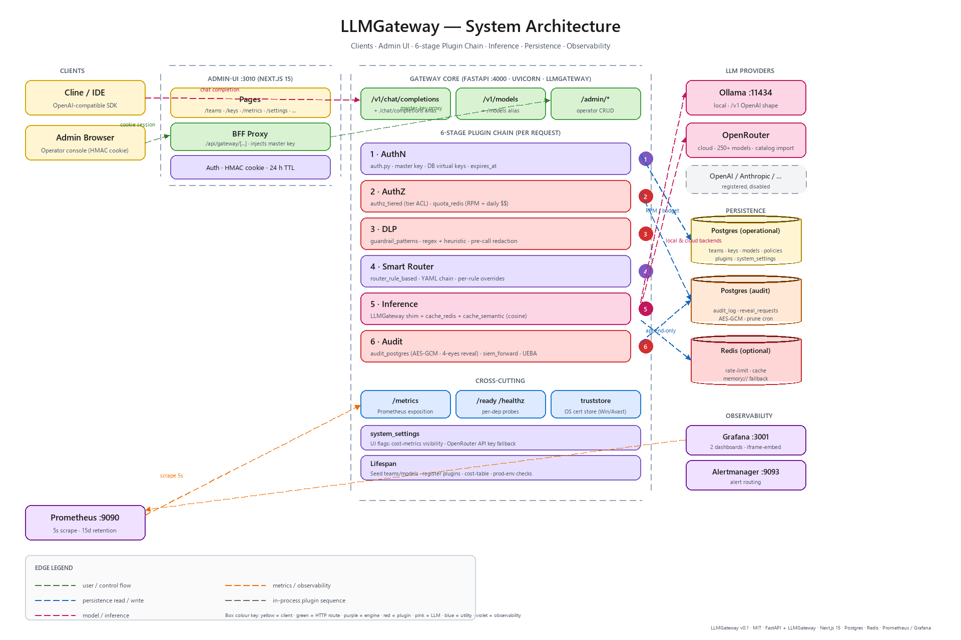
LLM GATEWAY ARCHITECTURE
PROPRIETARY AND CONFIDENTIAL | Open Access Technology International | 2026

Slide 7
LLM GATEWAY AUTHORIZATION
Access Tiers — L0 to L3 + Quarantined
TIERS
Every virtual key is bound to one tier. Tiers consolidate budget, model ACL, agent permissions and override rights into a single named bundle that's easy to audit and easy to change.
Tier
Models allowed
Budget / day
Agent mode
Override
Typical user
L0 Read-only
Gemma 4 only
20 k tokens
Disabled
No
Interns, contractors (first 30 d)
L1 Standard
Gemma 4 + Qwen3-Coder
100 k tokens
Tools but no shell
No
Most full-time engineers
L2 Senior
+ Kimi K2.6
300 k tokens
Full agent + shell
Yes
Tech leads, principals
L3 Privileged
All + experimental
Unlimited (4-eyes audit)
+ custom MCP tools
Yes + provider direct
2–3 named platform engineers
Quarantined
None
0
Disabled
No
Any user × triggered alert
Just-In-Time (JIT) Elevation Flow
Project-Scoped Keys
Dev hits /elevate portal · picks reason
Per-repo / per-project virtual keys
Manager (different person) approves in Slack
key-bk-pub → works anywhere
Temporary upgrade for 4 hours, auto-revokes
key-bk-cust → only inside customer-data/* repo
Full audit trail: who-approved-what-and-why
Lost laptop → revoke pub key; project key needs CI env
PROPRIETARY AND CONFIDENTIAL | OATI Technology | AI Model Evaluation 2026

Slide 8

Input DLP — Presidio Pipeline
DLP
Every prompt is scanned before it leaves the gateway. Hits on configured patterns are either redacted (default) or refused (strict teams).
Detectors enabled
Per-policy actions
Built-in: Person, Email, Phone — Presidio default recognisers
REDACT (default)
Replace match with <PII_TYPE> token; forward; log finding
Built-in: Credit Card, IBAN — PCI-relevant data
Built-in: AWS keys, GitHub PAT — common cloud / VCS secrets
REFUSE (strict)
Return 422 to IDE; do NOT forward; log finding + alert
Built-in: SSN, Aadhaar — region-specific national IDs
WARN (training)
Forward; log finding; surface gentle warning in IDE
Custom: customer-id regex — OATI-prefixed account numbers
Custom: regulated-repo path — /regulated/* paths in stack traces
NEVER LOG raw
Audit trail stores HASH of redacted text, not plaintext
Custom: PEM blocks — BEGIN PRIVATE KEY / certificates
Custom: high-entropy strings — likely-secret heuristic (>4.5 bits/char)
ALERT on rate spike
> 5 hits / dev / week → manager notification
PROPRIETARY AND CONFIDENTIAL | OATI Technology | AI Model Evaluation 2026

Slide 9
Guardrails — Prompt Injection, Output Filtering
GUARDRAILS
Two layers — defending the system prompt and policy from malicious input, and scrubbing the model's reply before it returns to the dev.
Input — pre-call hooks
Output — post-call hooks
Prompt-injection / jailbreak detection (LLM Guard)
Secret-pattern scan (TruffleHog / detect-secrets)
Refusal of "ignore previous instructions" / "system prompt"
High-entropy string detection (> 4.5 bits/char)
Off-topic / NSFW (custom NeMo Guardrails rails)
Output PII scan (echo of input PII)
Token-bomb / context-flood protection (> 100k tokens refused)
Hallucinated internal-URL detection (custom)
Off-task abuse (e.g., bulk translation, image gen prompts)
Code-output linting for unsafe patterns (eval, exec)
Block + log + alert on any positive hit
PROPRIETARY AND CONFIDENTIAL | OATI Technology | AI Model Evaluation 2026

Slide 10
Activity Monitoring — UEBA & Misuse Detection
MONITORING
Continuous behavioural baselining + signal-based alerts. Catches insider threat, policy violations and DLP-bypass attempts — without rummaging through every prompt. Ethics guardrails enforced by design, not policy.
Signals we watch (auto-baselined per user, alert at ≥ 3σ)
UEBA tooling
Signal
What it catches
Splunk UBA / Microsoft Sentinel UEBA
Volume anomaly
10× baseline tokens in a day
OSS: ELK + Elastic SIEM detection rules
Hour-of-day anomaly
Activity at 3 AM from a 10–6 user
Daily security digest → SOC inbox
Model-mix anomaly
Junior hits premium model 50×/day
Auto-quarantine: 3 signals → key disabled
DLP hit rate
Same user > 5 DLP hits / week
Quarterly red-team with decoy prompts
Prompt-topic drift
Competitor names, exfil keywords
Ethical guardrails (non-negotiable)
Jailbreak attempts
"Ignore previous instructions…"
Transparent monitoring; in AUP
Off-task usage
Recipes, gambling, personal chat
Purpose limitation: security ONLY (no perf-review use)
Refusal-velocity
10 refusals in 5 min = bypass attempt
4-eyes access to raw prompt text
DPDP Act 2023 + GDPR Art 5 compliant
Sensitive-keyword
Customer IDs / repo paths / PEM blocks
Retention: 90 d hot · 1 yr cold · hard delete
Cross-team boundary
Backend dev asking about HR data
Right to explanation if quarantined
PROPRIETARY AND CONFIDENTIAL | OATI Technology | AI Model Evaluation 2026

Slide 11
Smart Router — Automatic Model Selection
SMART ROUTER
The gateway picks the best model per prompt — based on length, intent and team policy — instead of asking the developer. Manual override always allowed; every routing decision is fully transparent in response headers.
Three-strategy ladder
Routing decision table (rule-based starter)
Prompt characteristic
Routes to
Rule-based (regex + length)
≤ 100 tokens, no tools, no code blocks
Gemma 4 27B
Ship in S2 · 70% accuracy · < 1 ms latency · zero cost
> 100 tokens, code blocks, refactor intent
Qwen3-Coder 30B
Embedding similarity (semantic-router)
Tool use / function calling / multi-step plan
Kimi K2.6 (if tier allows)
Add in S3 · 85% accuracy · 30–80 ms · small compute
Prompt has DLP-tagged content
Self-host only (never cloud)
Daily budget > 80% consumed
Force cheapest model
Classifier-LLM (tiny model decides)
Cache-hit (semantic dedup)
Skip inference; return cached
Only if (1)+(2) miss · 92% accuracy · 100–300 ms · 1 extra call
Transparency requirements — never hide the routing
Response header X-LLM-Model-Used: qwen3-coder-30b
Response header X-LLM-Routing-Reason: "long code block — default workhorse"
IDE badge: "Answered by Qwen3-Coder" — visible every reply
Override: ?model=kimi-k2.6 forces a specific model (logged, counted against that model's budget)
Admin UI: dev can see their last 24h routing distribution
Watch: override-rate per user — leading indicator the router is making bad calls
PROPRIETARY AND CONFIDENTIAL | OATI Technology | AI Model Evaluation 2026

Slide 12
SECURITY THREATS POSSIBILITY
Identity
Authorization
Data exfil (in)
Anyone on the LAN hits the model anonymously
Junior dev runs senior-grade agent + quotas
Dev pastes PII / secrets / regulated code
Impact: Stolen laptop = free model for an attacker
Impact: Interns running production-grade refactors
Impact: GDPR breach, lost IP, secrets in logs
Data exfil (out)
Cost / abuse
Audit / forensics
Model regurgitates a secret it saw earlier
One dev fires a 50-tab fuzz loop
"Did anyone send our auth code to the model?"
Impact: Leaked API keys appear in chat replies
Impact: Shared GPU saturated; legitimate users blocked
Impact: No answer = de facto breach during review
Each threat maps 1:1 to a control on the next slide.
PROPRIETARY AND CONFIDENTIAL | Open Access Technology International | 2026

Slide 13
What's Built — Gateway, Admin UI, Observability
Gateway
Admin UI
FastAPI :4000 · uvicorn
Next.js 15 :3010 · 4-theme picker (light/dark/solarized)
/v1/chat/completions · /v1/models · /admin/* · /metrics · /ready
Sidebar grouped by pipeline stage (AuthN → Audit)
LLMGateway shim — drop-in for LiteLLM Router
Settings · Models tab (typed form per provider) · App tab
Truststore (OS cert store) — works behind SSL-MITM AV
OpenRouter catalog browser · one-click import
Persistence
Observability
Postgres × 2 (operational + audit)
Prometheus :9090 · 5 s scrape · 15 d retention
audit_log body AES-GCM-encrypted at rest
Grafana :3001 · 2 provisioned dashboards · iframe-embedded
4-eyes reveal flow for plaintext access
Alertmanager :9093 · routes Prometheus alerts
Redis (optional) · in-memory fallback for dev
UEBA per-user baselines · 10-signal radar
All built. Verify status via /ready and the admin UI's Observability page.
PROPRIETARY AND CONFIDENTIAL | Open Access Technology International | 2026

Slide 14
CLUSTERING AND LOAD BALANCHING – YES SUPPORTED
The gateway is mostly stateless by design. Add a second replica behind a load balancer once these three caveats are addressed.
PER-PROCESS STATE — move to Redis for multi-replica
CLUSTER-SAFE TODAY — shared by construction
quota_redis
Postgres (op + audit)
In-memory counters when memory:// — each replica enforces its own RPM cap → effective limit × N.
Every replica reads / writes the same rows · no extra config.
cache_redis + cache_semantic
Audit log · UEBA · DLP findings
In-process dict on memory:// — cache hit rate drops by 1/N per replica.
Persist to Postgres · any replica sees the same view.
Plugin chain + Router config
TLS truststore + session cookies
Hot-reload only the receiving process — add Redis pub/sub or accept 'effective on restart'.
Per-process bootstrap · same SESSION_SECRET on every replica.
RECOMMENDED TOPOLOGY · 100 DEVELOPERS
nginx / Traefik with ip_hash → 2-3 gateway replicas → shared Postgres + shared Redis → GPU box (vLLM · Qwen3-Coder-30B + Gemma 4 27B) + OpenRouter (Kimi K2.6). Health-check /ready · sticky sessions for SSE streams.
PROPRIETARY AND CONFIDENTIAL | Open Access Technology International | 2026

Slide 15
HARDWARE REQUIREMENTS
HARDWARE — single-box dev vs 100-dev production
Component
Single-box dev
Clustered (100 devs)
Gateway
~600 MB · 1 vCPU · workers=1
8-16 GB · 4-8 vCPU · 2-3 replicas
Admin UI
~300 MB · 0.5 vCPU
shares a gateway box
Postgres
1-2 GB · 1 vCPU · 20 GB disk
8-16 GB · 4 vCPU · ~36 GB/year audit
Redis
100 MB (or memory:// fallback)
1 GB · 1 vCPU
GPU box (vLLM)
not required for dev
1× RTX 6000 Ada (48 GB) for 30B + 27B
Total (no GPU)
~4 GB · 2 vCPU · 20 GB
see rows above
PARALLEL CALLS — gateway-only overhead is ~10-15 ms per request. Real cap is the backend.
Backend
Concurrent per worker
Real bottleneck
OpenRouter / cloud (Kimi K2.6)
~500-1000 streams
Provider's per-key rate limit + your daily $ budget
vLLM self-host (Qwen3-Coder 30B)
8-15 active completions, queued beyond
GPU throughput (40-120 tok/s aggregated, batched)
Ollama (smaller local models)
2-3 streams
CPU/GPU · Ollama doesn't auto-batch
Mix (Smart Router picks)
Each request takes whichever fits
Mix of the above
WORKED EXAMPLE · 100 devs × 5 calls/hr × 30 s avg = ~4 concurrent streams at peak. One GPU + one gateway worker comfortably handles 100 devs. Daily $ budget + RPM caps are the safety net, not raw capacity.
PROPRIETARY AND CONFIDENTIAL | Open Access Technology International | 2026

Slide 16
At a glance
IDE: VS Code extension
Runtime: TypeScript · Node 20
OATI Code
10+ workspace packages
An Agentic Coding Assistant for VS Code, Visual Studio
60+ built-in tools
Architecture · Benefits · Comparison
5 modes: Ask → Auto
Multi-Provider
MCP Native
Parallel Agents
Open Source
MIT-licensed
Open Access Technology International · 2026

Slide 17
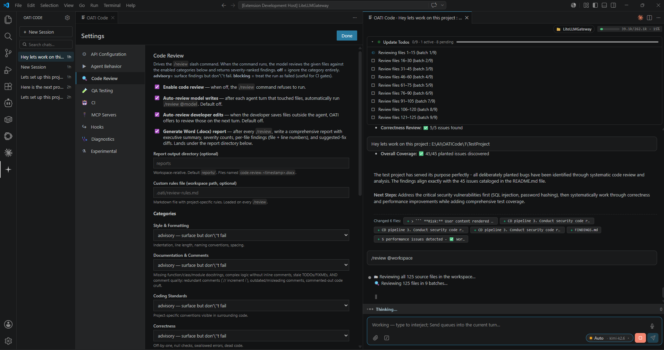
OATI Connect UI
PROPRIETARY AND CONFIDENTIAL | Open Access Technology International | 2026

Slide 18
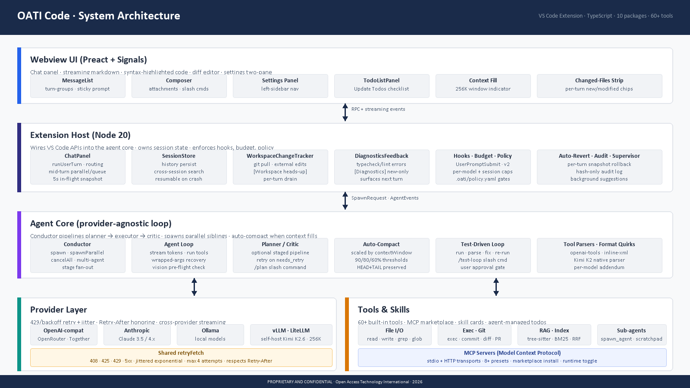
Architecture Diagram
Four-tier pipeline from webview to providers + tools
PROPRIETARY AND CONFIDENTIAL | Open Access Technology International | 2026

Slide 19
Core Components
What each package owns — and how they compose
Conductor
Agent Loop
Providers
Spawns agents · planner/critic stages · cancellation
Streams the model · executes tools · enforces caps
OpenAI · Anthropic · OpenRouter · Ollama · LiteLLM
Tools
Hooks & Memory
Webview UI
Read · Write · Exec · Grep · MCP · Sub-agents · 60+
OATI.md · facts · skills · rules · policy gates
Preact · markdown · streaming · settings panel
PROPRIETARY AND CONFIDENTIAL | Open Access Technology International | 2026

Slide 20
Why OATI Code is Better
The thesis, in plain English
Models stay themselves. The assistant adapts around them.
Most assistants force every model into one code path — the lowest common denominator.
Other assistants ask:
OATI Code asks:
"How do we support EVERY model with one code path?"
"What does THIS model need to perform at its best?"
Lowest-common-denominator JSON tool format
Native parsers per model — Kimi markers parse, not drop
Generic compaction at a fixed % across all models
Compaction thresholds scaled by each model's window
"Don't do X, don't do Y" prompts that scold the model
Smart args-recovery — the assistant fixes JSON, model stays sharp
Reasoning channel ignored — looks like empty response
Reasoning channel surfaced with 💭 prefix — visible, not lost
Provider 429s burn the turn — no retry
429 / 5xx retried with jitter + Retry-After honoring
PROPRIETARY AND CONFIDENTIAL | Open Access Technology International | 2026

Slide 21
Gets MORE Out of the Model
Five concrete ways OATI Code lets the model perform at its best
Speaks the model's native tool-call language.
1
Kimi K2.6 emits `<|tool_call_begin|>` markers; Cline/Continue/Aider see them as plain text and the call vanishes. OATI has a native parser, so calls actually fire.
Doesn't insult the model with fix-my-output prompts.
2
No "don't do X" scolding bolted to the system prompt. When args are malformed, the assistant fixes the JSON encoding silently — the model stays confident and writes better code.
Uses the model's full memory.
3
Cline auto-compacts at flat 80% on every model — Kimi 256K trims back to ~205K for no reason. OATI scales: 90% for 500K+ models, 80% for 100K+, 60% for small. Big-codebase work fits.
Surfaces thinking output instead of dropping it.
4
DeepSeek-R1, GPT-o1, Kimi K2.6 thinking-mode stream reasoning on a side channel. Most assistants see only the main channel and silently fail. OATI surfaces reasoning with a 💭 prefix.
Catches provider-side quirks at the gateway.
5
OpenRouter routes Kimi to mixed backends — some emit broken FP4 markers. OATI pins routing to clean providers (Fireworks, Together) automatically for Kimi-class models.
PROPRIETARY AND CONFIDENTIAL | Open Access Technology International | 2026

Slide 22
Gets Out of the Model's Way
Six concrete ways OATI Code removes friction between you and the model
Tests fail? Agent already sees them.
External file edits → heads-up note.
Mid-turn message? Parallel agent.
Run typecheck, it errors, send your next message — OATI prepends `[Diagnostics] N new errors` automatically. Others need copy-paste.
`git pull` or edit a file outside the chat → `[Workspace heads-up]` tells the model what changed. Others plow ahead with a stale mental picture.
Cline/Continue/Copilot queue your follow-up. OATI can spawn a sibling agent on a separate task in parallel — both work concurrently.
Webview crash? You don't lose the reply.
Provider 429? Retry with backoff.
Context running low? You can SEE it.
Every 5s during a long stream, OATI persists in-flight history. Reload Window → partial response is still there. Others save only at turn boundaries.
Jittered exponential, honors `Retry-After`, 4 attempts. OpenRouter bursts no longer burn the turn — fewer red errors, fewer re-runs.
A `184k / 256k · 72%` chip in the toolbar shows the current turn's prompt vs. the model's window — green/amber/red tiers. No mystery empty responses.
PROPRIETARY AND CONFIDENTIAL | Open Access Technology International | 2026

Slide 23
Robustness — 2026-05-26 Sprint
Six features that harden the agent for big-codebase work
429 / Backoff Retry
Parallel Mid-Turn Agent
Workspace Heads-Up
Jittered exponential · honors Retry-After · 4 attempts on transient failures
Send a message mid-flight → spawn a sibling agent on a new task (Kimi-friendly)
[Workspace heads-up] note prepended when files change outside the agent (git pull, etc.)
Diagnostics Feedback Loop
Resumable In-Flight Snapshot
/test-loop Slash Command
[Diagnostics] note auto-injects new typecheck/lint errors into the next turn
5s setInterval persists streaming history — webview reload preserves partial response
Run tests → fix failures → re-run; bounded loop with per-iteration user approval
PROPRIETARY AND CONFIDENTIAL | Open Access Technology International | 2026

Slide 24
Long-Context & UX Polish
Harness the full 256K of Kimi K2.6 — and show it
Scaled Auto-Compact. Threshold scales by contextWindow — 90% / 80% / 60% — so 256K models compact at ~190K, not artificially early.
Context windows supported
Scaled HEAD/TAIL. Compaction preserves 4+30 turns on 500K+ models, 2+20 on 100K+, 2+10 on smaller. No dropping into 8K mode.
Kimi K2.6
262,144 tokens
Context-Fill Indicator. Topbar chip shows current turn vs. window as bar + percent with green/amber/red tiers — capacity in use is visible.
Gemini 1.5
1,048,576 tokens
Sticky Turn-Group Header. Each turn lives in its own block; user prompt stays pinned at top while you scroll long replies.
Claude 3.5
200,000 tokens
Recently-Changed-Files Strip. Per-turn chips below assistant bubble — click to open new files or modified diffs vs pre-turn state.
GPT-4o
128,000 tokens
Streaming Polish. rAF-throttled auto-scroll · highlight.js skip during stream · code-block collapse · contain: layout style.
DeepSeek V3
131,072 tokens
Llama 3.1
131,072 tokens
PROPRIETARY AND CONFIDENTIAL | Open Access Technology International | 2026

Slide 25
Model Adaptability
Native support for the quirks open-weight models bring
Kimi K2.6 Native Parser
Wrapped-Args Universal Recovery
Vision Pre-Flight Check
State machine for `<|tool_call_begin|>` markers — works even when providers stream them as text (FP4 quants).
JSON candidate enumeration: peel quotes, de-escape, smart-quote fix, tolerant regex. Catches 12+ known shapes.
Image attachment + text-only model → clear error before request fires. Catches Kimi text-only mismatch upfront.
Guardrail-Aware Errors
Per-Model Prompt Addendum
ModelQuirks Registry
OpenRouter prompt_injection / guardrail_blocked → diagnostic message with recovery options surfaced in chat.
Kimi / Qwen / Gemma get extra format reminders (args-must-be-JSON, terseness). Frontier models don't pay the tax.
Per-model: contextWindow, maxTokens, toolCallFormat, supportsVision — single source of truth across the stack.
PROPRIETARY AND CONFIDENTIAL | Open Access Technology International | 2026

Slide 26
Code Review — `/review`
Quality is a first-class subsystem, not a prompt the user has to write each time
14 Review Categories
/review @workspace
Diff-Style Suggested Fixes
Style · docs · standards · correctness · security · perf · maintainability · testing · types · deps · architecture · a11y · i18n · observability — each user-tunable off / advisory / blocking
Walk the workspace, batch 15 files per model call, accumulate findings; update-todos panel ticks off `batch 3/9 done` as it runs
Findings carry verbatim before/after blocks — drop-in apply, rendered as diff in chat and color-shaded in the Word report
Auto-Review on Agent Writes
Word `.docx` Reports
Custom Workspace Rules
Post-turn hook re-reviews any file the agent just wrote — flags new issues before they land in your codebase
Brand-navy heading · severity-count table · BLOCKING / ADVISORY chips · findings grouped by file with monospace path bands · auto-opens in Word
`.oati/review-rules.md` extends the prompt with project-specific conventions; FileSystemWatcher invalidates the cache live — no reload
Where others stop: Cline / Cursor / Copilot ship code only — no structured review pass. Claude Code has todos but no `/review`. OATI Code makes review a separate, configurable lane.
PROPRIETARY AND CONFIDENTIAL | Open Access Technology International | 2026

Slide 27
QA Testing — `/qa` + `/ci`
Six QA modes · workspace-wide batching · multi-framework auto-detect · CI workflow generation
Six Subcommands
/qa @workspace
Multi-Framework
`/qa plan` · `/qa unit` · `/qa edge` · `/qa regression` · `/qa coverage` · `/qa security` — each tuned to a specific QA pass
`unit` / `edge` / `security` can sweep the whole repo — 15 files per batch, merged Word report, per-batch todo checklist
Auto-detects vitest / jest / pytest / mocha / unittest / junit from package.json · pyproject.toml · pom.xml · build.gradle
Diff-Style Issue Fixes
Auto-Open Reports
`/ci init` Scaffolding
Security findings + coverage gaps carry the same before/after blocks `/review` uses — Word report renders them as red/green diff
`/qa plan` writes TEST_PLAN.md and lands the cursor on it · Word reports open in Word the moment they're ready
Emits GitHub Actions · GitLab · CircleCI · Azure Pipelines · TFS workflows seeded from your QA settings — typecheck, lint, tests, coverage thresholds
Where others stop: Most assistants will write a test if asked — none ship a structured QA subsystem with workspace batching, severity-tiered findings, Word reports, and CI scaffolding under one command.
PROPRIETARY AND CONFIDENTIAL | Open Access Technology International | 2026

Slide 28
Comparison
OATI Code vs. Cline · Continue · Cursor · Copilot · Aider
Capability
OATI Code
Cline
Continue
Cursor
Copilot
Aider
Multi-provider models
10+ providers
Multi
Multi
Limited
OpenAI only
Multi
Agent loop + sub-agents
Yes
Yes
Limited
Limited
No
No
Planner + Critic stages
Yes (toggle)
No
No
No
No
No
MCP server support
First-class
Yes
Preview
Limited
Preview
No
Workspace memory + skills
OATI.md + skills
Rules only
Slash cmds
Basic
No
Conventions
Kimi K2 native parser
Yes
Via gateway
Via gateway
Limited
No
Via gateway
256K context utilisation
Scaled compact
Flat 80%
Flat
Limited
128K cap
Manual
Diagnostic feedback loop
Auto-inject
Manual
Manual
Limited
No
Manual
Parallel mid-turn agents
Yes
Queue only
Queue only
Queue only
No
No
In-flight resumable
5s snapshots
Turn-end
Turn-end
Turn-end
No
No
Test-driven loop + approval
Yes (/test-loop)
No
No
Limited
No
Yes
Inline diff approval
Per-hunk
Per-file
Per-file
Per-file
Inline only
Per-file
Open source / forkable
Yes (MIT)
Yes
Yes
No
No
Yes
PROPRIETARY AND CONFIDENTIAL | Open Access Technology International | 2026

Slide 29
Advantages & Benefits
Why OATI Code stands apart in the agent-IDE space
Provider-Agnostic. Switch between OpenAI, Anthropic, OpenRouter, Ollama, LiteLLM without changing prompts.
Proof points
Agentic by Design. Planner · Critic · Parallel sub-agents — not just chat-around-edits.
10+ providers supported
MCP-Native. First-class Model Context Protocol — plug any tool server in seconds.
60+ built-in tools
Configurable Modes. Ask, Plan, Code, Auto-Edit, Auto — choose autonomy per task.
MCP marketplace
Workspace Memory. OATI.md, persistent facts, skills, rules — survives every session.
Inline diff approval
Open & Inspectable. Clean-room TypeScript build — read the code, fork the tools.
Policy-aware gates
Budget guardrails
PROPRIETARY AND CONFIDENTIAL | Open Access Technology International | 2026

Slide 30
Built to be Yours
An agentic coding assistant on your terms
Your Open Source Models. Your OATILLMGateway. Your OATICode. Your Workspace.
OATI Code stays out of your way until you need it — and stays open when you do.
Install
Configure
Author OATI.md
Ship Faster
Get started
Make it yours
Trust the loop
Install the extension, pick a provider, set your API key.
Drop in MCP servers, write skills, layer OATI.md memory.
Pick a mode — from read-only Ask to fully-autonomous Auto.
PROPRIETARY AND CONFIDENTIAL | Open Access Technology International | 2026

