Slide 1
Ironhack week 2 project
François-Régis André & Boubacar Traoré
EMPLOYABILTY : Create a composite indicator

Slide 2
Table of Contents
01
02
03
04
Project setup
All the necessary steps
Collecting the data
Our sources and methods we needed to collect the data
MySQL
The main queries we use in mySQL
Creating the composite indicator

Slide 3
01
Project setup

Slide 4
Choose a subject
Employabilty : comparing the employability of differents countries

Slide 5
Planning the project
Using Jira
Decomposing the steps
Assigning tasks
As the planning tool

Slide 6



Development environment
Python
Visual studio code
MySQL
As the programming language
As a code editor
As a SQL editor

Slide 7
02
Collecting the data
API & WEB-SCRAPPING

Slide 8
The differents parameters of our composite indicator
Total unemployment rate
Youth ( 15-24) unemployment rate
01
02
World bank API
With the World Bank API
Women unemployment rate
03
World Bank API

Slide 9
The differents parameters of our composite indicator
unemployment with basic education rate
Unemployment with secondary education rate
04
05
OECD scrapping
OECD scrapping
unemployment with tertiary education rate
Average amount of labor in a year
06
07
OECD Scrapping
Wikipedia scrapping

Slide 10
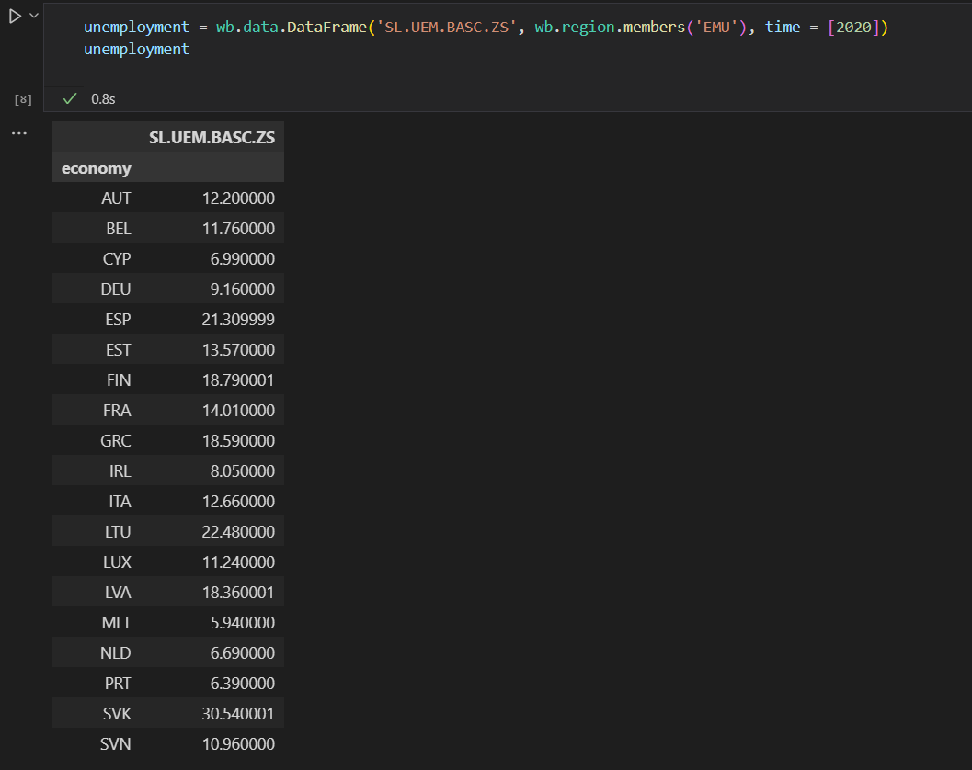
WORLD BANK API

Slide 11
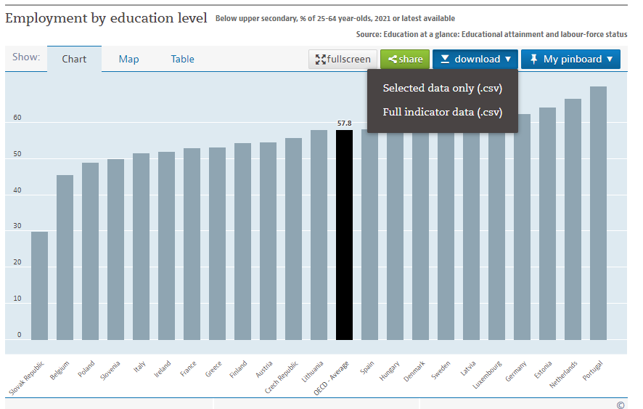
Web scrapping from OECD

Slide 12
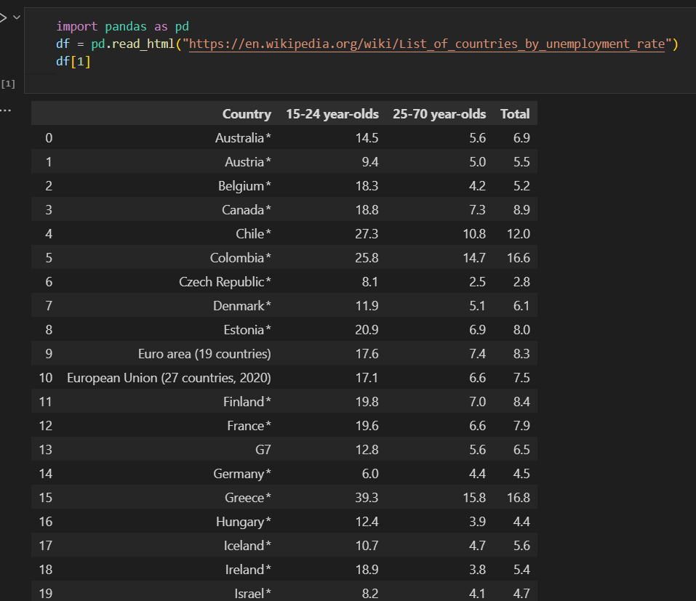
Web scrapping from Wikipedia

Slide 13
03
MySQL

Slide 14
Awards
Germany
Netherlands
Austria

Slide 15
Thanks for watching

Slide 16
Q & A

