Slide 1
DSC 530 Final Project: Vehicle Emissions Dataset
Bilal Kudaimi

Slide 2
Statistical Question
What features on a motor vehicle are most correlated with an increase in its carbon dioxide emissions?
Transportation accounts for about 26-28% of greenhouse gas emissions depending on the country. By answering this question, I will help consumers as well as myself make informed decisions on which cars to purchase to reduce our collective carbon footprint.
I also have three minor questions I would like to answer:
Do cars using premium-grade gasoline get better fuel economy compared to cars using base unleaded gasoline?
Are higher-cylinder engines more or less likely to carry a continuously variable transmission?
Are there car manufacturers that pollute more than others (i.e., are there car brands one should avoid to be eco-friendly)?
I will use a dataset of 7,385 fuel-powered Canadian vehicles from 2013-2020.

Slide 3
Dataset Variables (Chapter 1)
Make: The manufacturer of each car (model will not be used in the analysis as it is just a marketing name).
Vehicle Class: The overall shape of the vehicle, such as sedan, SUV, station wagon, etc. This variable factors in weight.
Engine Size: The displacement of the engine, or the volume swept by all the pistons, measured in liters.
Cylinders: The number of pistons within the engine.
Transmission: The mechanism used to transfer engine power to the wheels. Five transmission types currently exist: Automatic (A), Manual (M), Automated Manual (AM), Automatic Hybrid (AS), and Continuously Variable (AV).
Fuel Type: The fuel used to power the engine. Five fuels currently exist: gasoline (X), premium gasoline (Z), diesel (D), natural gas (N), and ethanol (E).
City Fuel Consumption: The estimated fuel consumed using city driving habits, measured in liters per 100 kilometers.
Highway Fuel Consumption: The estimated fuel consumed using highway driving habits, measured in liters per 100 kilometers.
Combined Fuel Consumption: An estimate of the real-world fuel economy from the car. This is NOT the arithmetic mean of the city and highway fuel economies.
CO₂ Emissions: The mass of carbon dioxide emitted by each vehicle, measured as grams CO₂ per kilometer traveled.

Slide 4
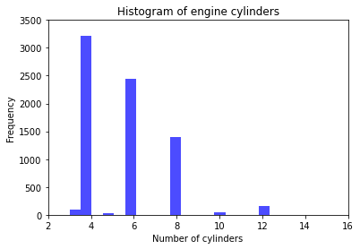
Histograms (Chapter 2)
Mean: 5.615030467163169
Mode: 4
Variance: 3.342252080994665
Skewness: 1.1101898640440213
The average number of cylinders may be near 6, but 4-cylinder engines are the most common due to their fuel economy. The 10- and 12-cylinder cars will be kept since they are heavy emitters of CO2.

Slide 5
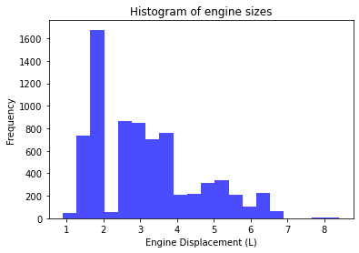
Histograms continued
Mean: 3.1600677048070125
Mode: 2.0
Variance: 1.8335293115975175 Skewness: 0.8090166237091084
The mean and most common engine size are 3.16L and 2.0L, respectively, due to car makers focusing on increasing the power output of smaller engines.

Slide 6
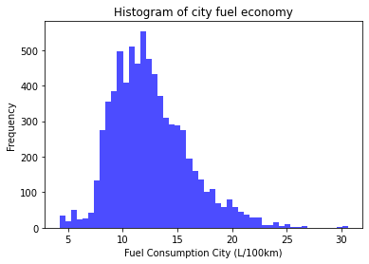
Histograms continued
Mean: 12.556533513879508 Mode: 10.8
Variance: 12.25025961515979 Skewness: 0.8088403827811873
For all three fuel consumption distributions, the higher values come from larger vehicles/engines, while the small values come from smaller vehicles/engines and hybrid vehicles.

Slide 7
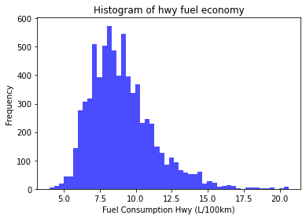
Histograms continued
Mean: 9.04170616113748
Mode: 7.8
Variance: 4.947536154687878
Skewness: 1.078997475325438

Slide 8
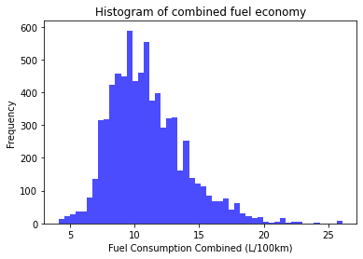
Histograms continued
Mean: 10.97507109004736
Mode: 9.4
Variance: 8.365459795216976
Skewness: 0.8931342662031229

Slide 9
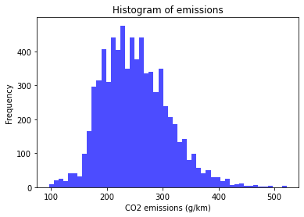
Histograms continued
Mean: 250.58469871360867
Mode: 242
Variance: 3423.270043460344
Skewness: 0.5259869435378954

Slide 10
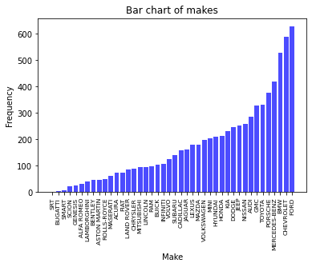
Bar charts*
Sports cars are much less frequent in the dataset due to their astronomically high prices compared to other cars.

Slide 11
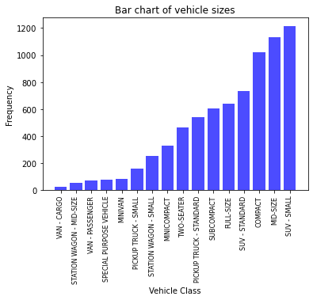
Bar charts continued

Slide 12
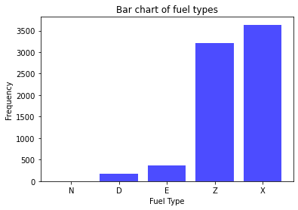
Bar charts continued
Only 1 car model runs on natural gas because the infrastructure for natural gas refueling is not as widespread as other fuels.

Slide 13
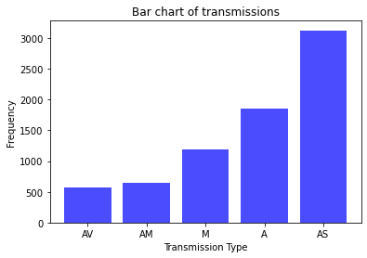
Bar charts continued

Slide 14
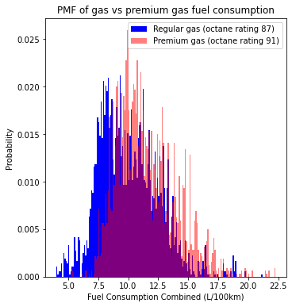
Probability Mass Function (Chapter 3)
Here, the variable is fuel consumption and the scenario is whether a car runs on regular gas or premium gas.
Below are the summary statistics of the two. We can see that premium gas has slightly different statistics.
The difference in means will be tested in a later slide.
Gas Mean: 10.084575199340101
Gas Mode: 9.4
Gas Variance: 6.071180827243045
Gas Skewness: 0.53489278479614
Premium Gas Mean: 11.422767020612149
Premium Gas Mode: 9.9
Premium Gas Variance: 5.935462299874252
Premium Gas Skewness: 0.7900462389283516

Slide 15
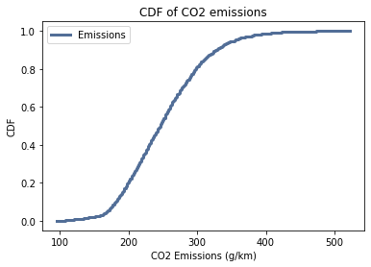
Cumulative Density Function (Chapter 4)
This CDF shows that most cars’ emissions are roughly below 300 g/km.
Thus, we can say that cars emitting around or above 300 g/km are most definitely bad for the environment.

Slide 16
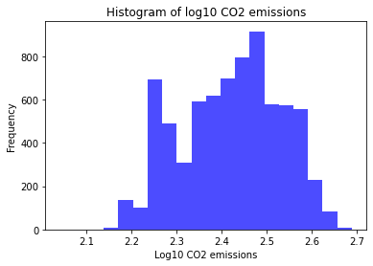
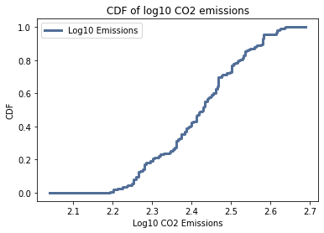
Analytical Distribution (Chapter 5)
Log Emissions Mean: 2.4195343542091905
Log Emissions Variance: 0.01207008739404742
Log Emissions Skewness: -0.08981425704872431
We can see that the distribution is approximately lognormal (supported by the skewness value).
All the emissions are within half an order of magnitude of each other (supported by the variance value). This reveals that most cars tend to have very similar emission values.

Slide 17
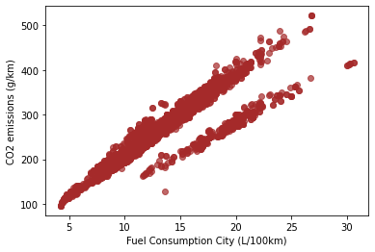
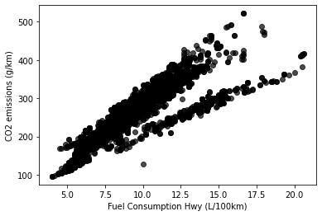
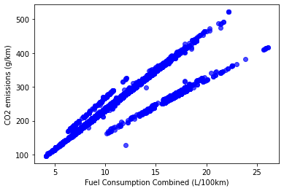
Scatter Plots (Chapter 7)
Pearson correlation: 0.919592474902484
Pearson correlation: 0.8835359454649435
Pearson correlation: 0.9180515723870852
Each plot of emissions vs fuel consumption is positively correlated and forms multiple lines. These multiple lines are due to the influence of fuel type (see the following slide).

Slide 18
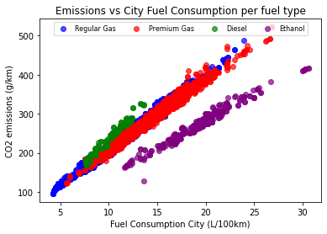
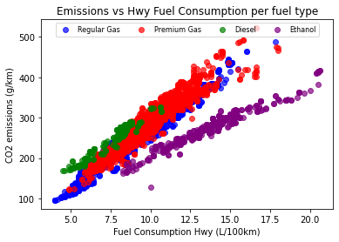
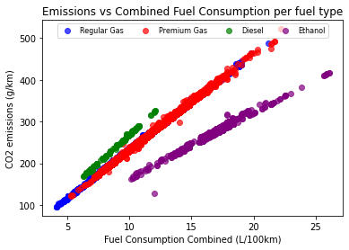
Scatter Plots continued
Pearson correlations for CO2 emissions vs city fuel consumption, separated by fuel type:
Gas: 0.9916813002841378
Premium gas: 0.9912005043729494
Diesel: 0.9880517014865934
Ethanol: 0.9820949677590284
Pearson correlation for CO2 emissions vs highway fuel consumption, separated by fuel type:
Gas: 0.9752567673414445
Premium gas: 0.9644273961679315
Diesel: 0.9722999057548193
Ethanol: 0.971276733692256
Pearson correlations for CO2 emissions vs combined fuel consumption, separated by fuel type:
Gas: 0.999104454969996
Premium gas: 0.9986701682176715
Diesel: 0.9992097488006007
Ethanol: 0.9907236726077863

Slide 19
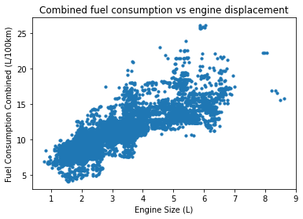
Scatter Plots continued
It is no surprise that an increase in engine displacement correlated to a linear increase in fuel consumption and thus emissions (seen in next slide).
Pearson correlation: 0.8153070402829823

Slide 20
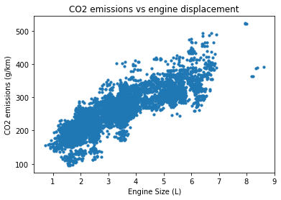
Scatter Plots continued
Pearson correlation: 0.8491893178045624

Slide 21
Hypothesis Test (Chapter 9)
Here, the difference in means between the fuel consumption of gas and premium gas cars is tested.
The p-value was found to be very close to 0, so we conclude that there is a statistically significant different between the fuel consumptions of gas and premium gas cars.
This confirms the difference seen in the earlier PMF slide.
Note that no plot is generated here, only a p-value.

Slide 22
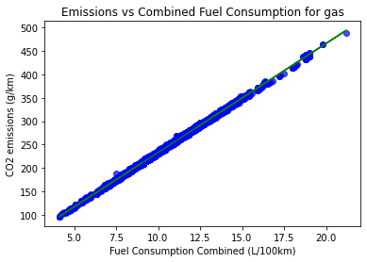
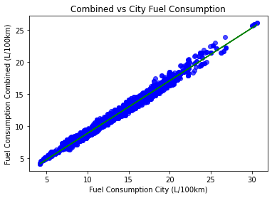
Regression Analysis (Chapter 10-11)
I have selected a few explanatory variables to run a linear regression analysis.

Slide 23
Summary
Vehicle shape, engine displacement, and fuel economy appeared to have the greatest effect on CO2 emissions. This makes sense, as vehicle shape factors in weight and air resistance, and displacement and fuel consumption affect the amount of carbon burned.
Cars running premium gas do consume more fuel than cars running regular gas. Premium gas has a greater octane rating, so I speculate the increased carbon content causes a greater combustion rate.
CVT transmissions are found mainly installed on smaller engines. CVTs are known for not being as reliable as other transmissions despite their improvement to fuel consumption, so this is most likely the reason.
Avoid sports cars! The brands that were guilty of emitting the most CO2 per kilometer were almost all sport brands (with some luxury brands as well). Alfa Romeo was strangely in the bottom third of emitters, however.
Box plots were not included with this presentation but can be found in the working code.

