Slide 1
UBLI: A Study on Soft-Core Processor Configurations for Embedded Applications
Ben Kueffler • Christopher Cole
Sasoun Torousian • Vlad Cretu
Rafi Meguerdijian • Dr. Mohammad El-Hadedy

Slide 2
Introduction
Since their inception, FPGAs have become popular due to their flexibility in creating custom hardware for a specific application without the cost of ASIC production
Processors are often desired by system designers as apart of the FPGA system
Enhances runtime control
Can reduce power [1]
Rapid development through software

Slide 3
Motivation
System on a chip solutions combining hard-processors with reprogrammable logic come at an increased cost compared to pure fabric alone [3]
Due to their nature, hard-processors can not be reconfigured after creation
Cannot create 100% application specific processor
Cannot replicate (or reduce) number of cores as application needs change
Cannot take advantage of FPGA dynamic reconfiguration
Soft-processors have significant potential by offering up reduced cost and greater flexibility
Reprogrammability is key! Processors can be specifically tailored for the exact application.

Slide 4
State of the Art
Traditionally, if a processor was warranted in an FPGA system it would need to be an external chip connected to the system.
PowerPC, ARM, etc...
But modern SoC such as the Xilinx Zynq now have processors and reprogrammable logic in the same fabric [2]
Standing to challenge these hard-processors are processors synthesized within the FPGA logic itself, called soft-processors
MicroBlaze, Cortex M1, LatticeMico, etc...

Slide 5
Purpose
Analyze the effect and realize the advantage of soft processor implementations by targeting a common embedded software application
Replicate a common system by utilizing a MicroBlaze soft processor on board an AXI bus on a Xilinx 7-Series FPGA (S7-50)
Perform RSA encryption and decryption tests and study performance, power, and utilization statistics
Six different MicroBlaze Implementations will be used, each implementing different hardware
Various pipelines
Various execution units
Branch target buffers

Slide 6
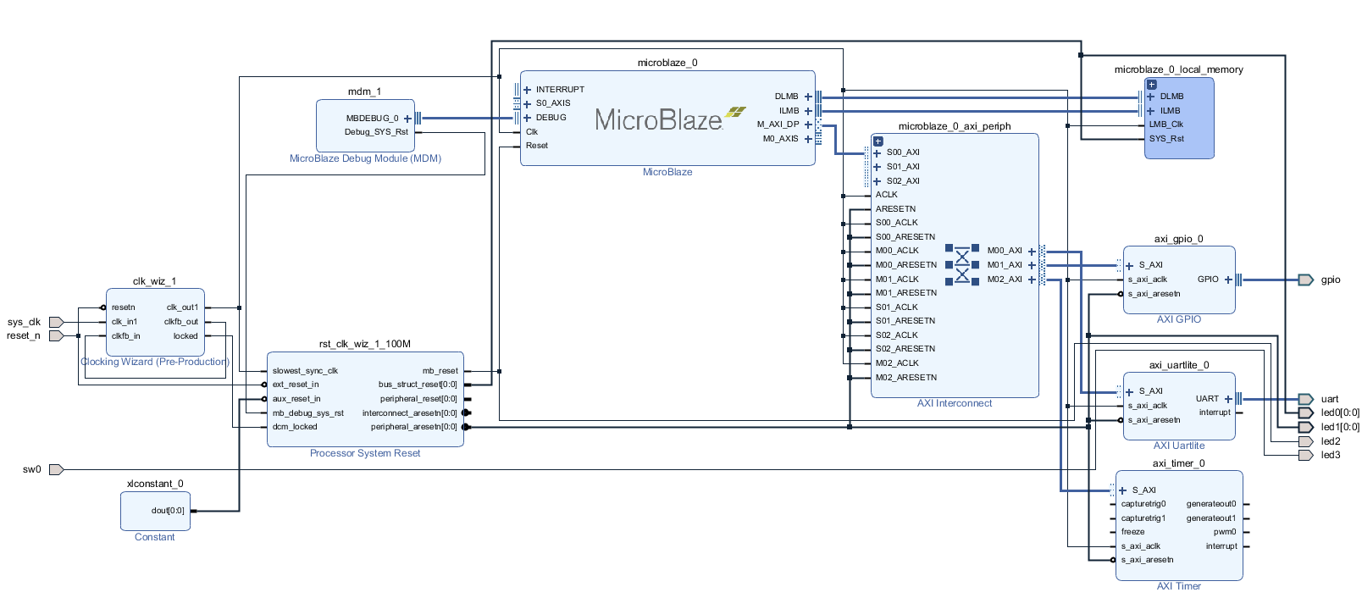
System Architecture

Slide 7
System Architecture Continued
The MicroBlaze soft processor acts as a master on the AXI bus
Commands slaves
AXI slaves include UART and Timer module
UART is used to input user data and output results for verification and status
Timer module keeps a cycle-accurate count in order to produce execution time
Clock generator allows for easy configuration of clocks different frequencies
For every processor implementation, the maximum frequency is used
Some implementations can only reach 100 MHz, others can reach 125 MHz, etc.

Slide 8
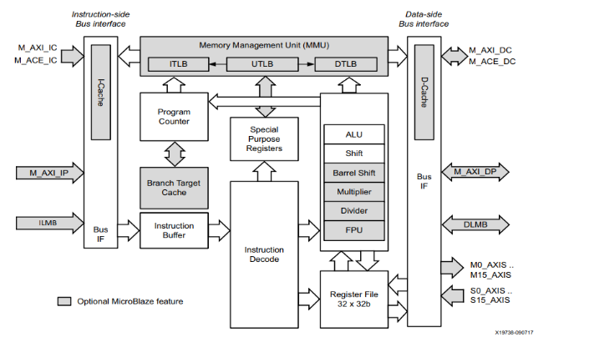
MicroBlaze core layout

Slide 9


Three Stage Pipeline
Five Stage Pipeline

Slide 10
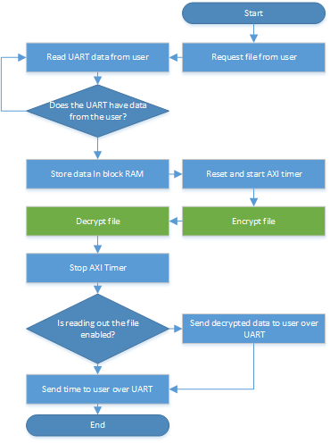
Software Architecture
Data, in the form of a file, is read in over UART
Timer is initialized and started
Encryption begins, the file is encrypted and written internally into BRAM
Decryption begins on the data in memory
Timer is stopped
Execution time is written to UART, optionally the file is written out for verification

Slide 11
Rivest–Shamir–Adleman (RSA) Encryption
Uses a two key system.
One public key for encryption
One private key for decryption
Two primes numbers p1/p2 are used, any prime can work (larger is safer)
Totient = (p1 - 1) (p2 - 1)
To get the encryption key, find a number > 1 that is the coprime to totient
Find a number ekey, such that GCD(totient, ekey) = 1
To get the decryption key, use (1 + k*totient) / e, where k is some integer
Now you’ve calculated the keys, you can use them to encrypt/decrypt

Slide 12
Encryption & Decryption using RSA
Use the encryption key to encrypt:
E = Encryption Key; d = Decryption Key; m = message; c = cipher text;
n = p1 * p2
C = m^e mod n
M = c^d mod n
This is called modular exponentiation, which is exponentiation performed over a modulus

Slide 13
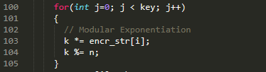
Encryption & Decryption using RSA continued
Modular Exponentiation can be solved directly, or through the memory efficient method
The memory efficient method was used, which involves more instructions, but each instruction is smaller
As a result, many multiply and divide operations are produced! This should be noted as we implement different processors with various multiply/divider unit support!

Slide 14
Testing
Goal: Compare changes in performance and resources use throughout different hardware implementations:
Platform: Xilinx 7s50csga324 FPGA
Tests: Encryption and decryption of 32kB of characters and 32kB of numbers

Slide 15
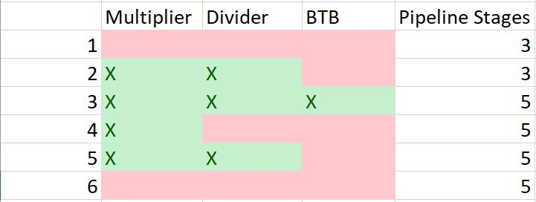
Testing continued
6 different implementations:
3 stage Pipeline
3 stage pipeline with multiplier & divider
5 stage pipeline
5 Stage pipeline with multiplier
5 stage pipeline with multiplier and divider
5 stage pipeline with multiplier and divider and BTB (Branch Target Buffer)

Slide 16
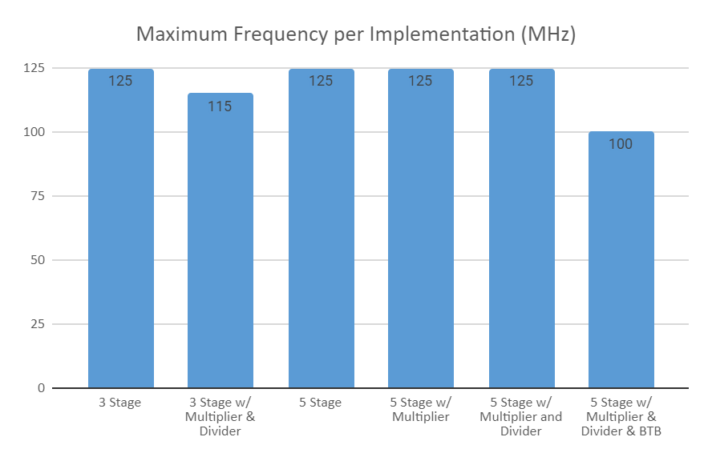
Results: Frequency

Slide 17
Results: Frequency
Maximum Frequency is 125 MHz for both 3 stage and 5 stage pipeline.
Maximum Frequency drops to 115 MHz when adding a multiplier and divider to 3 stage pipeline due to longer signal paths
The BTB (Branch Target Buffer) also slows down the clock speed by 20%

Slide 18
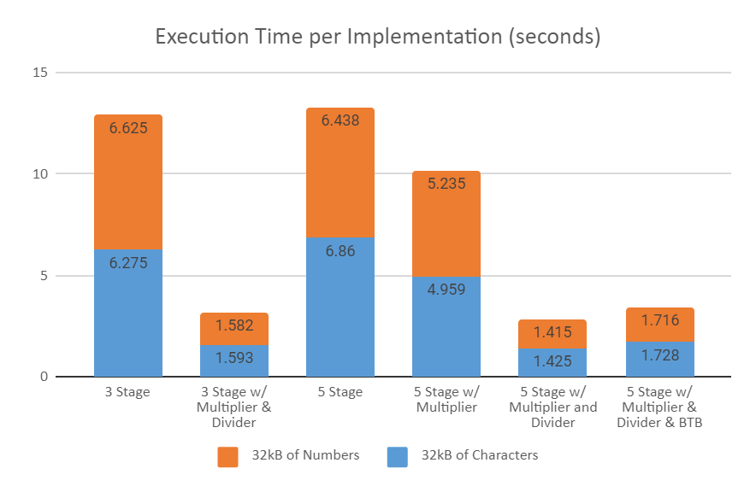
Results: Performance

Slide 19
Results: Performance
Multiplier improved performance by 20%
Divider improved performance by 60%
For both 3 stage pipeline and 5 stage pipeline, the inclusion of both a multiplier and a divider improved performance by 80%
BTB inclusion slows down the maximum clock speed, thereby there is actually a drop in overall performance

Slide 20
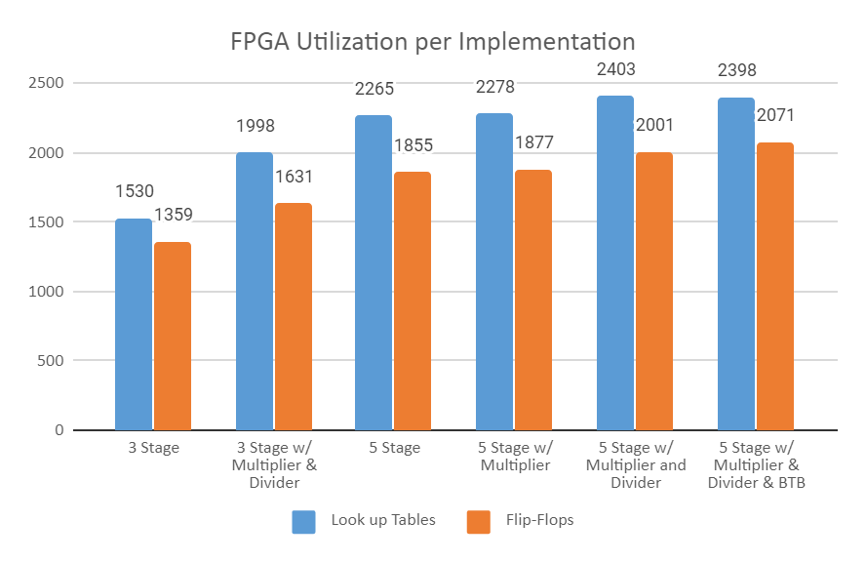
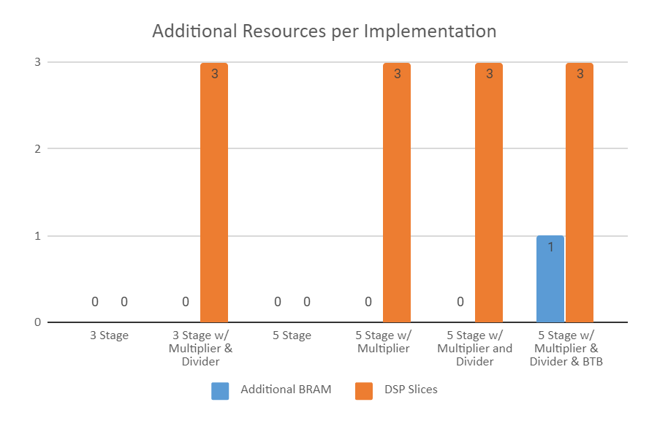
Results: Resources

Slide 21
Results: Resources
Resource Utilization increases by 33% when going from a 3 stage pipeline to a 5 stage pipeline
The addition of a multiplier does not add LUT/FF logic due to the presence of DSP slices in Xilinx FPGAs
The divider increases utilization by 6% but adds a 60% increase in performance
BTB does not add significant logic, but it does add an additional block of RAM to store the branch table

Slide 22
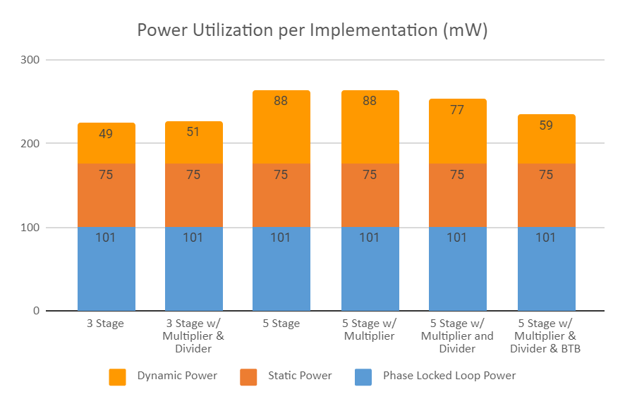
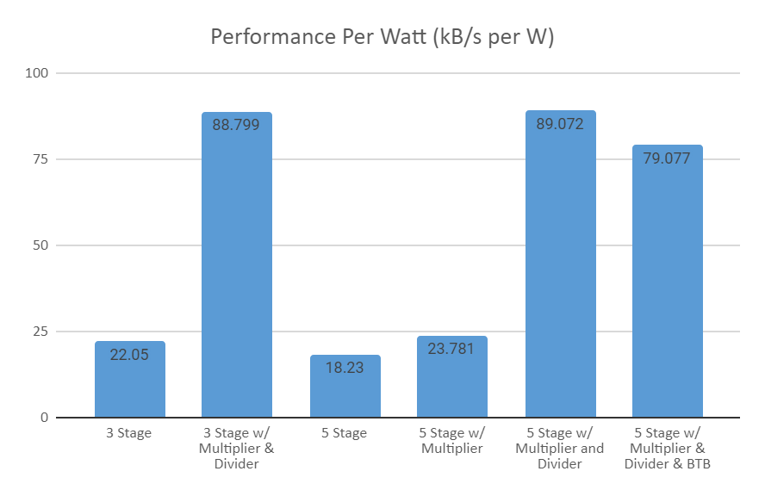
Results: Power Consumption

Slide 23
Results: Power Consumption
Although dynamic power appears low, dynamic power will scale much higher as the FPGA reaches capacity
Less logic and lower clock speed will give lower power
Addition of BTB gives a loss in overall performance due to its lower frequency, but it also returns lower power

Slide 24
Conclusion
Clock frequency plays a large role in power utilization and overall performance.
Addition of hardware can increase performance, however it is not guaranteed.
Hardware that directly targets the applications and instructions being processed in the core will see the largest benefit.
Soft processors, configured to target a specific application, can achieve competitive results with their hard processor counterparts

Slide 25
Acknowledgements
Dr Mohamed El-Hadedy, for support during this undertaking
Md Mohsin for a starting point on RSA encryption implementation in C.

Slide 26
References
[1] Henkel, J, “A low power hardware/software partitioning approach for core-based embedded systems,” Design Automation Conference (DAC), 1999.
[2] Xilinx, “Zynq-7000 SoC First Generation Architecture,” ds190 datasheet, July 2018.
[3] J. G. Tong, I. D. L. Anderson, and M. A. S. Khalid, “Soft-Core Processors for Embedded Systems,” 2006 International Conference on Microelectronics, Dec. 2006.

