Slide 1
Talking Clock
Benjamin Kueffler | Raymond Mak | Eugene Chiu | Rafi Meguerdijian Hardeep Dhillon | Celestino Gutierrez | Ryan Omidi | Vlad Cretu
Jonathan Plata | Jim Duong | Christopher Cole | Gerson Ramos

Slide 2
Applications
Signaling time for audiences of varying linguistic backgrounds
Lunch breaks for temporary workers
Airplanes for telling travel passengers what time it is
Restaurants that have high international customer base to inform visitors
Customers who want clocks that are multilingual
Cases were there are multiple languages spoken at home
Say the kids understand only english, but the grandparents only understand some other language

Slide 3
Bill of Materials
Gikfun 1.5” 4Ohm 3W Speaker | $4.00
HiLetgo 7-Segment Display | $1.00
Longrunner DFPlayer MP3 Player | $8.00
Aideepen Microphone w/ Amplifier | $2.80
Arduino/ATmega328 | $5.00
Total | $22.80

Slide 4
Theory of Operation

Slide 5
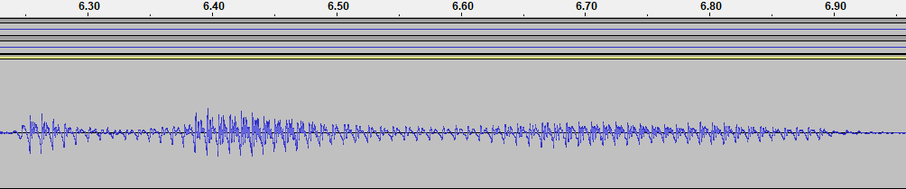
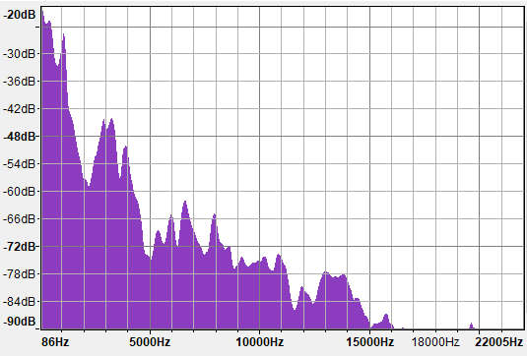
Human Voice saying “Hello World”
Human voice is generally low frequency (80-200 Hz). Rarely, up to 4 kHz for singing.
Narrowband (Not a wide frequency range)
The narrowband nature of the human voice allows for some filtering

Slide 6
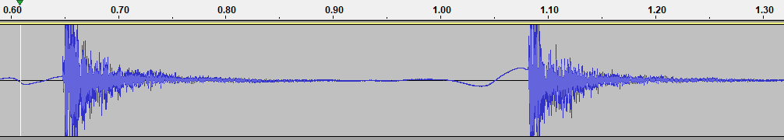
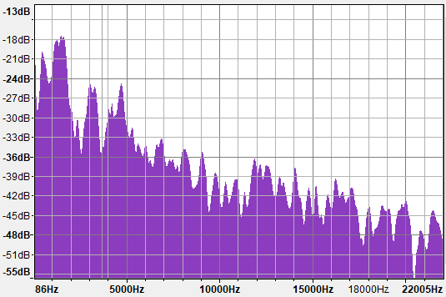
Flat-handed clap (Time Domain / Spectrum)
Clapping has a width of about 50 ms. This is generally smaller than most human conversations.
Frequency of clapping is more broadband and higher frequency than human voice.

Slide 7
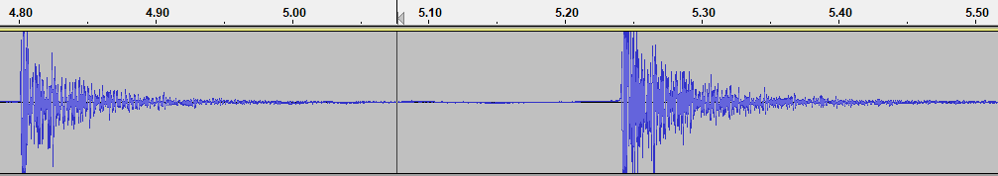
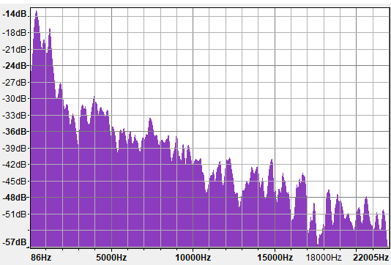
Deep clap (Time Domain / Spectrum)
Frequency of deep clap is lower than flat handed clap, but is higher than human speech

Slide 8
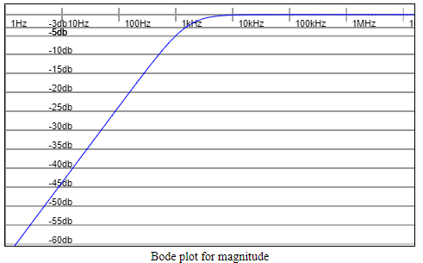
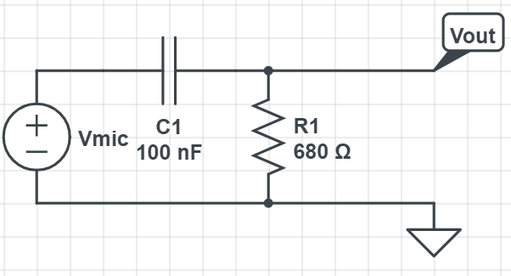
Multiple Solutions to isolate clapping
Attempt to filter out narrowband voice with high pass filter
More effective : Create program which filters out any noises that stay high after 20 ms period

Slide 9
Hardware

Slide 10
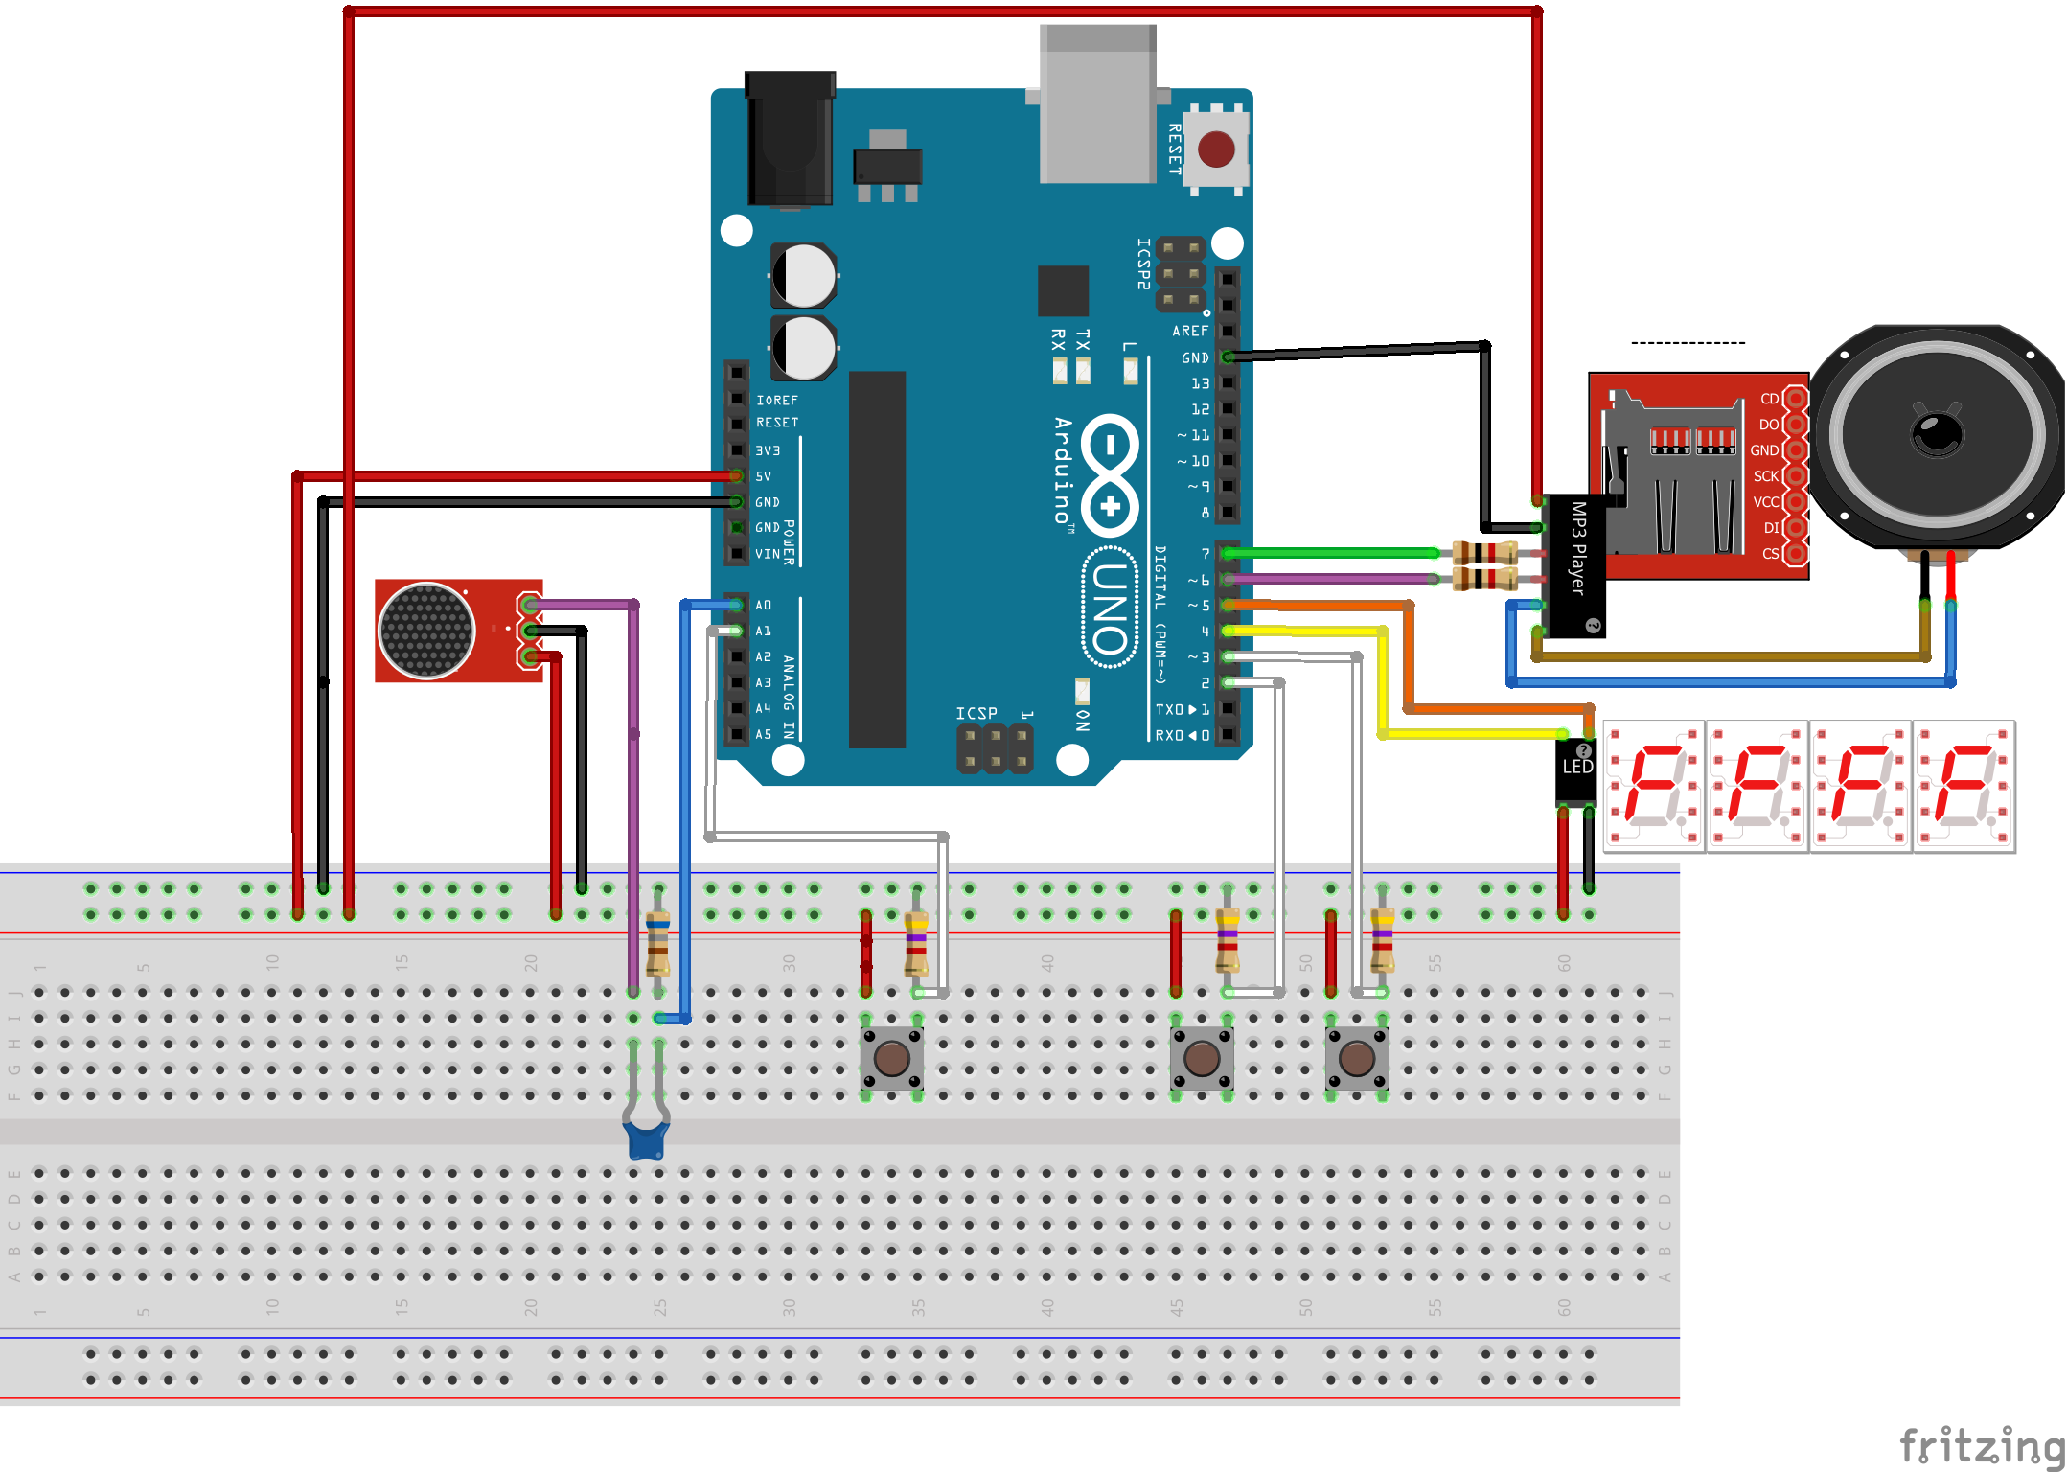
Breadboard

Slide 11
Software
Github: Talking-clock

Slide 12
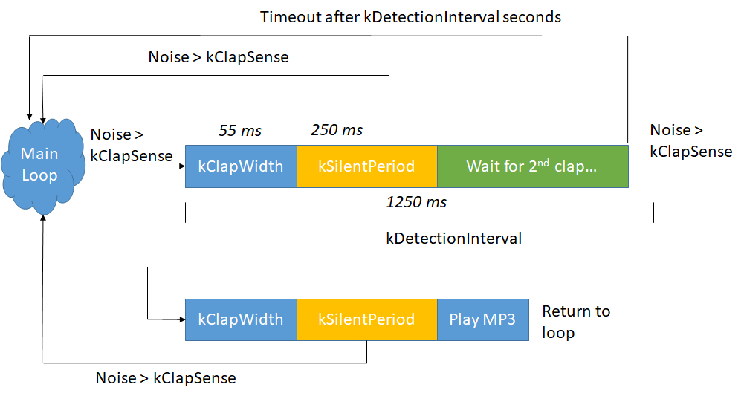
Clap Detector / Voice Rejector
Exploits time-domain properties of human voice and clapping

Slide 13
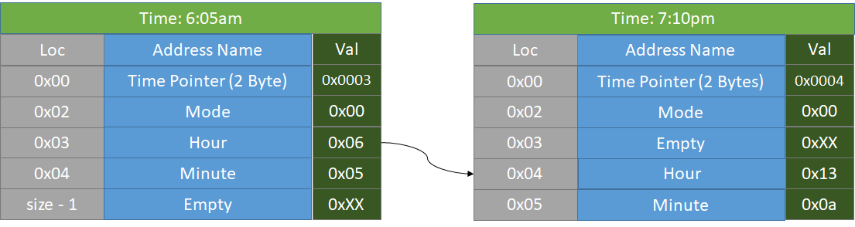
EEPROM Storage & Saver
A history of hour, minute, and mode selection (Language) is stored in EEPROM during runtime so that the time can be recalled after power off
Two static addresses (Time pointer, mode)
Two revolving addresses (Hour, minute)

Slide 14
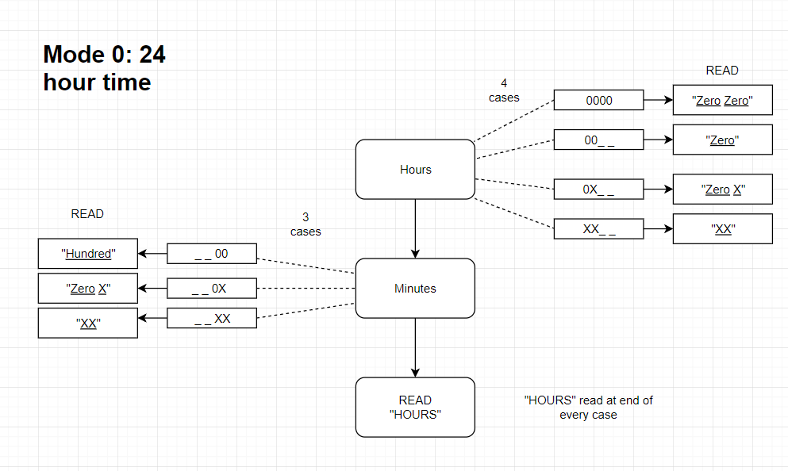
English Military Time (24 hr)

Slide 15
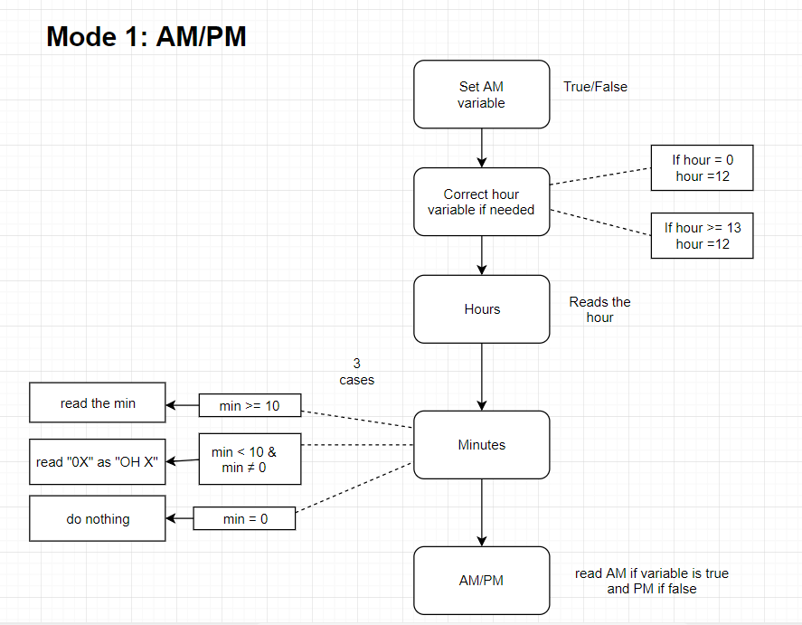
English Standard Time (AM/PM)

Slide 16
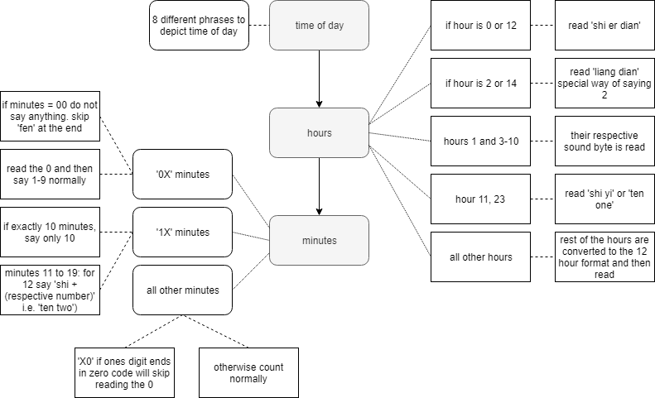
Mandarin Tree Diagram

Slide 17
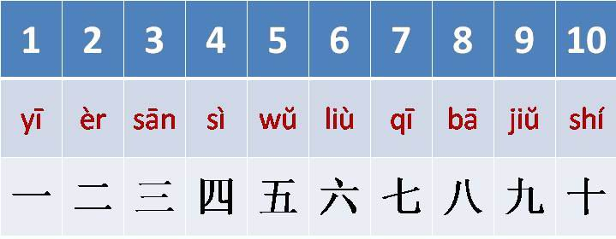
Mandarin Clock
Any two digit number can be represented by a combination of 1 to 10. For example:
12 = 十二 or “10 + 2”
54 = 五十四 or “5*10 + 4”
30 = 三十 or “3*10”
Only need 10 sound files to count out all two digit numbers
Special cases depend on (# of sound files used) AND special cases within Mandarin language
Figure: numbers 1 to 10 in mandarin
http://parnellmandarin.blogspot.com/2014/05/numbers-1-10.html
 | Rules and Exceptions
Time of Day | ~8 Different phrases to distinguish time of day Phrases aren’t strict / used loosely
Hours | Uses numbers 1-12 => at most 2 sounds Exception when using the number 2. Use ‘liang’
Minutes | Uses numbers 1-59 => at most 3 sounds Exception when using 1 digit numbers. Read ‘:03’

