Slide 1
Predicting Future Credits
By: Griffin Thurman, Brett Kuefler, and Hunter Weimar

Slide 2
Our Goals
Analyze
Analyze the Imperial credit data
Create
Create and tune multiple models to predict future credit data
Use
Use the most accurate model to predict future Imperial credits

Slide 3
The Data
Had one field describing the credits received in millions
On average we received 1.57 million credits per month
A column was added to track the date of credits
Credits have seen a steady increase monthly [Insert Graph to the right]

Slide 4
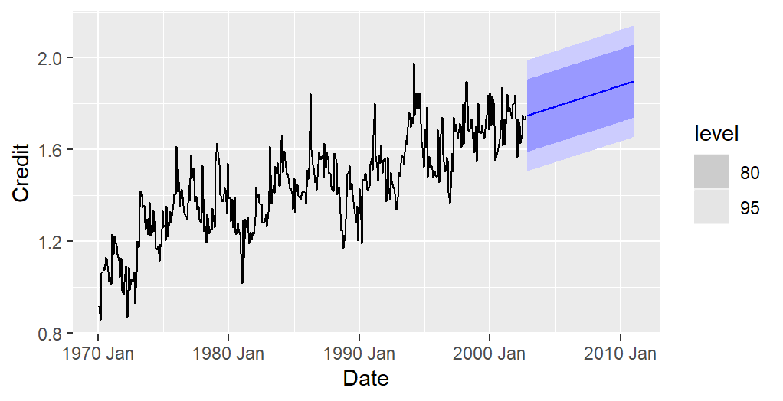
Linear Forecast model

Slide 5
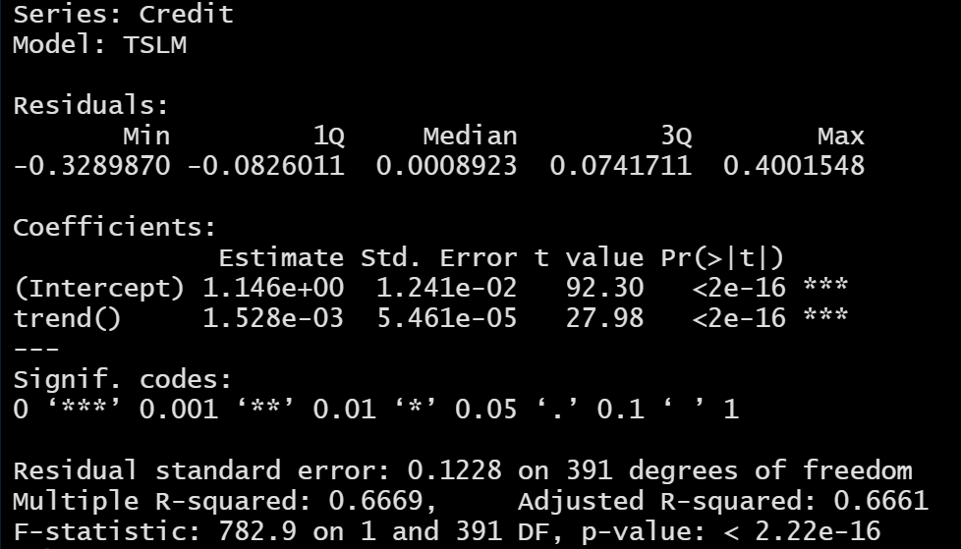
Linear Fit Model Report

Slide 6
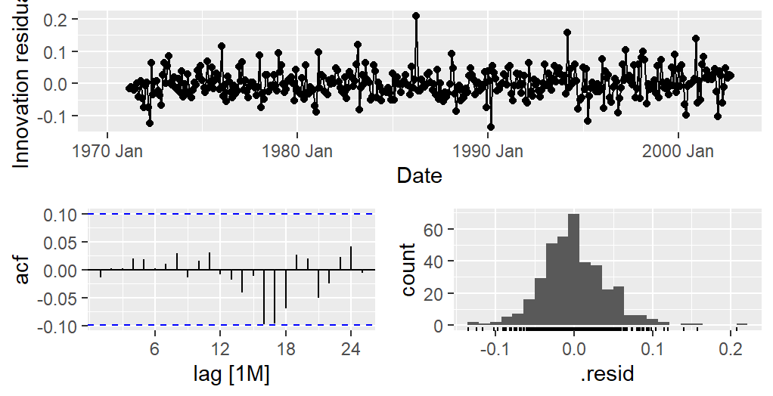
Neural Network Model

Slide 7
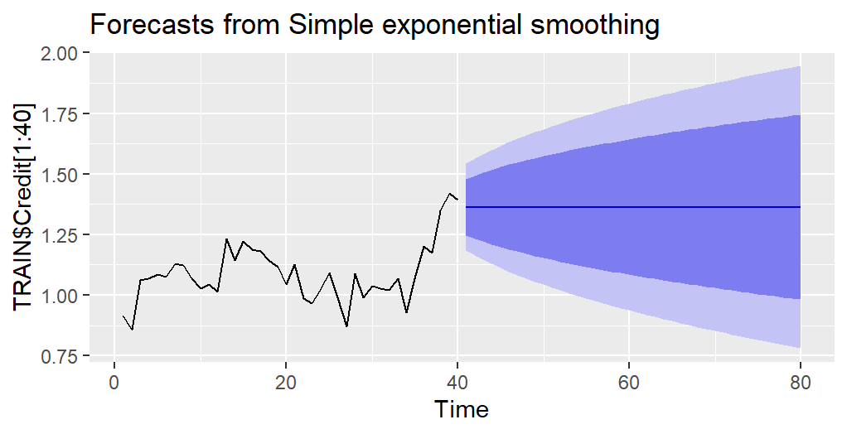

Slide 8
Model of choice
We created Neural Network, Exponential Smoothing, and ARIMA models.
The best model was the model to make the most accurate predictions
We chose the [model name] which made predictions that were accurate [1-rmse]% of the time.

Slide 9
Predictions
Forecast shows a steady increase in Imperial credits
We predict to gain [sum(predictions)] credits over the next 12 months
The final predicted month is expected to be [last prediction month / first data month] times higher than the first month in our credit data.

