Slide 1
Language Grounding

Slide 2

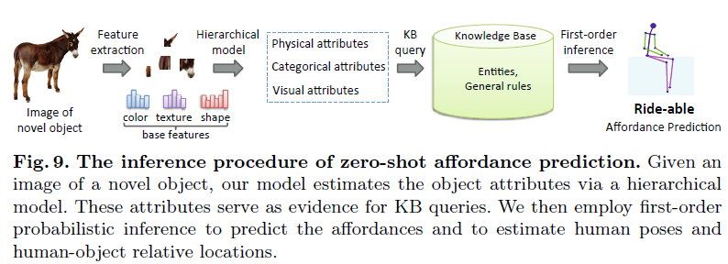
XGLUE
( XLNI, PAWS-X)
Introduction
Language Grounding – Objective:
learning textual representation that infuses knowledge of entity affordances and functionalities
Reasoning with such representation
Task 2
Task 1
Model
(Hierarchical + KB + MLN)
Named Entity Recognition
(Identify noun phrases)
Model
Images (ImageNet)
Context
Top 10 affordance
Downstream Applications
(GrAffordQA, GrAnalogy, AffordanceKB)

Slide 3
Questions
How can we get KB of those 40 objects ( We could not find it online)
From where should we feed the corresponding images for noun phrases (NER output) in the XGLUE data?
Ref: proposal page 2 footnotes – Do we need to consider person and location also? In the data set (parallel), most of the named entities are person, location etc.
Non-English – How do we plan to handle corresponding images of non-English text? (Translation?)
Non-English – Do we need to create separate embeddings for all languages?

Slide 4
Thank you!

Slide 5
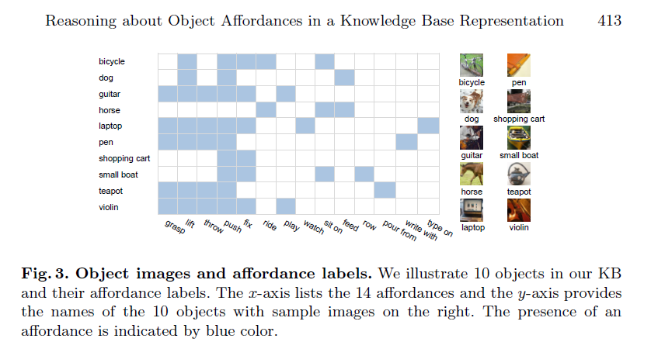
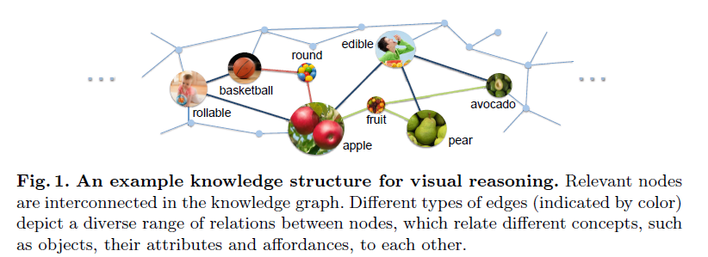
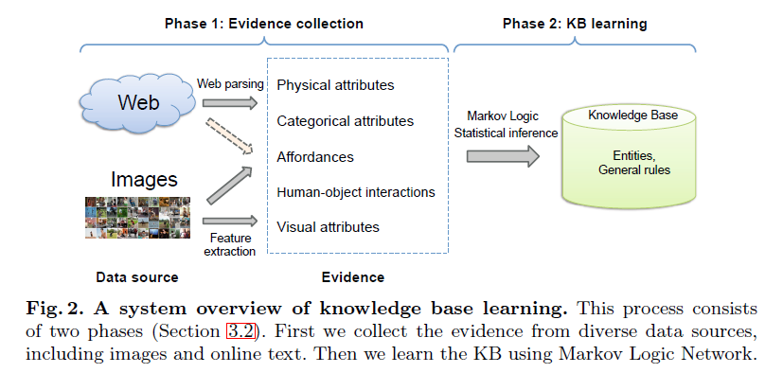
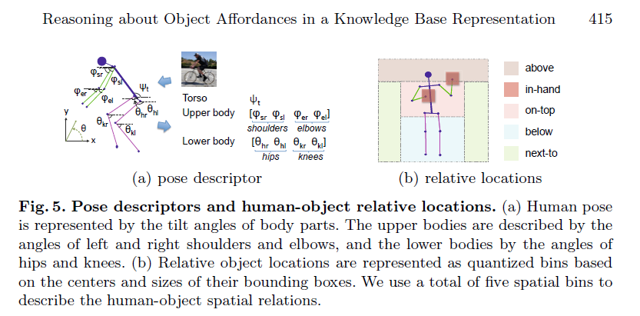
Components

Slide 6
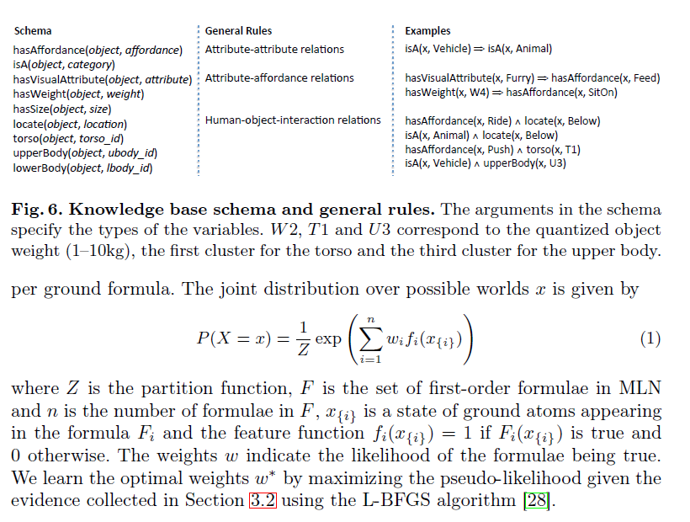
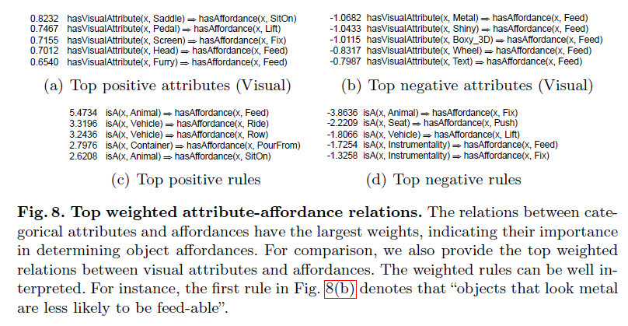
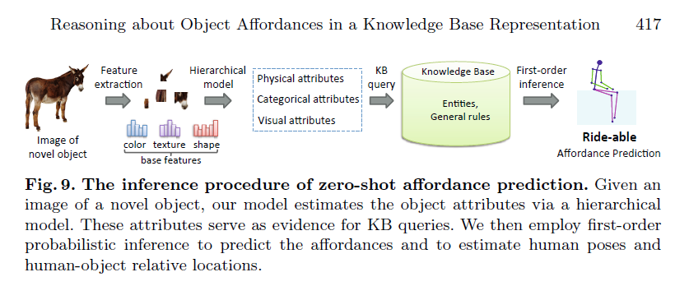
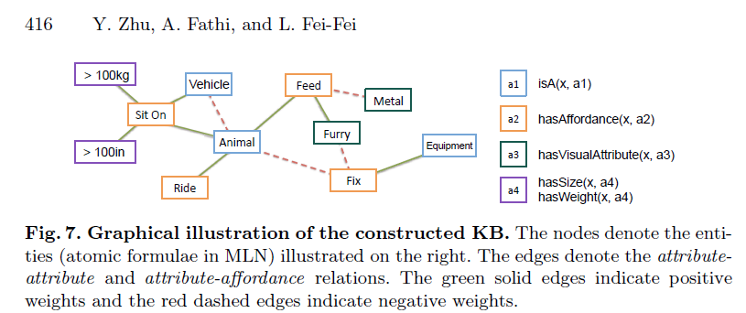
Components

Slide 7
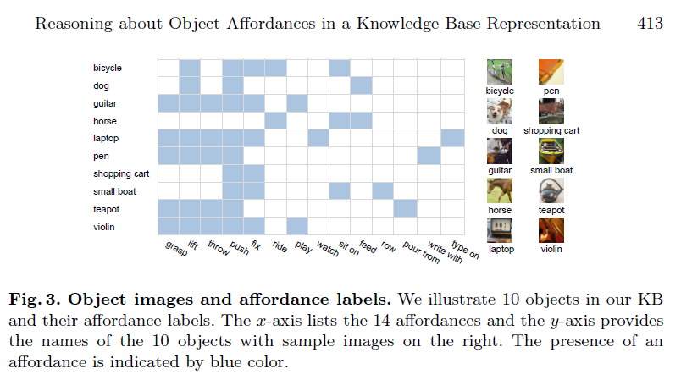
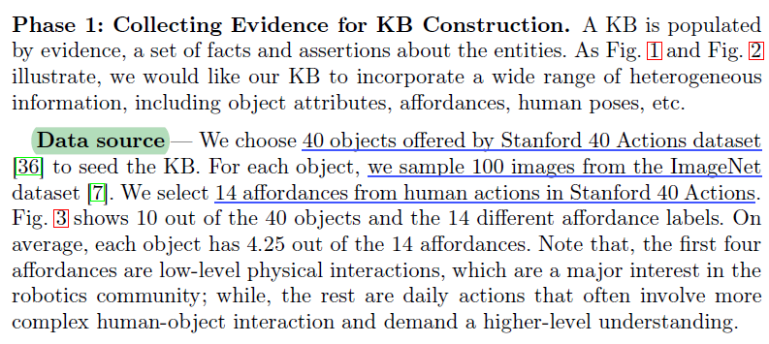
Knowledge Base

Slide 8
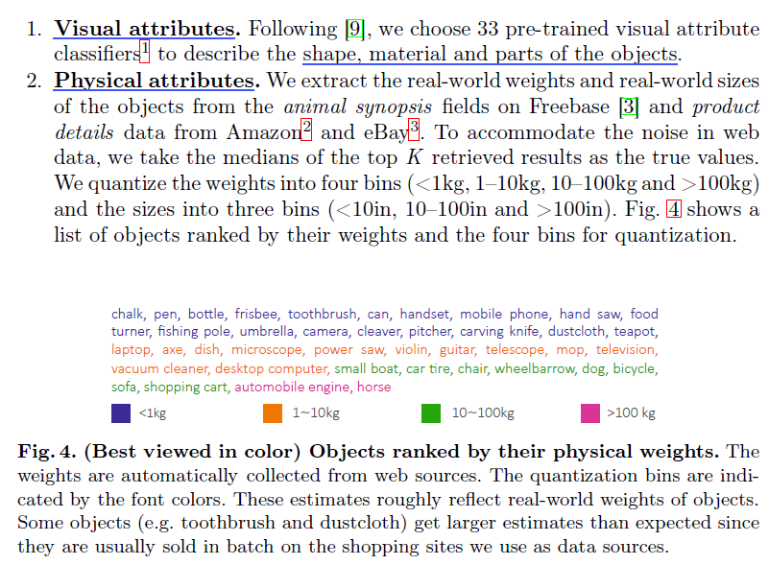
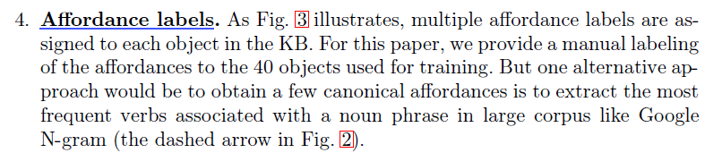
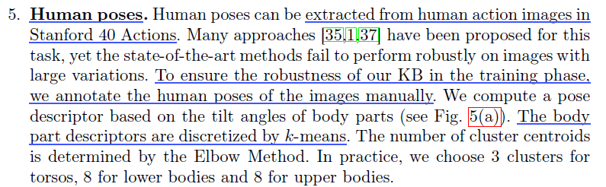
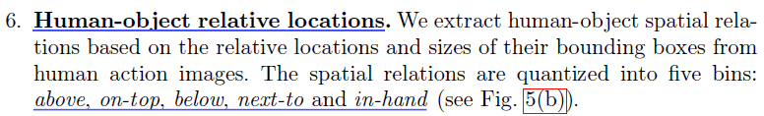
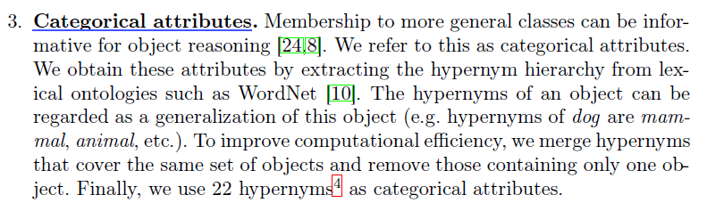
Knowledge Base - Evidence

