Slide 1
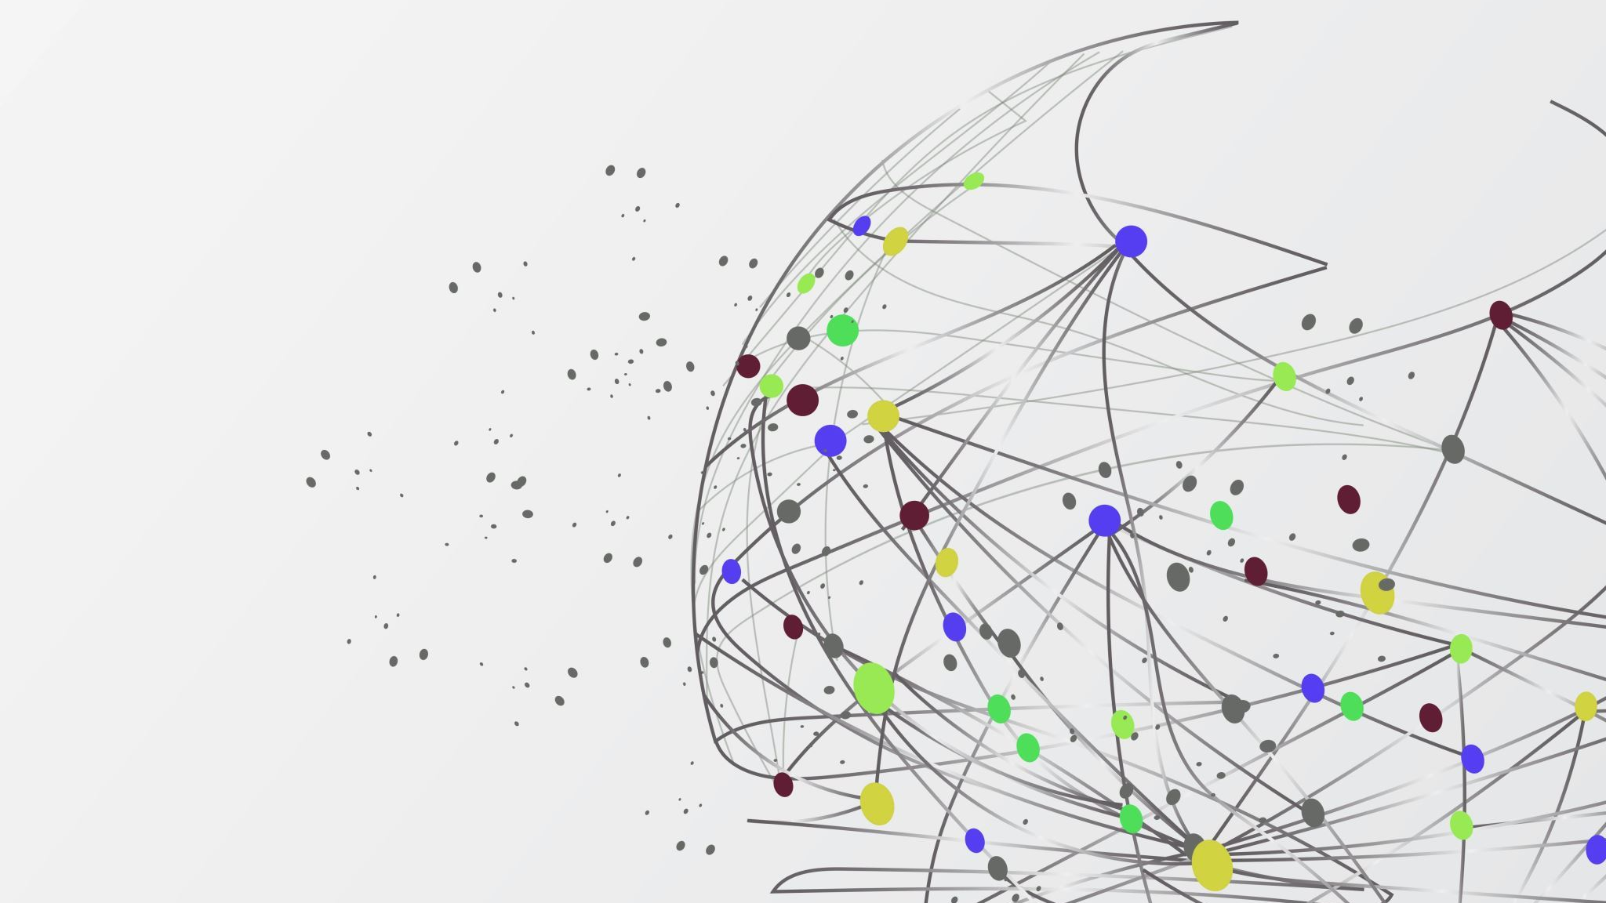
Qualitative COVID-19 Behavioural Modeling with Universal Differential Equations
Bruce Kuwahara

Slide 2
Background

Slide 3
Disease modeling

Slide 4
Universal differential equations

Slide 5
Methods

Slide 6

Model
$$\frac{dS}{dt}=β\left(M(t−τ_{m})\right)S(t)I(t)$$
$$\frac{dI}{dt}=−β\left(M\left(t−τ_{m}\right)\right)S\left(t\right)I\left(t\right)−γI(t)$$
$$\frac{dM}{dt}=f(M\left(t\right),I\left(t−τ_{I}\right), ∆I\left(t−τ_{I}\right))$$
Where $∆I\left(t\right)=I\left(t\right)−I\left(t−1)\right)$

Slide 7
Model
Monotonic increasing
Nonnegative
M
β

Slide 8
Model
Negative above baseline and positive below when infections are low
Larger magnitude when farther from baseline
Monotonic decreasing in I and ΔI
M
I
f
ΔI

Slide 9
Loss Function
Accuracy loss
β qualitative loss
Weighted average
Total loss
f qualitative loss

Slide 10
Results

Slide 11
Future Directions

Slide 12
Refernces

