Slide 1
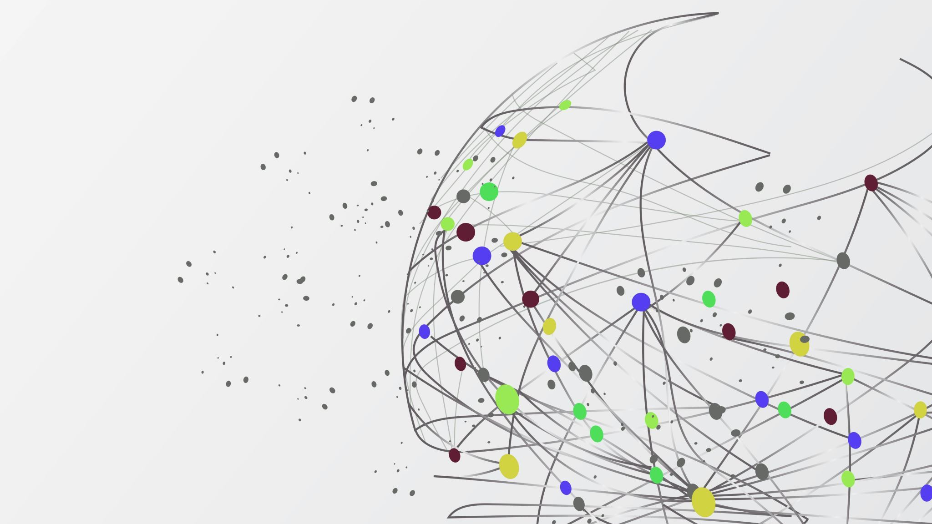
Qualitative COVID-19 Behavioural Modeling with Universal Differential Equations
Bruce Kuwahara

Slide 2
Outline
Background
The big picture
Technical implementation
Results
Conclusions

Slide 3
Background

Slide 4

behavioural modeling
$$\frac{dS}{dt}=μ\left(1−x\right)−βSI$$
$$\frac{dI}{dt}=βSI−μI−γI$$
$$\frac{dV}{dt}=kV(1−V)(ω+I+δ\left(2V−1\right))$$
Oraby, Thampi & Bauch (2014)
Problem:
How do we measure perceived risk of vaccine compared to infection or the strength of social norms?

Slide 5

Universal differential equations
$$\frac{dS}{dt}=μ\left(1−x\right)−βSI$$
$$\frac{dI}{dt}=βSI−μI−γI$$
$$\frac{dV}{dt}=N(S,I,V;θ)$$
Solution:
Replace unknown dynamics with a neural network

Slide 6

New problem:
What if we know something about the function, but not its exact form?
$$\frac{dV}{dt}=kx(1−x)(ω+I+δ\left(2x−1\right))$$

Slide 7
Big idea:
Adapt UDEs to encode mathematical properties of unknown functions without specifying the functions themselves

Slide 8
Details

Slide 9
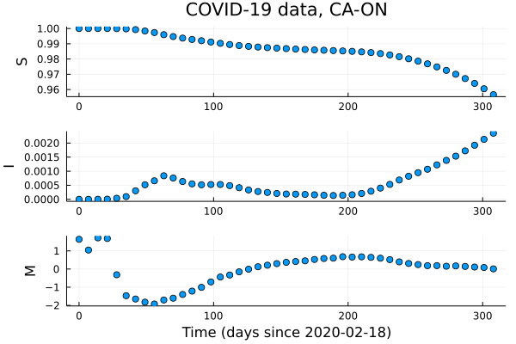

Model
$$\frac{dS}{dt}=β\left(M(t−τ_{m})\right)S(t)I(t)$$
$$\frac{dI}{dt}=−β\left(M\left(t−τ_{m}\right)\right)S\left(t\right)I\left(t\right)−γI(t)$$
$$\frac{dM}{dt}=f(M\left(t\right),I\left(t−τ_{I}\right), ∆I\left(t−τ_{I}\right))$$
Where $∆I\left(t\right)=I\left(t\right)−I\left(t−1)\right)$

Slide 10
Model
Monotonic increasing
Nonnegative
M
β

Slide 11
Model
Negative above baseline and positive below in absence of infection
Larger magnitude when farther from baseline
Monotonic decreasing in I and ΔI
M
I
f
ΔI

Slide 12
Loss Function
Accuracy loss
β qualitative loss
Weighted average
Total loss
f qualitative loss

Slide 13


Loss Function (accuracy)
$$L_{acc}=\frac{1}{n}\sum_{U=S,I,M}{\frac{1}{(U_{max}−U_{min})}\sum_{i=1}^{n}{{(U_{i}−{\overline{U}}_{i})}^{2}}}$$
$n$: Number of observations
$U_{i}$: $i$th observation of state$U$
${\overline{U}}_{i}$: $i$th UDE approximation of state $U$

Slide 14


Loss Function (qualitative)
$$L_{β}=\sum_{i=1}^{m}{relu(\left(β\left(M_{i}\right)−β\left(M_{i}+ε\right)\right)+relu(−}β\left(M_{i}\right))$$
$m$: Number of points sampled
$M_{i}$: $i$th sampled value of state$M$

Slide 15
Loss Function (qualitative)
$$L_{β}=\sum_{i=1}^{m}{relu(\left(β\left(M_{i}\right)−β\left(M_{i}+ε\right)\right)+relu(−}β\left(M_{i}\right))$$
$m$: Number of points sampled
$M_{i}$: $i$th sampled value of state$M$

Slide 16
Training algorithm
3 stages (1/3, 2/3, and 3/3 of training data)
Adam optimizer (learning rates 0.05, 0.005, 0.0005)
2500, 5000, 10,000 iterations
Last stage halts early if accuracy loss < 0.05, qualitative loss <0.005

Slide 17
Results

Slide 18
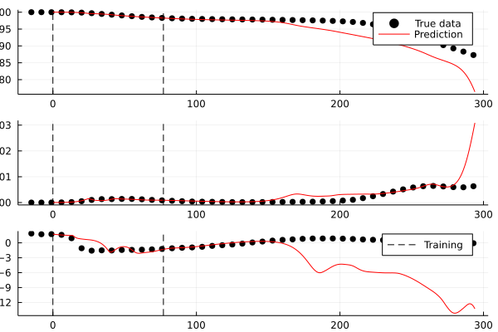
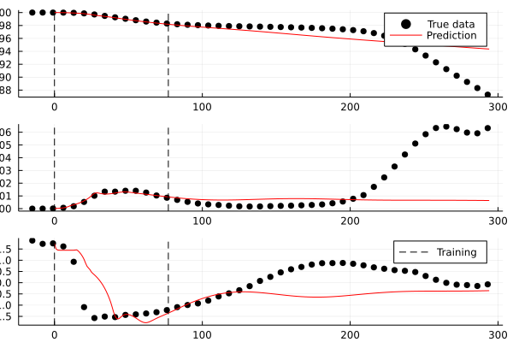
Individual simulations

Slide 19
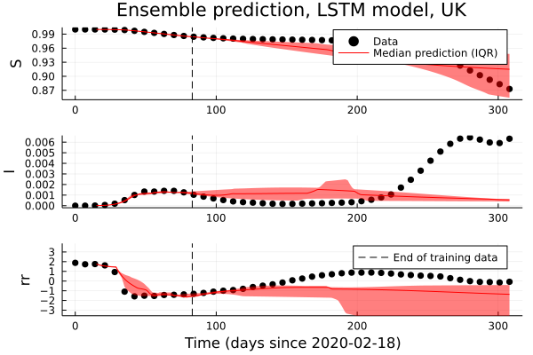
Ensembles

Slide 20
Ensembles

Slide 21
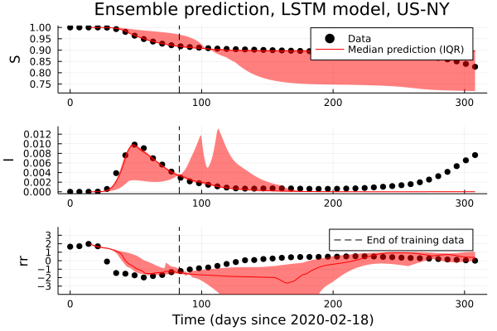
Ensembles

Slide 22
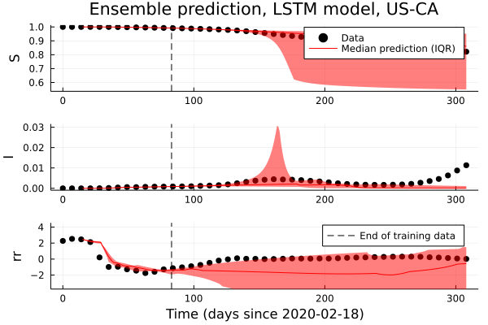
Ensembles

Slide 23
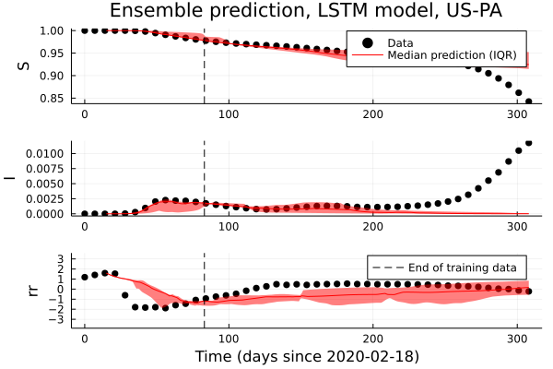
Ensembles

Slide 24
Who cares?
Improved qualitative accuracy
Frees us from choosing among possible candidate functions
Ensemble simulations capture variety of possible responses

Slide 25
Future Directions

Slide 26
Refernces

