Slide 1
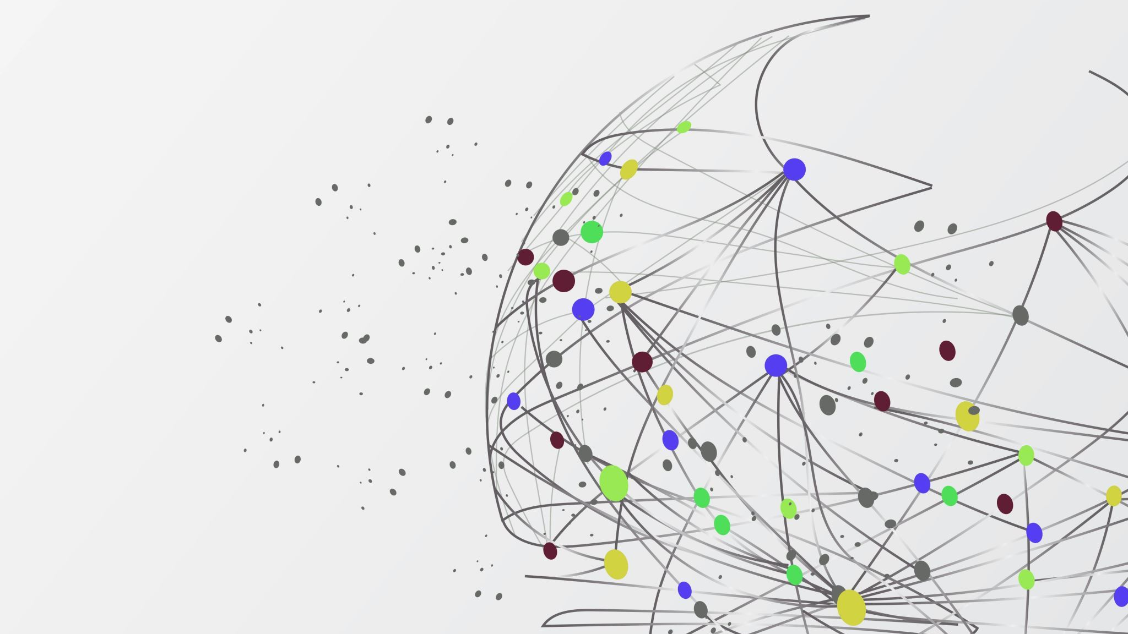
Qualitative COVID-19 Behavioural Modeling with Universal Differential Equations
Bruce Kuwahara

Slide 2
Background

Slide 3
behavioural modeling
$$\frac{dS}{dt}=μ\left(1−x\right)−βSI$$
$$\frac{dI}{dt}=βSI−μI−γI$$
$$\frac{dV}{dt}=kx(1−x)(ω+I+δ\left(2x−1\right))$$
Oraby, Thampi & Bauch (2014)
Problem:
How do we measure perceived risk of vaccine compared to infection or the strength of social norms?

Slide 4
Universal differential equations

Slide 5
Methods

Slide 6

Model
$$\frac{dS}{dt}=β\left(M(t−τ_{m})\right)S(t)I(t)$$
$$\frac{dI}{dt}=−β\left(M\left(t−τ_{m}\right)\right)S\left(t\right)I\left(t\right)−γI(t)$$
$$\frac{dM}{dt}=f(M\left(t\right),I\left(t−τ_{I}\right), ∆I\left(t−τ_{I}\right))$$
Where $∆I\left(t\right)=I\left(t\right)−I\left(t−1)\right)$

Slide 7
Model
Monotonic increasing
Nonnegative
M
β

Slide 8
Model
Negative above baseline and positive below in absence of infection
Larger magnitude when farther from baseline
Monotonic decreasing in I and ΔI
M
I
f
ΔI

Slide 9
Loss Function
Accuracy loss
β qualitative loss
Weighted average
Total loss
f qualitative loss

Slide 10


Loss Function
$$L_{acc}=\frac{1}{n}\sum_{U=S,I,M}{\frac{1}{(U_{max}−U_{min})}\sum_{i=1}^{n}{{(U_{i}−{\overline{U}}_{i})}^{2}}}$$
$n$: Number of observations
$U_{i}$: $i$th observation of state$U$
${\overline{U}}_{i}$: $i$th UDE approximation of state $U$

Slide 11


Loss Function
$$L_{β}=\sum_{i=1}^{m}{relu(\left(β\left(M_{i}\right)−β\left(M_{i}+ε\right)\right)+relu(−}β\left(M_{i}\right))$$
$m$: Number of points sampled
$M_{i}$: $i$th sampled value of state$M$

Slide 12
Loss Function
$$L_{β}=\sum_{i=1}^{m}{relu(\left(β\left(M_{i}\right)−β\left(M_{i}+ε\right)\right)+relu(−}β\left(M_{i}\right))$$
$m$: Number of points sampled
$M_{i}$: $i$th sampled value of state$M$

Slide 13

Training algorithm
$$L_{acc}=\frac{1}{n}\sum_{U=S,I,M}{\frac{1}{(U_{max}−U_{min})}\sum_{i=1}^{n}{{(U_{i}−{\overline{U}}_{i})}^{2}}}$$
$n$: Number of observations
$U_{i}$: $i$th observation of state$U$
${\overline{U}}_{i}$: $i$th UDE approximation of state $U$

Slide 14
Results

Slide 15
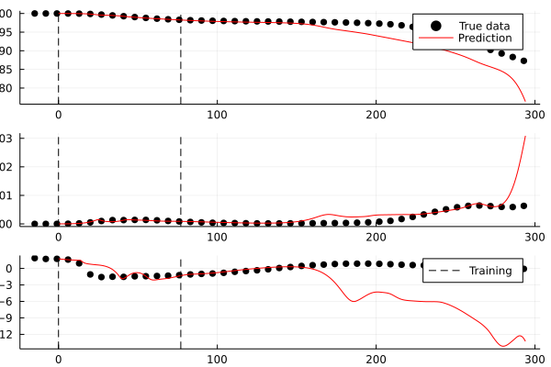
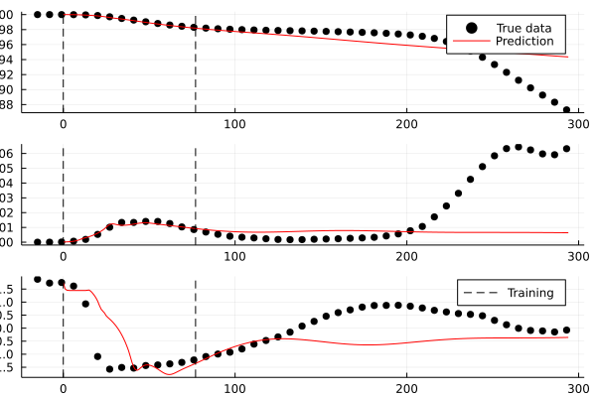
Individual simulations

Slide 16
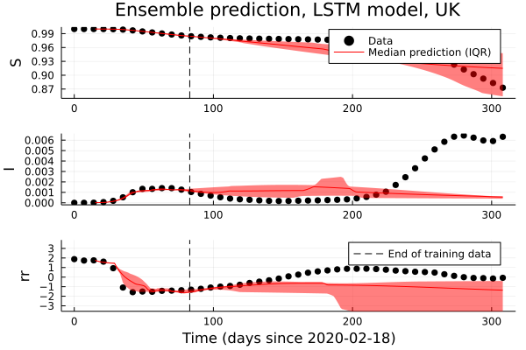
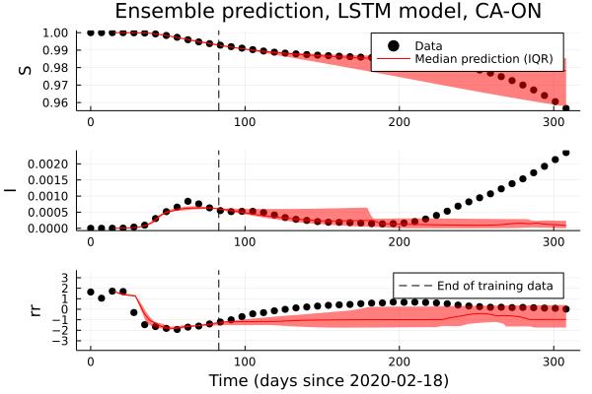
Ensembles

Slide 17
Who cares?
Frees us from choosing among possible candidate functions
Ensemble simulations capture variety of possible responses

Slide 18
Future Directions

Slide 19
Refernces

