Slide 1
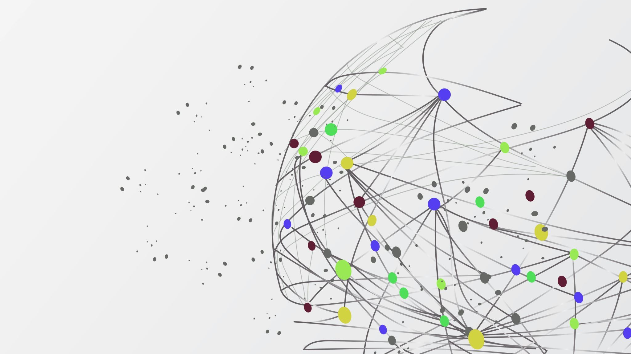
Qualitative COVID-19 Behavioural Modeling with Universal Differential Equations
Bruce Kuwahara

Slide 2
Background

Slide 3
behavioural modeling
$$\frac{dS}{dt}=μ\left(1−x\right)−βSI$$
$$\frac{dI}{dt}=βSI−μI−γI$$
$$\frac{dV}{dt}=kx(1−x)(ω+I+δ\left(2x−1\right))$$
Oraby, Thampi & Bauch (2014)
Problem:
How do we measure perceived risk of vaccine compared to infection or the strength of social norms?

Slide 4
Universal differential equations

Slide 5
Methods

Slide 6

Model
$$\frac{dS}{dt}=β\left(M(t−τ_{m})\right)S(t)I(t)$$
$$\frac{dI}{dt}=−β\left(M\left(t−τ_{m}\right)\right)S\left(t\right)I\left(t\right)−γI(t)$$
$$\frac{dM}{dt}=f(M\left(t\right),I\left(t−τ_{I}\right), ∆I\left(t−τ_{I}\right))$$
Where $∆I\left(t\right)=I\left(t\right)−I\left(t−1)\right)$

Slide 7
Model
Monotonic increasing
Nonnegative
M
β

Slide 8
Model
Negative above baseline and positive below when infections are low
Larger magnitude when farther from baseline
Monotonic decreasing in I and ΔI
M
I
f
ΔI

Slide 9
Loss Function
Accuracy loss
β qualitative loss
Weighted average
Total loss
f qualitative loss

Slide 10


Loss Function
$$L_{acc}=\frac{1}{n}\sum_{U=S,I,M}{\frac{1}{(U_{max}−U_{min})}\sum_{i=1}^{n}{{(U_{i}−{\overline{U}}_{i})}^{2}}}$$
$n$: Number of observations
$U_{i}$: $i$th observation of state$U$
${\overline{U}}_{i}$: $i$th UDE approximation of state $U$

Slide 11


Loss Function
$$L_{β}=\sum_{i=1}^{m}{relu(\left(β\left(M_{i}\right)−β\left(M_{i}+ε\right)\right)+relu(−}β\left(M_{i}\right))$$
$m$: Number of points sampled
$M_{i}$: $i$th sampled value of state$M$

Slide 12
Training algorithm
$$L_{acc}=\frac{1}{n}\sum_{U=S,I,M}{\frac{1}{(U_{max}−U_{min})}\sum_{i=1}^{n}{{(U_{i}−{\overline{U}}_{i})}^{2}}}$$
$n$: Number of observations
$U_{i}$: $i$th observation of state$U$
${\overline{U}}_{i}$: $i$th UDE approximation of state $U$

Slide 13
Results

Slide 14
Who cares?
Frees us from choosing among possible candidate functions
Ensemble simulations capture variety of possible responses

Slide 15
Future Directions

Slide 16
Refernces

