Slide 1
CS 347 – Data Management Option A
By: Adan Cortez, Brittany Kvanvig, Paola Jara

Slide 2
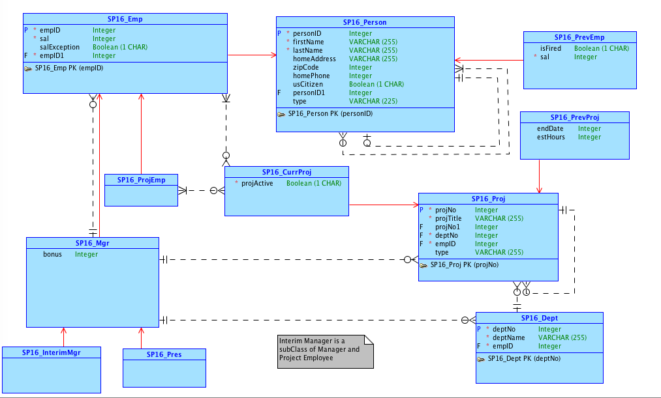
Part 1 Conceptual Model

Slide 3
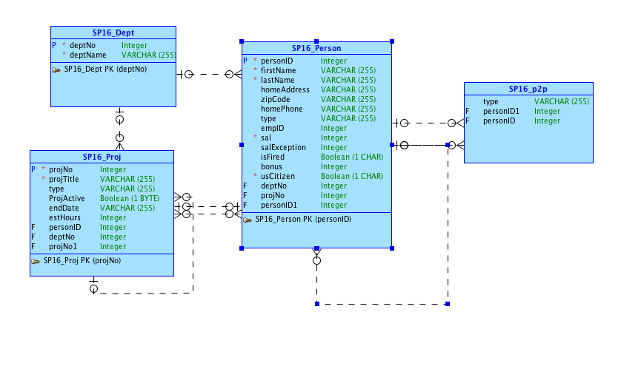
Part 1 Logical Model

Slide 4
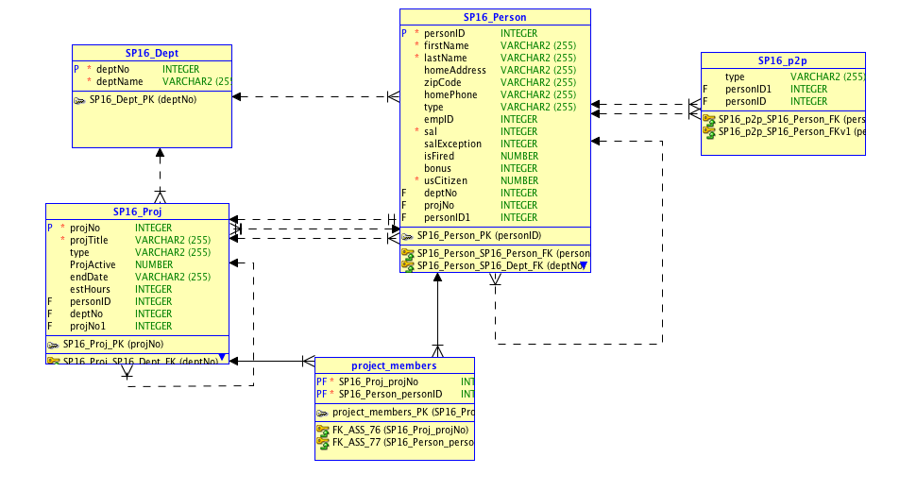
Part 1 Relational Model

Slide 5
Git Repository
https://github.com/bkvanvig/S16D4_FinalProject

Slide 6
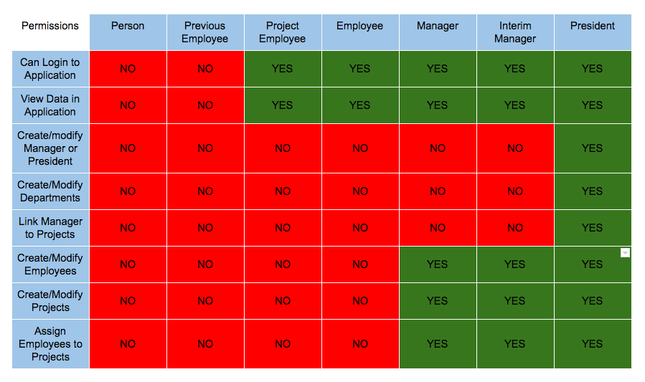
Application Logic

Slide 7
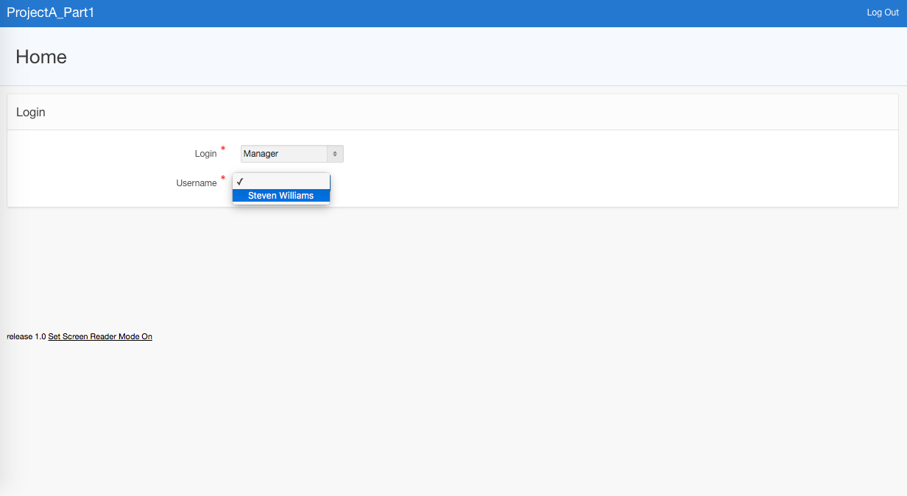
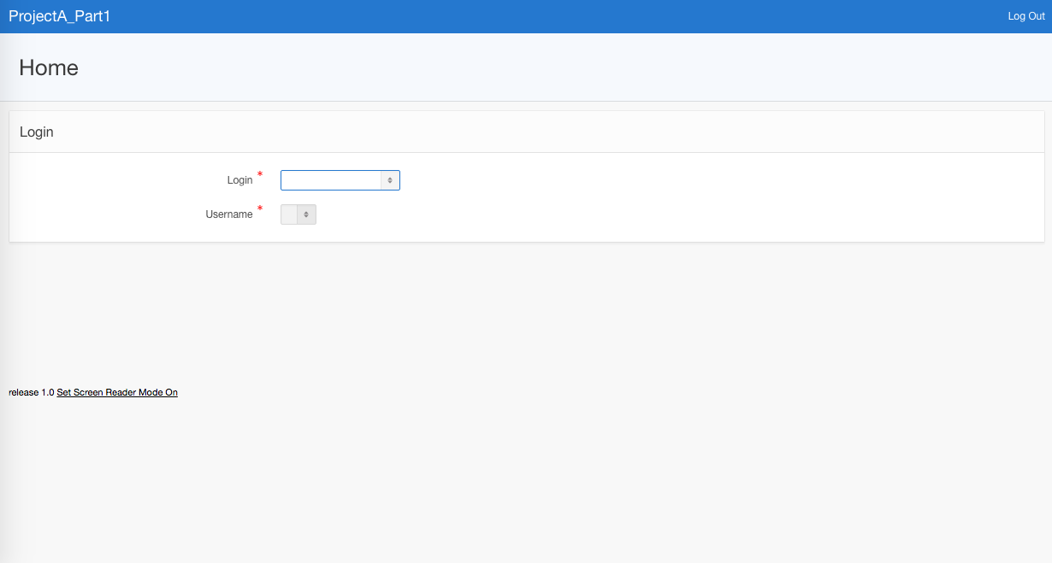
Login Page

Slide 8
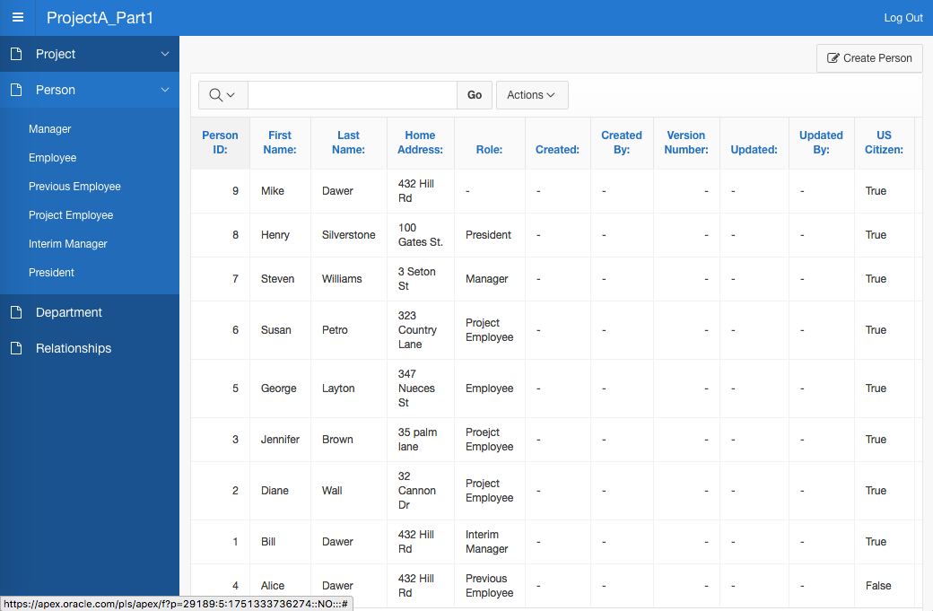
Authorization

Slide 9
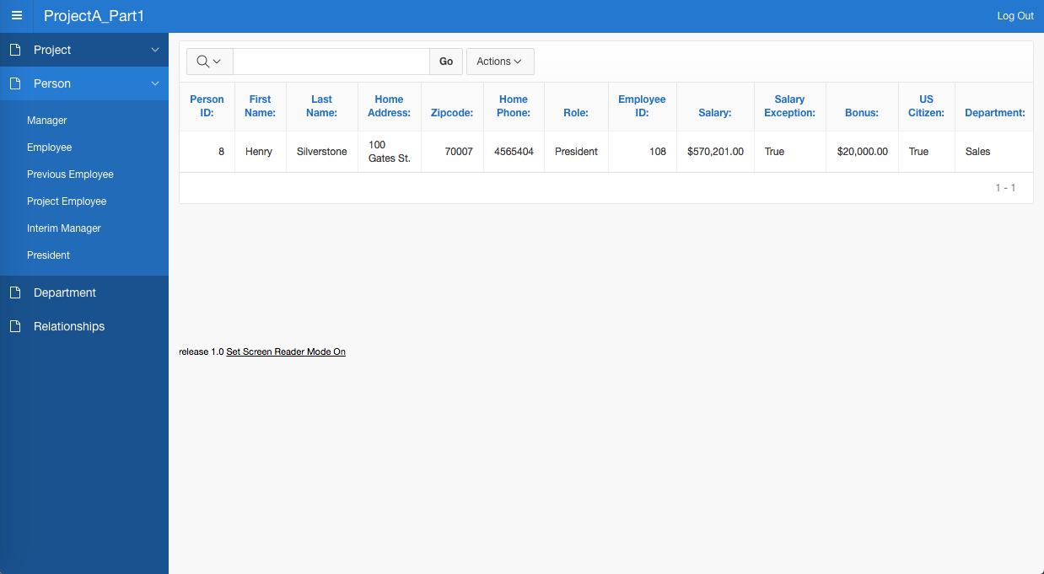
Authorization

Slide 10
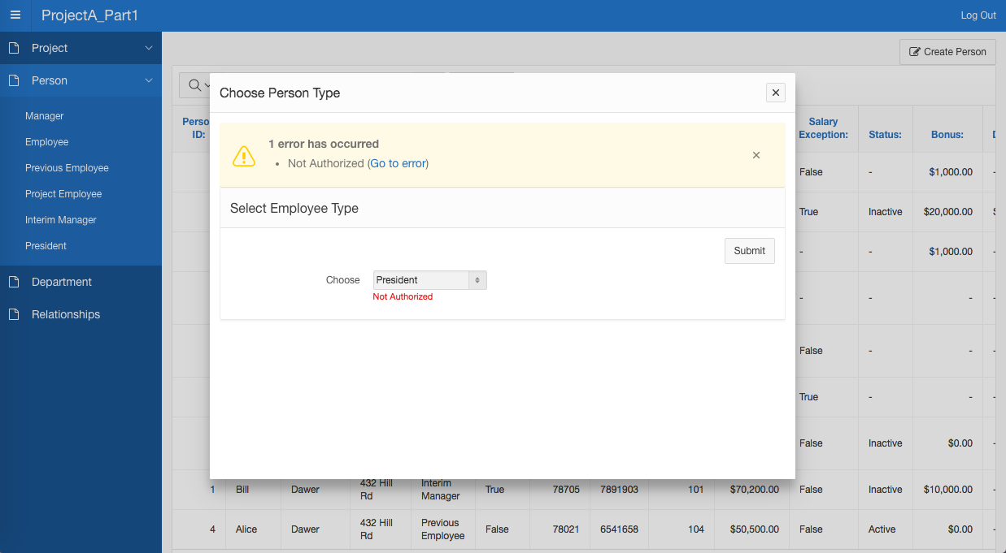
Authorization

Slide 11
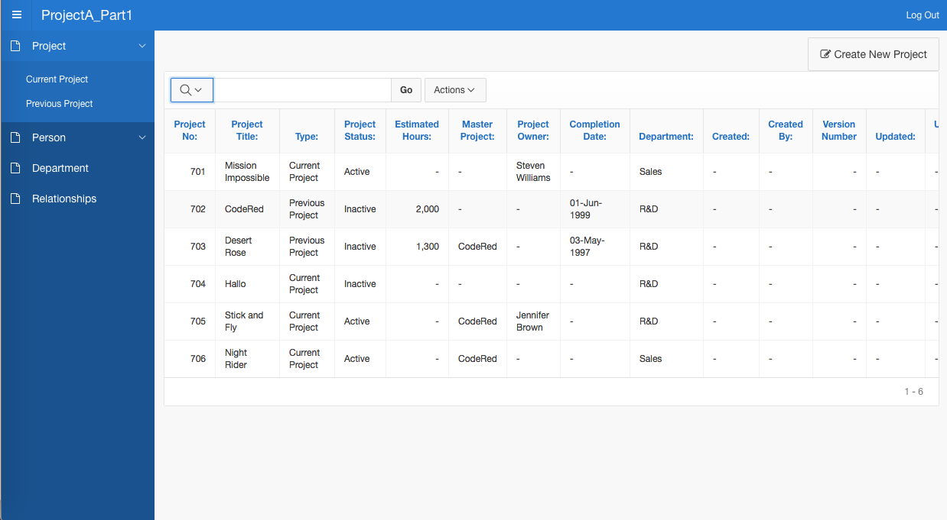
Project

Slide 12
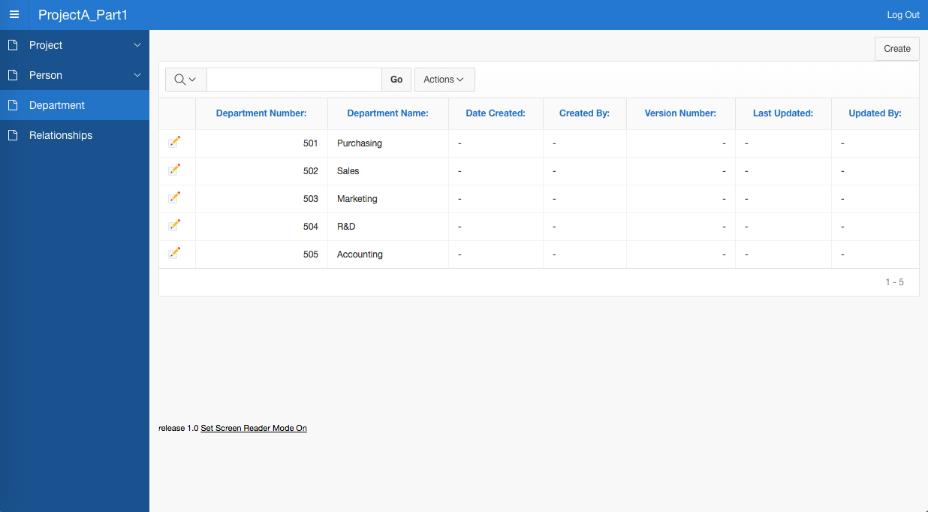
Department

Slide 13
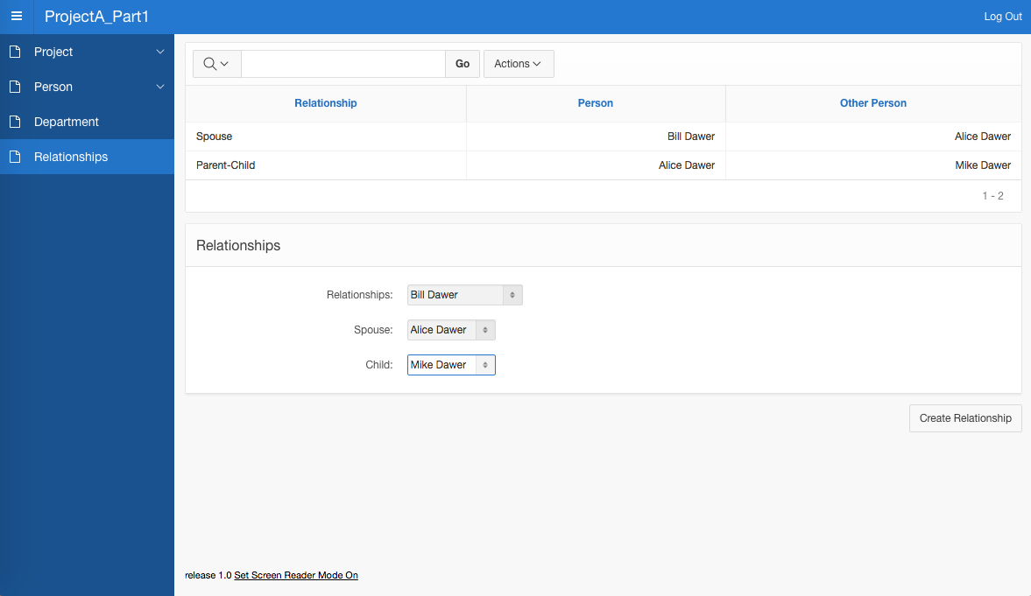
Relationships

Slide 14
Part 1 Problems
Editing entries from the Person or Project page – all others work correctly
Creating approval pages
Creating inverse parent-child relationships dynamically
Setting the columns to specific order
'Updated By' column to display logged-in user

Slide 15
Part 2 Conceptual Model

Slide 16
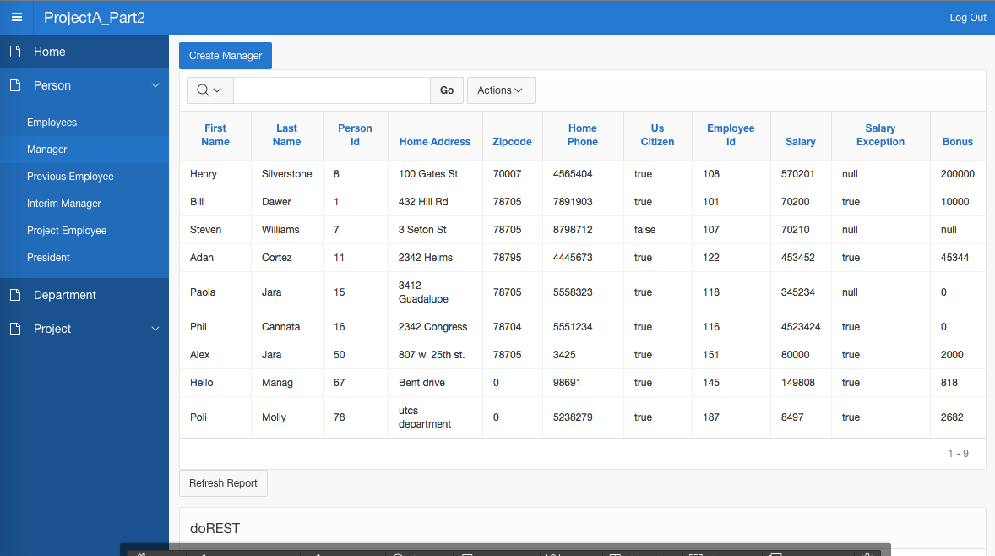
Part 2 - Apex

Slide 17
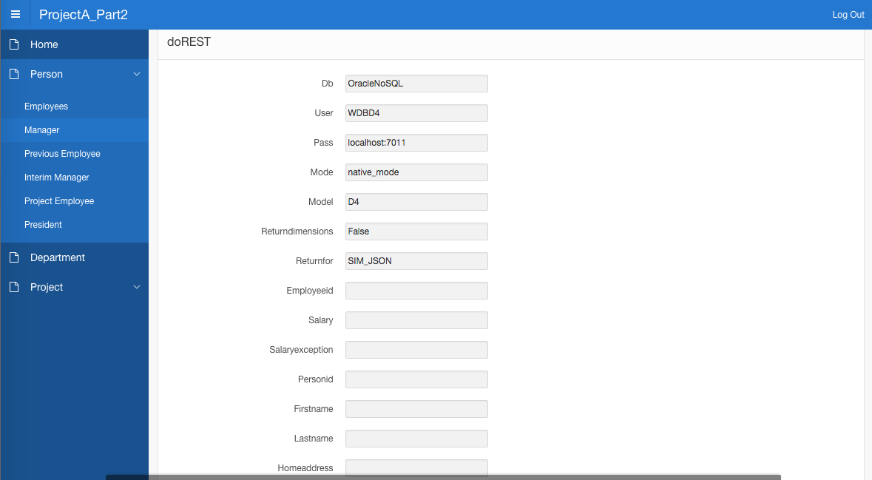
Part 2

Slide 18
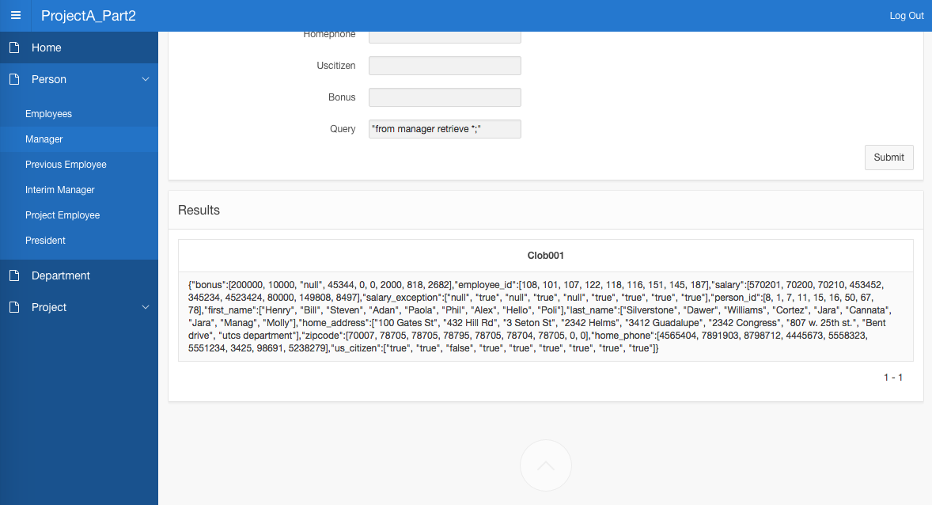
Part 2

Slide 19
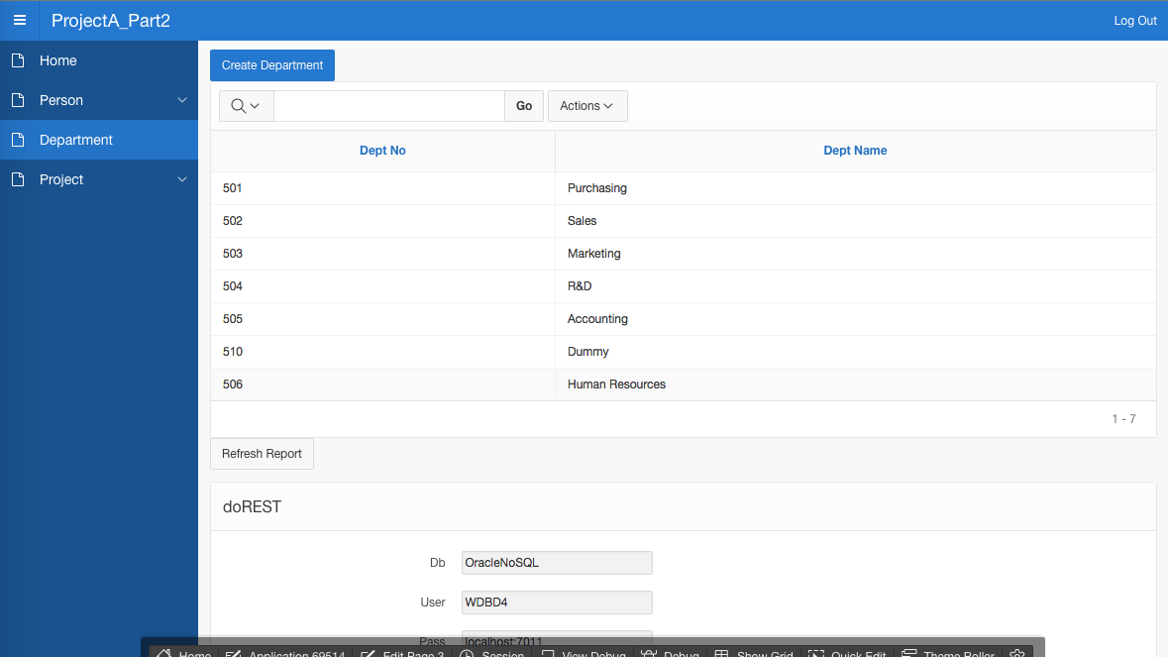
Part 2

Slide 20
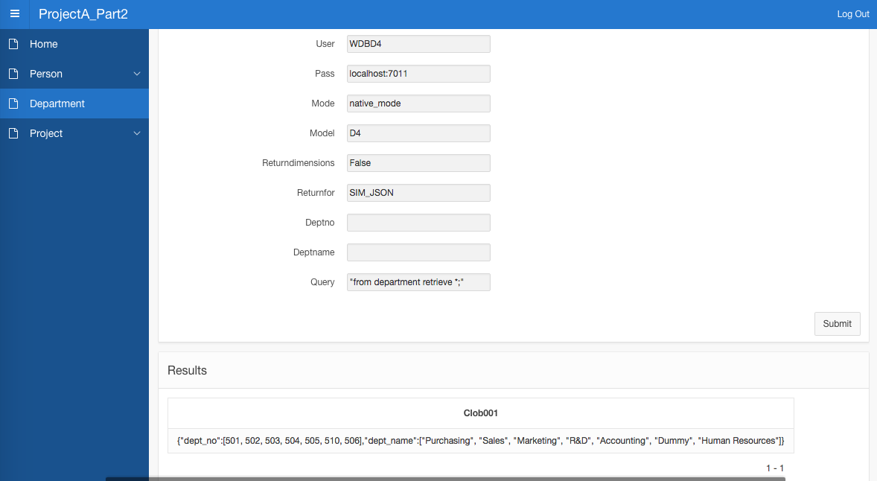
Part 2

Slide 21
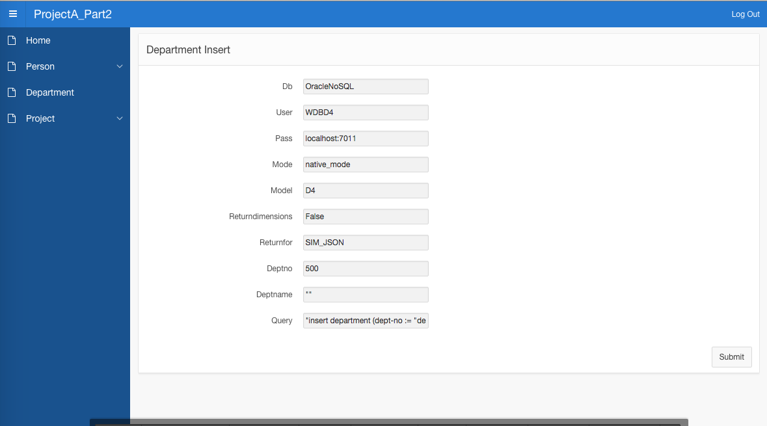
Part 2

Slide 22
SIM Differences
Lack of update and delete functionality make application more difficult to use
Easier to query the database
Less Apex overhead to implement

Slide 23
Thank you for your time

