Slide 1
Title:- Formulas for Filters
Presented By – 107054, 107052 107055, 107053

Slide 2



First Order Low Pass Filter
Where,
Simplifying equation we get,

Slide 3



And the Output Voltage is,
That is,
Or

Slide 4
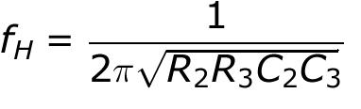
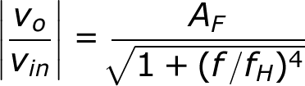
Second Order Low Pass Filter
A first order low pass filter can be converted into a second order type simply by using an additional RC network. Second order filters are important because higher order filters can be designed using them. The gain of the Second-order filter is set by R1 and RF, while the high cutoff frequency fH is determined by R2, C2, R3, and C3 as follows
For a second order low-pass filter Butterworth response, the voltage gain magnitude equation is

Slide 5


F = frequency of the input signal

Slide 6


First Order High Pass Filter
The same circuits are used for the High Pass and the Low Pass filter except that the frequency- determining components R & C are interchanged
The Output Voltage for the High Pass filter is -
Or,

Slide 7


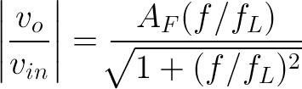
f = frequency of the input signal (Hz)
The magnitude of the voltage gain is

Slide 8
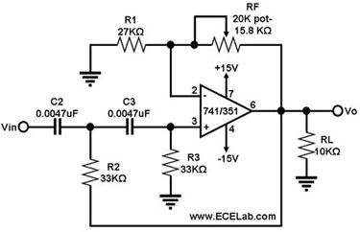
Circuit Diagram
For Second Order High Pass Filter

Slide 9
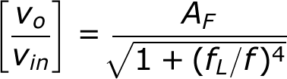
Second Order High Pass Filter
The Voltage gain magnitude equation of the second order high pass filter is as follows -
Where, AF = 1.586 = Passband gain for the second order Butterworth response
F= frequency of the input signal
fL = low cutoff frequency (Hz)

Slide 10
******************** Thank You !!! ********************

