Slide 1


Intro to Git
presented by Brian K. Vagnini
Hosted by

Slide 2
What is version control?
Local Version Control
Centralized Version Control
Distributed Version Control
Notes:
Concurrent Versioning System (CVS) and Subversion (SVN) are examples of Centralized. Mercurial and Git are examples of Distributed.

Slide 3
What is Git
Software that stores a snapshot of your files
Everything is local to your machine
Does a SHA-1 checksum and stores that for each snapshot

Slide 4
Three stages
Modified
Staged
Committed

Slide 5
Three sections of a git project
Working directory
Staging area
git repo

Slide 6
Installing git
Linux - yum install git-core (or apt-get install git-core)
Mac - using macports, sudo port install git-core or browse to git-scm.com/download/mac
Windows - msysgit.github.com
post install git config --global user.name ‘Your Name’ git config --global user.email youremail@domain.com

Slide 7
Getting help
Google
Offline:
git help <verb> git <verb> --help man git <verb>
Notes:
demo this and show them how to get out of the man page (q)

Slide 8
Getting started
1- Existing folder with files and no version control
git init git add . git commit -m “Your message here”
2- Nothing at all- Cloning an existing repo
git clone https://github.com/vinta/awesome-python.git or git clone https://github.com/zedshaw/python-lust.git
Notes:
Python Little Unix Server Toolkit

Slide 9
What about security?
Two options:
1- Host your own server that has git on it
2- Pay github (or others) monthly and you get private repos that you can control
You control who can commit to your project even in the free github accounts

Slide 10
Workflow
1- Ensure that you are on the CORRECT branch. (This is vital later on…)
2- Make modifications to your code. (SAVE the changes.)
3- Add the files to the staging area.
4- Commit the changes to your local repo.
5- Merge your Dev branch with your Master branch.
6- Push the changes to your remote repo.

Slide 11
git init
fivestringbass:EJv2 brian$ touch index.htm
fivestringbass:EJv2 brian$ git init
Initialized empty Git repository in /Users/brian/Google Drive/Code/JavaScript/EJv2/.git/

Slide 12
git status
fivestringbass:EJv2 brian$ git status
# On branch master # Initial commit # Untracked files: # (use "git add <file>..." to include in what will be committed)
# ch2exa.js # index.htm
nothing added to commit but untracked files present (use "git add" to track)

Slide 13
git add
fivestringbass:EJv2 brian$ git add .
(You can specify particular files if someone else in your team needs them, or you can use the period, which signifies adding everything in the current directory and subdirectories.)

Slide 14
git status (again)
fivestringbass:EJv2 brian$ git status
# On branch master # Initial commit # Changes to be committed:
# (use "git rm --cached <file>..." to unstage) # new file: ch2exa.js # new file: index.htm

Slide 15
git commit
fivestringbass:EJv2 brian$ git commit -m "Initial commit. Start of project."
[master (root-commit) de4ed60] Initial commit. Start of project. 2 files changed, 16 insertions(+) create mode 100644 ch2exa.js create mode 100644 index.htm
Notes:
Point out the de4ed60 (it’s the first part of the 40 character SHA-1 string)

Slide 16
git status (yet again)
fivestringbass:EJv2 brian$ git status
# On branch master
nothing to commit, working directory clean
fivestringbass:EJv2 brian$

Slide 17
Wash, Rinse, and Repeat
How often to commit?
Whenever you make a major change.

Slide 18
Make changes and repeat
fivestringbass:EJv2 brian$ git status # On branch master # Changes not staged for commit:
# (use "git add <file>..." to update what will be committed) # (use "git checkout -- <file>..." to discard changes in working directory)
# modified: ch2exa.js
no changes added to commit (use "git add" and/or "git commit -a")

Slide 19
How do I see my changes?
git log
use gitk --all (MAY need a separate install)
Notes:
vs. git log -5 (show on vagnini.net website)

Slide 20
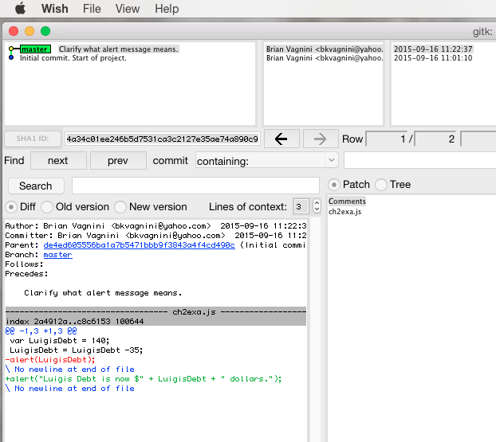
Notes:
When demoing this, point out the SHA-1 ID field, reminding them of the Commit response they got back- also point out that your command line is not returned to you until you exit Wish (at least on a MAC)

Slide 21
.gitignore
Specifies intentional untracked files & folders that Git should ignore .DS_Store files (if using a MAC)
data/ ( if you are processing data that is temporary)
Can use regular expressions to specify the pattern to look for
Can ignore all .php files with *.php EXCEPT you can add !index.php to have git track changes to that one php file
Notes:
Look at vagnini.net .DS_Store is for MAC, the .htm~ is for the temp files that get created when editing .htm files

Slide 22
git revert
Used to “undo” a commit. Similar to the Previous Versions feature in Windows Server.
git revert SHA# or git revert HEAD
git reset --soft SHA# ( resets the HEAD to the point you specify but doesn’t alter staging index or working directory) git reset --hard SHA# (very destructive- changes staging index and working directory to match the repo- all future changes are GONE!)
Notes:
Once you rewind/reset, your log won’t show you the commits- save them in a text file - can see where HEAD is via cat .git/HEAD or cat .git/refs/heads/master (shows you the SHA#)

Slide 23
Remote repositories
to view: git remote -v
to add a remote: make directory (repo.git) on the remote git server, CD to it and type “git init --bare”
then on your dev machine, cd to your folder, then type “git remote add REMOTENAME USER@HOST:/USERNAME/REPO_NAME”
for github, it would be: git remote add github https://github.com/bkvagnini/REPO.git
Notes:
Look in /Users/brian/Google Drive/from_dropbox/Projects/cala-learn or /learning_files/python_book (has 2 remote repos)
git remote -v github acct bkvagnini:korea hill pw http://git-scm.com/docs/git-remote

Slide 24
git branch
To see what branches are available: “git branch”
To create a new branch: “git branch develop”
To use a different branch: “git checkout develop”
To create a new branch and switch to it: “git checkout -b develop
To delete a branch: “git branch -d dev”
Notes:
look at 24thbay website for develop vs. master branch
git branch -r (shows remote branches) or git branch -a (shows local and remote branches)

Slide 25
git merge
(from your develop branch, in a clean state)
git checkout master git merge develop git checkout develop WRITE CODE!
merge conflicts (look for the >>> and <<< in the document)
Notes:
occurs mainly when two or more team members try to modify the same file at the same time

Slide 26
Revised workflow
git fetch origin master
git pull origin master
git checkout develop
git merge master
change files
test and verify (The add to staging and commit to local repo steps are done here)
git checkout master
git merge develop
code review
git push origin master
Notes:
origin is this case is the name of the remote repo that you had created earlier

Slide 27
git stash
Saves changes to your code in progress without committing them to the repo
git stash save “message”
git stash list (views stash changes)
Notes:
make a change and save it- DO NOT COMMIT- change branches- git yells at you-

Slide 28
Retrieve your stash
git stash pop stash@{0} (removes the changes from the stash)
git stash apply stash@{0} (leaves a copy in the stash)
-Deleting your stash
git stash drop stash@{0}
git stash list to confirm
Notes:
Look at /from_dropbox09websites/vagnini website for stashes in the develop branch- show using gitk --all - demo pop and apply then drop - demo with git stash list

Slide 29
Questions?

Slide 30
Thanks for coming!

