Slide 1


Intro to Python
Presented by Brian K. Vagnini
~ 45 minutes / 38 slides

Slide 2
Agenda
What is Python?
History of Python
What is Python used for?
Who uses Python?
Zen of Python
Language basics
Python Resources

Slide 3
What is Python?
Python is an interpreted high-level programming language for general-purpose programming.
It has a design philosophy that emphasizes code readability, notably using significant whitespace.
It offers duck typing* and allows for object oriented, functional, and procedural programming.
Two versions- ver 2.7.x and ver 3.x (Use ver 3.x if possible)
https://www.python.org/
* an object passed into a function or method supports all method signatures and attributes expected of that object at run time.

Slide 4
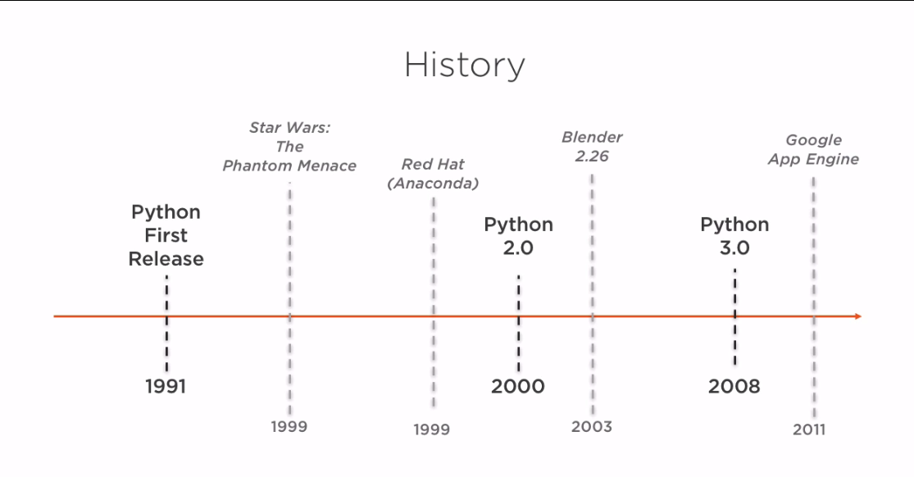
History of Python

Slide 5
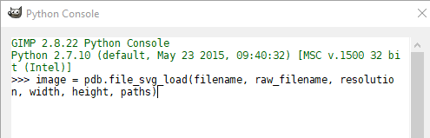
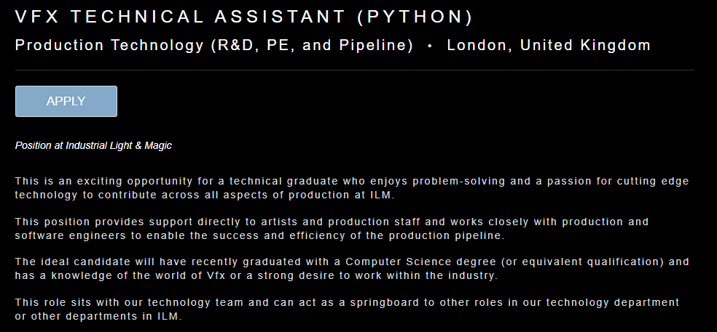
What is Python used for?
Linux Scripting and Administration
Web Development
Application Scripting
VFX Pipeline
Data Science
Machine Learning

Slide 6
Who Uses Python?
Paypal/Ebay
Disney
ILM
Bank of America
Pinterest
Google
YouTube
NASA
CIA
Battlefield 2 (game)
National Weather Service
Redhat
Thawte (digital certs)
IBM

Slide 7
Zen of Python
>>> import this
The Zen of Python, by Tim Peters
Beautiful is better than ugly.
Explicit is better than implicit.
Simple is better than complex.
Complex is better than complicated.
Flat is better than nested.

Slide 8
Zen of Python
Sparse is better than dense.
Readability counts.
Special cases aren't special enough to break the rules.
Although practicality beats purity.
Errors should never pass silently.
Unless explicitly silenced.
In the face of ambiguity, refuse the temptation to guess.

Slide 9
Zen of Python
There should be one-- and preferably only one --obvious way to do it.
Although that way may not be obvious at first unless you're Dutch.
Now is better than never.
Although never is often better than *right* now.
If the implementation is hard to explain, it's a bad idea.
If the implementation is easy to explain, it may be a good idea.
Namespaces are one honking great idea -- let's do more of those!

Slide 10
Python Language Basics
Why Use Python
Readable and Maintainable Code
Multiple Programming Paradigms (OOP, Functional, etc)
Multiple OS Support
Robust Standard Library
Many Open Source Frameworks/Tools
Simplify Complex SW Development
Supports TDD
Why NOT to use Python
Slower than Compiled languages
Not the best at Web Development
Not for Game Development
Not for Low Level Systems
Not the best at managing Memory

Slide 11
Python Language Basics
Print statements
Comments
Variables
Lists
Strings
Operations
User input
Logic (if, else, for, while)
Types/Casting
Functions
OOP
Importing Modules
Exceptions
Types of Errors

Slide 12
Python Language Basics
Print statements
print (“Hello, World!”)
In C#
using System; namespace HelloWorld { class Hello { static void Main() { Console.WriteLine("Hello World!"); } } }

Slide 13
Python Language Basics
Comments
#print (“Hello, World!”)
print (“Yo! Dude!”) #this is more what I like to do
‘’’ This is a
Multi
Line comment ‘’’

Slide 14
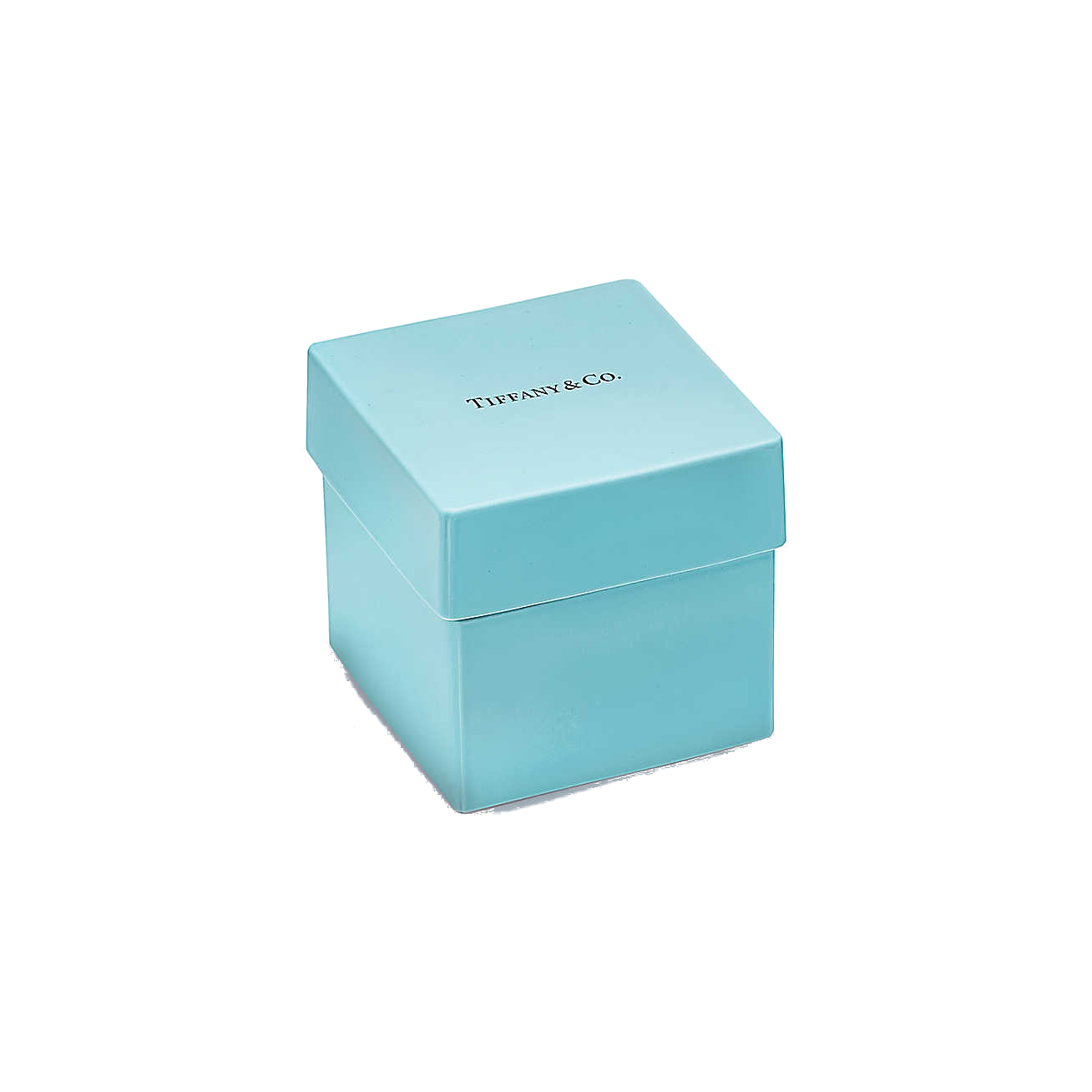
Python Language Basics
Variables*
Age = 29
print (Age)
Using the variable:
print (“Hey, I didn’t know that you were“, Age)
Note:
Age != age != AGE
*A variable is just a name that refers to an object.

Slide 15
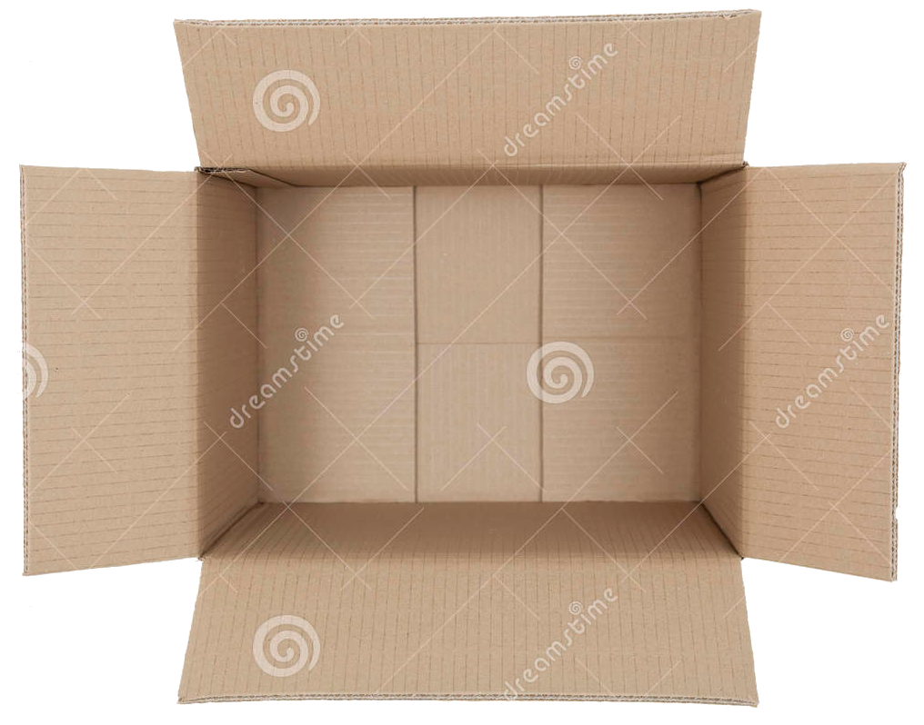
Python Language Basics
Lists
winning_numbers = [29, 14, 37, 2, 10, 42]
Me = [49, “musician”, “writer”, ”developer”]
print (winning_numbers)
print (Me[2])
# prints the item contained at index location 2 out of the list
A list is a resizable array, which differs from a tuple, which is immutable

Slide 16
Python Language Basics
String- Properties
>>> my_string = "abc"
>>> string_length = len(my_string)
>>> print(string_length)
3
len() is a function that works on many different Objects, including Strings

Slide 17
Python Language Basics
String- Concatenate
>>> string1 = "abra"
>>> string2 = "cadabra"
>>> magic_string =string1 + string2
>>> print(magic_string) abracadabra
String- Concatenate
>>> print("abra"+"ca"+"dabra")
abracadabra
or
>>> print("abra","ca","dabra")
abra ca dabra

Slide 18
Python Language Basics
String- More
>>> flavor ="birthday cake"
>>> print(flavor[3])
t
>>> flavor = "birthday cake"
>>> print(flavor[0:3])
bir
Up to but not including the 3rd character (so it would omit the t)

Slide 19
Python Language Basics
String- Format
We want the following statement:
Zaphod has 2 heads and 3 arms
num_heads = 2
name = “Zaphod”
num_arms = 3
print("{} has {} heads and {} arms".format(name, num_heads, num_arms))
Order matters here

Slide 20
Python Language Basics
Operations
A = 13
B = 5
Addition: print (A + B) (18)
Subtraction: print (A - B) (8)
Multiplication: print (A * B) (65)
Division: print (A /B) (2.6)
Exponents: print (A ** B) (371293)
Modulo: print (A % B) (3) (the remainder)

Slide 21
Python Language Basics
Assigning / Incrementing Value
A = “B” #A is a string
A = 1 #A is now an Integer
A+=1 (means to take the value of A (which is 1), and then add 1 to it)
A+=5 (means to take the value of A (which is 1), and then add 5 to it)
A-=5 (means to take the value of A (which is 1), and then subtract 5 from it)
etc.

Slide 22
Python Language Basics
Logical Operators
(AND) (both left side and right side must be True)
if a>b and a > 10:
(OR) (if left side or right side is True)
if a>b or a < 10:
! (NOT) (negates the rest of the expression)
If a != b: and others...

Slide 23
Python Language Basics
Comparison Operators
A = 13
B = 5
Equality: print (A== B) (False)
Inequality: print (A != B) (True)
Greater than: print (A > B) (True)
Less than: print (A <B) (False)
= is NOT the same as ==, which is not the same as ===

Slide 24
Python Language Basics
User Input
Age = input (“How old are you in years?: “)
Using that input
print (“Hey, I didn’t know that you were “ + Age)

Slide 25
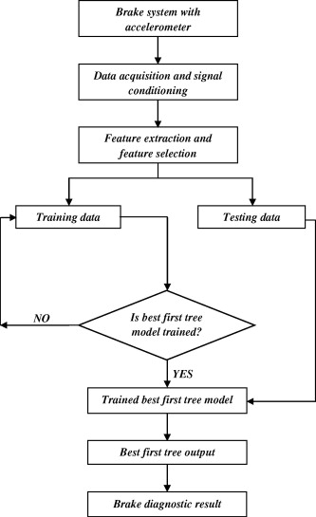
Python Language Basics
Logic (if / elif / else)
Age = input (“How old are you in years?: “) *
if Age < 30:
print (“You still have your youth.”)
elif Age <=50:
print (“Aging gracefully”)
else:
print (“Geez! You’re old!”)
Notes:
Will need to have Age = int(Age) before the If statements; otherwise, it throws an error

Slide 26
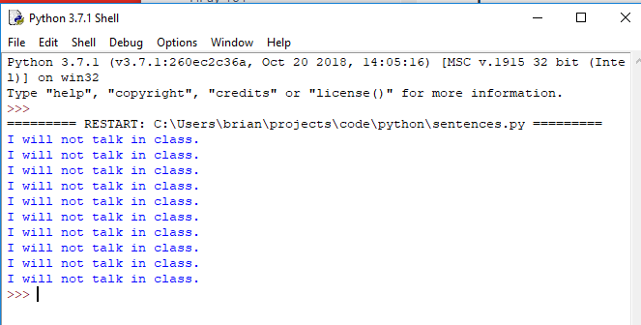
Python Language Basics
Logic (for / while loops)
## For loop
for i in range (1,11):
print ("I will not talk in class.")

Slide 27
Python Language Basics
Logic (for / while loops)
b = 0 #defines the variables we are using outside of the loop
while b < 100: # while this condition is true
print (b) # do this
b += 1 # very important step...why?
print (“I’m done…”)
Returns 0,1,2,3,4,5,6,etc.

Slide 28
Python Language Basics
Types/Casting
int()
float()
str()
type(Age)
>>> print("1" + 1)
Traceback (most recent call last): File "<pyshell#1>", line 1, in <module> print("1" + 1)
TypeError: cannot concatenate 'str' and 'int' objects
Notes:
Will need to have Age = int(Age) before the If statements; otherwise, it throws an error

Slide 29
Python Language Basics
Functions
def printme( str ): print (str) return
def squared(x): x = x * x return x
...more code here...
To Use
>>> printme ("hello, world!")
hello, world!
>>> squared(4)
16

Slide 30
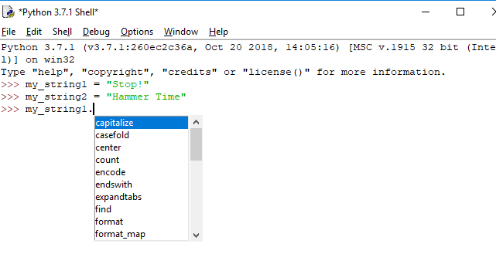
Python Language Basics
Object Oriented Programming
Methods are functions that belong to Objects
Use dot notation to call methods (e.g. mystring.upper)

Slide 31
Python Language Basics
class BankAcct:
def __init__(self, acct_type, amount):
self.acct_type = acct_type
self.amount = amount
This creates a bank account with two attributes: account type and amount
self is a requirement, but really isn’t an attribute

Slide 32
Python Language Basics
def deposit(self, dep_amount):
self.amount += dep_amount
def withdraw(self, wd_amount):
self.amount-= wd_amount
def __str__(self):
return "Your {} Account balance is: ${}".format(self.acct_type, self.amount)
It has 2 primary methods: deposit and withdrawal
It also has an additional method, for reporting the balance.

Slide 33
Python Language Basics
bkv = BankAcct("Checking", 100)
print(bkv.acct_type)
bkv.deposit(25)
print (bkv.amount) #prints only the dollar amt
print(bkv) #prints the full statement, including amt
bkv.withdraw(51.62)
print(bkv)
To use the class:

Slide 34
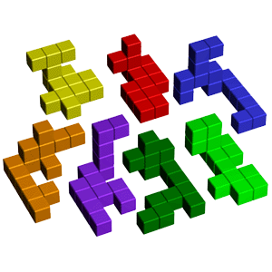
Python Language Basics
Modules
Allows you to logically organize your Python code.
Can define functions, classes and variables.
Importing Modules
import <module_name>
Or
from <module_name> import <function>

Slide 35
Python Language Basics
Exceptions
An event, which occurs during the execution of a program, that disrupts the normal flow of the program's instructions.
Python interpreter must either handle the exception immediately; otherwise, it terminates and quits.
Use a Try/Except block if you have some code that MAY raise an exception.

Slide 36
Python Language Basics
Exceptions
global_var = 1
def my_vars():
print ("Global variable:", global_var)
local_var = 2
print ("Local variable:", local_var)
my_vars()
try:
print ("Local Variable called from outside of function is:", local_var)
except:
print ("local_var is not available")
Notes:
This code displays the concept of variable scope, as well as a successful Try/Except block. This code sample is found in easySteps repo as scope.py

Slide 37
Python Language Basics
Types of Errors
Syntax - code doesn’t conform to language rules
print (“Python is cool!) (missing a “)
Runtime - errors during execution
print (x) (you get x is not defined)
Semantic- program performs unexpectedly (the hardest to find)
print (5 - 2 *10 ) (you get -15 not the 30 you were expecting)

Slide 38
Python Resources
https://medium.freecodecamp.org/learning-python-from-zero-to-hero-120ea540b567
https://www.stavros.io/tutorials/python/
https://www.theseus.fi/bitstream/handle/10024/115922/Kazakov_Vladislav.pdf?sequence=1
Realpython.com
https://www.tutorialspoint.com/python3/python_functions.htm
https://wiki.python.org/moin/OrganizationsUsingPython
https://www.paypal-engineering.com/2014/12/10/10-myths-of-enterprise-python/
http://python-history.blogspot.com/2009/01/introduction-and-overview.html
https://pydanny-event-notes.readthedocs.io/en/latest/socalpiggies/20110526-wda.html
Python in Easy Steps (book)
git clone git@github.com:pythontlh/intro_to_python_meetup.git
http://www.pythonchallenge.com/

Slide 39
Conclusion
Thanks for coming!
Any Questions?

