Slide 1




Python Web Programming
+
OR
Presented by Brian K. Vagnini
~ 60 minutes / 42 slides

Slide 2
Agenda
Early Attempts
Flask
Django
Using Flask to create API’s
Setting up Production Django / Flask Sites
Apache / Nginx

Slide 3
Some Early Attempts
Bottle - 1995
Zope - 1999
*Django - 2005
Web2Py - 2007
*Flask - 2010
Pyramid - 2011

Slide 4
History of Bottle
Launched in 1995
Micro Web Framework
No dependencies (after installation) other than Standard Library
Includes:
Routing
Templates
Utilities
Server
Used by:
https://bottlepy.org/docs/dev/

Slide 5
Bottle Basics
Installation:
pip3 install bottle
Create a Project:
from bottle import route, run, template
@route('/hello/<name>')
def index(name):
return template('<b>Hello {{name}}</b>!', name=name)
run(host='localhost', port=8080)
Running Bottle:
Run the script, then point browser to http://localhost:8080/hello/world

Slide 6

Roadmap
Choose Python Framework
Simple test of Framework
Write your app
Test in Dev
Deploy App to Production
Configuring Web Servers

Slide 7
History of Flask
Released in 2010
Micro web framework
Includes:
Jinja2 Templating (a modern and designer-friendly templating language for Python, modelled after Django’s templates (Django was released in 2005.))
RESTful request dispatching
Support for cookies
Extensions available
Used by:
Pinterest, LinkedIn
http://flask.pocoo.org/

Slide 8
Flask Basics
Installation:
pip3 install Flask
Create a Project:
hello.py
from flask import Flask
app = Flask(__name__)
@app.route("/")
def hello():
return "Hello World!"
if __name__ == "__main__":
app.run()
Running Flask (in Dev):
FLASK_APP = hello.py
flask run
(Can also run this in IDLE and it will work as well)

Slide 9
Flask Basics - More Realistic Example
Folder Structure
/static
/css
6gen3.css
/images
6gen3-logo.png
/vendor
/bootstrap
/jquery
/font-awesome
/templates
index.html
w2e.html
app.py
main_dish.txt
starch.txt
vegetable.txt
Folder Structure of Basic Static Website
/css
6gen3.css
bootstrap.min.css
jquery.min.css
/js
bootstrap.min.js
jquery.min.js
/images
6gen3-logo.png
index.html
w2e.html
vs.

Slide 10
Flask Basics - More Realistic Example
app.py
from flask import Flask, render_template
import random
app = Flask(__name__)
@app.route('/')
def index():
return render_template('index.html')
@app.route('/suggest')
def meal_idea():
main = open ("main_dish.txt", 'r').read()
main_split= main.split('\n')
starch = open ("starch.txt", 'r').read()
starch_split= starch.split('\n')
vegetable = open ("vegetable.txt", 'r').read()
vegetable_split= vegetable.split('\n')
main_dish = random.choice(main_split)
starch_side = random.choice(starch_split)
veggie_side = random.choice(vegetable_split)
suggested = 'How about ' + main_dish + ' with ' + starch_side + ' and ' + veggie_side + '?'
return render_template('w2e.html', result=suggested)
if __name__ == '__main__':
app.run(debug=True,host='0.0.0.0', port=5002)

Slide 11
Flask Basics - More Realistic Example
index.html
<!DOCTYPE html>
<html lang="en">
<head>
{% block head %}
<meta charset="utf-8">
<meta http-equiv="X-UA-Compatible" content="IE=edge">
<meta name="viewport" content="width=device-width, initial-scale=1">
<meta name="description" content="">
<meta name="author" content="">
<title>{% block title %}About{% endblock %}</title>
<!-- Bootstrap Core CSS -->
<link href="/static/vendor/bootstrap/css/bootstrap.min.css" rel="stylesheet">
<!-- Theme CSS -->
<link href="/static/css/6gen3.css" rel="stylesheet">
<!-- Custom Fonts -->
<link href="/static/vendor/font-awesome/css/font-awesome.min.css" rel="stylesheet" type="text/css">

Slide 12
Flask Basics - More Realistic Example
index.html
<!-- About Section -->
<section class="text-center" id="about">
<h2>About</h2>
<p> wut2eat is a meal suggestion application, randomly pulling main dishes, side dishes, and vegetable choices
<br />from text files that you upload (for now).</p>
<p> It is designed to help you plan out your meals, thereby saving you money at the grocery store.</p>
<h3><em>Free version</em></h3>
<a href="suggest"><h3>Suggest a meal</h3></a>
This points back to app.py
@app.route('/suggest')
def meal_idea():
etc...

Slide 13
Flask Basics - More Realistic Example
w2e.html
{% extends "index.html" %}
{% block title %}Your Meal Suggestion{% endblock %}
{% block content %}
<br />
<br />
<div class = "meal">
<h2>{{result}}</h2>
<br />
<button onClick="window.location.reload();">Another Suggestion?</button>
</div>
</header>
{% endblock %}
etc...
{{result}} points back to app.py
suggested = 'How about ' + main_dish + ' with ' + starch_side + ' and ' + veggie_side + '?'
return render_template('w2e.html', result=suggested)
etc...

Slide 14
Questions
Any Questions on Flask?

Slide 15
History of Django
Created in the Fall of 2003 for a Newspaper
Released July 2005
“Batteries Included”
Includes:
Authentication system
Administrative interface
Tools for RSS and Atom feeds
Sites framework (One Django installation- multiple websites)
Supports PostgreSQL, MySQL, SQLite and Oracle, as well as MongoDB
Mitigation for cross-site request forgery, cross-site scripting, SQL Injection and more
Used by:
PBS, Instagram, Mozilla, The Washington Times, Discus, Bitbucket & NextDoor
https://www.djangoproject.com/

Slide 16
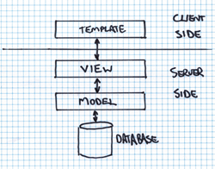
Django Philosophy
Project vs. App
Everything is considered an app (blog & ecommerce store = 2 dif apps).
A project can contain multiple apps and is a collection of configuration and apps for a website.
Generally, you will be playing around with models (data) and views (display of that data).
Django works off of MVT concept
(Model - View - Templates)
A model is the single, definitive source of data about your data. It contains the essential fields and behaviors of the data you’re storing. Generally, each model maps to a single database table.

Slide 17
Django Basics - Installation
Installation
pip3 install django==3.0
python3 -m django --version
(to verify)
Create a project
django-admin startproject mysite
Testing your site
python manage.py runserver
Creates the following:
mysite/ <= this can be renamed to anything
manage.py
mysite/ <= mysite is the management app
__init__.py
asgi.py
settings.py
urls.py
wsgi.py

Slide 18
Django Basics - Management site
Folder Structure
mysite/
manage.py
mysite/
__init__.py
asgi.py
settings.py
urls.py
wsgi.py
manage.py <= this is the command center for our app
mysite/
__init__.py
asgi.py
settings.py <= has project wide settings
urls.py <=used to route to our other apps
wsgi.py

Slide 19
Django Basics - our first app
You can add other apps to the project with:
django-admin startapp <appName>
Folder Structure
mysite/
manage.py
mysite/
...
polls/
__init__.py
admin.py
apps.py
migrations
models.py ⇐ defines what db tables look like
tests.py
views.py ⇐ defines our code to return
urls.py <= defines our paths within the app
templates/ <= this folder holds html templates that views.py returns

Slide 20
Django Basics - creating our view
polls/views.py
from django.http import HttpResponse
def index(request):
return HttpResponse("Hello, world. You're at the polls index.")
polls/urls.py (you may need to create this file)
from django.urls import path
from . import views
urlpatterns = [
path('', views.index, name='index'),
]
Modify mysite/settings.py
from django.contrib import admin
from django.urls import include, path
urlpatterns = [
path('admin/', admin.site.urls),
path('polls/', include('polls.urls')),
]

Slide 21
Django Basics - Flow of a Request
Running Django (development server)
python3 manage.py runserver
To view:
http://localhost:8000/polls/
or
http://localhost:8000/admin/
(since we defined an admin url as well)
Url > View > Model > Template
User goes to http://localhost:8000/polls
mysite/urls.py - directs to urls.py in the app
polls/urls.py - forwards to views.py
polls/views.py - code logic happens - directs to specific template
/templates - html gets rendered and gets returned to the browser

Slide 22
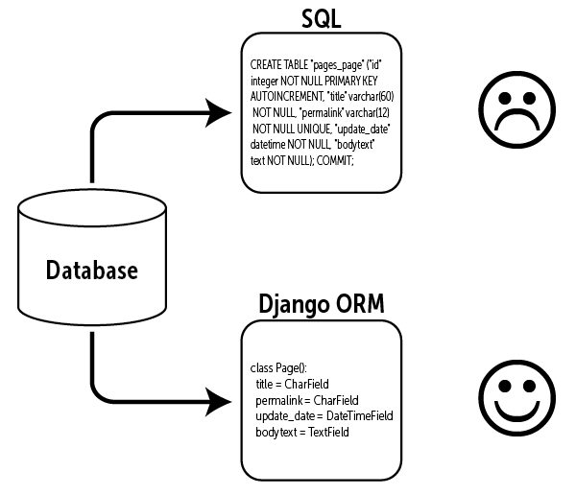
Django Basics - models
Models.py allows you to map classes in your Django code to Database tables and columns
High level steps
Change your models
python3 manage.py makemigrations
python3 manage.py migrate
python3 manage.py makemigrations
(lets you update your database live, without losing data)
python3 manage.py migrate
(helps create the database (if not already created) used by Django - defaults to sqlite3 unless you specify another database - file is called db.sqlite3)

Slide 23
Questions
Any Questions on Django?

Slide 24

Creating REST APIs Using Flask
https://blog.miguelgrinberg.com/post/designing-a-restful-api-with-python-and-flask (Author of Flask Web Development - O’Reilly)
Why use an API? (https://www.mulesoft.com/resources/api/restful-api)
Can use HTTP to retrieve data
Data is not tie to resources or methods in your code
Can return different data formats
Allows for multiple types of clients (web browser, IOS App, Android App, etc.) to access the data

Slide 25
What is REST?
REpresentational State Transfer (or REST), has emerged as the standard architectural design for web services and web APIs.
6 design rules for REST
Client-Server
Stateless
Cacheable
Layered System
Uniform Interface
Code on demand
Notes:
Client-Server: There should be a separation between the server that offers a service, and the client that consumes it.
Stateless: Each request from a client must contain all the information required by the server to carry out the request. In other words, the server cannot store information provided by the client in one request and use it in another request.
Cacheable: The server must indicate to the client if requests can be cached or not.
Layered System: Communication between a client and a server should be standardized in such a way that allows intermediaries to respond to requests instead of the end server, without the client having to do anything different.
Uniform Interface: The method of communication between a client and a server must be uniform.
Code on demand: Servers can provide executable code or scripts for clients to execute in their context. This constraint is the only one that is optional.

Slide 26
What is REST?
HTTP Method | Action | Examples
GET | Obtain information about a resource | http://example.com/api/orders (retrieve order list)
GET | Obtain information about a resource | http://example.com/api/orders/123 (retrieve order #123)
POST | Create a new resource | http://example.com/api/orders (create a new order, from data provided with the request)
PUT | Update a resource | http://example.com/api/orders/123 (update order #123, from data provided with the request)
DELETE | Delete a resource | http://example.com/api/orders/123 (delete order #123)
The HTTP request methods are typically designed to affect a given resource in standard ways:
The REST design does not require a specific format for the data provided with the requests. In general data is provided in the request body as a JSON blob, or sometimes as arguments in the query string portion of the URL.

Slide 27
Designing the API
http://[hostname]/todo/api/v1.0/ is the url format that we will use
HTTP Method | URI | Action
GET | http://[hostname]/todo/api/v1.0/tasks | Retrieve list of tasks
GET | http://[hostname]/todo/api/v1.0/tasks/[task_id] | Retrieve a task
POST | http://[hostname]/todo/api/v1.0/tasks | Create a new task
PUT | http://[hostname]/todo/api/v1.0/tasks/[task_id] | Update an existing task
DELETE | http://[hostname]/todo/api/v1.0/tasks/[task_id] | Delete a task
Fields for each task
id: unique identifier for tasks. Numeric type.
title: short task description. String type.
description: long task description. Text type.
done: task completion state. Boolean type.

Slide 28
Creating the API
http://[hostname]/todo/api/v1.0/tasks is the url format that we will use
#!flask/bin/python
from flask import Flask, jsonify
from flask_cors import CORS #per https://flask-cors.readthedocs.io/en/latest/
api = Flask(__name__)
CORS(api) # per https://flask-cors.readthedocs.io/en/latest/
api = Flask(__name__)
tasks = [
{
'id': 1,
'title': u'Buy groceries',
'description': u'Milk, Cheese, Pizza, Fruit, Tylenol',
'done': False
},
{
'id': 2,
'title': u'Learn Python',
'description': u'Need to find a good Python tutorial on the web',
'done': False
}
]
@api.route('/todo/api/v1.0/tasks', methods=['GET'])
def get_tasks():
return jsonify({'tasks': tasks})
if __name__ == '__main__':
api.run(debug=True,host='0.0.0.0', port=5001)

Slide 29
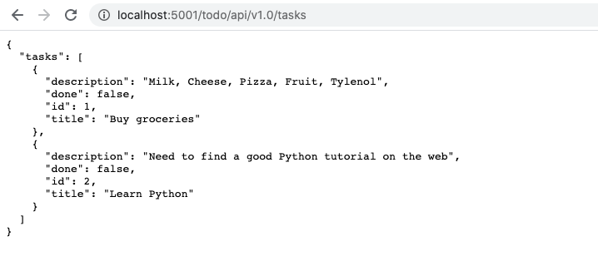
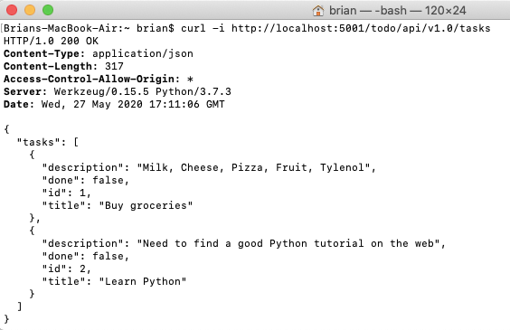
Testing the API
Notes:
If I run into issue of “Address already in use” when demoing this: (from https://www.logcg.com/en/archives/536.html)
lsof -i:5001
Then kill -9 <pid>

Slide 30
Using the API
https://scotch.io/tutorials/how-to-use-the-javascript-fetch-api-to-get-data
Index.html
<!DOCTYPE html>
<html lang="en">
<head>
<meta charset="utf-8" />
<meta name="viewport" content="width=device-width, initial-scale=1.0" />
<title>How to Access API</title>
</head>
<body>
<script src="js/script.js" crossorigin="anonymous"></script>
<div id = "tasks">Test of the API</div>
</body>
</html>

Slide 31
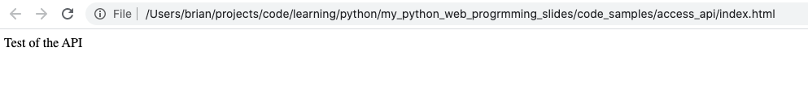
Using the API
script.js
const url = 'http://localhost:5001/todo/api/v1.0/tasks';
fetch(url)
.then((resp) => resp.json())
.then(function(data) {
API_result = JSON.stringify(data);
document.getElementById('tasks').innerHTML = API_result;
})
.catch(function(error) {
console.log(error);
});
Notes:
Go to the local file and show how the API doesn’t retrieve any data - it displays “Test of the API”

Slide 32

Python Module
In Terminal, go to your folder where your development website lives
“python -m SimpleHTTPServer” (2.7) or “python -m http.server” (3+)
In your browser, go to localhost:8000
Why do this?
Ajax/Jquery code sometimes requires an actual web server, vs. opening a local file, in order to work properly

Slide 33
Questions
Any Questions on Flask APIs?

Slide 34
Production Django / Flask Sites
Running Flask (in Production):
http://flask.pocoo.org/docs/0.12/deploying/
Use Gunicorn, or Phusion Passenger
To stop gunicorn3
pkill -9 gunicorn3
To start gunicorn (from the folder where app.py is located)
gunicorn3 app:app -b localhost:5000&
To confirm gunicorn3 is running
ps -eaf |grep gunicorn3
Running Django (in Production):
https://developer.mozilla.org/en-US/docs/Learn/Server-side/Django/Deployment
Use Gunicorn, or Phusion Passenger (if self hosting)
Or https://djangofriendly.com/index.html to use a hosted service
This gets to be more cumbersome, as you have to modify your Django app somewhat between the dev version and production.
You also need a web server, regardless of framework or application server.
Notes:
Gunicorn = Python Web Server Gateway Interface
Phusion Passenger = web app server that integrates with Apache and Nginx.

Slide 35
Production Django Sites
Running Django (in Production):
Have a separate settings.py file for production,
Import sensitive settings from a separate file or an environment variable.
This file should then be protected, even if the rest of the source code is available on a public repository.
settings.py
DEBUG. This should be set as False in production (export DJANGO_DEBUG=False)
SECRET_KEY. This is a large random value used for CSRF protection etc.
# Read SECRET_KEY from an environment variable
import os
SECRET_KEY = os.environ['SECRET_KEY']
# OR
# Read secret key from a file
with open('/etc/secret_key.txt') as f:
SECRET_KEY = f.read().strip()
https://docs.djangoproject.com/en/2.1/howto/deployment/checklist/

Slide 36
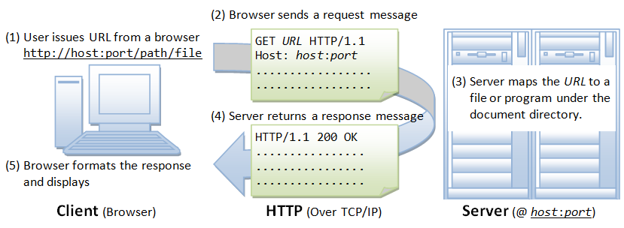
Apache / Nginx
Browser HTTP GET request > web server

Slide 37
Apache Config File Sample
And further down, at the bottom…
<VirtualHost *:80>
ServerAdmin brian@vagnini.net
DocumentRoot /websites/st/
ServerName www.serpenttalk.com
ServerAlias serpenttalk.com
ErrorLog "logs/st-error_log"
#CustomLog "logs/st-access_log" common
</VirtualHost>
Change Document root
(if desired)
#DocumentRoot "/var/www/html"
DocumentRoot "/websites"

Slide 38
NGinx Config File Sample - Static HTML
File is called 6gen3 and is stored in /etc/nginx/sites-available
server { listen 80; server_name www.6gen3.com; rewrite ^/(.*) http://6gen3.com/$1 permanent; }
server { listen 80; server_name 6gen3.com;
access_log /var/www/html/6gen3/logs/access.log; error_log /var/www/html/6gen3/logs/error.log;
location /{ root /var/www/html/6gen3/; index index.html; }
}

Slide 39
NGinx Config File Sample - Flask/Django
File is called w2e and is stored in /etc/nginx/sites-available
server { listen 80; server_name www.wut2eat.com; rewrite ^/(.*) http://wut2eat.com/$1 permanent; }
server { listen 80; server_name wut2eat.com;
access_log /var/www/html/w2e/logs/access.log; error_log /var/www/html/w2e/logs/error.log;
location /{ proxy_set_header Host $host; proxy_set_header X-Real-IP $remote_addr; proxy_pass http://localhost:5000; } }

Slide 40
NGinx Config File Sample - Testing
Set symlinks for sites-enabled
sudo ln -s /etc/nginx/sites-available/<sitename> /etc/nginx/sites-enabled/
test to make sure that there are no syntax errors in any of your Nginx files:
sudo nginx -t
If no problems were found, restart Nginx to enable your changes:
sudo systemctl restart nginx
Create Logs folder
mkdir /var/www/html/<sitename>/logs
cd into logs
touch access.log
touch error.log
Set permissions on new site
chown -R www-data:www-data <site name>
Allow NGinx to read new config files
sudo systemctl reload nginx
Restart Nginx
systemctl restart nginx

Slide 41
Resources
https://news.netcraft.com/archives/2019/04/22/april-2019-web-server-survey.html
https://bottlepy.org/docs/dev/
http://flask.pocoo.org/
https://jinja.palletsprojects.com/en/2.11.x/
http://flask.pocoo.org/docs/0.12/deploying/
https://www.djangoproject.com/start/
https://docs.djangoproject.com/en/1.8/intro/tutorial02/
https://developer.mozilla.org/en-US/docs/Learn/Server-side/Django/Deployment
https://blog.miguelgrinberg.com/post/designing-a-restful-api-with-python-and-flask
https://scotch.io/tutorials/how-to-use-the-javascript-fetch-api-to-get-data
https://devcenter.heroku.com/articles/python-gunicorn
https://docs.gunicorn.org/en/latest/settings.html
https://github.com/bkvspeaks/pythonWebProg

Slide 42
Conclusion
Thanks for coming!
Any Questions?
https://github.com/bkvspeaks/pythonWebProg
brian@vagnini.net

