Slide 1


Introduction to Shiny
RESBAZ SYDNEY
3 - 5 JULY, 2018
#RESBAZSYD
Instructor: James Lawson, Macquarie University

Slide 2
Housekeeping
Slides and lessons for the morning are on GitHub
https://github.com/jamesrlawson/ShinyWorkshop_ResBazSydney2018/raw/master/ResBaz2018_shiny.zip
We’ll be using Etherpad as a collaborative scratchpad
http://pad.software-carpentry.org/ResBaz2018_shiny
Session runs from 9:45am – 1pm, morning tea at 10:45am
We’ll take a few smaller breaks as we go

Slide 3
Introductions
Who am I and why am I here?
James Lawson, postdoc in conservation ecology at Macquarie Uni
Needed to learn Shiny for a new project, best way to learn is to teach!
Who are you and why are you here?
Introduce yourself to your neighbours
Using the EtherPad, please tell us your name, where you’re from, and what you do. Have you seen Shiny before? Used it already?
Can you think of a way Shiny might be useful in your work?
http://pad.software-carpentry.org/ResBaz2018_shiny

Slide 4
Session overview
Introductions
What actually is Shiny?
What can Shiny do?
Walk through some basic Shiny apps
Build a data explorer app
Create interactivity with reactive programming
Build an effective user interface

Slide 5
What is Shiny?
Shiny is an R package that makes it easy to build interactive web apps straight from R.
No web development skills are required.
Host standalone apps on a webpage or embed them in R Markdown documents or build dashboards. You can also extend your Shiny apps with CSS themes, htmlwidgets, and JavaScript actions.
shinyapps.io from Rstudio provides free hosting for open source projects.

Slide 6
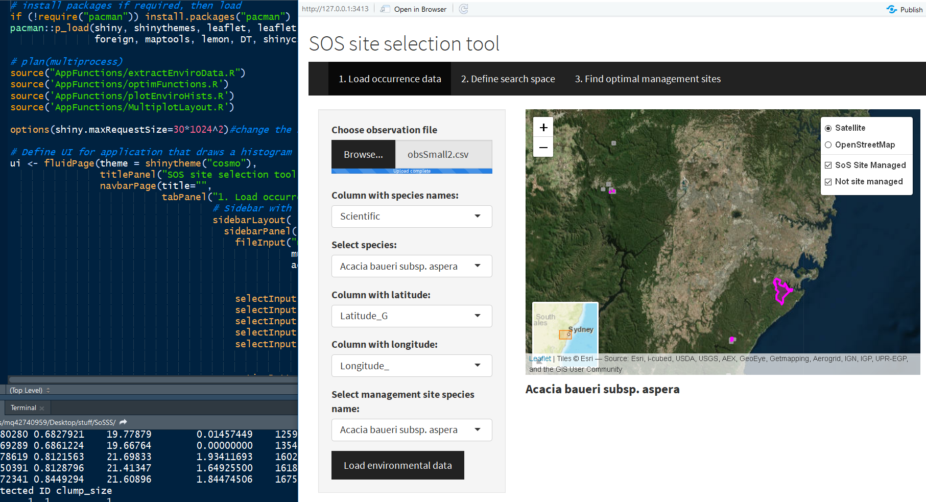
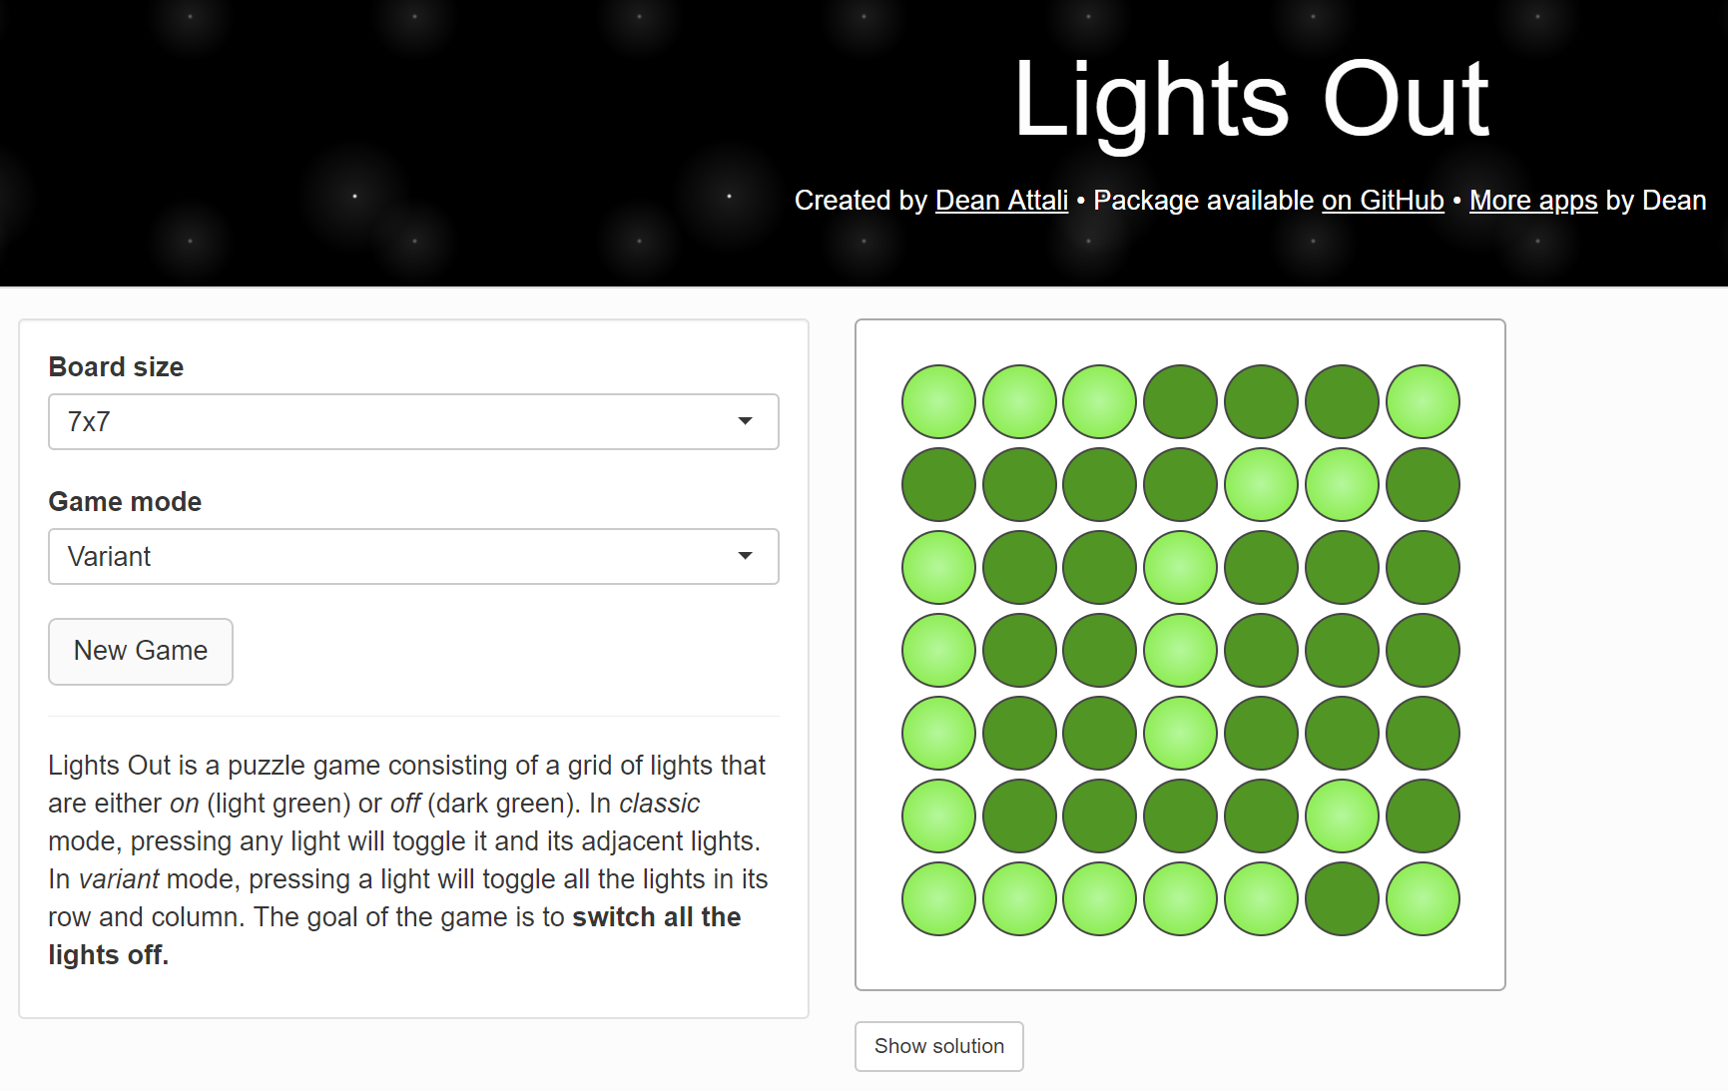
What can Shiny do?
Interactive data exploration and visualisation
Dashboards with realtime data feeds
Use powerful open source Javascript visualisation libraries
Check out the Shiny example gallery
https://shiny.rstudio.com/gallery/
Check out the Shiny widgets gallery
https://shiny.rstudio.com/gallery/widget-gallery.html
Even games! https://daattali.com/shiny/lightsout/
Notes:
Which Shiny gallery examples to look at?
https://shiny.rstudio.com/gallery/superzip-example.html - note the lightning fast reactivity of the map, which should be welcome to people with GIS experience
https://shiny.rstudio.com/gallery/google-charts.html
- Anybody ever asked you what the points mean on your graph?
https://gallery.shinyapps.io/lake_erie_fisheries_stock_assessment_app/
Comprehensive interface for wildlife managers to explore data
https://gallery.shinyapps.io/CDCPlot/
- Dashboard, collects information on the fly

Slide 7
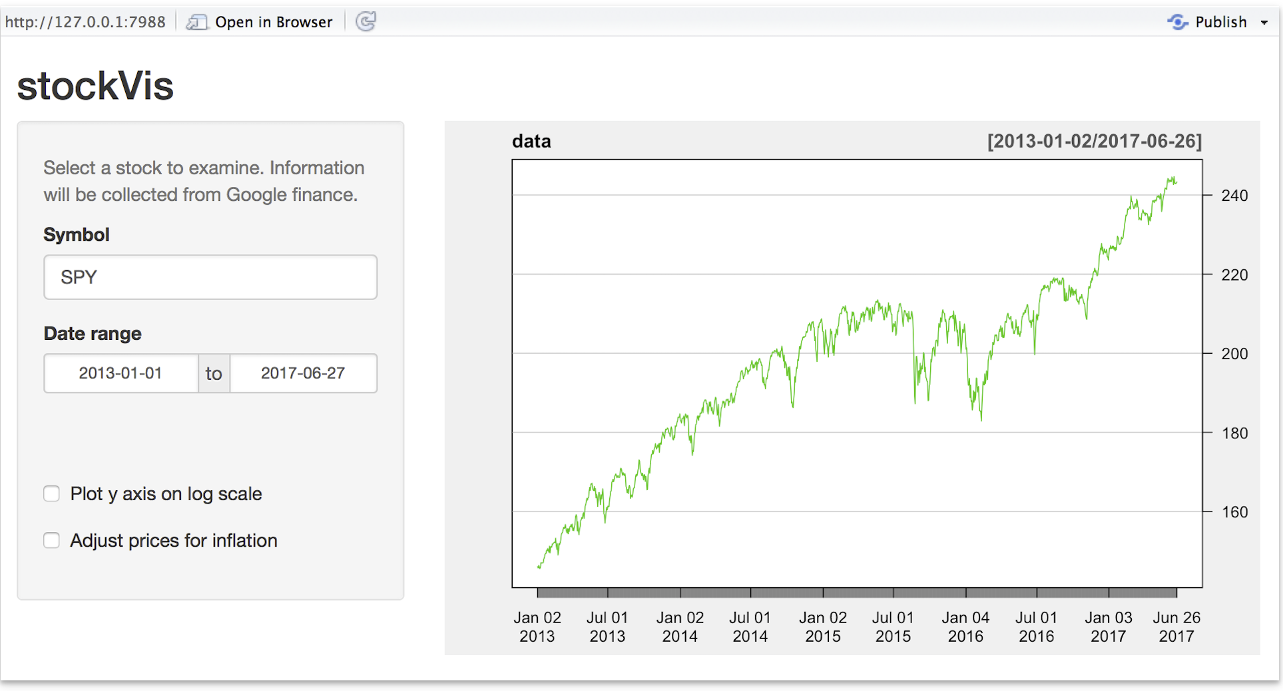
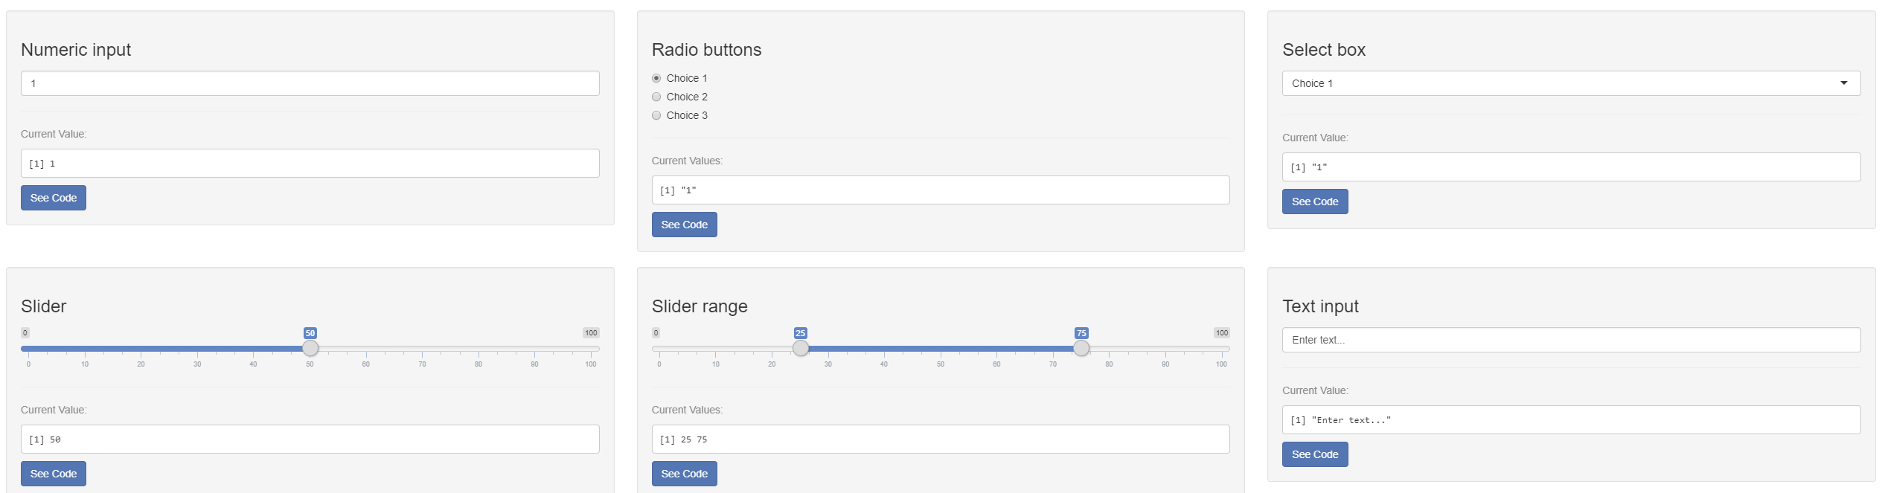
Reactive programming
Reactive programming forms the basis of Shiny apps.
Reactive objects change in response to changes in other objects.
These objects can be connected in a chain of reactivity.
A well known example is found in Microsoft Excel, where changing one cell can have consequences throughout the Workbook.
Notes:
Example of chaining might be if a certain symbol is chosen by the user, log scale y axis is automatically selected.

Slide 8
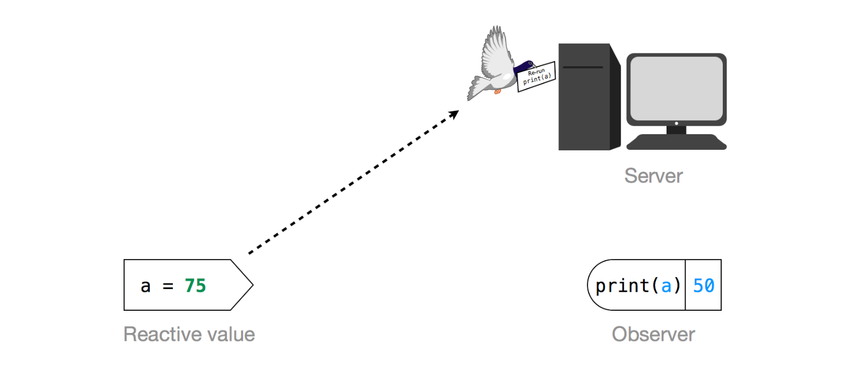
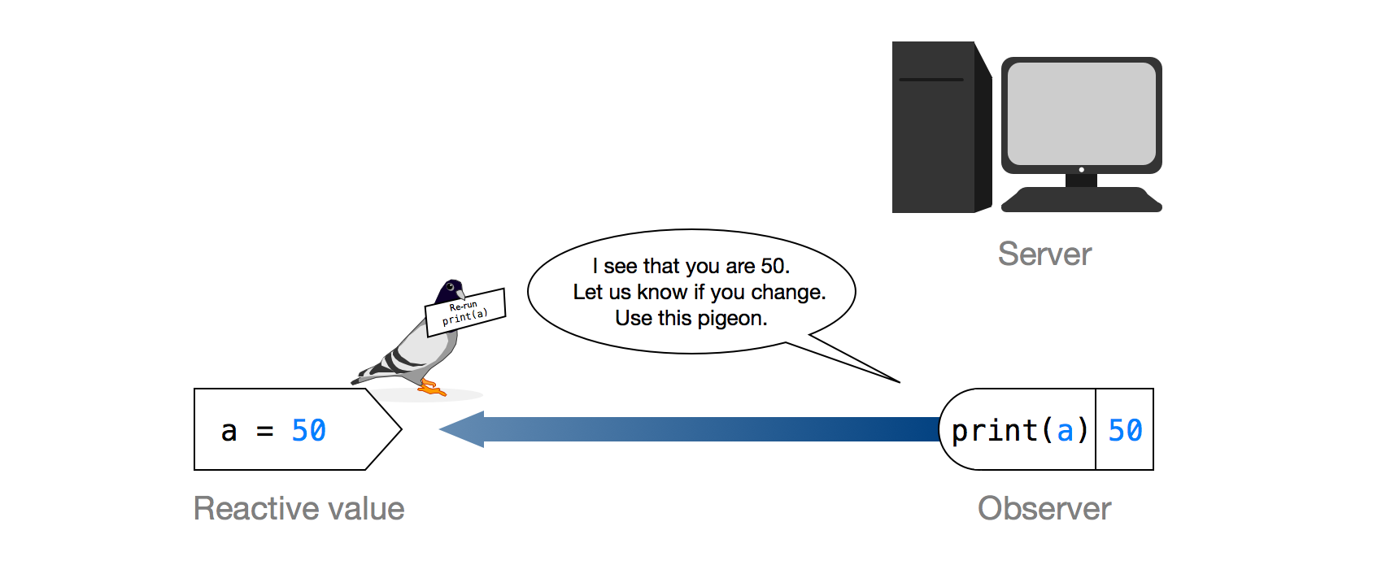
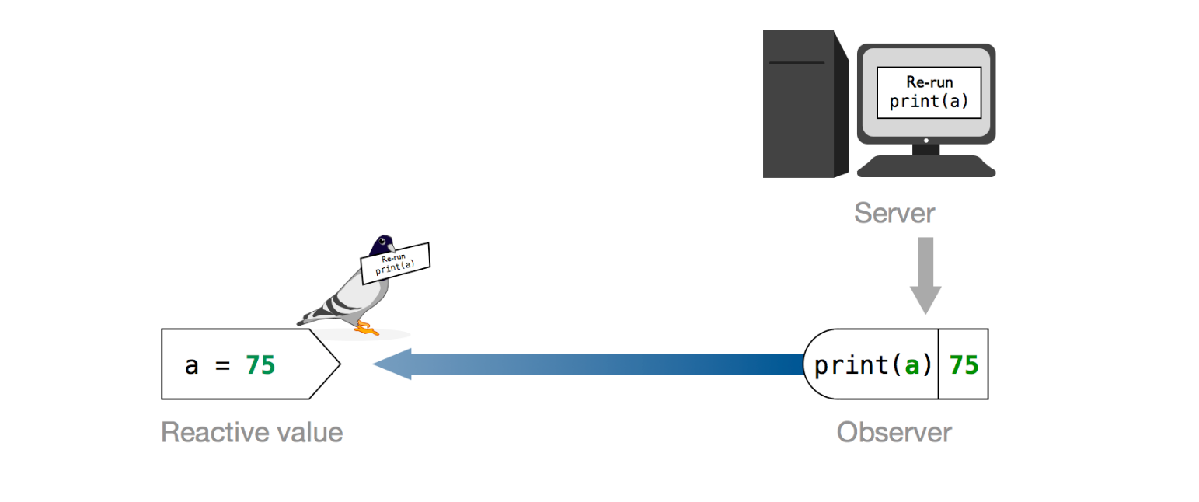
Understanding reactivity
https://shiny.rstudio.com/articles/understanding-reactivity.html

Slide 9
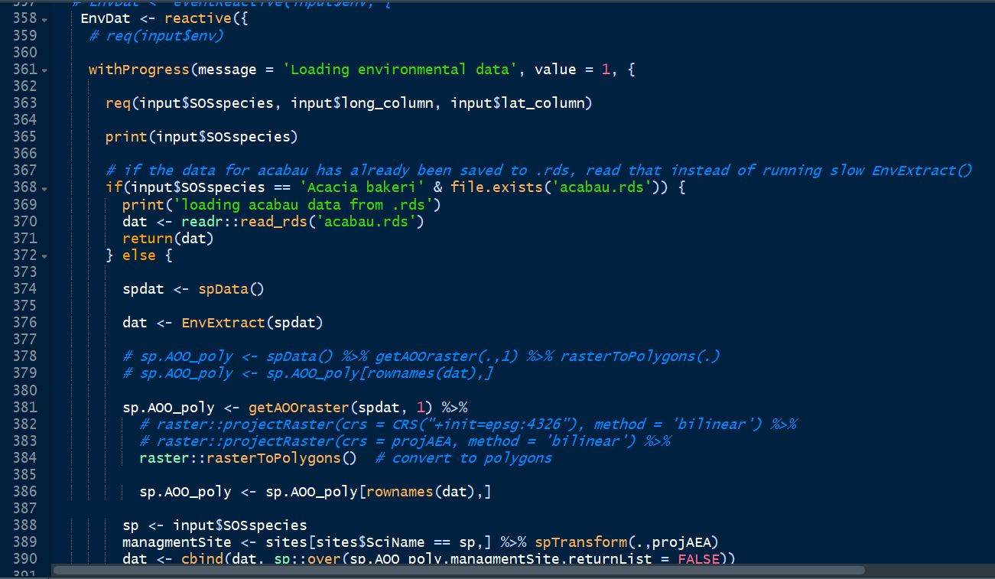
Core components of a Shiny app
UI – user interface (front end)
Input widgets collect information from the user
Displays outputs, such as plots or tables
Define how visual elements are laid out
Written in R syntax, but most functions won’t be familiar
Server (back end)
Where data is processed
Regular R code combined with special shiny:: functions that implement reactivity
Reactive expressions are re-evaluated when their dependent values have changed

Slide 10
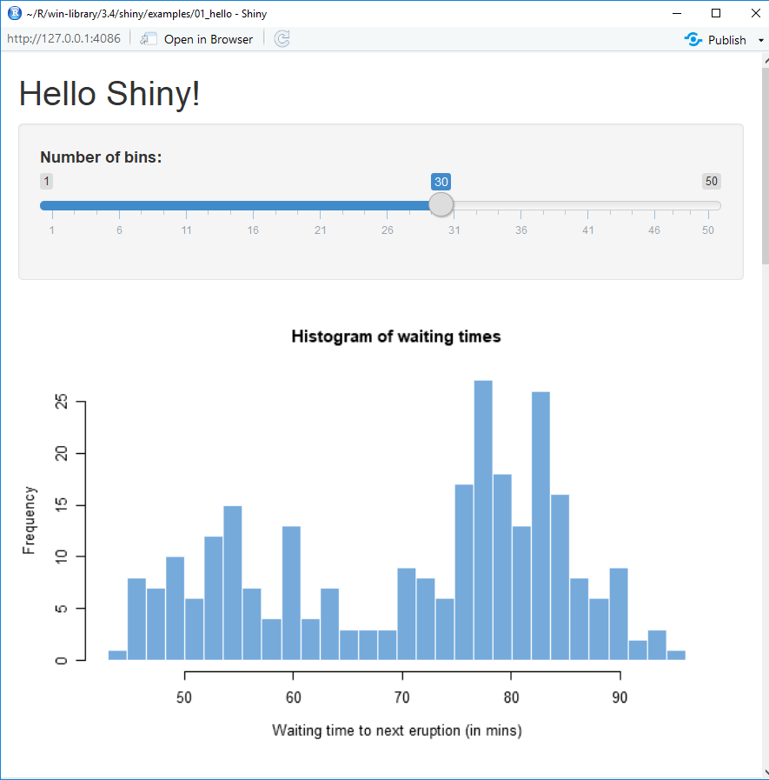
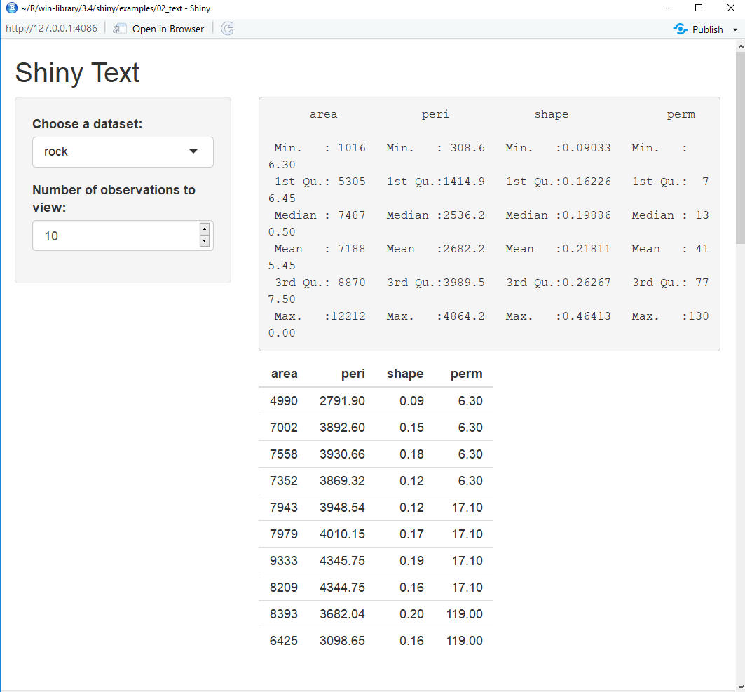
Lesson 1 – some simple Shiny apps
Load up lesson1_under_the_hood/lesson1.R in Rstudio
These instructive examples come with the Shiny package
Check out https://shiny.rstudio.com/articles/basics.html for their guide to the code

Slide 11
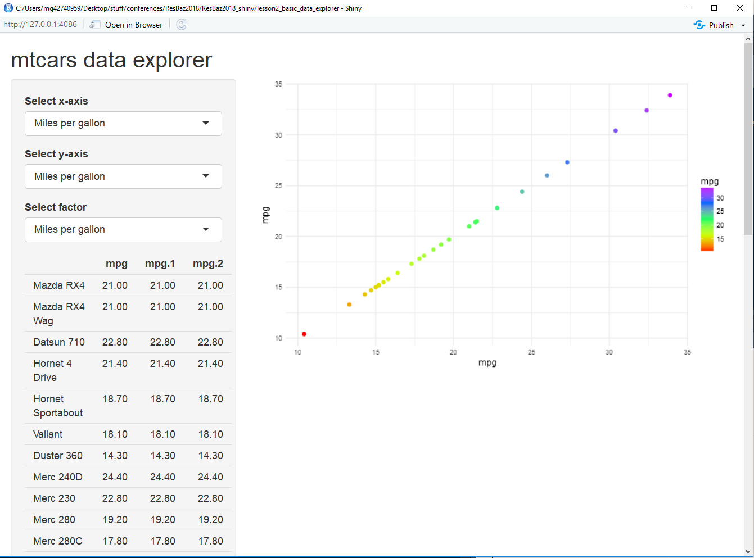
Lesson 2 – build a data explorer app
Load up lesson2_basic_data_explorer/ lesson2_basic_data_explorer_TEMPLATE.R in Rstudio
We’ll build our first app!
Exercise: add functionality to select a variable to colour points or change point shapes

Slide 12
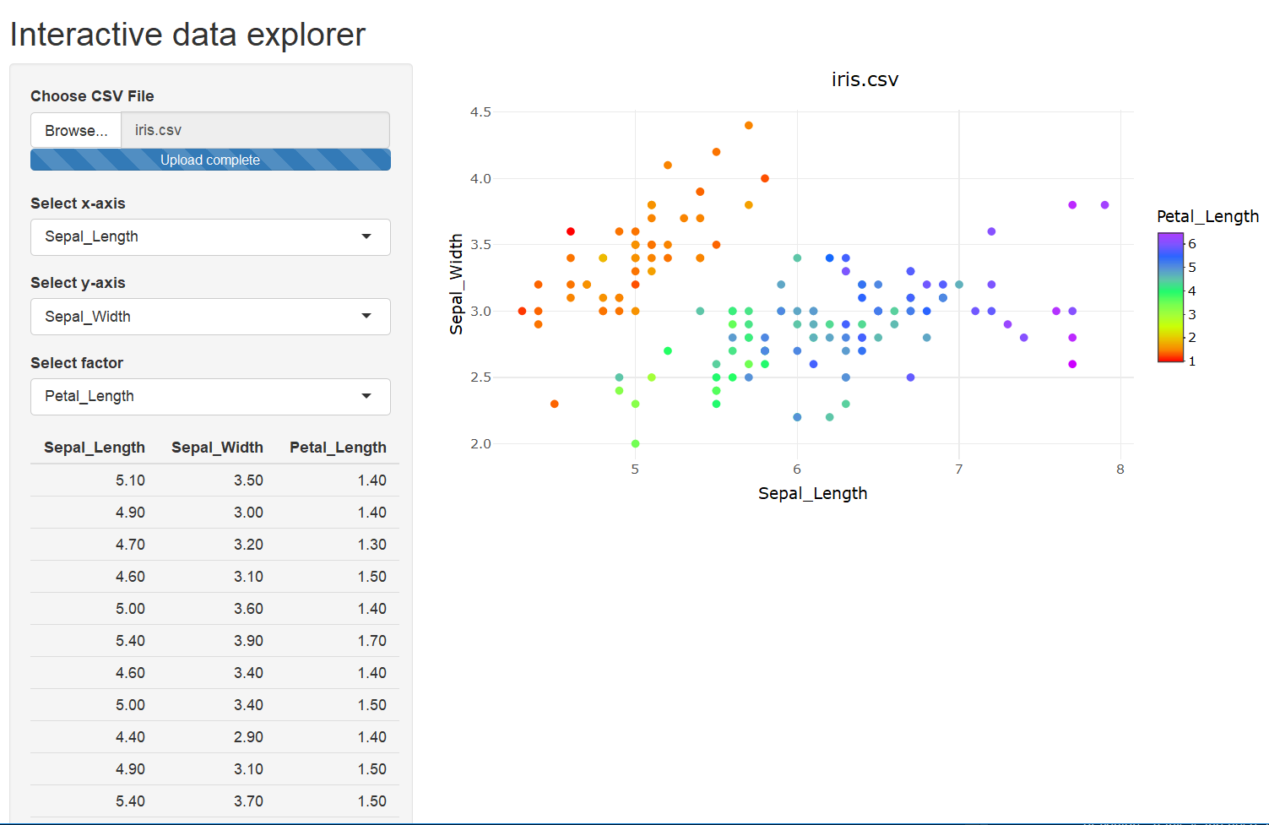
Lesson 3 – add interactivity to data explorer
Our first app was a one trick pony – lets generalise it to use other datasets!

Slide 13
Lesson 3 – chaining reactive expressions
Basic data explorer structure
Interactive data explorer structure
Input
Output
Input 1
Input 2
Output
dependency
dependency
x axis
dependency
x axis
data table
data table
y axis
uploadedFile
y axis
graph
graph
factor
factor
Load up lesson3_interactive_data_explorer/lesson3_interactive_data_explorer.R in Rstudio

Slide 14
Thank you! Hope you learned something
These slides and all the code is available on GitHub:
https://github.com/jamesrlawson/ShinyWorkshop_ResBazSydney2018
Enjoy the rest of RezBaz Sydney 2018 – say hi if you see me around ☺
Come and chat if you need help, or have ideas you’d like to discuss
Or find me online:
james.r.lawson.nz@gmail.com
https://github.com/jamesrlawson
https://jamesrlawson.netlify.com

