Slide 1
Samsung SDS Global Internship
Byoungil (Andrew) Kwun

Slide 2
Overview
Created an Engineering Blog for the Agile Core Team in Samsung SDS
Mainly used Nuxt.js & Vue.js

Slide 3
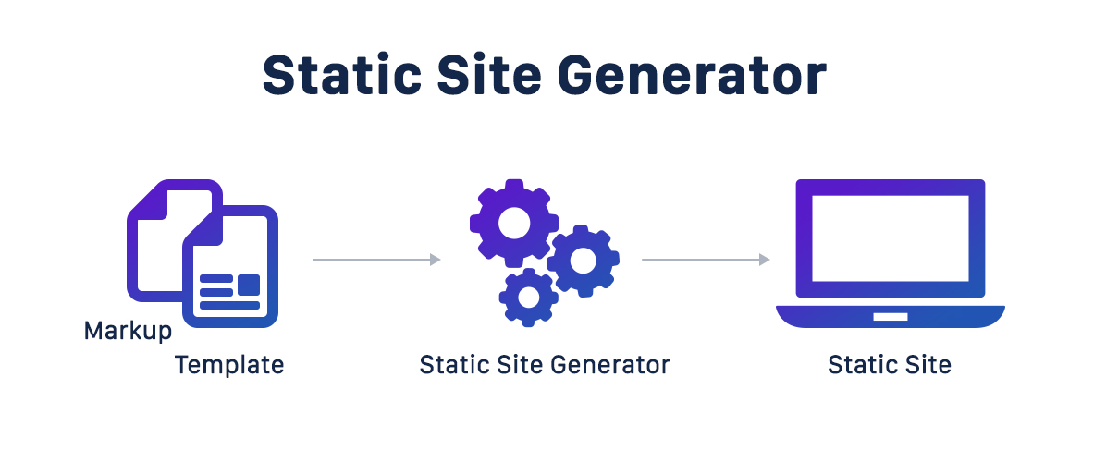
SSG (Static Site Generator)

Slide 4
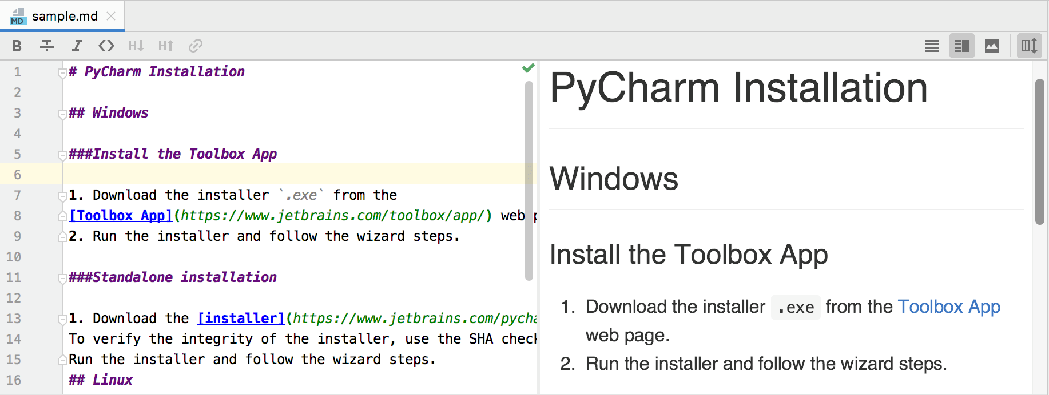
What is a Markdown File( MD file)?
How is it different from ordinary blogs, such as Naver blog
Why we chose MD file

Slide 5

Vue.js/Nuxt.js
Used Vue.js to build user interfaces and interactive web interfaces
Converted md files into HTML using Nuxt.js

Slide 6
HTML, CSS, JavaScript
HTML
Structure of a web page
<div> tag
CSS
Presentation of a webpage
JavaScript
Makes Web pages interactive

Slide 7
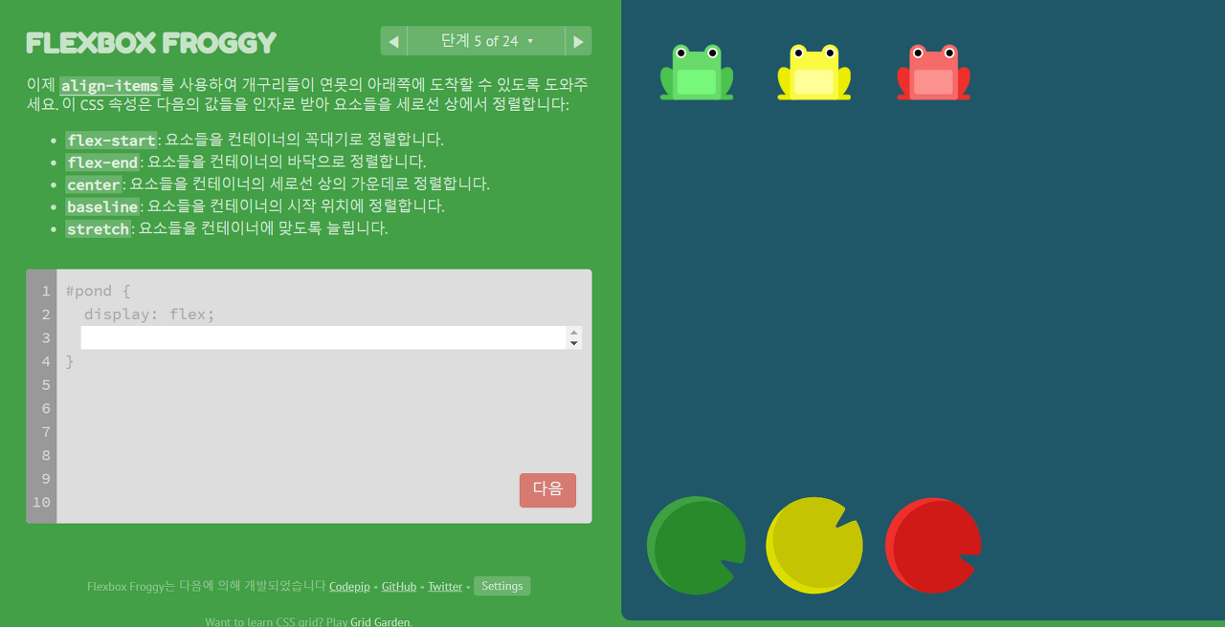
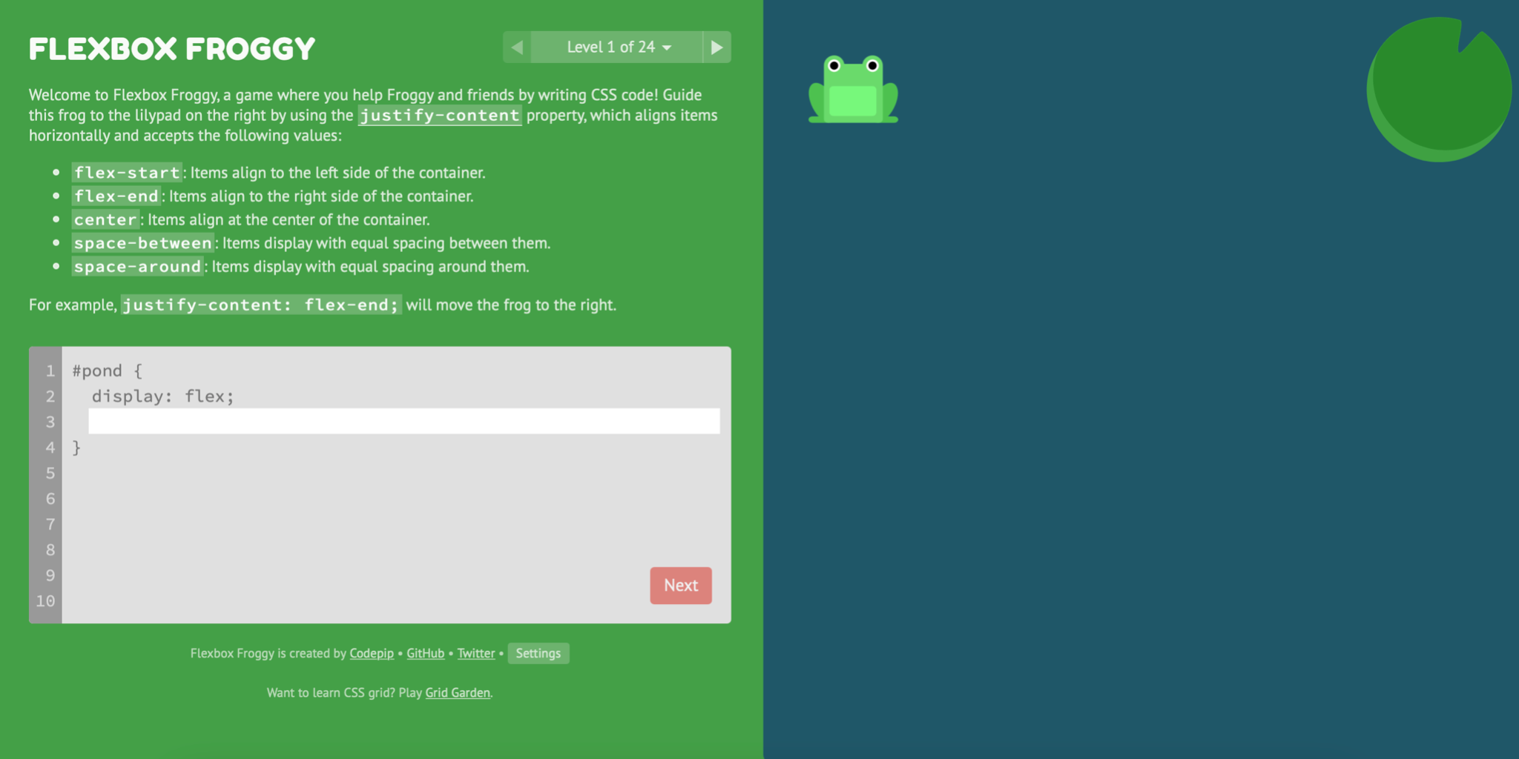
what is CSS?
CSS
FlexBox

Slide 8
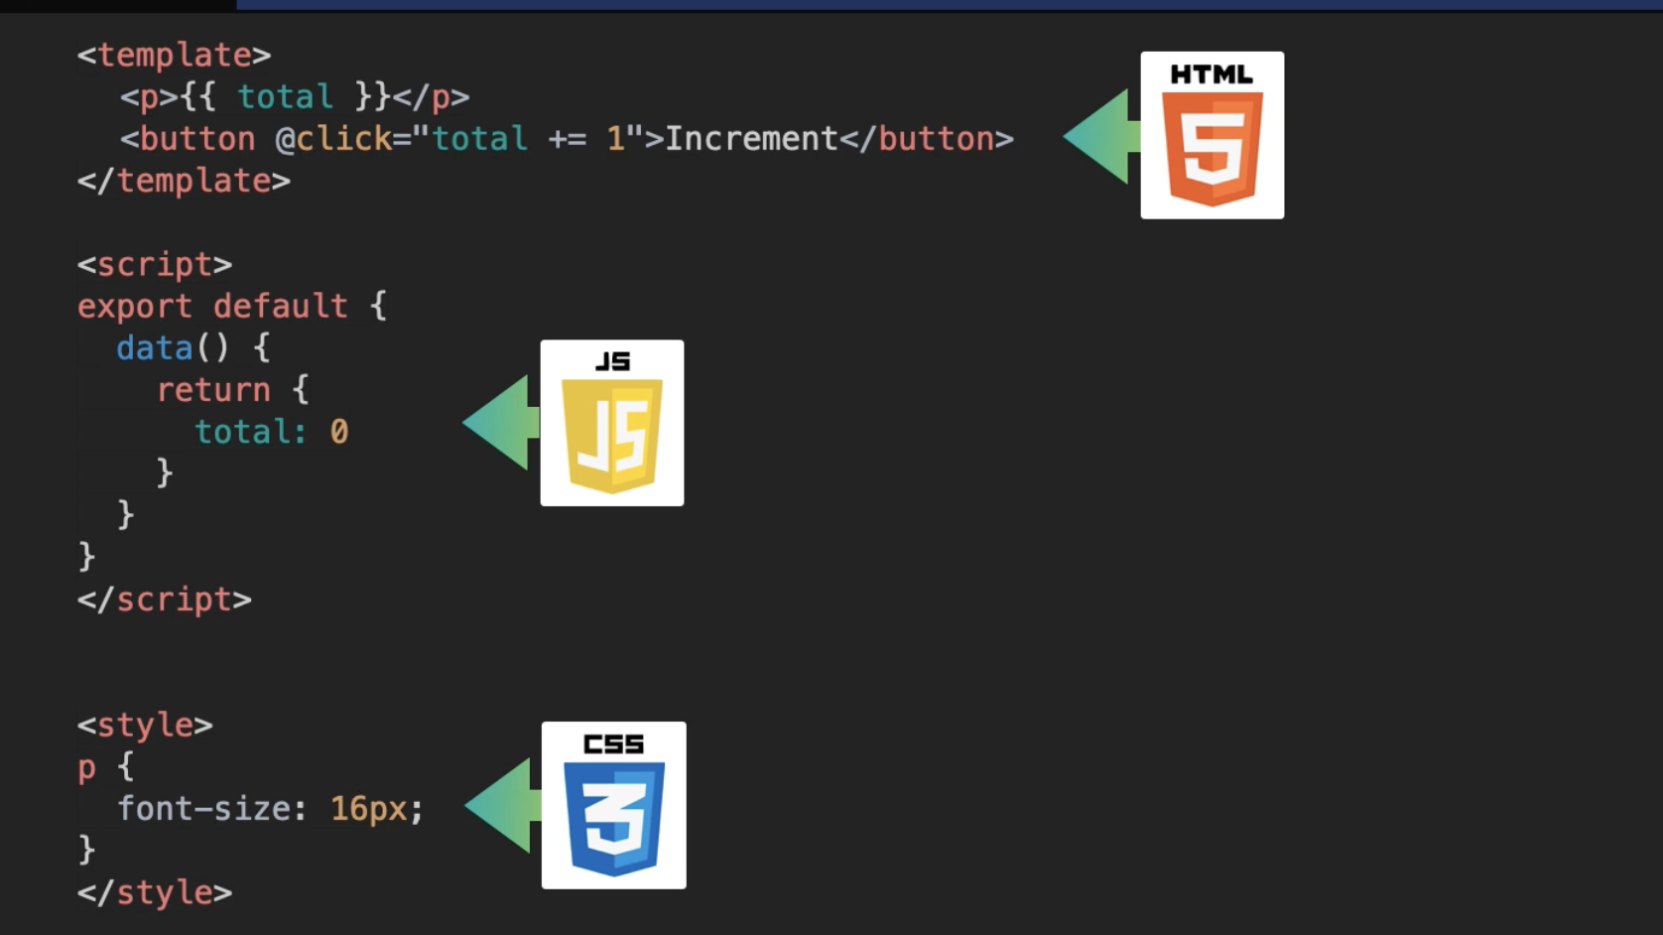
Intro to Vue.js
Single File Component
Reusability
Readability
Client Side Rendering(CSR)

Slide 9

Intro to Nuxt.js
Builds upon Vue.js
Server Side Rendering(SSR)
Uses Vue components
Why SSR over CSR?

Slide 10
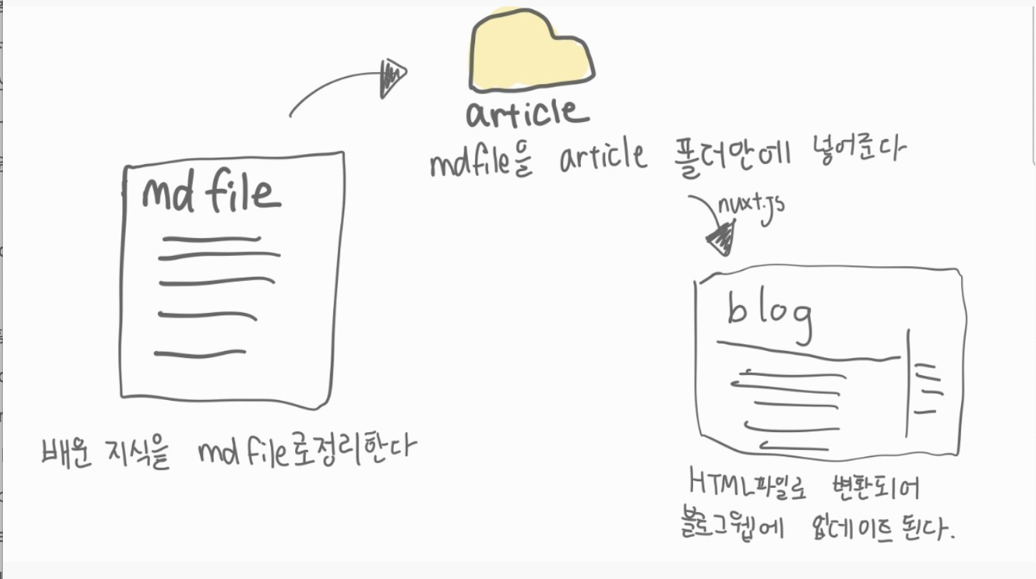
Demo
Put md files into the article folder
Write blog contents in md file
Changes to HTML file & updates the blog page

Slide 11
Server Side Rendering(SSR) -> Static Site Generator(SSG)
What we used during the internship
Server Side Rendering(SSR)
What we’ll be continue learning
Static Site Generator(SSG)

