Slide 1
Simple MSMQ
Introduction to Microsoft's Messaging Queue
© Stephen Reece 2011
Slide show licensed under Creative Commons Attribution-ShareAlike license.
Source Code licensed under MIT license

Slide 2
MSMQ
Message are durable
Queues may have multiple subscribers
Multicast support (not covered tonight)

Slide 3
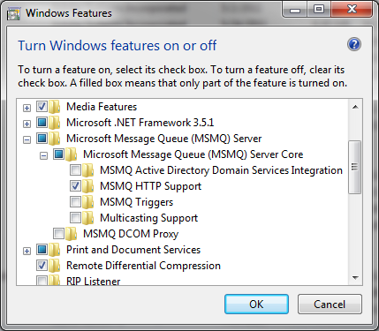
Prerequisites
Add Microsoft Message Queue Server in Turn Windows features on or Off

Slide 4
C# Publisher
Add reference to System.Messaging
Create or open queue
Create message and post
Let's code

Slide 5
C# Subscriber
Add System.Messaging to project
Open queue
Open a read loop
Let's code

