Slide 1
ECHOES
Find your voice in the words of others.
Team Catdog
Bailey Sheridan
Nicholas Chaput

Slide 2
Game Summary
You play as Echo, a chatty forest nymph who distracts Hera from discovering her husband Zeus’s cheating ways. By talking, you draw Hera’s attention and the attention of passerby and lead them away from Zeus. Hera grows angry at Echo for distracting her, and curses Echo to only be able to repeat (echo!) others. From there, you fruitlessly pine for your love, Narcissus, and keep others away from him from beyond the grave until his own miserable demise.
Custom sound effects
Interactive tutorial
Chat/repeat others to move them
Tragic story

Slide 3
Target Audience & Experience Goals
People looking for a fun action game or who are also interested in Greek mythology
Despair as an experience goal
Echo & Narcissus is a sad tale for all parties involved :(

Slide 4
Measurable Experience Goals
We want at least 50% of players to complete the game
We want at least 75% of players to complete the Zeus section in less than 3 restarts
We want players to act (click or press spacebar) every 5 seconds or faster on average

Slide 5
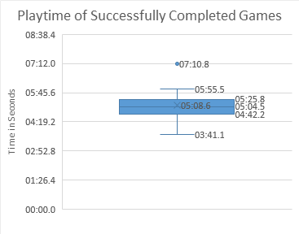
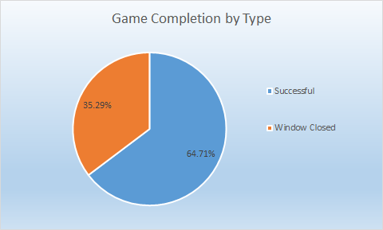
Analytics - Game Completion

Slide 6
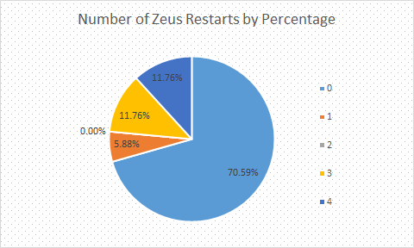
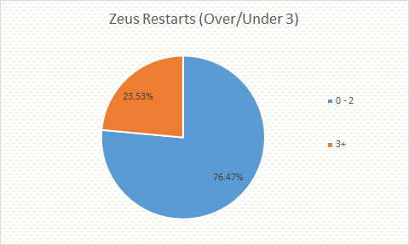
Analytics - Zeus Restarts

Slide 7
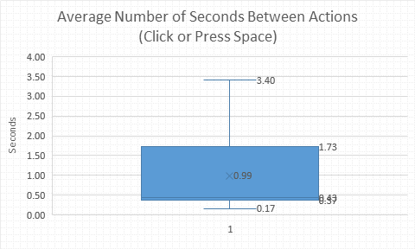
Analytics - Frequency of Actions

Slide 8
Play Description
Click or click & hold to move Echo around the screen
Press space to talk; most entities in your vicinity (Hera, ladies, and Narcissus) will follow you to listen
For the first half of the game, distract Hera from approaching Zeus with your chatter until enough time has passed
For the second half of the game, keep other nymphs away from your man, Narcissus, by talking to them and to him as a ghost. However, you can only repeat words you’ve heard from passerby
Approach passerby to hear what they say, then press space to repeat their words. In part 2 you have three different repeatable phrases, with three different results (luring, repelling, and freezing)

Slide 9
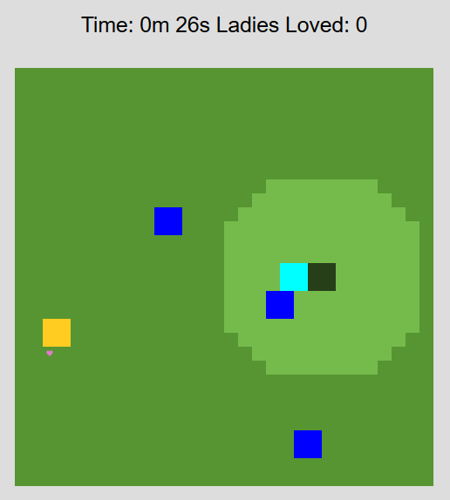
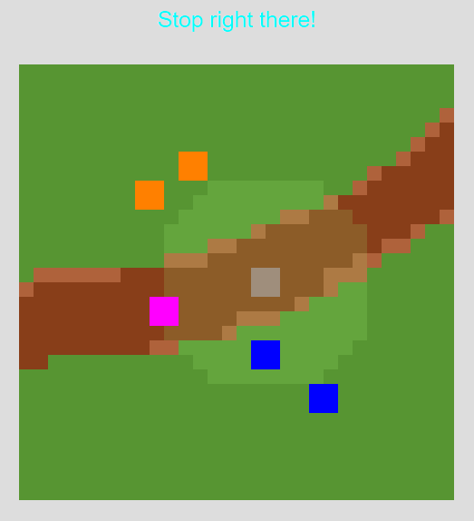
Screenshots

Slide 10
Playtesting
Phrasing of status text unclear
Effect when Zeus collides with ladies
Click and hold/drag movement
Unclear when you lose
Audio suggestions: mumbling, non-English
Hera should track Zeus
Visual cue for the lure mechanic
Balancing

Slide 11
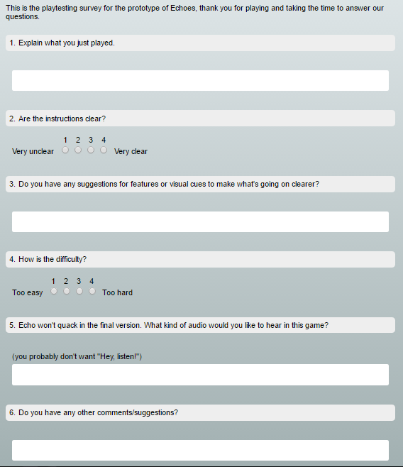
Survey #1

Slide 12
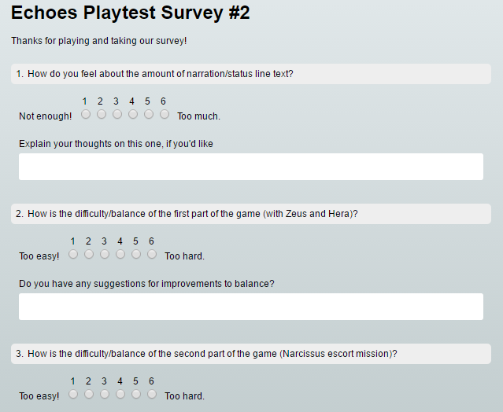
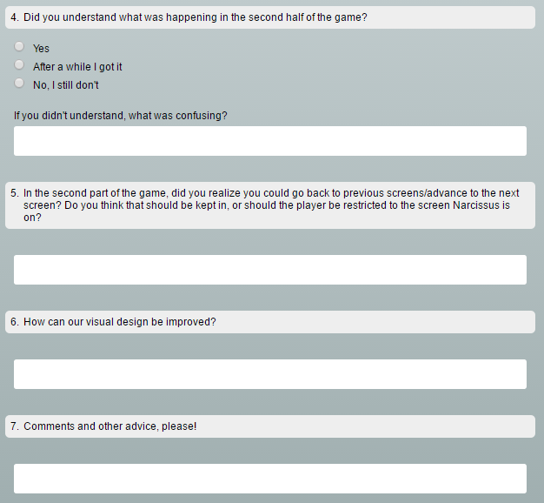
Survey #2

Slide 13
Survey
Neutral about part 1 difficulty/balance, thought part 2 was a bit tough
In part 2, you can move between screens freely, we asked if that was a feature that should be kept in or removed, people were pretty split down the middle about it. 6 people said keep, 5 said remove, and 3 were neutral/didn't state their opinion.
More sound effects, but it seemed some people enjoyed the quacking
Fix lure radius visual & tweak ability to leave screen (can leave when you don't mean to)

Slide 14
Critique
Fix sprite overlap
Sound design
Cutscenes are lengthy

Slide 15
Thank you!
Questions?

