Slide 1
EADAS
Abhimanyu Chopra
Lalitha Baskharuni
Nisarg Patel
Sammy Lin

Slide 2
Project Objectives
In person monitoring of the elderly is not always convenient
Solution :
EADAS- Elderly Asset Distress Alarm System

Slide 3
Block diagram
Pulse Sensor
MSP-430EXPFR6989
LCD
Gyro
LSM9DS0
Adafruit fona
GSM/GPS Module
4*3 matrix
Keypad
GSM Power Supply
Power Supply
Key:
Input
Output
Power
Logic

Slide 4
System Flow Chart
Start
Capture phone number
Initialize clock
Initialize FONA
Initialize clock
Initialize SPI
Read gyro
Initialize UART
Check heart rate
Initialize timer
Distress?
No
Yes
Get GPS location
Initialize ADC
Send SMS
Initialize LCD
Print to LCD
Initialize gyro

Slide 5
Major components
Fall calculation
Heart beat calculation
GSM module communication

Slide 6
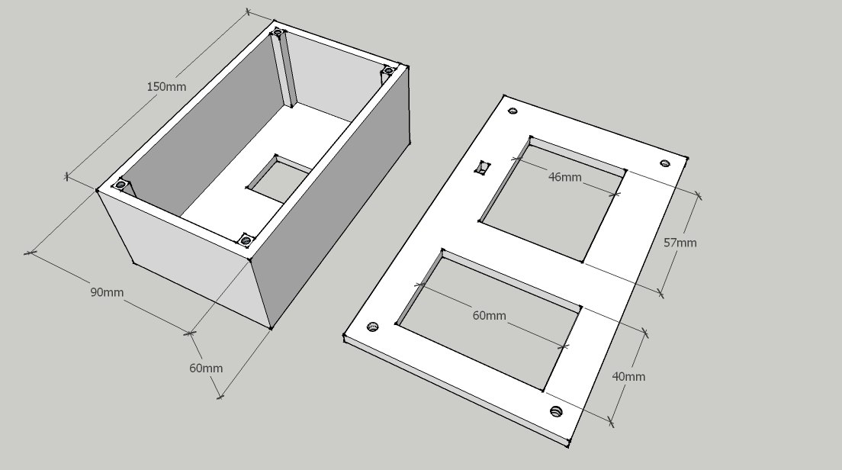
Box & Lid

Slide 7
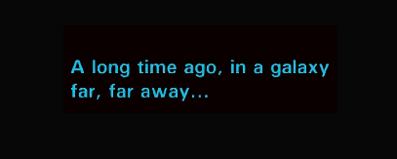
Project Time-line

Slide 8
Project Time-line
LCD code working
UART comm working/keypad working/PCB cut/complete assembly
Pulse sensor working
Gyro working
Started code
Distributed tasks amongst team
Complete documentation & 3D printing
Hardware received and distributed
Hardware researched/sourced
EADAS is born!
Complete pulse/SMS code
Formed team
Demo!
12/1/2015
12/8/2015
09/01/2015
11/24/2015
09/08/2015
09/15/2015
09/22/2015
09/29/2015
10/06/2015
10/13/2015
10/20/2015
10/27/2015
11/03/2015
11/10/2015
11/17/2015

Slide 9
Software
Code Composer Studio v6.1 – Integrated development environment for TI microcontrollers
Git – Source code control
Arduino C++ libraries ported to TI Launchpad in C (for gyro)

Slide 10
Issues/Solutions
SPI interface – Hard to initially understand and get configuration right on Launchpad
UART – printf to CCS console caused timing issues and UART wasn't working as expected
Most components purchased from Sparkfun/Adafruit come with Arduino libraries. Took full advantage and ported to MSP430 C/C++
ISRs – They had to be really fast
Didn't include buzzard in PCB design

Slide 11
Demo Time!

Slide 12

Questions?

Slide 13

MotD

