Slide 1
EADAS Project Progress
Elderly Asset Distress Alarm System
Lalita Bhaskaruni
Abhimanyu Chopra
Sammy Lin
Nisarg Patel

Slide 2
Project Objective
Distress detection
  Spike in heart rate
  Sudden change in orientation
Notification
  Loud continuous beep
  SMS to configured party

Slide 3
Project Assignments
Lalita Bhaskaruni – FONA GSM + GPS module
Abhimanyu Chopra – Heart rate sensor (Photoplethysmograph)
Sammy Lin – Accelerometer and Gyroscope
Nisarg Patel - LCD

Slide 4
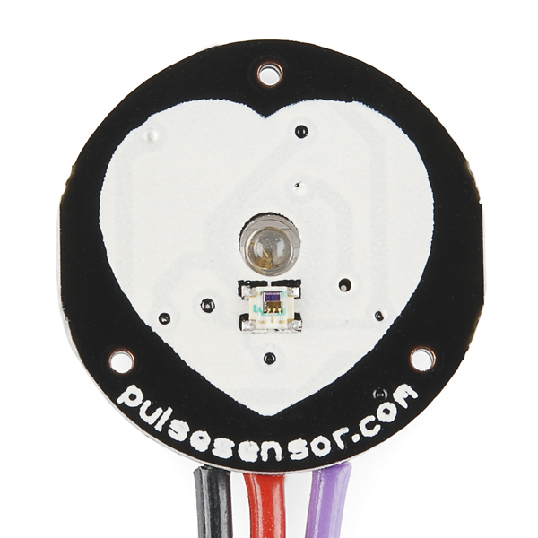
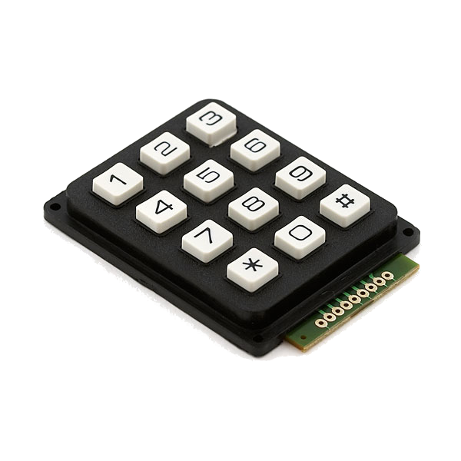
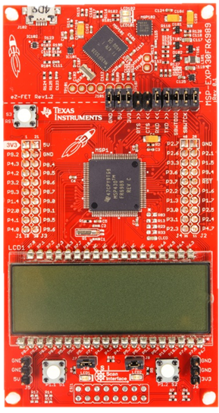
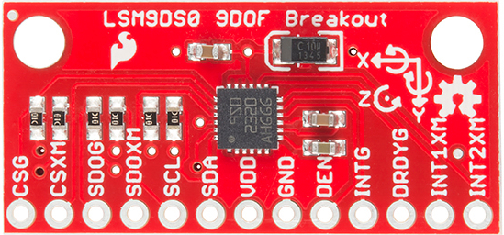
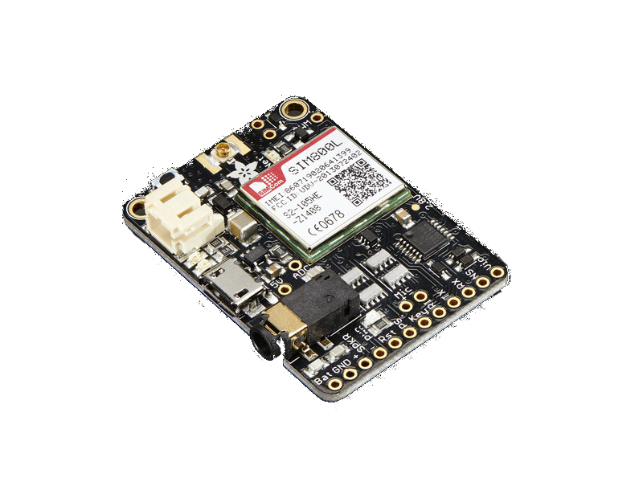
EADAS Components
MSP430FR6989
Pulse Sensor
Keypad
GPIO (6)
Analog (1)
LSM9DS0
SPI (4)
FONA+GPS
UART/AT (2)
LCD Controller
LCD
Bat.

Slide 5
EADAS Main Flow
Start
Read alarm bit
Initialize gyro/Xm
Initialize pulse sensor
No
Distress?
Send Notification
Initialize FONA
Yes
Sound Alarm
Initialize LCD
Configure Alert

Slide 6
EADAS Sensors Flow
Start
Obtain baseline
Read sensor
Distress?
Set alarm bit
No
Yes

Slide 7

Questions?

