Slide 1
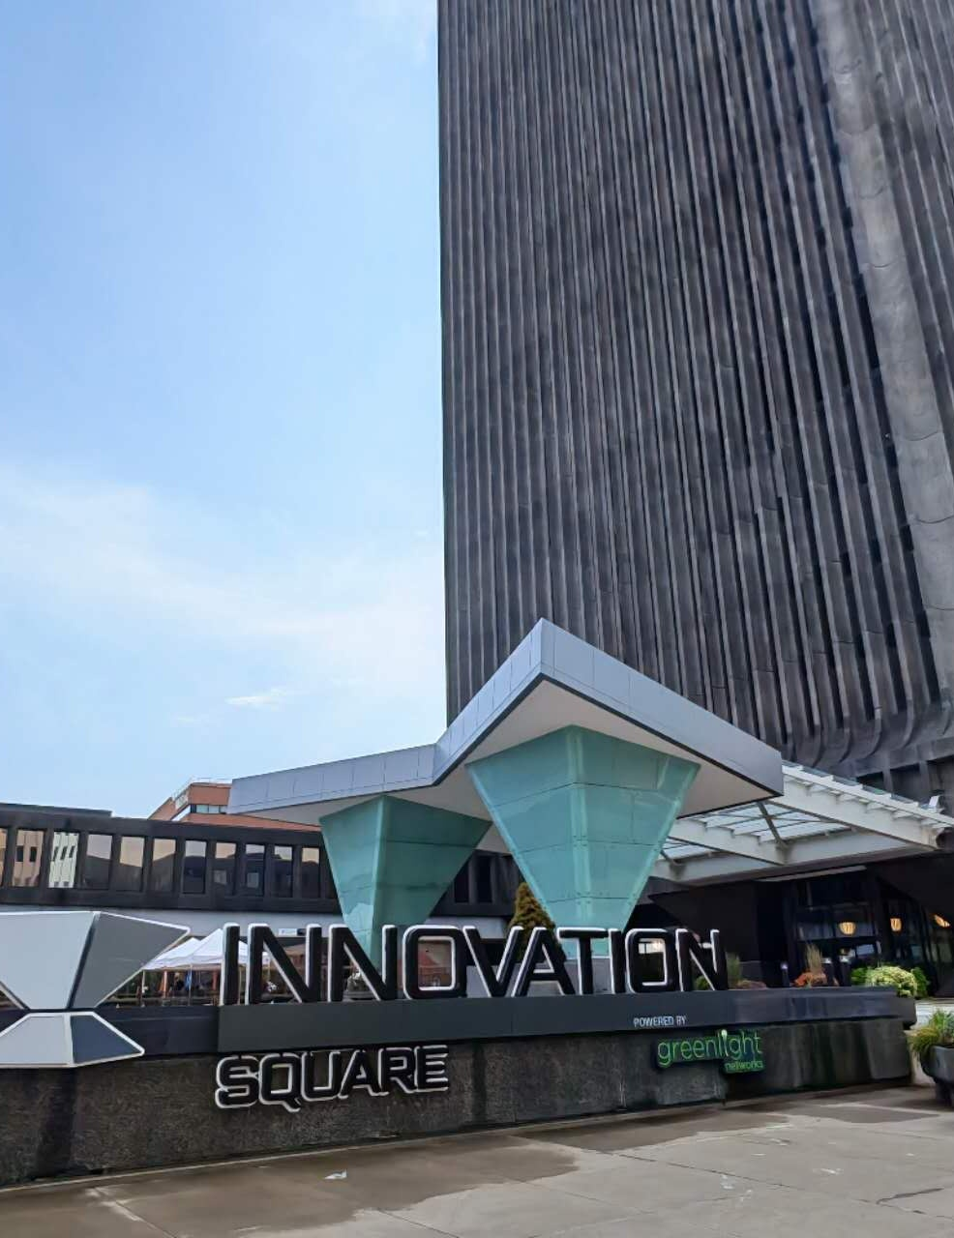
ECON 238 — GET OUTSIDE
A Short Walk Around
Innovation Square
Noise, quiet, and the tradeoffs of an active downtown
Bingkun Ye

Slide 2
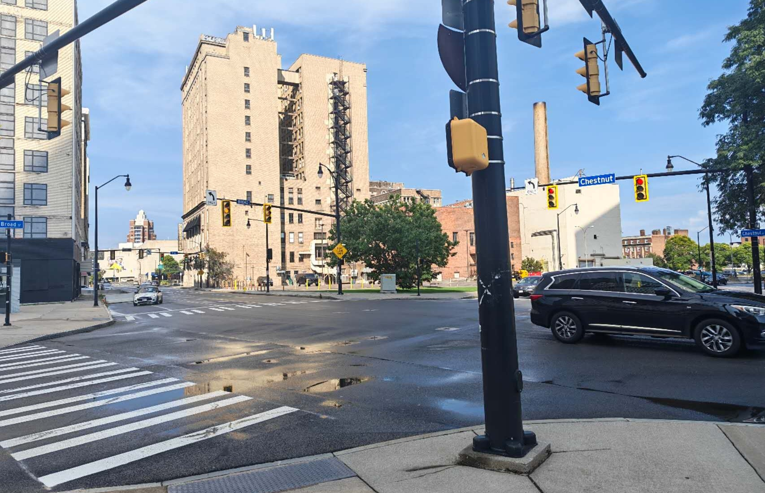
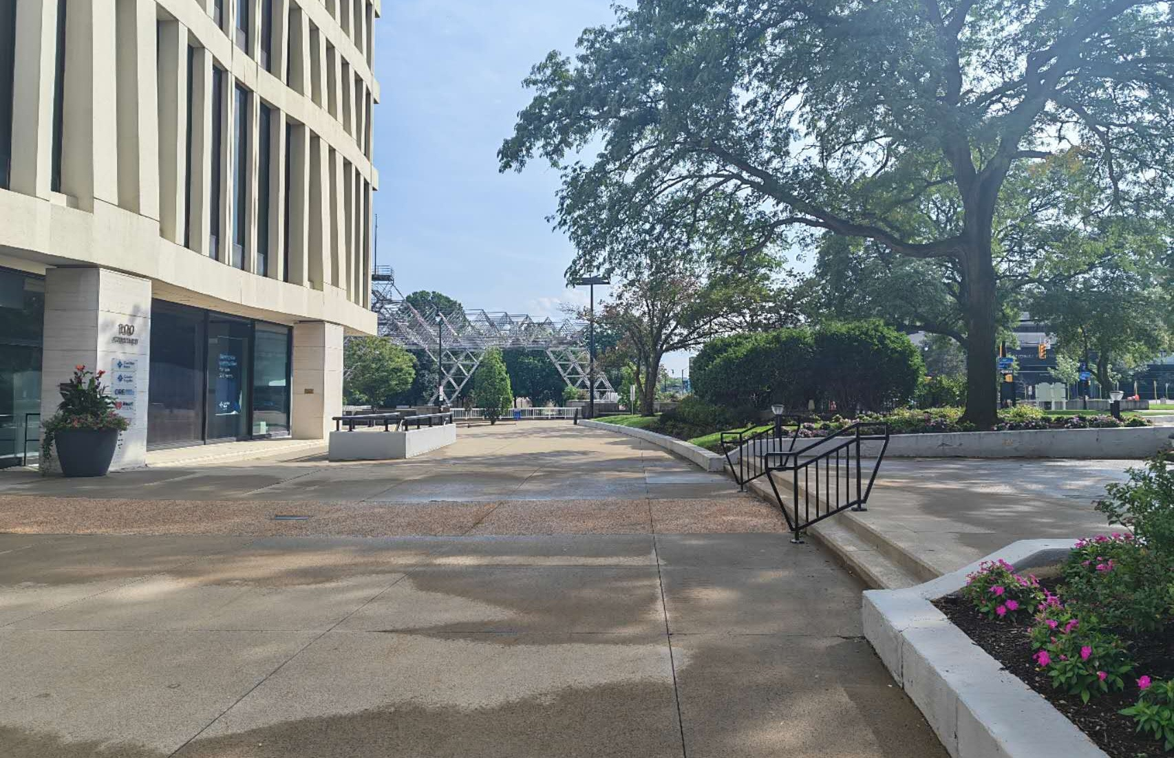
What I noticed
The spaces were close together, but they were built for very different uses.
Broad / Chestnut: movement, cars, signals, road space
Nearby plaza: walking, sitting, trees, less direct traffic
That contrast made me think less about “getting rid of noise” and more about how downtown space is divided between different uses.

Slide 3
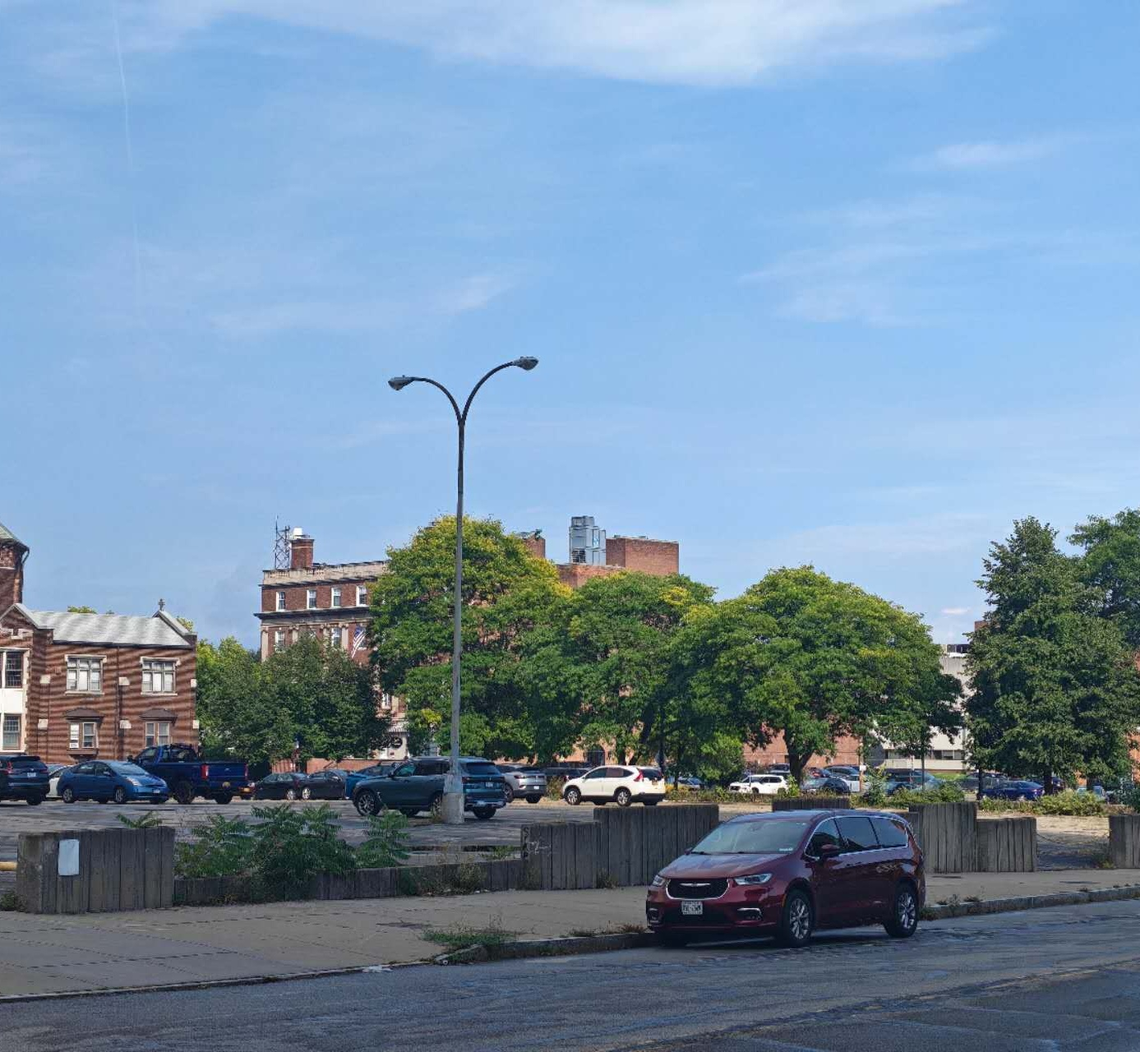
Why this is an economics problem
Cars, parking, deliveries, and construction are not just sources of noise. They also make downtown easier to reach and easier to use.
The externality appears because some of the noise cost can fall on people nearby who are not making the trip or receiving the same benefit.
So the question is not simply whether noise is bad. It is who gets the benefit, who bears the cost, and whether those costs can be reduced without giving up too much of the activity.

Slide 4
The tradeoff
If downtown becomes quieter
But if that comes from removing activity
• outdoor spaces may feel more comfortable
• nearby residents may face less disturbance
• walking and sitting outside may become more attractive
• travel can become less convenient
• deliveries and businesses may face higher costs
• people may lose some access to the places they want to reach
The relevant margin is probably not “noise vs. silence.” It is how much quiet we want, where we want it, and what we are willing to give up to create it.

Slide 5
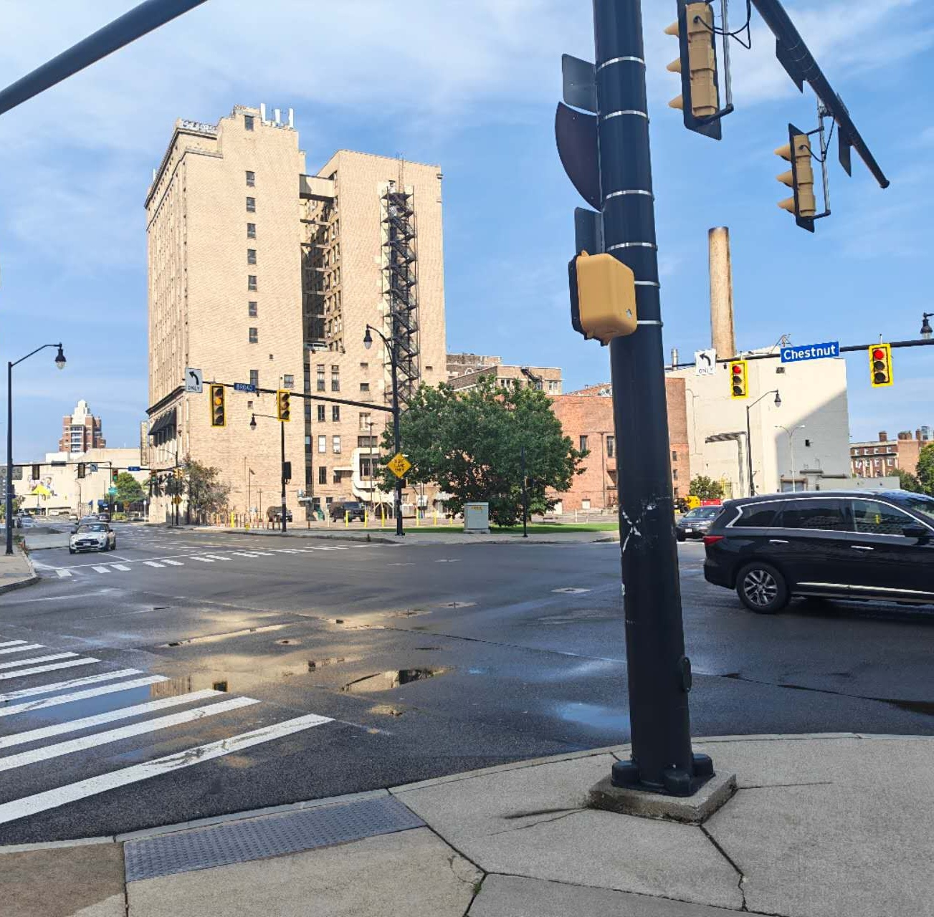
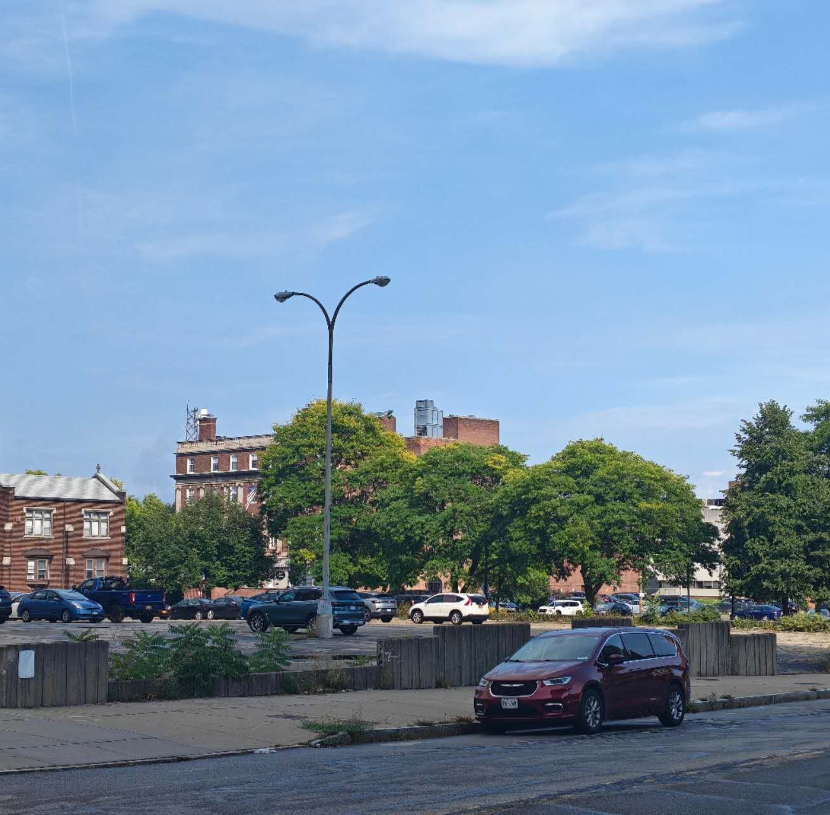
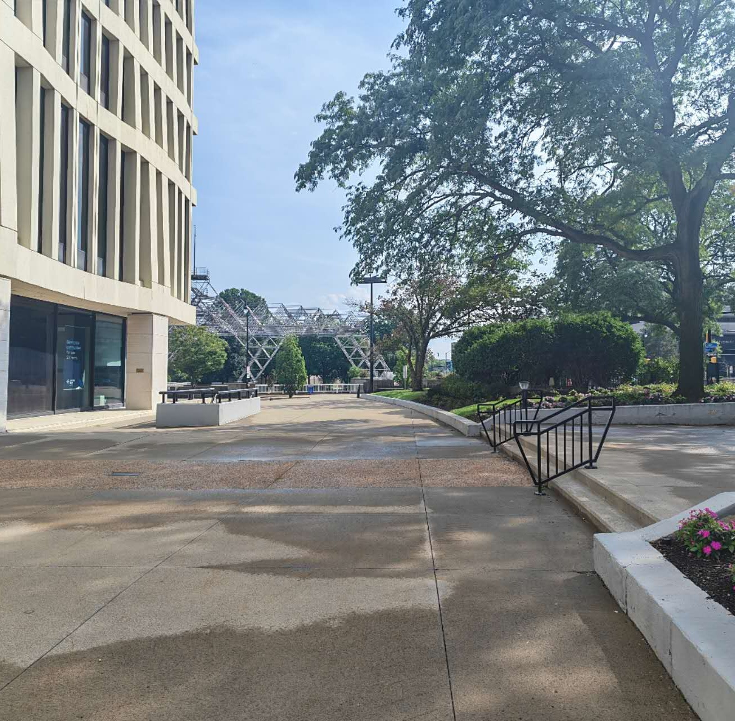
My main takeaway
I do not think the interesting question is whether downtown should be quiet. Downtown is useful partly because people, roads, and businesses are concentrated there.
What seems more interesting is whether quieter pedestrian space can exist close to noisy uses without requiring either side to disappear.

Slide 6
What I would want to know next
This walk was only a short observation, not a noise study. I did not measure decibels, property values, or how long people actually stay in each space.
If I were taking this further, I would want to ask:
• Do people spend more time in the quieter plaza than near the road?
• Do rents or property values reflect traffic exposure?
• Which design choices reduce spillover noise without reducing access?
• How much would residents or businesses actually be willing to pay for those changes?
For me, the useful part of the walk was that it changed the problem from “noise is bad” into a question about tradeoffs, incidence, and the way urban space is organized.

