Slide 1


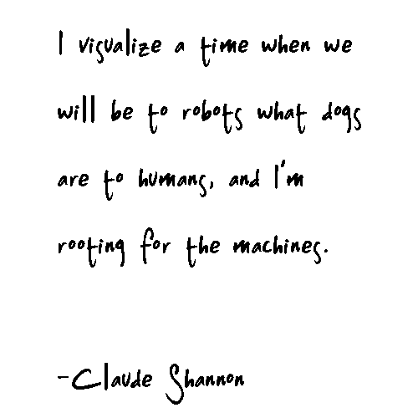
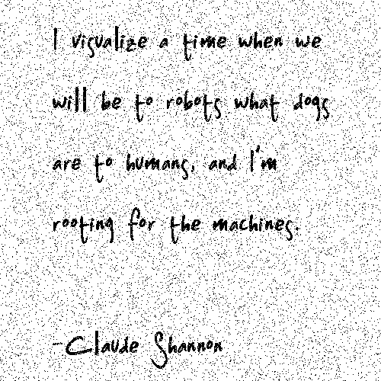

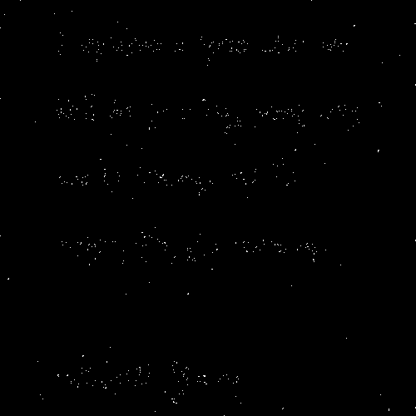

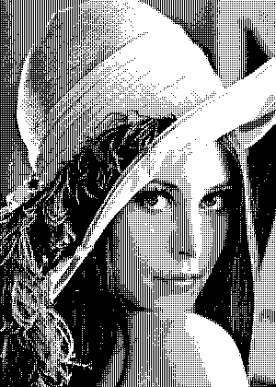

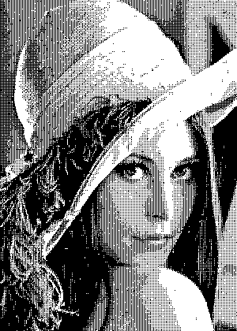
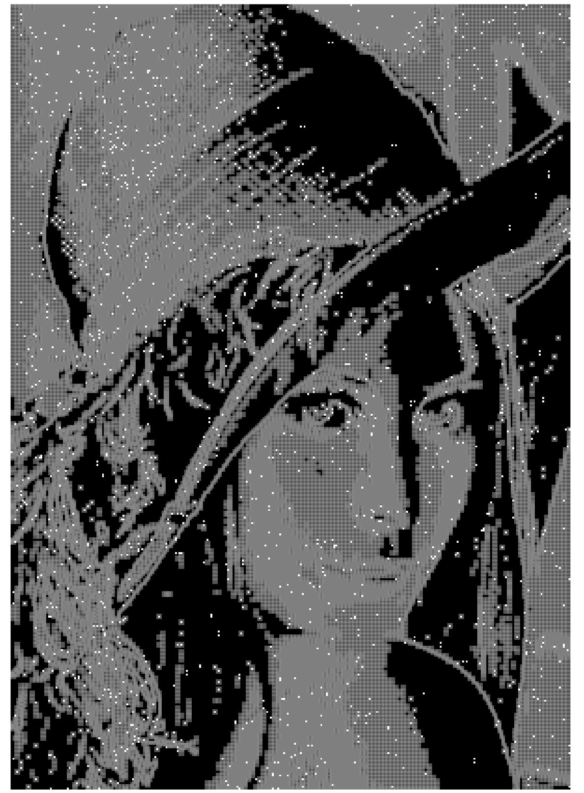

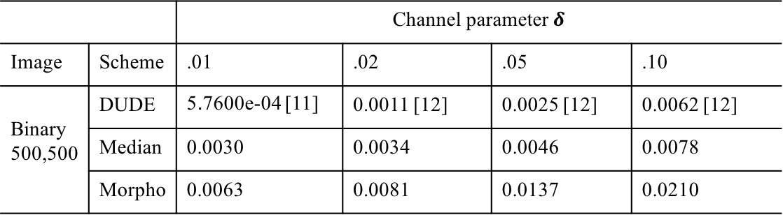

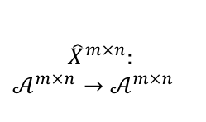


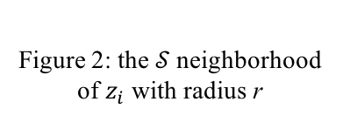
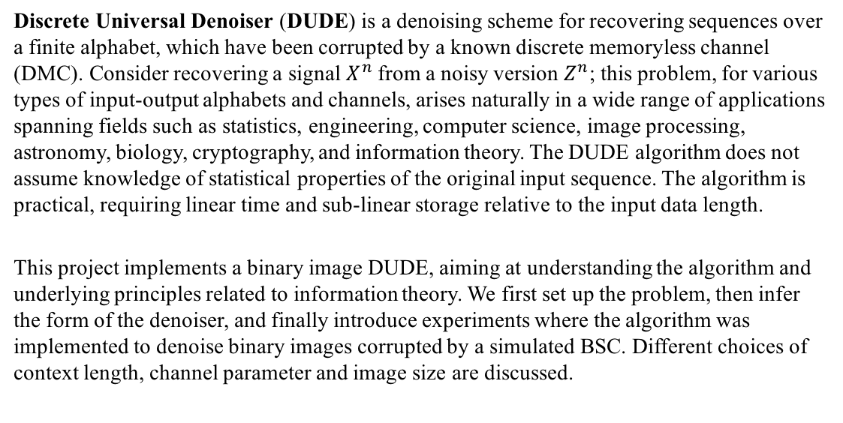
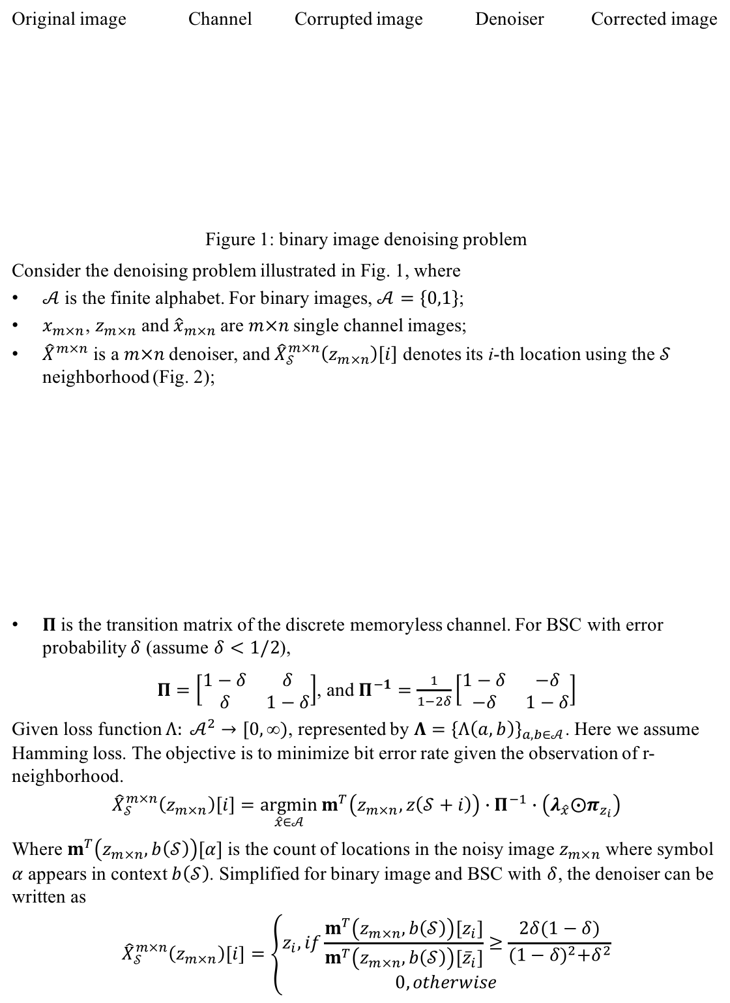
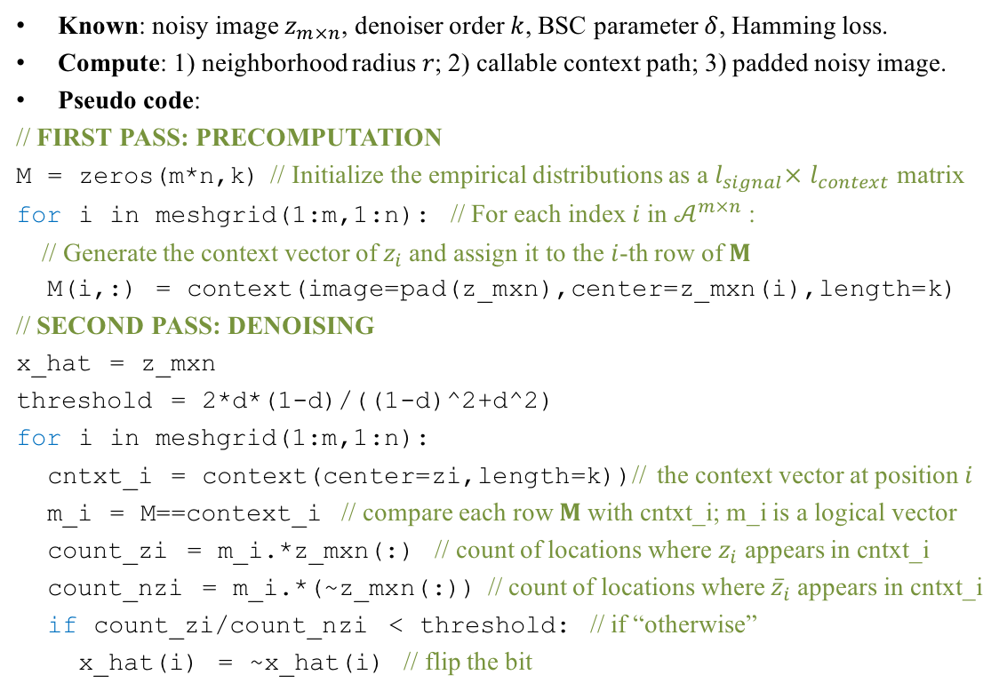



A Discrete Universal Denoiser and Its Application to Binary Images Boning Li ECE 587 Information Theory
Original paper by
Introduction
Algorithm
Table 1: Denoising results (bitwise error rate of corrected images) for binary images
Known: noisy image $z_{m×n}$, denoiser order $k$, BSC parameter $δ$, Hamming loss.
Compute: 1) neighborhood radius $r$; 2) callable context path; 3) padded noisy image.
Pseudo code:
// FIRST PASS: PRECOMPUTATION
M = zeros(m*n,k) // Initialize the empirical distributions as a $l_{signal}×$ $l_{context}$ matrix
for i in meshgrid(1:m,1:n): // For each index $i$ in $𝒜^{m×n}$:
// Generate the context vector of $z_{i}$and assign it to the $i$-th row of $M$
M(i,:) = context(image=pad(z_mxn),center=z_mxn(i),length=k)
// SECOND PASS: DENOISING
x_hat = z_mxn
threshold = 2*d*(1-d)/((1-d)^2+d^2)
for i in meshgrid(1:m,1:n):
cntxt_i = context(center=zi,length=k))// the context vector at position $i$
m_i = M==context_i // compare each row $M$with cntxt_i; m_i is a logical vector
count_zi = m_i.*z_mxn(:) // count of locations where $z_{i}$ appears in cntxt_i
count_nzi = m_i.*(~z_mxn(:)) // count of locations where ${\overline{z}}_{i}$ appears in cntxt_i
if count_zi/count_nzi < threshold: // if “otherwise”
x_hat(i) = ~x_hat(i) // flip the bit
 |  | Channel parameter $δ$
Image | Scheme | .01 | .02 | .05 | .10
Binary 500,500 | DUDE | 5.7600e-04 [11] | 0.0011 [12] | 0.0025 [12] | 0.0062 [12]
 | Median | 0.0030 | 0.0034 | 0.0046 | 0.0078
 | Morpho | 0.0063 | 0.0081 | 0.0137 | 0.0210
Discrete Universal Denoiser (DUDE) is a denoising scheme for recovering sequences over a finite alphabet, which have been corrupted by a known discrete memoryless channel (DMC). Consider recovering a signal $X^{n}$from a noisy version $Z^{n}$; this problem, for various types of input-output alphabets and channels, arises naturally in a wide range of applications spanning fields such as statistics, engineering, computer science, image processing, astronomy, biology, cryptography, and information theory. The DUDE algorithm does not assume knowledge of statistical properties of the original input sequence. The algorithm is practical, requiring linear time and sub-linear storage relative to the input data length.
This project implements a binary image DUDE, aiming at understanding the algorithm and underlying principles related to information theory. We first set up the problem, then infer the form of the denoiser, and finally introduce experiments where the algorithm was implemented to denoise binary images corrupted by a simulated BSC. Different choices of context length, channel parameter and image size are discussed.
Inference
a) Original image
b) Corrupted image
c) Denoised image
d) Error map
Figure 8: DUDE on a sample binary image ($size=500×500, k=12, δ=.05$)
Original image Channel Corrupted image Denoiser Corrected image
Figure 1: binary image denoising problem
Consider the denoising problem illustrated in Fig. 1, where
$𝒜$ is the finite alphabet. For binary images, $𝒜=\left\{0,1\right\}$;
$x_{m×n}$, $z_{m×n}$and ${\hat{x}}_{m×n}$are $m×n$single channel images;
${\hat{X}}^{m×n}$ is a $m×n$denoiser, and ${\hat{X}}_{𝒮}^{m×n}\left(z_{m×n}\right)\left[i\right]$ denotes its i-th location using the $𝒮$ neighborhood (Fig. 2);
$Π$ is the transition matrix of the discrete memoryless channel. For BSC with error probability $δ$ (assume $δ<1/2$),
$Π=\left[\begin{matrix}1−δ & δ \\ δ & 1−δ\end{matrix}\right]$, and $Π^{−1}=\frac{1}{1−2δ}\left[\begin{matrix}1−δ & −δ \\ −δ & 1−δ\end{matrix}\right]$
Given loss function $Λ: 𝒜^{2}→[0,\text{∞}\text{)}$, represented by ${Λ=\left\{Λ\left(a,b\right)\right\}}_{a,b∈𝒜}$. Here we assume Hamming loss. The objective is to minimize bit error rate given the observation of r-neighborhood.
$${\hat{X}}_{𝒮}^{m×n}\left(z_{m×n}\right)\left[i\right]=\underset{\hat{x}∈𝒜}{argmin}{m^{T}\left(z_{m×n},z\left(𝒮+i\right)\right)}∙Π^{−1}∙\left(λ_{\hat{x}}{⨀π}_{z_{i}}\right)$$
Where $m^{T}\left(z_{m×n},b\left(𝒮\right)\right)[α]$ is the count of locations in the noisy image $z_{m×n}$ where symbol $α$ appears in context $b\left(𝒮\right)$. Simplified for binary image and BSC with $δ$, the denoiser can be written as
$${\hat{X}}_{𝒮}^{m×n}\left(z_{m×n}\right)\left[i\right]=\left\{\begin{aligned}z_{i}, if\frac{m^{T}\left(z_{m×n},b\left(𝒮\right)\right)[z_{i}]}{m^{T}\left(z_{m×n},b\left(𝒮\right)\right)[{\overline{z}}_{i}]}≥\frac{2δ(1−δ)}{{(1−δ)}^{2}+δ^{2}} \\ 0, otherwise\end{aligned}\right.$$
DMC
DUDE
Results
$$x_{m×n}$$
$${Π=\left\{Π\left(a,b\right)\right\}}_{a,b∈𝒜}$$
$$z_{m×n}$$
$${\hat{X}}^{m×n}:$$
$$𝒜^{m×n}→𝒜^{m×n}$$
$${\hat{x}}_{m×n}$$
a) Original image
b) Corrupted image
c) Denoised image
d) Error map (background being the local std.)
Figure 9: DUDE on a halftone image ($size=420×300, k=14, δ=.02$)
Conclusions
21
18
23
Figure 4: correction error rate vs. context length
17
11
Center $z_{i}$
11
In this paper, we extended the theory underlying the DUDE to two-dimensionally indexed data, and reported on its implementation for binary images. It can be argued that the binary case is one whose implementation can be kept closest to the asymptotically optimal scheme.
Yet, even the binary case exhibits some of the fundamental practical challenges, including the design of a feasible and efficient context model. The requirement for such a design becomes essential when extending the domain of application to larger alphabets (e.g., continuous tone images).
In particular, techniques for context model optimization through context quantization and aggregation, as well as incorporation of prior knowledge on the data, are likely to yield significant improvements on the DUDE’s practical performance.
13
3
7
15
Neighborhood $𝒮_{r}⊆ℤ^{2}$
r
9
5
0
2
10
1
4
16
14
6
8
24
22
19
12
20
Figure 2: the $𝒮$neighborhood of $z_{i}$ with radius r
Figure 3: creation path of a
context of length 12 ($r=2$)
Figure 5: correction error rate vs. channel parameter
References
Weissman T, Ordentlich E, Seroussi G, Verdú S, Weinberger MJ. Universal discrete denoising: Known channel. IEEE Transactions on Information Theory. 2005 Jan;51(1):5-28.
Ordentlich E, Seroussi G, Verdu S, Weinberger M, Weissman T. A discrete universal denoiser and its application to binary images. InImage Processing, 2003. ICIP 2003. Proceedings. 2003 International Conference on 2003 Sep 14 (Vol. 1, pp. I-117). IEEE.
$$\overline{z_{i}}, otherwise$$
Figure 6: correction error rate vs. image size

