Slide 1
Peer Seminar HIV Progression
Anna, Andreas, Domenico, Pierre
10.05.2022 – 12.05.2022

Slide 2

The Challenge (I)
Predict HIV Progression
“This contest requires competitors to predict the likelihood that an HIV patient's infection will become less severe, given a small dataset and limited clinical information.”
Binary classification task
The dataset:
Subsets:
1000 patients in the training set
692 patients in the test set
Data types:
Numeric values – blood counts
String values – genetic sequence (nucleotids)

Slide 3
The Challenge (II)
This contest focuses on using the nucleotide sequence of the Reverse Transcriptase (RT) and Protease (PR) to predict the patient's short-term progression.
Nucleotide sequence is the blueprint for building proteins
RT enzyme is responsible for copying the HIV genome within the cell
PR protein cuts this string into the numerous functional units - required by the HIV life-cycle.
Two common clinical indicators used to determine the "general health“
CD4+ T cell count - number of this white-blood-cells
Viral load - the number of viral particles in the blood

Slide 4
Dataset Description
These sequences are from patients who had only recently contracted HIV-1 and had not been treated before. The Dataset is organized as follows:
Patient ID – numeric value
Responder status – "1" for patients who improved and "0" otherwise
Protease nucleotide sequence:
string of “ABCDGHKMNRSTVWY” values (216-297)
Reverse Transcriptase nucleotide sequence:
string of “ABCDGHKMNRSTVWY” values (579-1482)
Viral load – at the beginning of therapy (log-10 units)
CD4+ T cell count – at the beginning of therapy

Slide 5
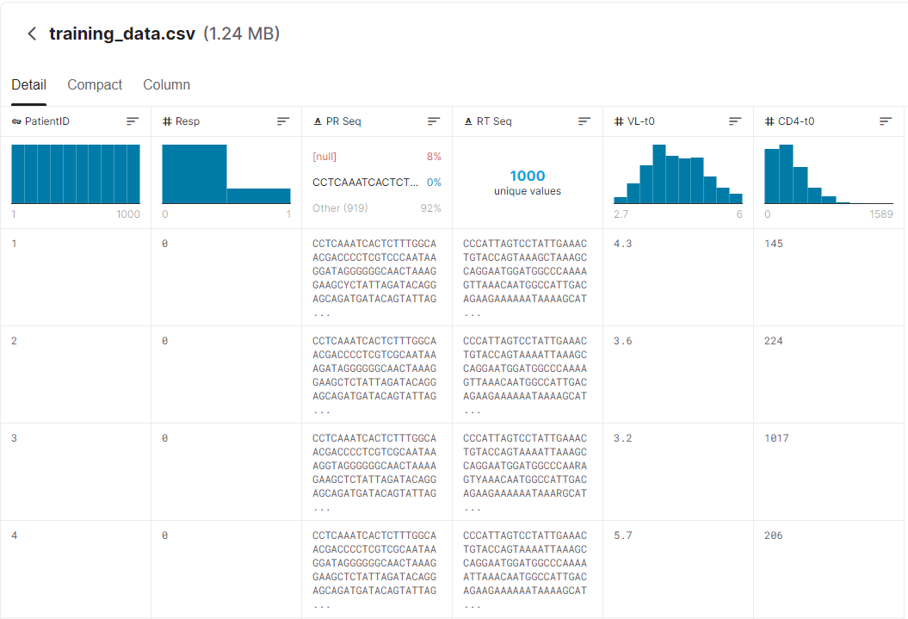

Slide 6
Data Preprocessing
The key of this challenge is to identify the mutations in the sequences that are related to the prognostics of the patient
Strategy:
Work together in the data analysis
Try different algorithms working independently
Data issues: How to handle the sequences?
Convert strings to numbers
Grouping – nucleotides combine in groups of 3
Common patters and sequence alignments

Slide 7
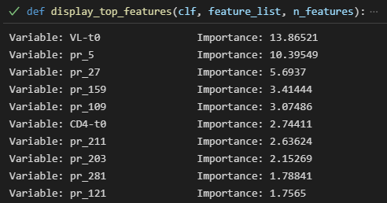
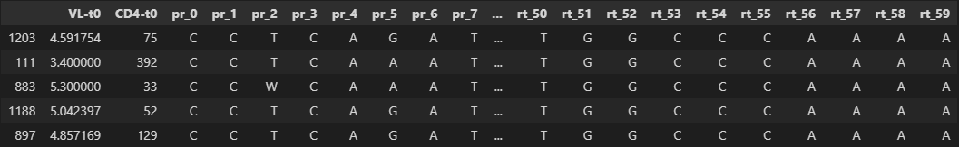
Method 1 – Decision Trees
Accuracy of best model:
Train: 85%
Test: 57%
Most important features
Data structure used

Slide 8

Method 2 – Naïve Bayes
Only sequences are used as features
Tf - Idf matrix of triples
Naïve Bayes classifiers
Test size 43%
Accuracy around 60%
Triplets in test set has new values

Slide 9
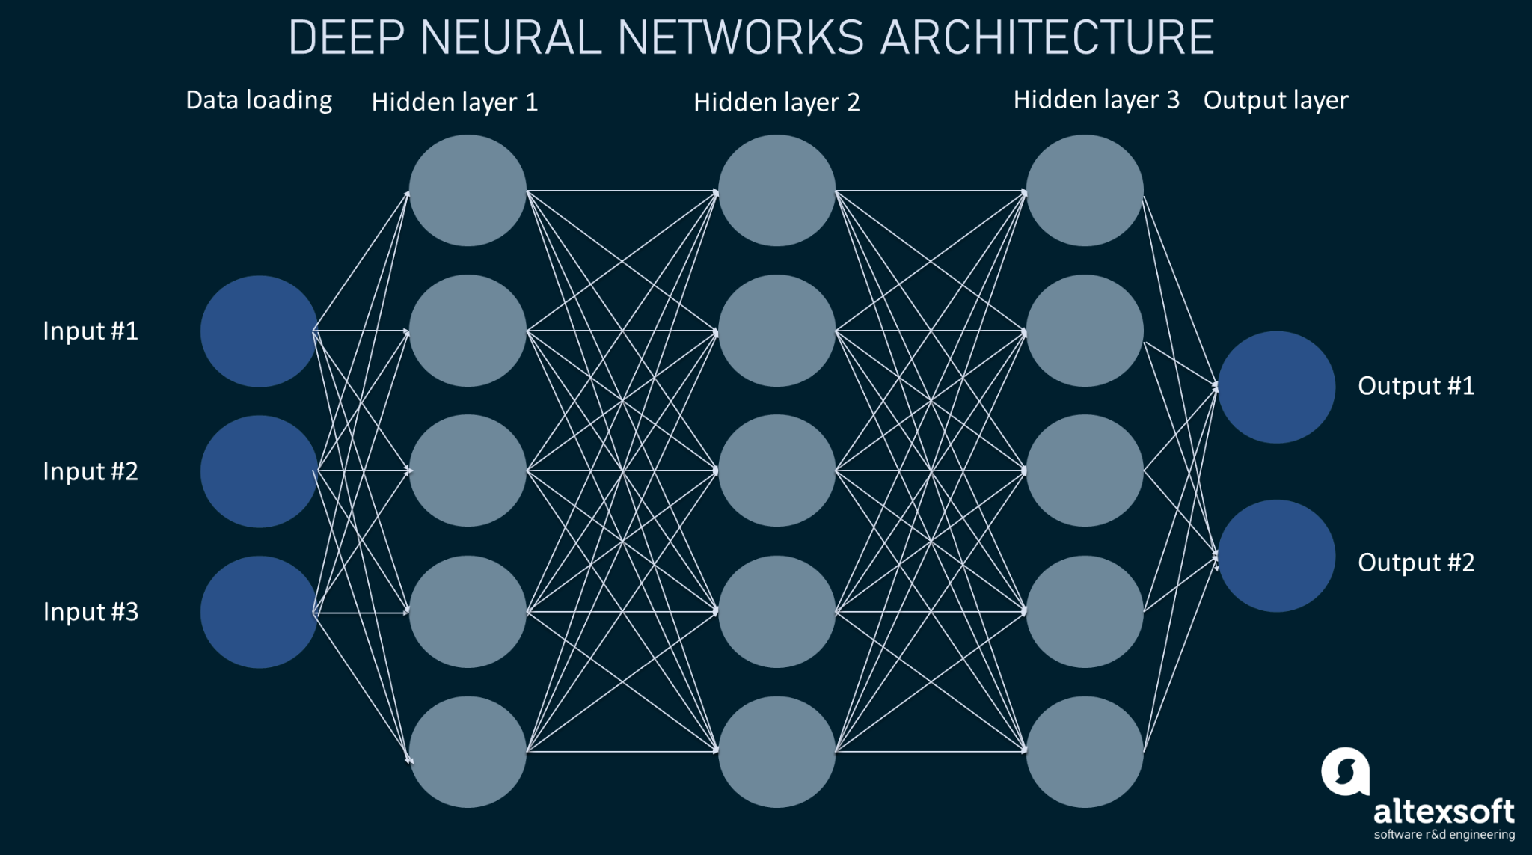
Method 3 – Neural networks
Data input:
Each sequence separately, both sequences, all inputs
Networks:
Dense layers
Recurrent NN (LSTM) + dense layers
Techniques:
Dropout – focus on important data
Class weights – imbalanced dataset

Slide 10
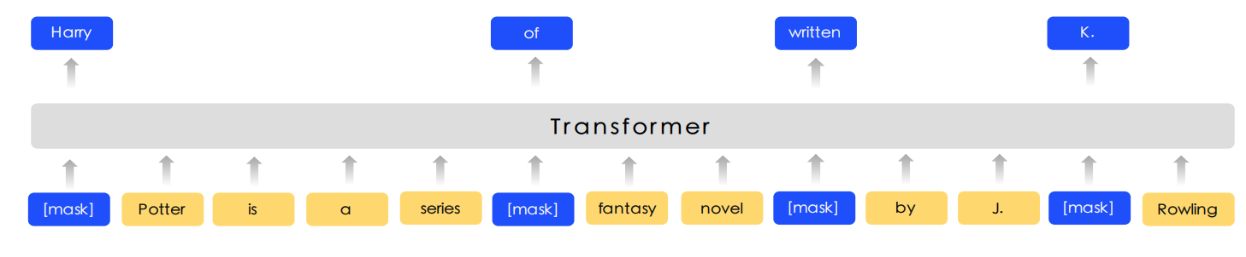
Method 4 – Transformers NN (I)
Nucleotide sequence self-supervised pre-training
Teach the model to understand nucleotide sequences
Two independent transformer based language models, one for protease, another for the reverse transciptase sequence
Both model provide a scalar representing the sequence to a 2-hidden layer MLP

Slide 11
Method 4 – Transformers NN (II)
Base model overfit super-hard
Techniques to mitigate this:
Label smoothing: 0.1
Weighted loss function (x4 for positive)
Strong dropout: 0.5
Weight decay: 3e-3
Cosine learning rate annealing

Slide 12
Results
Method | Test Accuracy
1 - Decision Trees: CatBoost | 57%
2 – Naïve Bayes | 60%
3a - Neural Networks (single-input) | 57%
3b - Neural Networks (multi-input) | 50%
4 - Transformers | 63%
Worst results – multi-input NN
Best results - transformers

Slide 13
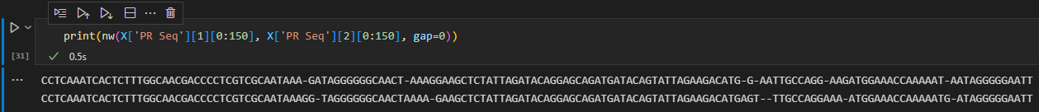
Conclusions
https://github.com/bl1zzardx/hivprogression
What we learned:
The data is key:
Domain expertise – nucleotides sequences, HIV mutations
The dataset: small size, strong bias offset in the training (80-20) and test set (50-50)
Analyze the weight of the different inputs – trade-off complexity/contributions
What could be done afterwards:
Properly align the sequences to compare apples with apples
Consider different ways to codify the nucleotide strings

