Slide 1

Bike station System
Bayan Ali

Slide 2
Overview
Backstory.
Design.
Data.
Algorithms.
Tools.

Slide 3
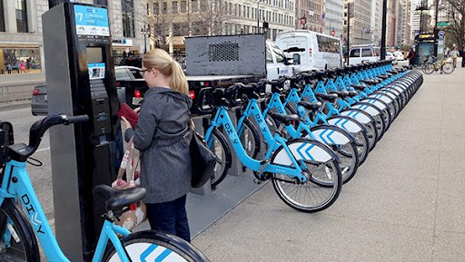
Backstory
Bike sharing systems Chicago.

Slide 4
Design
How do bike trip patterns vary by time of day and the day of the week?
What are the most used stations?
Is the number of users increasing over the years?
Did the presence of a system for subscribers help in increasing the number of users?

Slide 5
Design
Description | Data
the user number | ID
the time during which use it . | Duration
The date on which the bike began to be used. | Start_date
The name of the station from which the user . | start_station_name
The id of the station from which the user started. | start_station_id

Slide 6
Design
Description | Data
The date of the end use it. | end_date
The name of the station where the user ended up. | end_station_name
The id of the station where the user ended up. | end_station_id
The Identifier of the bike. | bike_id:
Type of use Is user or subscriber. | subscription_type
A ZIP code for the Customer. | zip_codr:

Slide 7
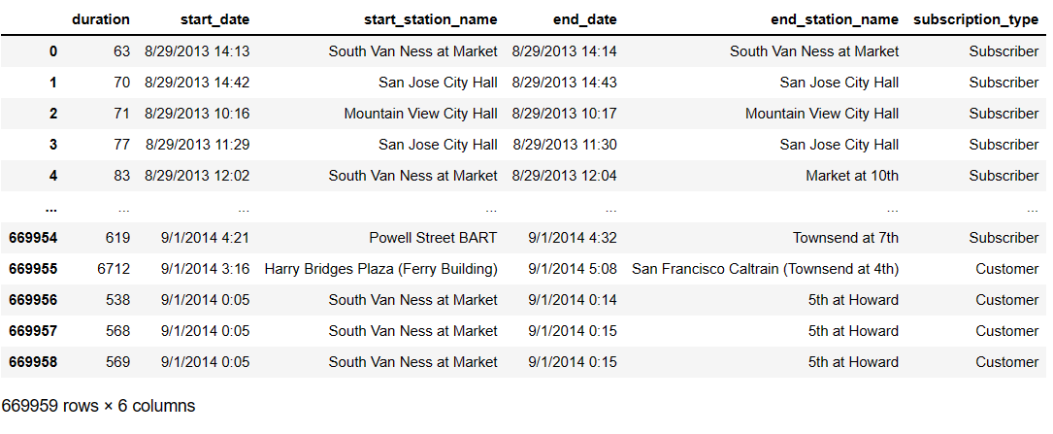
Data

Slide 8
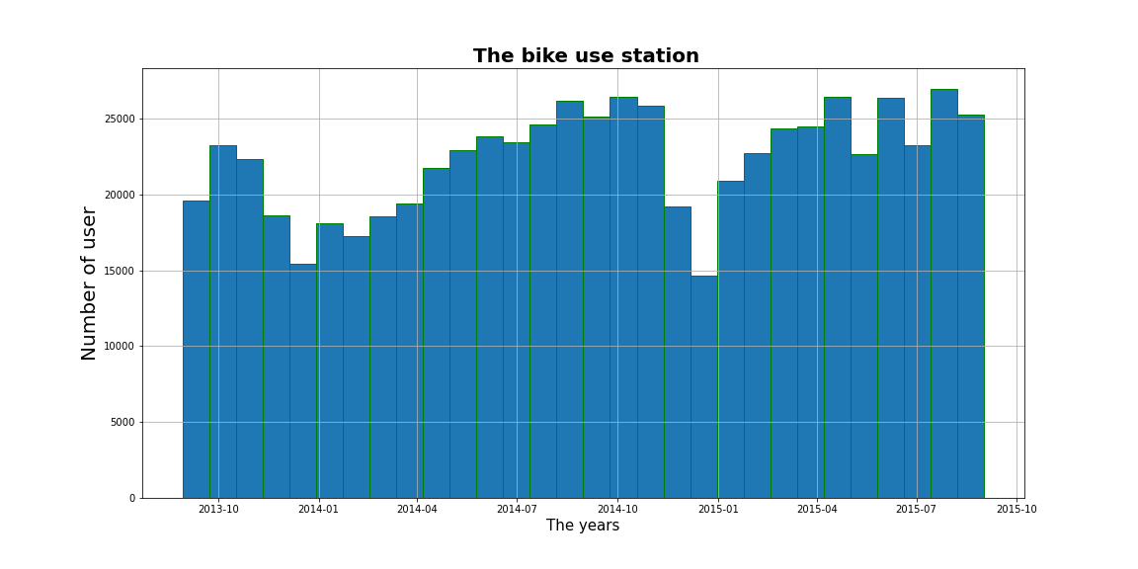
Results

Slide 9
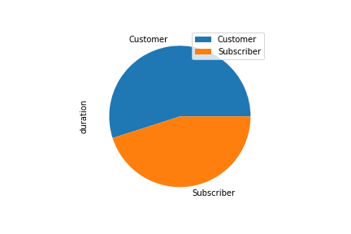
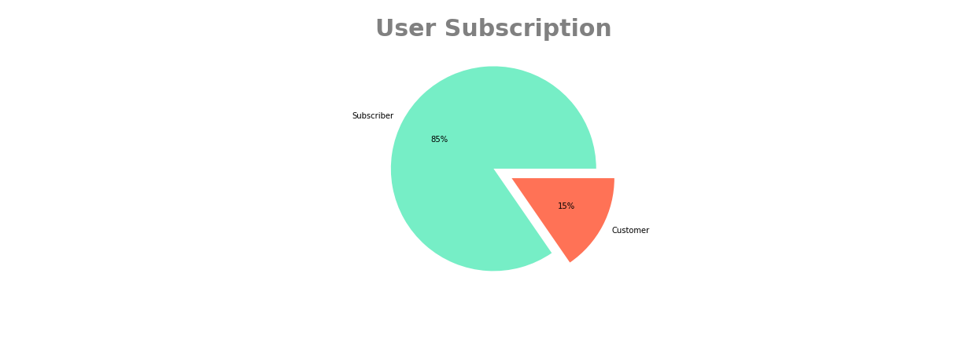
Results

Slide 10
Tools
Python programming language .
Jupyter lab as programming environment.
Numpy seaborn ,and Pandas for data manipulation.
scipy and math for mathematical operations.
PowerPoint for presentation.

Slide 11
Any questions?
Thank you for listening

