Slide 1

Bike station System
Bayan Ali

Slide 2
Overview
Backstory.
Design.
Data.
Algorithms.
Tools.

Slide 3
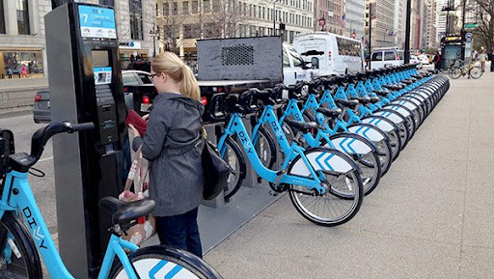
Backstory
Bike sharing systems Chicago.

Slide 4
Design
How do bike trip patterns vary by time of day and the day of the week?
What are the most used stations?
Is the number of users increasing over the years?
Did the presence of a system for subscribers help in increasing the number of users?

Slide 5
Design
Description | Data
the user number | ID
the time during which use it . | Duration
The date on which the bike began to be used. | Start_date
The name of the station from which the user . | start_station_name
The id of the station from which the user started. | start_station_id

Slide 6
Design
Description | Data
The date of the end use it. | end_date
The name of the station where the user ended up. | end_station_name
The id of the station where the user ended up. | end_station_id
The Identifier of the bike. | bike_id:
Type of use Is user or subscriber. | subscription_type
A ZIP code for the Customer. | zip_codr:

Slide 7
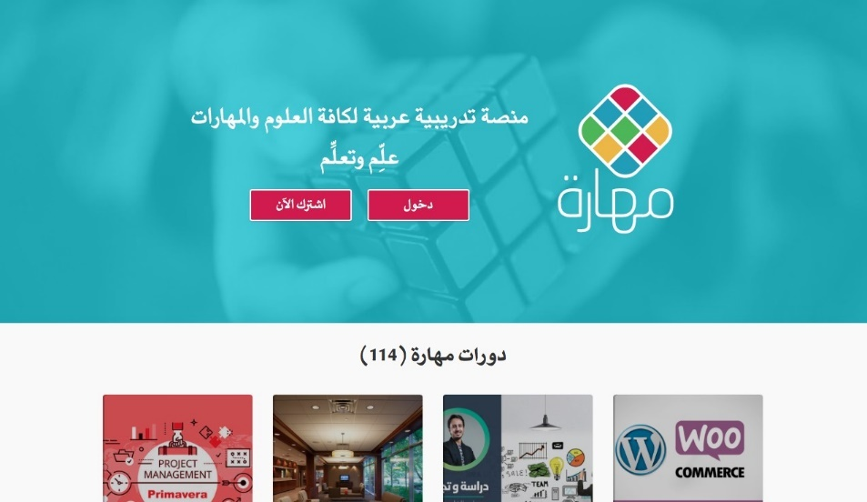

Achievements: Maharah
In February 2015 he launched the newest Startup Maharah.net.
It is the Arabic marketplace for online training courses, it provides a platform for experts of any kind to create courses which can be offered to the public, either for free or a fee.

Slide 8
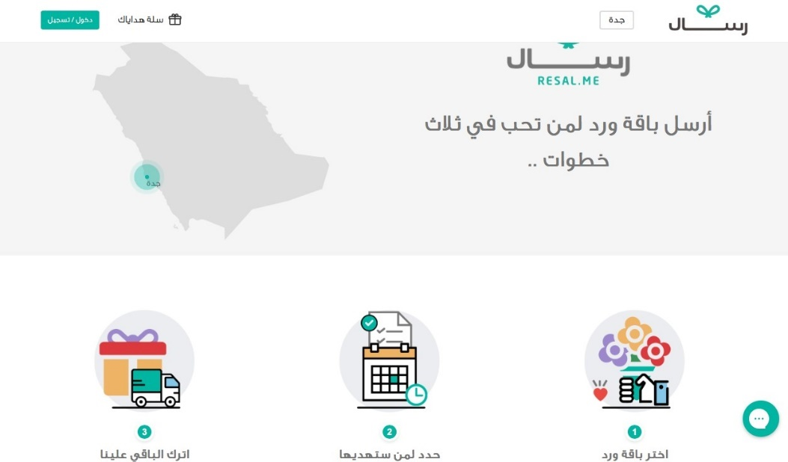

Achievements: Resal
November 2016 he Launched Resal.me.
a cool service helping people send flowers in three clicks.

Slide 9
Learned Lessons
we learn from the obstacles faced in life and become more resolve and determination.
To know what are we really passionate about and work on it.
Commitment and hard work are a key aspect for achieving our goals.
Never give up on following our dreams.
It is always possible to start a business with the simplest methods.

Slide 10
Thank you for listening! ☺

