Slide 1
SOX compliance
Balazs Lendvay

Slide 2
Agenda
Introduction
What is ISMS
Frameworks & Standards overview
SOX detailed review
Conclusion
Questions

Slide 3
Information Security Management System
Centrally managed framework, specific to your business environment
Set of policies and procedures for systematically managing sensitive data
Applied to the whole company or to specific data
Based on a risk assessment across the organization, likelihood and potential impact
Business management process, not an IT function
Goal is to minimize risk and ensure business continuity
Typically addresses employee behavior and processes as well as data and technology

Slide 4
ISMS - Benefits
Manage information in all its forms
Technology-based risks and other, more common threats
Reduces costs (through risk assessment)
Constantly adapts to changes, controls remain up to date and work properly
Organizational culture and making processes efficient
Data Confidentiality, Integrity and Availability
Timely recovery
Significantly more resilient to cyber attacks

Slide 5
ISMS - Frameworks
ISO/IEC 27000 (International Organization for Standardization)
Standard and Framework
Defines a global approach to security management
ITIL (IT Infrastructure Library)
Defines the processes to be implemented to deliver and support IT services focusing on the business.
COBIT (Control Objectives for Information and Related Technology)
Overlaps with ITIL considerably
Up-to-date international set of generally accepted control objectives
Focused on controls and metrics
Lacks a security component but provides a more global view of IT processes

Slide 6
ISO/IEC 27001:2013 – What is it?
Requirements for establishing, implementing, maintaining, and improving an Information Security Management System (ISMS)
Requirements for the assessment and treatment of information security risks
Does NOT formally mandate specific information security controls
Management may elect to avoid, transfer or accept information risks
“Statement of Applicability” (SoA) is not explicitly defined, but mandatory
Certified compliance with ISO/IEC 27001 is optional (refer to SoA)

Slide 7
ISO/IEC 27001:2013 - Contents
Introduction - process
Scope - generic ISMS requirements
Normative references
Terms and definitions
Context of the organization - understanding the organizational context, the needs and expectations, defining the scope of the ISMS
Leadership - top management commitment to the ISMS
Planning - process to identify, analyze and plan to treat information risks, clarify the objectives
Support - adequate, competent resources must be assigned, awareness raised, documentation prepared and controlled
Operation - more detail about assessing and treating information risks, managing changes, and documenting things (auditable)
Performance evaluation - monitor, measure, analyze and evaluate/audit/review controls, processes and management system
Improvement - address the findings of audits and reviews, refinements to the ISMS

Slide 8
ISO/IEC 27002:2013 – What is it?
Internationally-recognized standard of good practice for information security
Covers security of all forms of information
ISO/IEC 27001 formally defines the mandatory requirements for an ISMS
ISO/IEC 27002 is merely a code of practice/guideline rather than a certification standard
Recommends information security controls addressing information security control objectives arising from risks to the confidentiality, integrity and availability of information
Control objectives are at a fairly high level and, in effect, comprise a generic functional requirements specification
Requires the Statement of Applicability (SoA)
Forward looking 3 year cycle

Slide 9
ISO/IEC 27002:2013 - Contents
Information security policies
Organization of information security
Human resource security
Asset management
Access control
Cryptography
Physical and environmental security
Operations security
Communications security
System acquisition, development and maintenance
Supplier relationships
Information security incident management
Information security aspects of business continuity management
Compliance

Slide 10
SOC - What is it?
Service Organization Controls Report (SOC)
AICPA - American Institute of CPAs - framework for CPAs to examine controls at a service organization
Conducted in accordance with Statements on Standards for Attestation Engagements – SSAE 16
SOC 1
Audit of internal controls over financial reporting. If your service provides a number that affects the financial status of your customer, this might apply
Description of a service organization’s system; suitability of the design of controls
SOC 2
Typically IT focused audit over one, to all five, of the Trust Services Principles (TSP’s): Security, Availability, Processing Integrity, Confidentiality, Privacy
Description of a service organization’s system; design and operating effectiveness of controls
Point in time report (type I); cover a period of time (type II)
SOC 3
Similar to a SOC 2 audit, less detail, results is mostly used for marketing purposes
SOC for Cybersecurity
Notes:
Security
Physical and logical protection against unauthorized access.
Availability
The system is operationally available for use as committed or agreed.
Processing Integrity
System processing is complete, accurate, timely and authorized.
Confidentiality
All information is classified and protected as committed or agreed.
Privacy
Personal information is collected, used, retained and transferred as committed or agreed.

Slide 11
SOX – What is it?
Sarbanes-Oxley Act of 2002
Goals:
Increase transparency in corporate governance and financial reporting
Formalize a system of internal checks and balances
Applicable to:
All publicly held American companies
International companies having registered equity or debt securities with the U.S. Securities and Exchange Commission (SEC)
Any accounting firm or other third party that provides financial services to either of the above
Penalties:
Penalties for non-compliance: Formal penalties for non-compliance with SOX can include fines, removal from listings on public stock exchanges and invalidation of D&O insurance policies. Under the Act, CEOs and CFOs who willfully submit an incorrect certification to a SOX compliance audit can face fines of $5 million and up to 20 years in jail.
Takes place once a year. An independent auditor must conduct SOX audits. Company’s responsibility
Applies to any third parties you outsource financial work to – service organizations; SOC report!

Slide 12
SOX - Compliance audit
Measure of how well your company manages its internal controls.
Section 302:
Relates to a company’s financial reporting
CEO and CFO to confirm that they accept personal responsibility for all internal controls and have reviewed these controls in the past 90 days, including information security infrastructure.
Section 404:
Further requirements for the monitoring and maintenance of internal controls related to accounting and financials
Requires annual audit of these controls performed by an independent firm. Audit assesses the effectiveness of all internal controls and reports its findings back directly to the SEC.

Slide 13
SOC vs ISO summary
ISO 27001/2
Provides best practice framework for establishing an ISMS. Guide for implementing a security program
Outlines the organization’s conformance to the standard set of requirements
SOC 2 type II
Provides an organization a way to demonstrate that security practices are in place and operating effectively
Report outlining the controls that meet the applicable Trust Services Criteria
Both
Provide independent assurance on the service organization’s controls that were designed and implemented to meet a specific set of requirements or criteria
Internationally recognized standards and are accepted worldwide
Allow a service organization to gain significant advantage over competitors

Slide 14
SOC vs SOX Summary
SOC
Audit of internal controls to ensure data security
Granular, internal control reports to makes sure the information and data you store is accurate and protected at all times
SOX
Government-issued record keeping and financial information disclosure standards law
Doesn’t tell you exactly how to run your record keeping, it does spell out what controls should be in place to provide accurate financial statements
Both
Serve as a protective agent for consumers and organizations
Strive for enhanced financial data accuracy and greater internal control support

Slide 15
SOX - Important acronyms
PCAOB: The Public Company Accounting Oversight Board. Develops auditing standards and train auditors on the best practices for assessing a company’s internal controls. Publishes periodic recommendations and changes to the auditing process.
COSO: Committee of Sponsoring Organizations, a joint organization consisting of representatives from the Institute of Management Accountants (IMA), the American Accounting Association (AAA), the American Institute of Certified Public Accountants (AICPA), the Institute of Internal Auditors (IIA) and Financial Executives International (FEI). Since 1992, COSO has published periodic updates to their internal control framework recommendations this document outlines guidelines for creating and implementing internal controls, and serves as the basis for the auditing standards developing by PCAOB.
COBIT: COBIT (Control Objectives for Information and Related Technology) is a framework published by ISACA. ISACA covers guidelines for developing and assessing internal controls related to corporate information technology. Effectively a more specific version of the COSO framework, it outlines best practices for 34 IT processes. Many organizations will rely on both frameworks when developing a roadmap to SOX compliance.

Slide 16
COSO - Details
Unified approach for evaluation of the internal control systems
Effectiveness and efficiency of operations
Compliance with actual laws and regulations
Reliability of financial reporting
COSO framework control components
Internal Environment
Objective Setting
Event Identification
Risk Assessment
Risk Response
Control Activities
Information & Communication
Monitoring
Risk Assessment
Analysis of risk
Consideration of likelihood and impact
How risks should be managed
Risk Response
Avoid Risk
Accept Risk
Reduce Risk
Share Risk

Slide 17
COBIT - Structure
Covers four domains:
Plan and Organize (PO)
Acquire and Implement (AI)
Deliver and Support (DS)
Monitor and Evaluate (ME)
Audit based on Information Technology General Controls (ITGC)

Slide 18
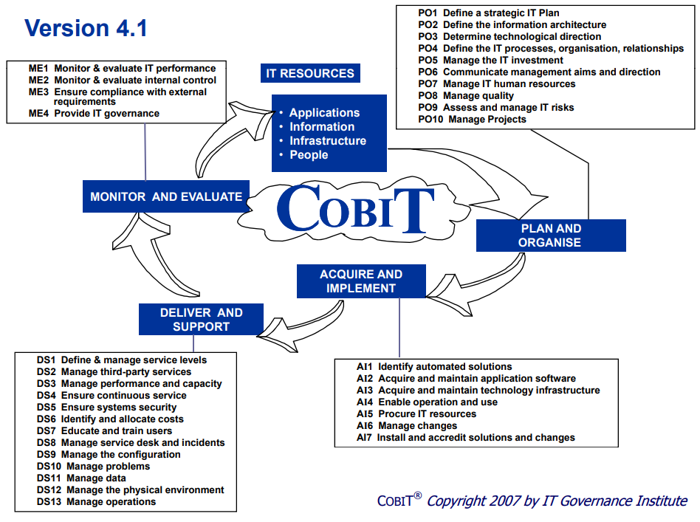

Slide 19
SOX – Key points
Financial Objectives:
Completeness
Accuracy
Validity
Authorization
Operational & IT Objectives:
Confidentiality
Integrity
Availability
Effectiveness and Efficiency
Control types by implementation:
Automated Controls
Manual Controls
Partially Automated Controls
Control types:
Preventive Controls
Detective Controls
Corrective Controls
Ensures:
Confidentiality
Integrity
Availability

Slide 20
SOX - Audit process
Understand and identify the IT environment and systems to be reviewed
Perform interviews, walkthroughs, and documentation reviews to gain an understanding on processes
Assess appropriateness of existing control environment (control design)
Validate existing controls to assess control operating effectiveness

Slide 21
SOX – ITGC domains
Access to Programs and Data
Program Development
Program changes
Computer operations

Slide 22
SOX – ITGC – Access to programs and data
Policies and procedures
Physical and environmental security
Logical access to systems and data
Security configurations, e.g. password controls, lockout screens
User Management
Principle of Least Privilege (POLP)
Segregation of Duties (SoD)
Monitoring of access

Slide 23
SOX – Examples - Access
User Access (DS5)
Users and their system activity should be uniquely identifiable
User access requests, modifications, and removals should be documented and approved
Terminated users should have access removed timely
Access levels should based on a user’s job duties (least privilege principle)
Remote access should rely on secure protocols

Slide 24
SOX – Examples - Access
Logical Security (DS5)
Confidentiality, integrity, and availability over systems and data
Strong authentication controls should prevent user accounts from being compromised
File shares should be adequately restricted to appropriate users
Patches/system updates should be applied timely
Network services should be closed unless necessary for business reasons
Anti‐virus software should be installed and up‐to‐date
Sensitive data should be encrypted

Slide 25
SOX – ITGC – Program development & Program changes
Having a record of what was changed, in addition to when it was changed and who changed it
Documentation and Training over program development process
Controls over Program Changes (e.g.: approvals, checkpoints)
Transfer to live
Maintenance activities
Change Requests
Software Development Life Cycle (SDLC)

Slide 26
SOX – Examples
Change Management (AI6 & AI7)
Addresses how an organization modifies system functionality to meet business needs
Requests for changes should be documented and follow defined change management procedures
Emergency changes should follow a defined process
Changes should be properly tested (in separate environments) to ensure functionality meets defined requirements
Controls should restrict migration of program changes to production by authorized and appropriate individuals.

Slide 27
SOX – ITGC – Computer Operations
Organization of IT function
Service Level Agreements
Business Continuity and Disaster Recovery Plans
Network Management
Backups and Recovery

Slide 28
Conclusion
Frameworks complement each other
You can supplement the IT operational process strengths of ITIL with the critical success factors (CSF)
and key performance indicators (KPI) of COBIT,
and both can make good use of the security processes and controls defined in ISO
COBIT and ISO also provide
guidance, key indicators, and controls for the definition of service-level agreements,
capacity planning, availability management, and business continuity, which complement ITIL service delivery processes
Mapping, mapping, mapping…

Slide 29

Questions?

Slide 30
References
http://www.iso27001security.com/
https://linfordco.com/blog/soc-2-security-vs-iso-27001-certification/
https://www.ssae-16.com/
https://www.aicpa.org/InterestAreas/FRC/AssuranceAdvisoryServices/DownloadableDocuments/OtherMapping/Trust_Services_Map_to_ISO_27001.xlsx
http://www.sox-online.com/coso-cobit-center/original-coso-framework/
https://www.csoonline.com/article/220639
http://www.isaca.org/chapters7/Sacramento/NewsandAnnouncements/Documents/Overview_of_SOC_Reports_-_ISACA_Presentation_2-21-13_.pdf

