Slide 1
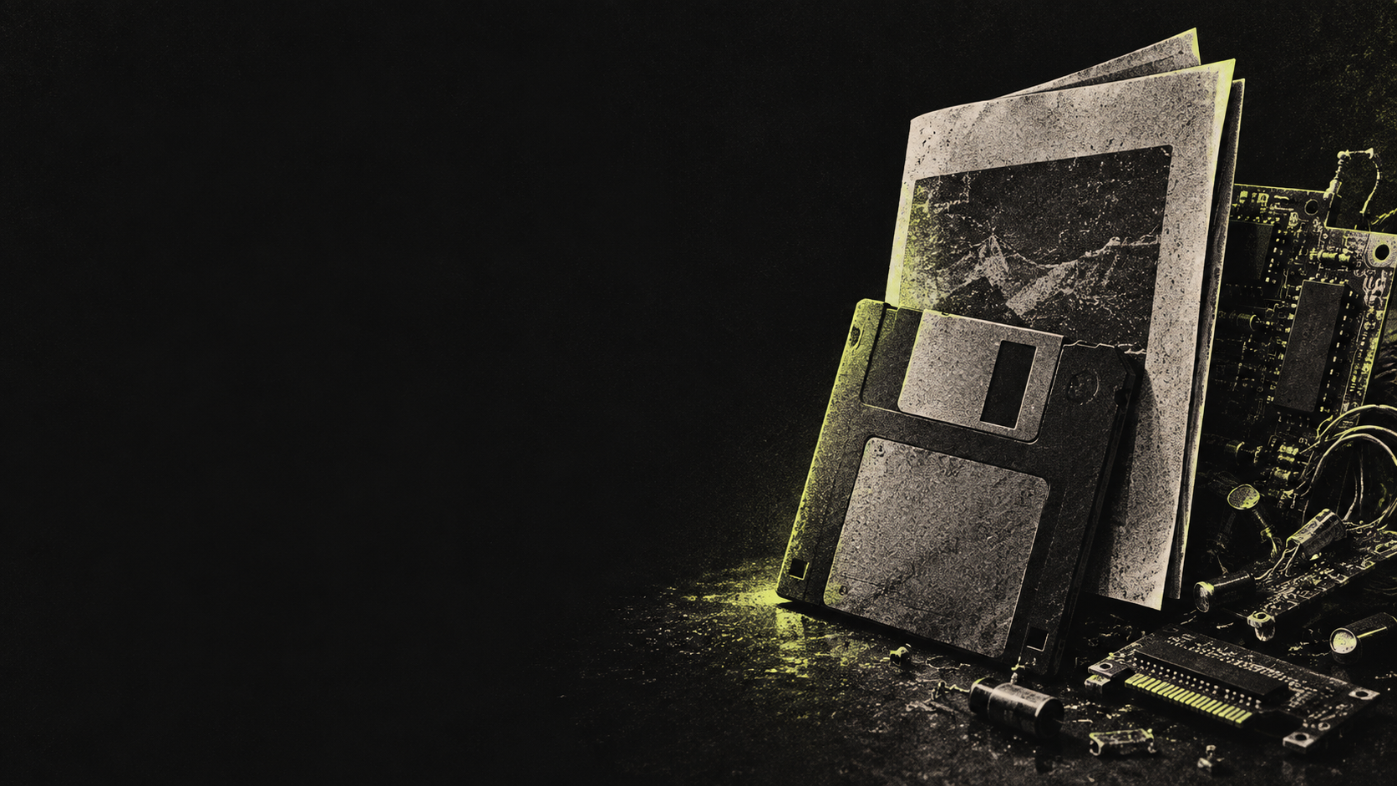
Reconstructing a 1992 Virus
to Understand Modern Malware
Charley Pfaff
GrrCON
Notes:
SLIDE 1 · 0:00–0:30 · 30 seconds
Title and introduction: Charley Pfaff, GrrCON. Reconstructing a 1992 Virus to Understand Modern Malware. Give a brief introduction, then move directly to the DOS demonstration on the next slide.
VISUAL: AI-generated conceptual illustration. It does not depict the actual source or lab evidence.

Slide 2
A day at the DOS prompt
DOS. A drive.
FIND.COM.
Work in DOS
Mount the lab drive
Run FIND.COM
Observe the result
Charley Pfaff / GrrCON / Opening demo
Notes:
SLIDE 2 · 0:30–3:30 · 180 seconds
OPENING DEMO: 3:00. Begin directly with the demonstration, before explaining the project. Stage a person working at a DOS machine or emulator: 0:00–0:45 ordinary directory navigation and routine work. 0:45–1:15 show mounting or attaching the prepared disposable lab drive in the actual VM or emulator interface. Mounting is environment-specific, not a universal DOS command. 1:15–2:15 show the FIND.COM utility being executed on that lab drive. 2:15–2:45 hold on its real output and observed file changes. 2:45–3:00 transition: What did it take to reconstruct this from a magazine? Use the actual tool name and actual result from a prepared recording or live isolated demonstration. The user selected FIND.COM. A recording has not been supplied, so this slide is a demo cue rather than embedded footage. Do not invent a successful outcome. If using the file-finding utility, distinguish the supplied first-match build from the intended all-files listing. Speaker introduction can be one sentence during the transition: Charley Pfaff, Reconstructing a 1992 Virus to Understand Modern Malware, GrrCON.

Slide 3

Notes:
SLIDE 3 · 3:30–3:40 · 10 seconds
Brief reaction beat after the opening DOS demonstration. Let the Cousin!! joke land, then transition to Why do this? Visual: AI-generated fan-art meme depicting Richie from The Bear, not an actual frame from the show.

Slide 4
Why do this?
What happened back then? Vienna and Cascade infected .COM files.
How hard would rebuilding one really be?
Start with a known public sample: the 1992 printed listing.
Learn from the past by inspecting what the code actually does.
For fun. Apparently my hobbies need a DOS prompt.
History repeats itself. I wanted to single-step it.
Notes:
SLIDE 4 · 3:40–4:45 · 65 seconds
Explain your motives after the audience has seen the demo. Historical COM infectors supply the context: Vienna searched for another file when an infected program ran, and Cascade is known for infecting COM files and its falling-letter display in some versions. These examples are historical context, not identifications of your sample. Your starting point was a publicly printed listing from 2600, Spring 1992, rather than a newly invented design. Ask how difficult it would be to turn the page into working, understood code. Close with your own playful line: History repeats itself. I wanted to single-step it. This is original talk copy, not a quotation attributed to a historian.
SOURCES
F-Secure, Vienna: https://www.f-secure.com/v-descs/vienna
F-Secure, Cascade: https://www.f-secure.com/v-descs/cascade
Source photographs: 2600, Spring 1992, pages 5–6.

Slide 5
What you will walk away with
Historical knowledge of DOS .COM file infectors
A DOS 6.22 environment with networking enabled. Woot!
Assembly source files for testing in the lab
Disinfector code for this variant
Notes:
SLIDE 5 · 4:45–5:30 · 45 seconds
Set expectations for the takeaways Charley intends to provide: historical context, a DOS 6.22 environment with networking enabled, assembly files for lab testing, and the variant disinfector source. These are planned audience resources, not a claim that this deck embeds or distributes them. Provide the actual resource location when the release is ready. The environment and networking setup have not been verified during deck preparation. Networking capability is useful for lab file transfer; the malware demonstration belongs in an isolated setup. Describe the disinfector as the research prototype discussed later, including its candidate-detection and I/O-validation limitations, rather than a general-purpose antivirus.
SOURCES
Charley Pfaff: requested audience takeaways.

Slide 6
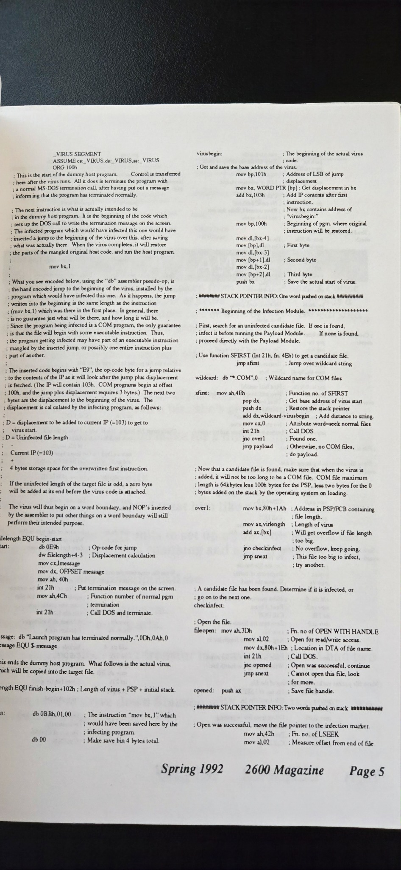
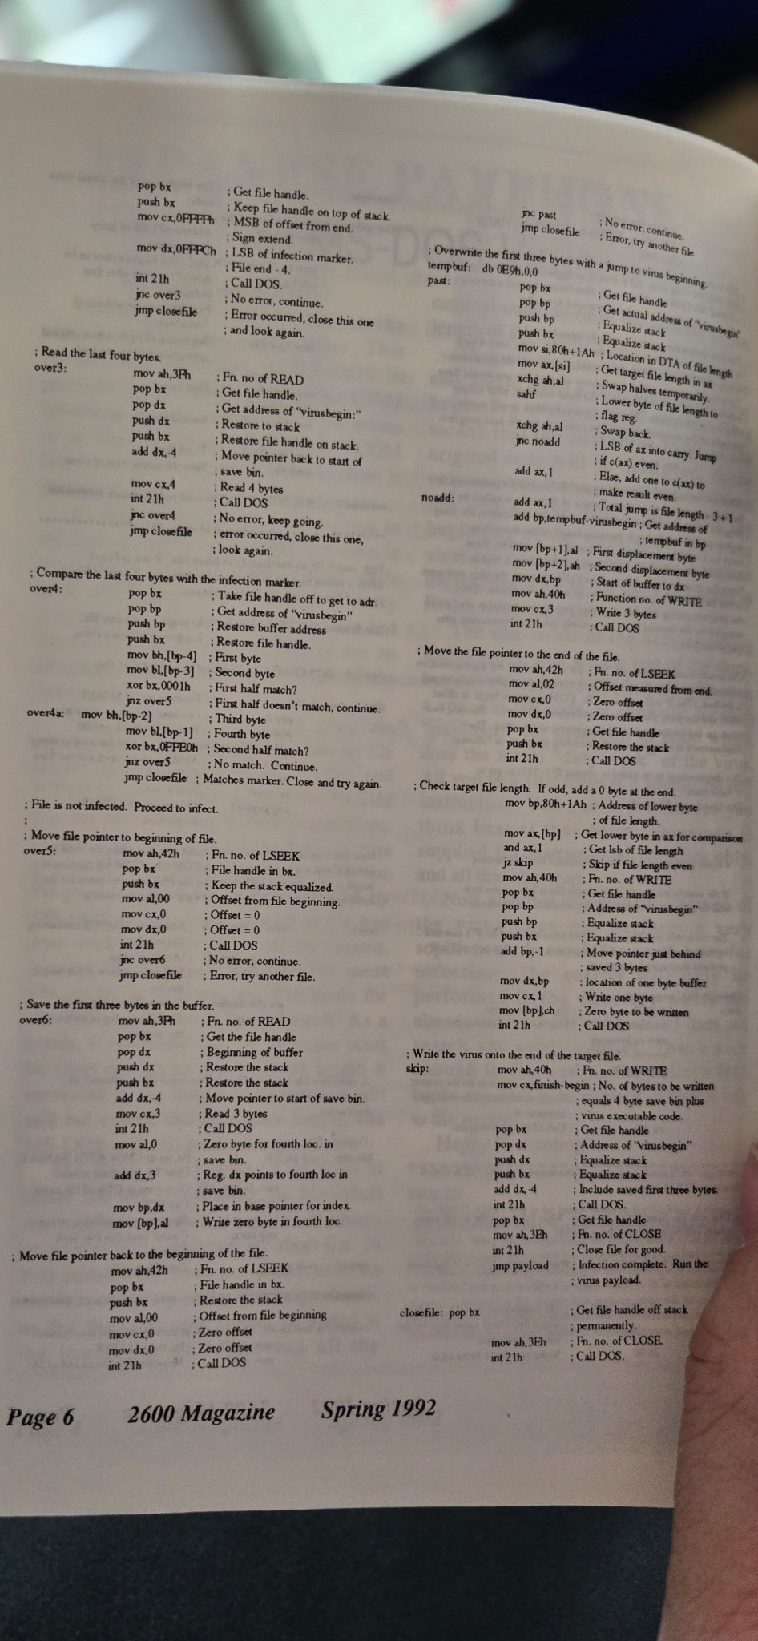
The start: image to code
Spring 1992
Pages 5–6
DOS .COM listing
Notes:
SLIDE 6 · 5:30–6:45 · 75 seconds
Transition from the motivation to the actual beginning: photographs of the printed listing. The original source pages are shown here. Describe the first conversion from image to transcribed assembly, then the NASM conversion questions that followed. The pages identify Spring 1992, pages 5–6. A printed, public starting point gives a reference against which to check the transcription. It does not mean every later local variant is identical to the publication. The next slides follow that reconstruction work.

Slide 7
Tools needed
A hypervisor with virtual floppy-drive support
A DOS environment for running the programs
Assemblers: NASM and MASM
DOS DEBUG to inspect memory and instructions
A way to move source files and binaries into the lab
Edit on the host. Transfer to the lab. Inspect in DOS.
Notes:
SLIDE 7 · 6:45–7:45 · 60 seconds
Describe the working setup needed for the reconstruction. A hypervisor with virtual floppy support provides a way to attach disk images to the DOS guest. DOS supplies the execution environment. NASM and MASM are assemblers: explain the syntax differences that made conversion part of the project, without claiming that every saved version was built with both. DOS DEBUG provides the memory and instruction inspection shown later in the talk. Explain your actual file-transfer workflow between the host and the guest, such as preparing and attaching floppy images. Keep the workflow concrete: editing source, assembling, transferring the build and inspecting it in DOS. The exact transfer utility and hypervisor configuration are not specified here.
SOURCES
Charley Pfaff: requested lab-tool list and supplied DOS DEBUG screenshots.

Slide 8
One character changed the instruction
PHOTO
FIRST TRANSCRIPT
0BBh, 01, 00
08Bh, 01, 00
Source photograph above. Initial transcription below right.
Notes:
SLIDE 8 · 7:45–9:00 · 75 seconds
The source photograph contains 0BBh,01,00 with a mov bx,1 comment. An early transcription changed 0BBh to 08Bh. Use this as a concrete lesson in checking an AI-assisted transcription against the source. A separate harmless instruction check for this presentation confirmed mov bx,1 emits BB 01 00. Do not claim this single discrepancy explains every runtime issue.

Slide 9
NASM conversion needed byte checks
SAME VALUE
DIFFERENT INSTRUCTIONS
0FF0Eh
0xFF0E
mov cx, 0
xor cx, cx
Equivalent register values can still hide different bytes and side effects.
Notes:
SLIDE 9 · 9:00–10:15 · 75 seconds
The conversations covered individual syntax conversions. NASM accepts both hexadecimal suffix and prefix notation. Syntax equivalence differs from substituting an instruction: mov cx,0 and xor cx,cx use different encodings, and xor changes flags. These isolated checks explain why plausible advice still needed verification. No full malware build is demonstrated here.
SOURCES
https://www.nasm.us/doc/nasm03.html#section-3.4.1

Slide 10
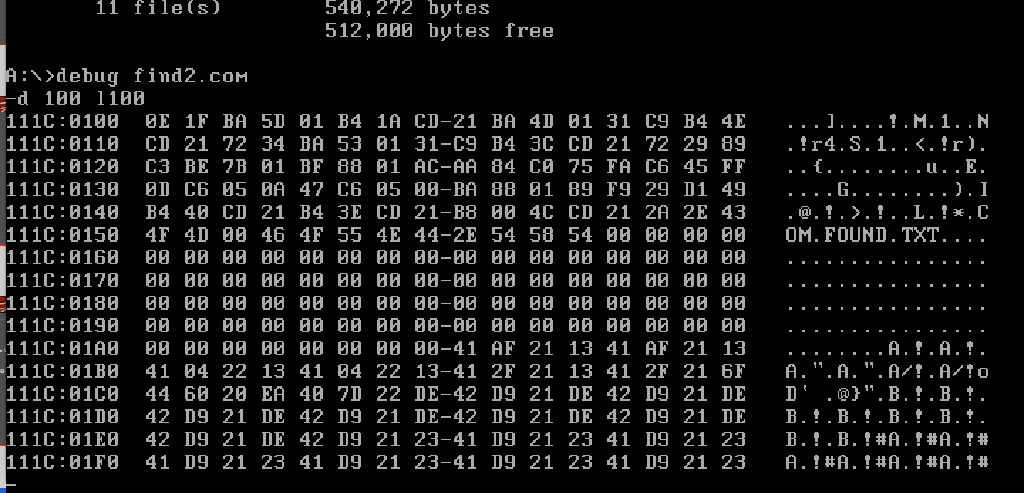
The debugger made the bytes visible
January 19: DEBUG inspecting find2.com
Notes:
SLIDE 10 · 10:15–11:30 · 75 seconds
Point out the actual dump, the address column and visible strings. Explain the distinction between the source text you intended and the bytes in memory. Avoid reading out the entire dump or turning it into a construction recipe. A memory dump alone does not establish successful infection or cleanup.

Slide 11
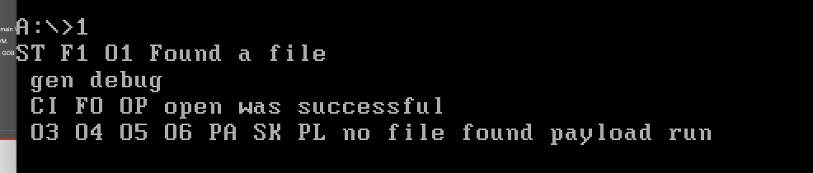
Progress messages narrowed the search
“Found a file” and “open was successful”
Notes:
SLIDE 11 · 11:30–13:00 · 90 seconds
The strings Found a file, gen debug and open was successful appear in 1992c.asm, matching the January 19 screenshot. This connects the capture to the listing-port development work. The source contains instrumentation and variant changes. These messages indicate reached program stages, not independent proof of every DOS operation or successful infection.
SOURCES
Static source review: Charley Pfaff, ~/code/1992/, September 2026. Sources are distinct from historical run evidence.

Slide 12
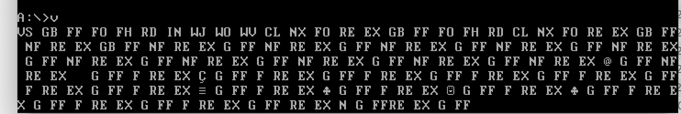
Repeated traces exposed more behavior
January 30: repeated markers and corrupted-looking output
Notes:
SLIDE 12 · 13:00–14:15 · 75 seconds
v3.asm defines the visible two-character markers. FF precedes FindFirst, FO marks the found-file/open path, FH follows a successful open, RD precedes reading, IN enters the modification path, WJ/WO/WV mark intended writes, CL precedes close, NX precedes FindNext, RE marks entry restoration and EX marks exit or return to host. GB follows segment setup but has no explicit expanded name. The macro preserves AX and DX. Messages printed before writes do not establish that writes completed. Repetition in a screenshot alone does not identify a defect or prove a loop diagnosis.
SOURCES
Static source review: Charley Pfaff, ~/code/1992/, September 2026. Sources are distinct from historical run evidence.

Slide 13
The later variant changes the entry path
ENTRY
Redirects execution into appended code
SAVED STATE
Retains the original entry bytes
HOST RETURN
Restores those bytes in memory
Notes:
SLIDE 13 · 14:15–15:15 · 60 seconds
Static reading of v3.asm shows an appending .COM file infector design with saved entry bytes and host return. Explain these as source behavior and intent, not fresh runtime validation. Returning the host entry in memory does not remove the appended content from disk. This distinction motivates the separate cleaner. Do not equate the later variant with every detail of the 1992 printed source.
SOURCES
Static source review: Charley Pfaff, ~/code/1992/, September 2026. Sources are distinct from historical run evidence.

Slide 14
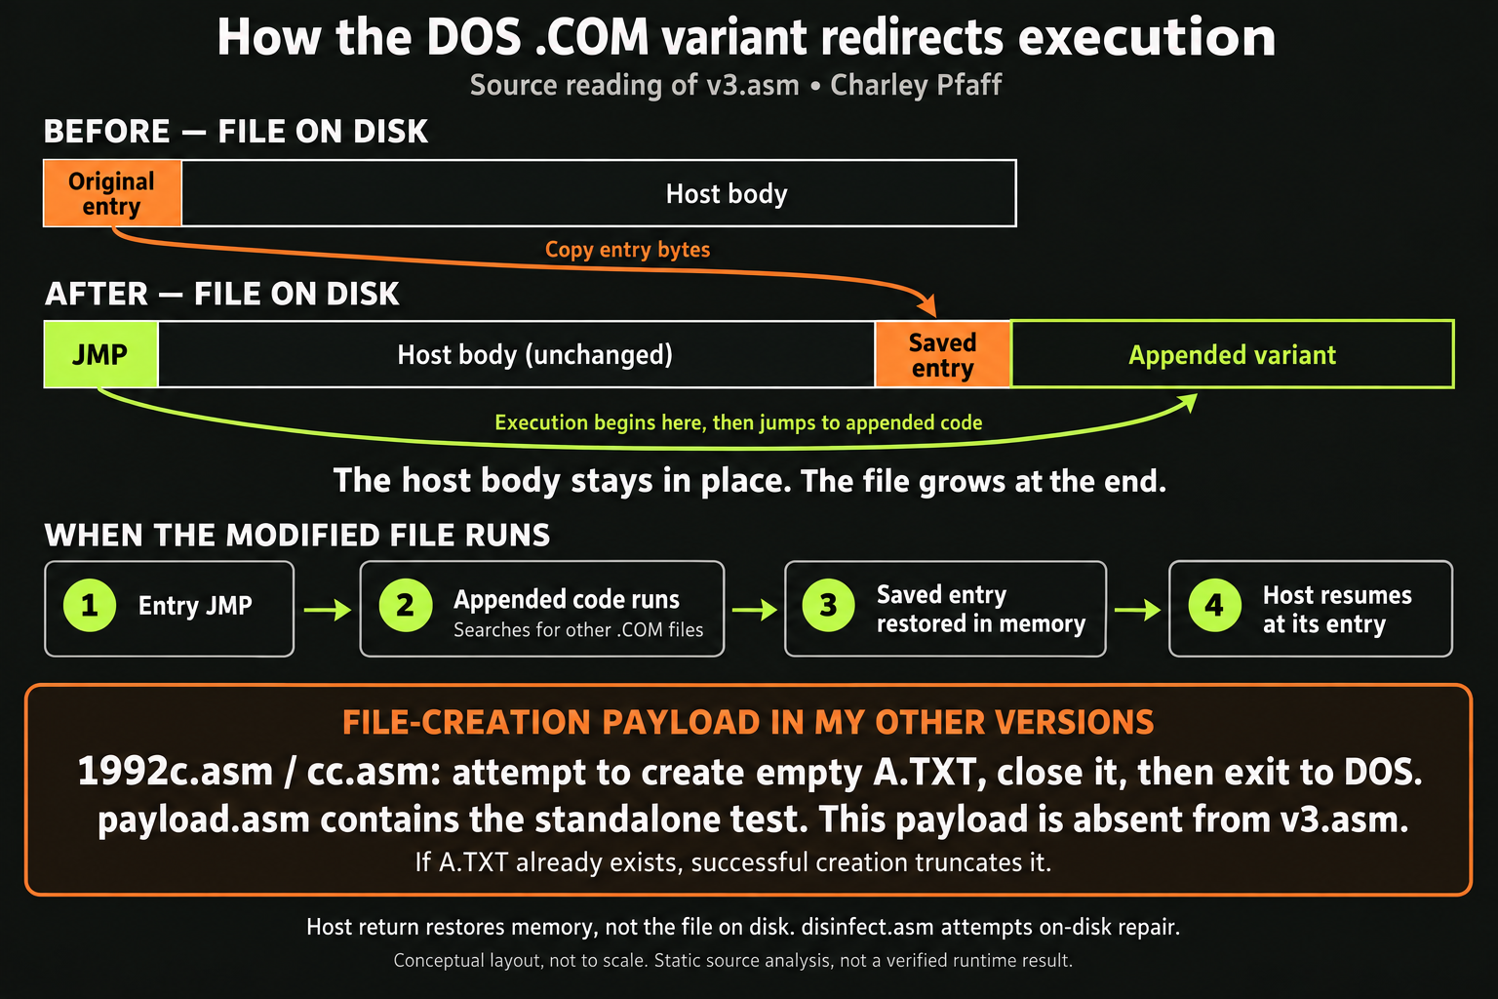
Notes:
SLIDE 14 · 15:15–16:45 · 90 seconds
The upper diagram shows v3.asm: the host body stays in place, entry bytes are saved at the end, appended code receives control from the entry JMP, and saved entry bytes are restored in memory before host return. The lower payload section belongs to different files: 1992c.asm and cc.asm attempt to create A.TXT with normal attributes, close it and exit to DOS. payload.asm is the standalone test. No data write occurs in this payload, so successful creation leaves an empty file. If that filename already exists, successful creation truncates it. Do not describe this as an extra v3.asm stage: that source lacks this payload. These are static source findings, not newly verified run results. Host return does not clean the disk file.
SOURCES
Static source review: ~/code/1992/v3.asm, 1992c.asm, cc.asm, payload.asm and disinfect.asm. AI-generated explanatory graphic.

Slide 15
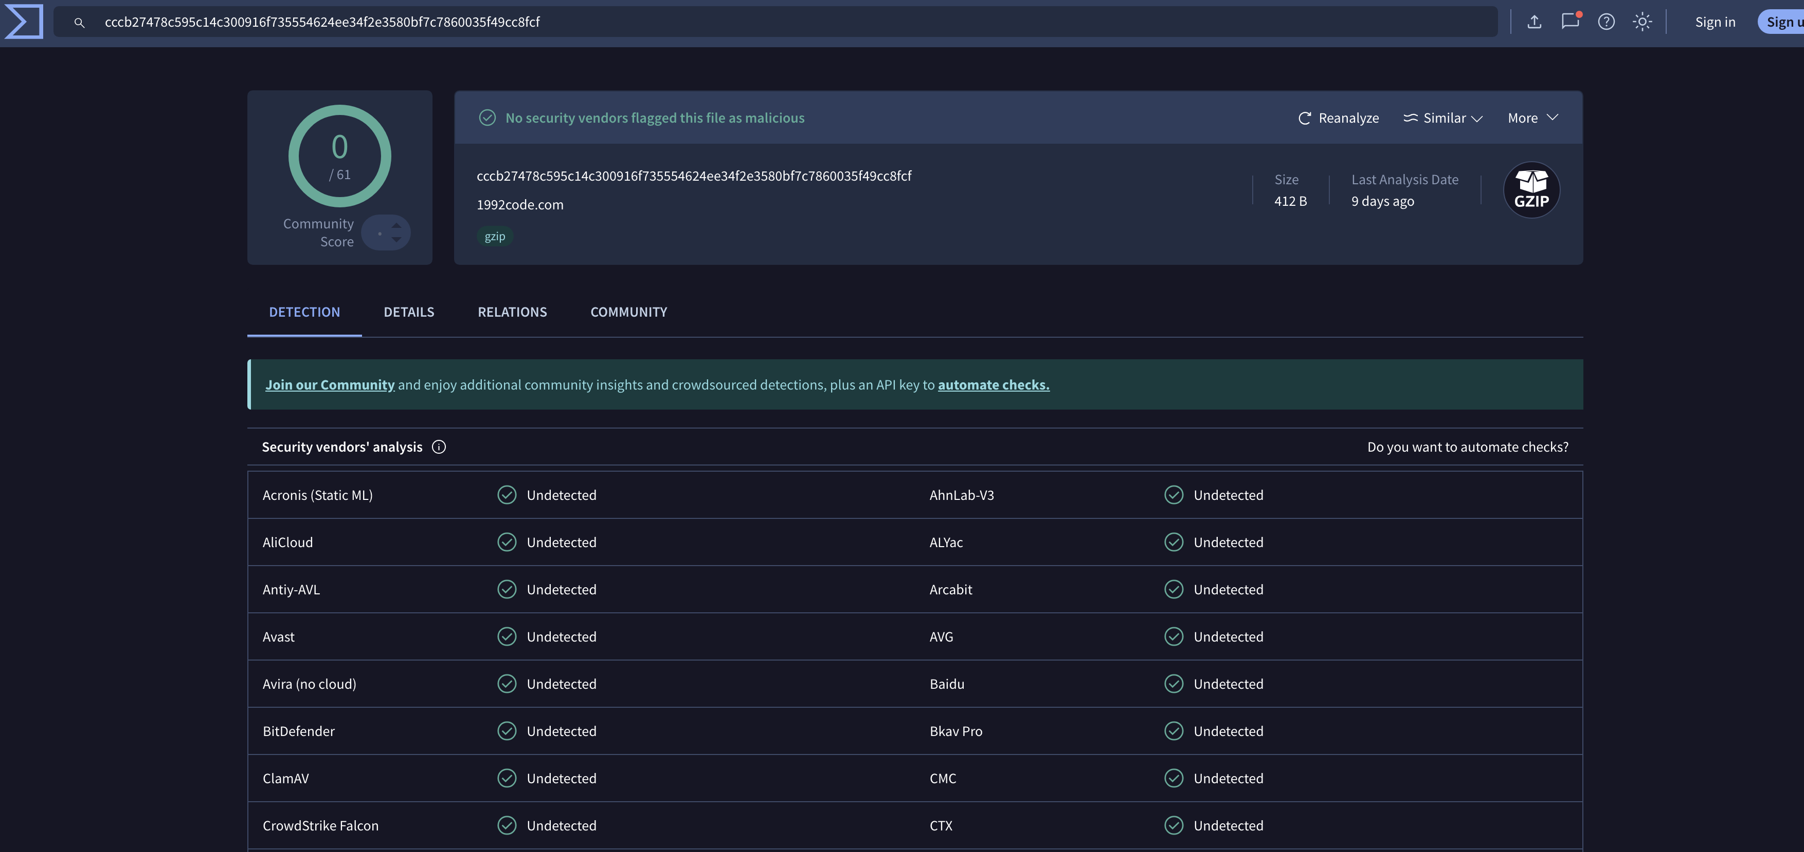
This report showed zero detections
1992code.com / 412 bytes / identified as gzip / 0 of 61
Notes:
SLIDE 15 · 16:45–18:00 · 75 seconds
The capture dated January 22 shows zero vendors flagging this exact submitted object. Its name ends in .com, but VirusTotal identifies it as gzip. The capture does not explain whether compression was intentional, what an extracted object would contain, or whether engines analyzed it as an executable. This result cannot by itself establish a runtime protection bypass. The displayed “9 days ago” is relative analysis age, not the capture date. SHA-256: cccb27478c595c14c300916f735554624ee34f2e3580bf7c7860035f49cc8fcf.

Slide 16
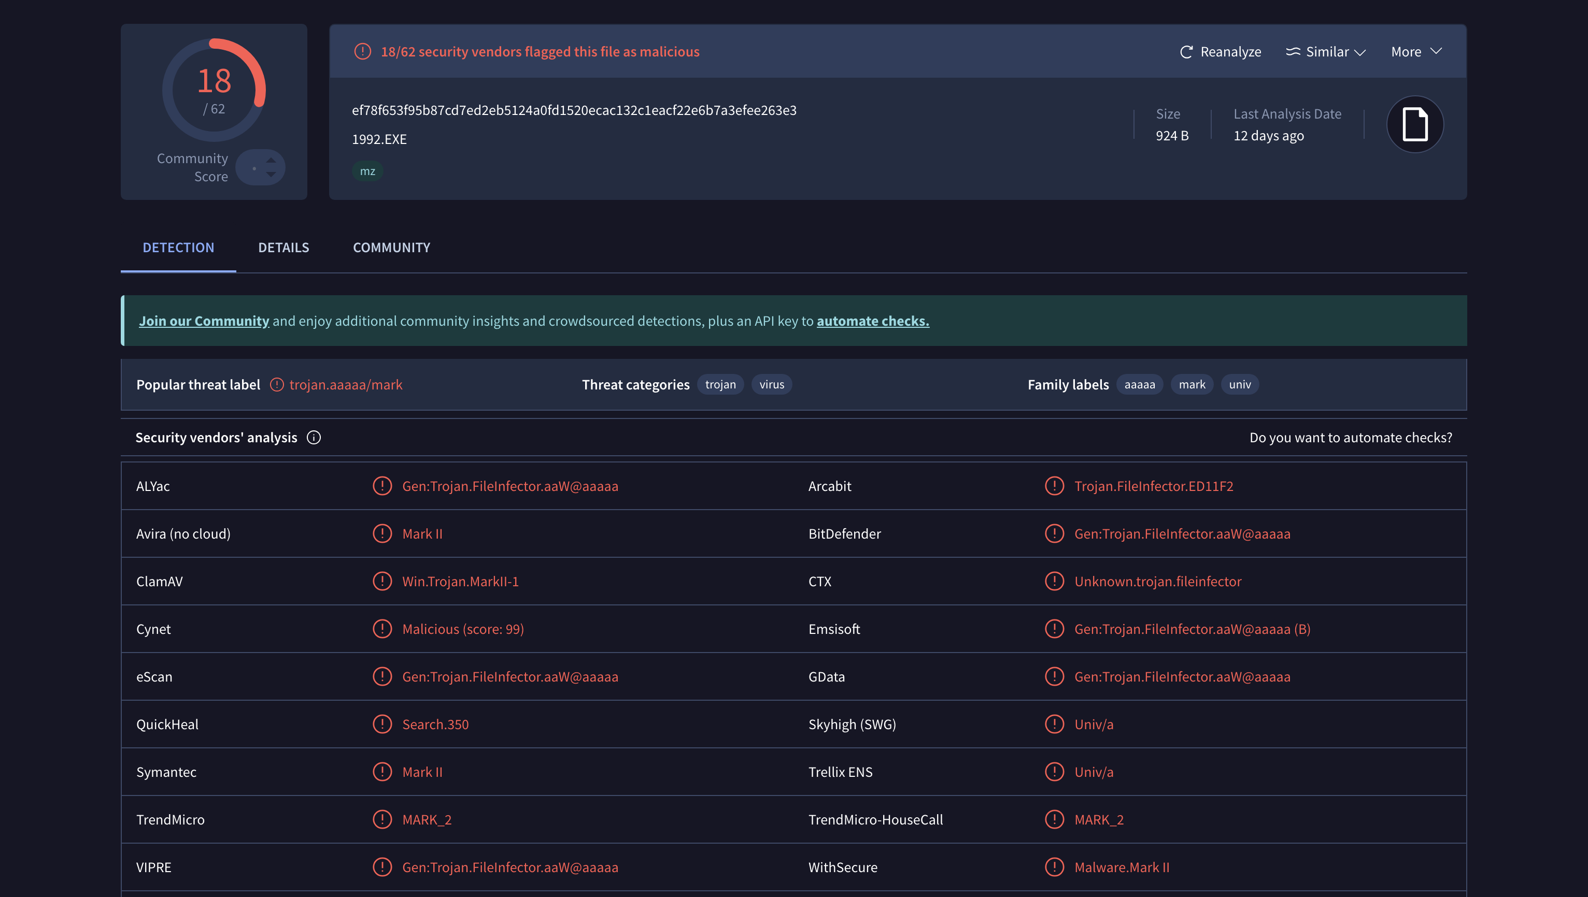
Another report showed 18 detections
1992.EXE / 924 bytes / identified as MZ / 18 of 62
Notes:
SLIDE 16 · 18:00–19:15 · 75 seconds
This is a different hash, size and file type. Several vendor labels contain Mark II, but labels alone do not establish the historical identity or relationship between the two samples. Explain why this second result belongs beside the zero result. Do not frame it as a controlled before-and-after test. SHA-256: ef78f653f95b87cd7ed2eb5124a0fd1520ecac132c1eacf22e6b7a3efee263e3.

Slide 17
The submitted objects differed
Submitted file | Recognized format | Reported detections
1992code.com 412 bytes | gzip | 0 / 61
1992.EXE 924 bytes | MZ | 18 / 62
Captured January 22, 2026. Different hashes, formats and analysis ages.
Notes:
SLIDE 17 · 19:15–20:15 · 60 seconds
Compare the actual metadata. Two screenshots of the zero-detection report refer to the same hash and are not independent tests. The causal explanation for the differing results remains unresolved. A useful follow-up is to establish file provenance and intended formats from the original artifacts before interpreting detector behavior. The loose files inspected in ~/code/1992/ did not match either screenshot SHA-256. The VM archive was not unpacked. The gzip question therefore remains unresolved.

Slide 18
A green result leaves questions open
0 detections
≠ proof of safety
File identity and execution evidence still matter.
Notes:
SLIDE 18 · 20:15–20:45 · 30 seconds
The defensible observation is zero reported detections for a particular submitted object at a particular analysis. The next questions are what bytes were submitted, what format was recognized and what actually ran in the lab. This turns a surprising result into a lesson about evidence. Avoid broad claims that modern antivirus cannot detect a 1992 virus.

Slide 19
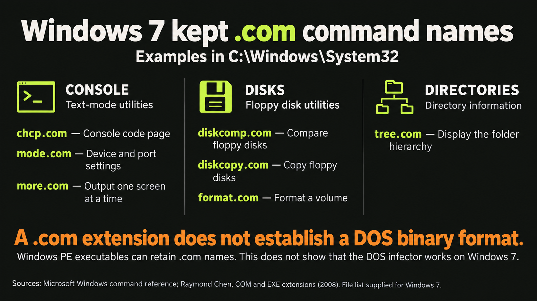
Notes:
SLIDE 19 · 20:45–21:45 · 60 seconds
Connect the historical extension to the later Windows command environment. The supplied list includes chcp.com, diskcomp.com, diskcopy.com, format.com, mode.com, more.com and tree.com, reported in Windows 7 System32. Explain their roles by the groups shown. Microsoft command documentation supports the command functions and its archived reference includes Windows 7. This is not a fresh-install inventory independently tested across editions. The crucial distinction is that an extension does not determine executable format: Windows PE executables can carry .com filenames. Do not claim the DOS flat-binary entry-patching method works on these Windows utilities. Microsoft documents that 64-bit Windows lacks NTVDM, so a shared filename extension does not establish 16-bit execution support. Relevance to defense: identify the actual format and execution environment before interpreting a filename or detection result.
SOURCES
User-supplied Windows 7 file list.
Microsoft Windows command reference (includes Windows 7): https://learn.microsoft.com/en-us/previous-versions/windows/it-pro/windows-server-2012-r2-and-2012/cc772390(v=ws.11)
Microsoft command reference: https://learn.microsoft.com/en-us/windows-server/administration/windows-commands/windows-commands
Raymond Chen: https://devblogs.microsoft.com/oldnewthing/20080324-00/?p=23033
Microsoft NTVDM: https://learn.microsoft.com/en-us/windows/compatibility/ntvdm-and-16-bit-app-support
AI-generated conceptual infographic, not an operating-system screenshot.

Slide 20
My cleaner: disinfect.asm
Restore the entry.
Remove the appendage.
A separate DOS tool works on the file on disk.
Notes:
SLIDE 20 · 21:45–23:00 · 75 seconds
disinfect.asm provides concrete source evidence for the defensive tool. It enumerates .COM files, opens candidates, reads the entry, selects files beginning with E9, obtains saved entry bytes using the layout it assumes, writes them back and truncates the file. It then prints CLEANED and the filename. The intended layout corresponds to the later variant, but selection and I/O validation are too weak to establish safe general-purpose disinfection. No cleaner was executed during this review.
SOURCES
Static source review: Charley Pfaff, ~/code/1992/, September 2026. Sources are distinct from historical run evidence.

Slide 21
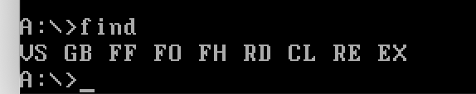
This trace belongs to the variant
RD: read / CL: close / RE: restore entry / EX: exit
Notes:
SLIDE 21 · 23:00–24:00 · 60 seconds
The source resolves the earlier ambiguity: these markers are in v3.asm, while disinfect.asm prints CLEANED followed by a filename. The short trace is consistent with a close/restore/exit path in an instrumented variant, not evidence of the cleaner running. This capture omits NX, which current v3.asm prints after close. That difference prevents assigning it to an exact build from the screenshot alone. RE denotes in-memory entry restoration. It does not establish removal of infection from disk.
SOURCES
Static source review: Charley Pfaff, ~/code/1992/, September 2026. Sources are distinct from historical run evidence.

Slide 22
A jump byte is a weak detector
CURRENT TEST
LIMITATION
First byte is E9
Legitimate .COM files
can start with a jump
A candidate match alone cannot justify rewriting a file.
Notes:
SLIDE 22 · 24:00–25:30 · 90 seconds
The cleaner checks only the initial E9 opcode before interpreting the file according to its expected layout. It does not establish a variant-specific signature, validate the recovered extent against the actual file size, or compare the appended region against a known variant. Several seek and write results are unchecked, and read counts are not verified. Therefore CLEANED is a status message rather than proof of verified recovery. Discuss this candidly as the defensive engineering lesson, without implying the prototype is a production antivirus.
SOURCES
Static source review: Charley Pfaff, ~/code/1992/, September 2026. Sources are distinct from historical run evidence.

Slide 23
Recovery deserves a before-and-after test
ORIGINAL
Preserved file and hash
CLEANED
Byte comparison and expected behavior
CONTROLS
Uninfected and unsupported files
Proposed demonstration evidence, not claimed measurements.
Notes:
SLIDE 23 · 25:30–26:50 · 80 seconds
The source makes these validation needs concrete. Keep a known-good original and require byte equality after restoration. Include legitimate files beginning with E9, short or truncated files, unknown variants and failed I/O conditions. These are proposed controls, not completed tests. The supplied folder has backups, but their names do not prove a controlled before/after relationship. No matched restoration run was established by this static review.
SOURCES
Static source review: Charley Pfaff, ~/code/1992/, September 2026. Sources are distinct from historical run evidence.

Slide 24

Notes:
SLIDE 24 · 26:50–27:00 · 10 seconds
Brief reaction beat after recovery validation. Caption requested by Charley: Mangia baby!! Image is AI-generated fan-art inspired by Richie presenting Original Beef sandwiches in The Bear season 4 episode 3, not an authentic episode still. Pause, then continue to modern parallels.
SOURCES
Scene context: https://www.subtitlecat.com/subs/1125/The%20Bear%20s04e03.eng.html

Slide 25
Modern parallels: evidence survives the era
Historical observation | Modern question | Evidence to seek
Execution path changes | Who altered execution? | Provenance and state difference
Marker in a file | What does it establish? | Content plus context
Host behavior resumes | What happened first? | Event sequence and process lineage
Notes:
SLIDE 25 · 27:00–28:30 · 90 seconds
Connect principles rather than claiming this DOS sample executes on modern systems. A changed entry path raises provenance questions. A marker needs context. Normal-looking host behavior does not explain everything that happened earlier. On Windows, Sysmon can supply process creation and selected file or registry events, but it is not a byte-level history of DOS guest activity. The relevant observation point must match the environment.
SOURCES
https://learn.microsoft.com/en-us/sysinternals/downloads/sysmon

Slide 26
What the reconstruction taught me
SOURCE
A plausible transcription can still be wrong
LAB
A visible stage is stronger than a guess
DEFENSE
Cleaning needs evidence of recovery
Notes:
SLIDE 26 · 28:30–29:30 · 60 seconds
Close with the concrete work: source photographs exposed transcription errors, debugger output made intermediate states visible, and writing the cleaner forced the recovery question. Mention the role of the earlier conversations as an aid you tested against evidence. The original CFP asked whether old ideas still matter. Your answer is that execution changes, detection assumptions and restoration all remain questions defenders must resolve.

Slide 27
Rebuilt. Inspected. Detected. Cleaned.
Old code.
Very current questions.
Charley Pfaff
Questions
Notes:
SLIDE 27 · 29:30–30:00 · 30 seconds
End on the work you actually undertook, including the detector and cleaner you reported. Invite questions about reconstruction and defensive verification. Do not summarize the VirusTotal result as universal evasion.
VISUAL: AI-generated conceptual illustration. It does not depict the actual source or lab evidence.

