Slide 1
Анализ функциональной архитектуры S/4HANA
Группа 1, Вариант 1 • 06.05.2022

Slide 2
Описание бизнес-процессов
Project Management
Plan your Project
Record your Time
Analyze existing Project

Slide 3
Plan your Project

Slide 4
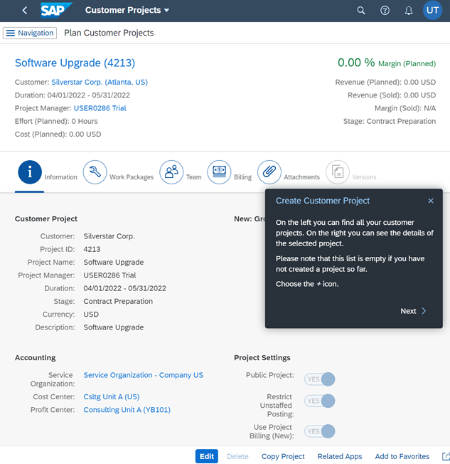
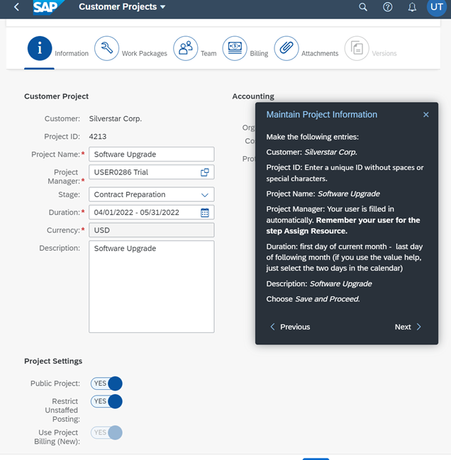
Plan your Project

Slide 5
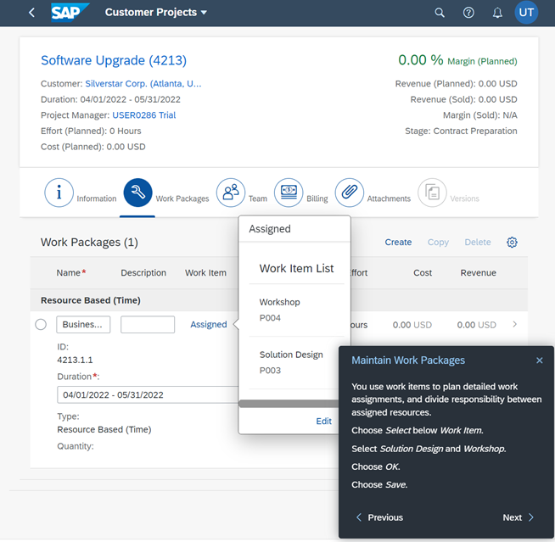
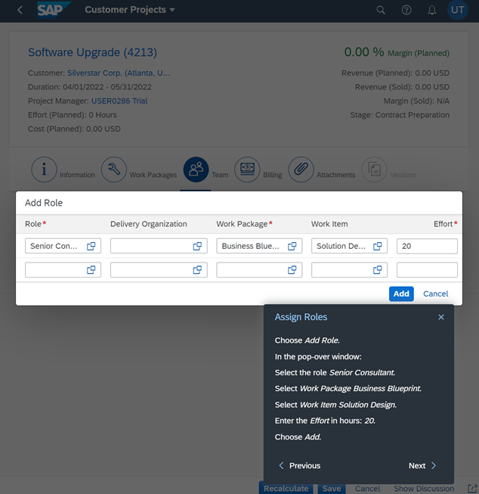
Plan your Project

Slide 6
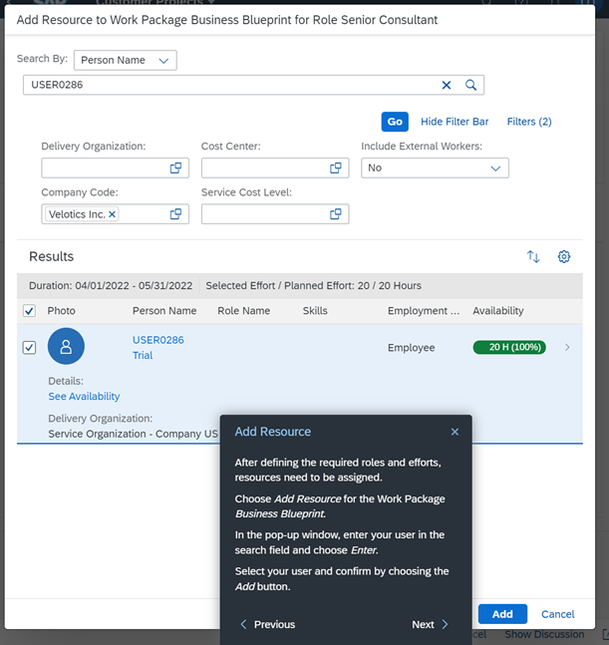
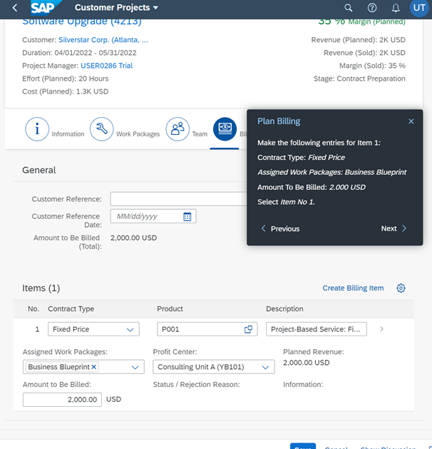
Plan your Project

Slide 7
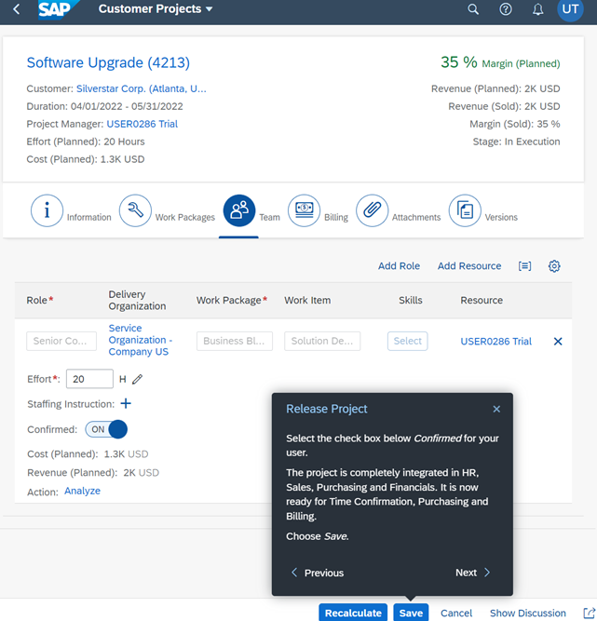
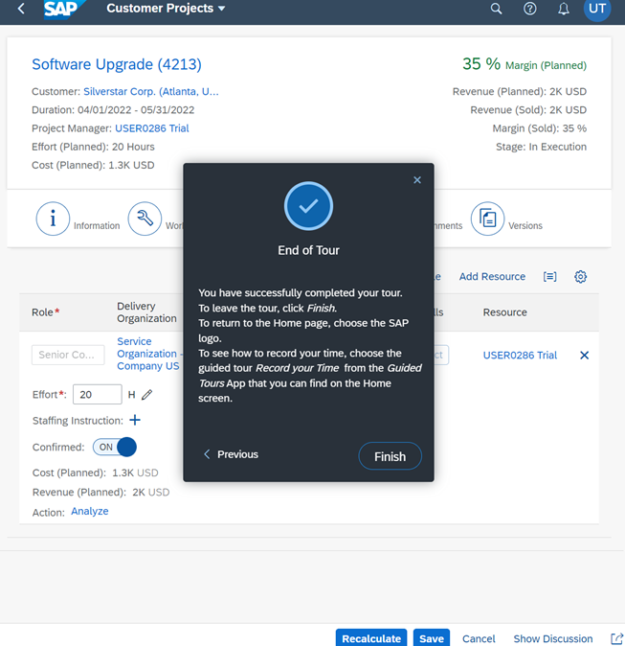
Plan your Project

Slide 8
Record your Time

Slide 9
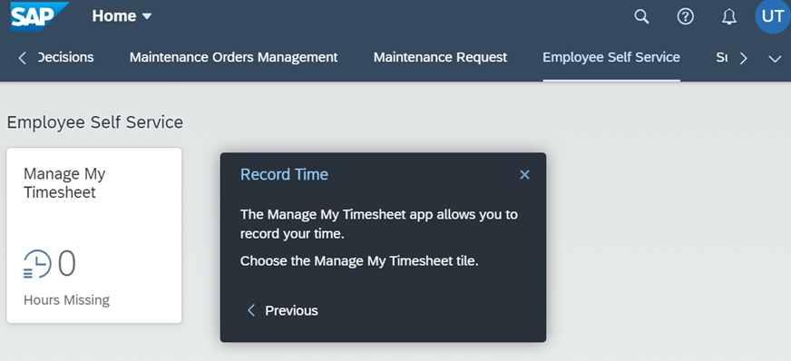
Record your Time

Slide 10
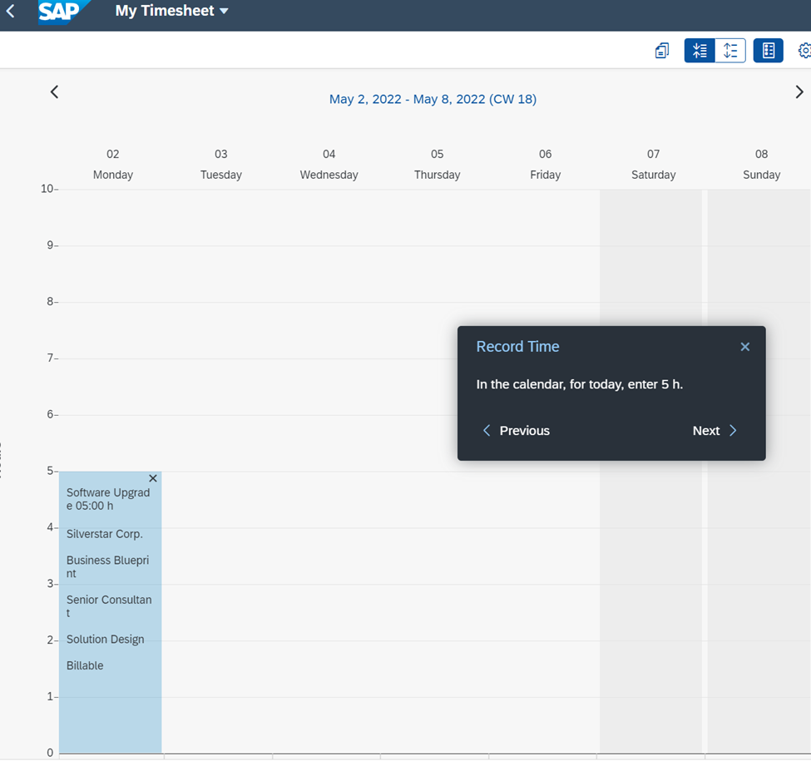
Record your Time

Slide 11
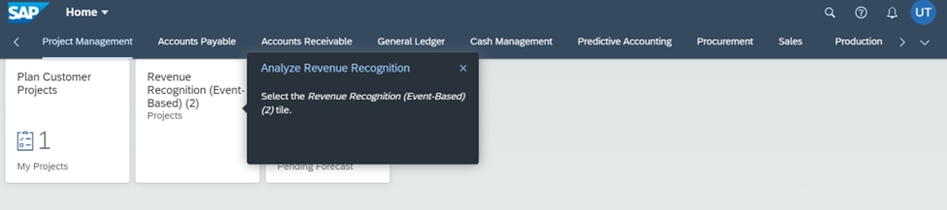
Record your Time

Slide 12
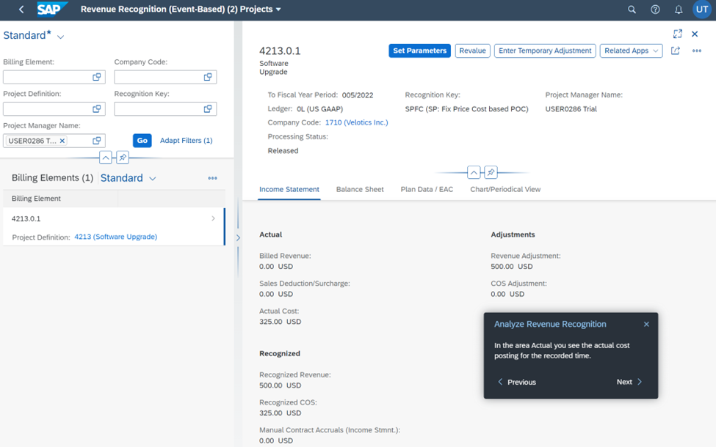
Record your Time

Slide 13
Analyze existing Project

Slide 14
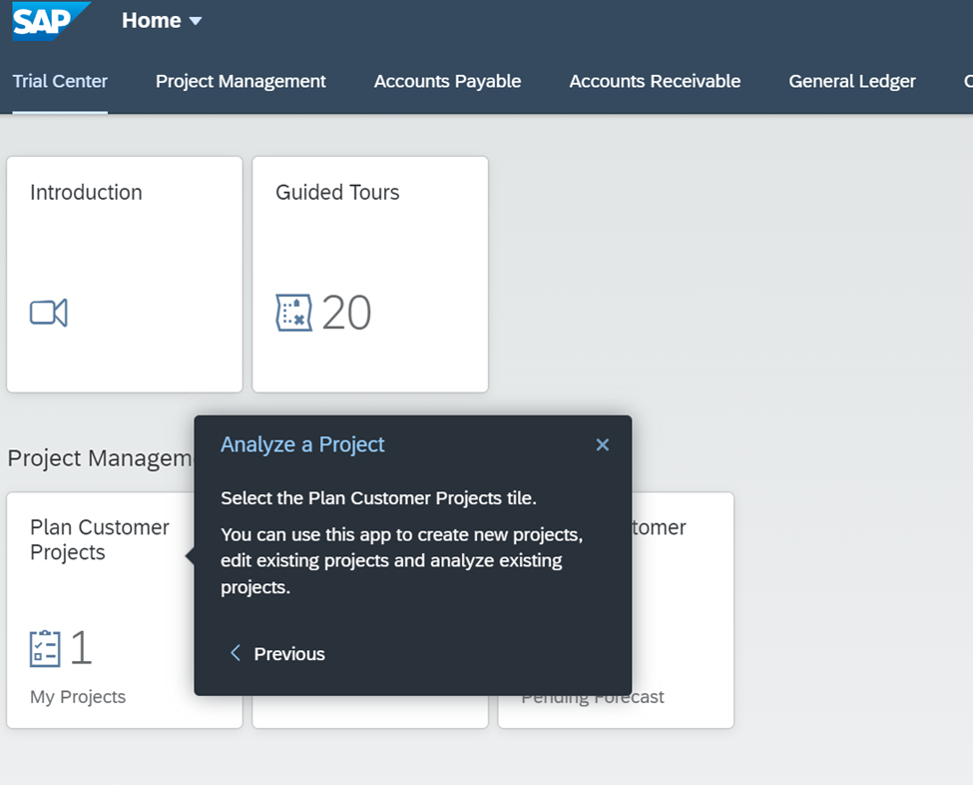
Analyze existing Project

Slide 15
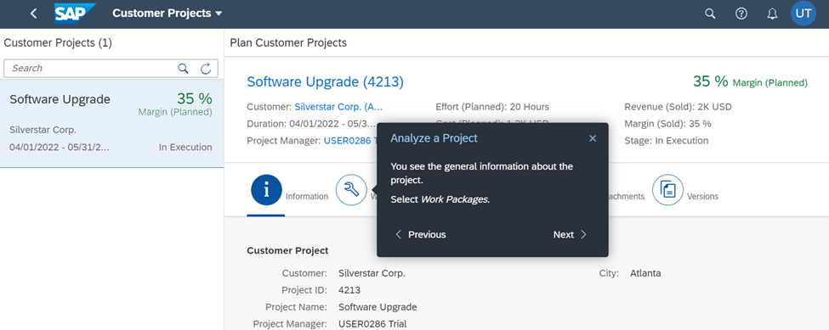
Analyze existing Project

Slide 16
Use-Case and Class Diagrams

Slide 17
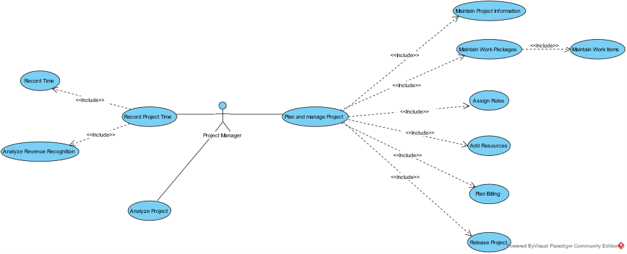
Use-Case Diagram

Slide 18
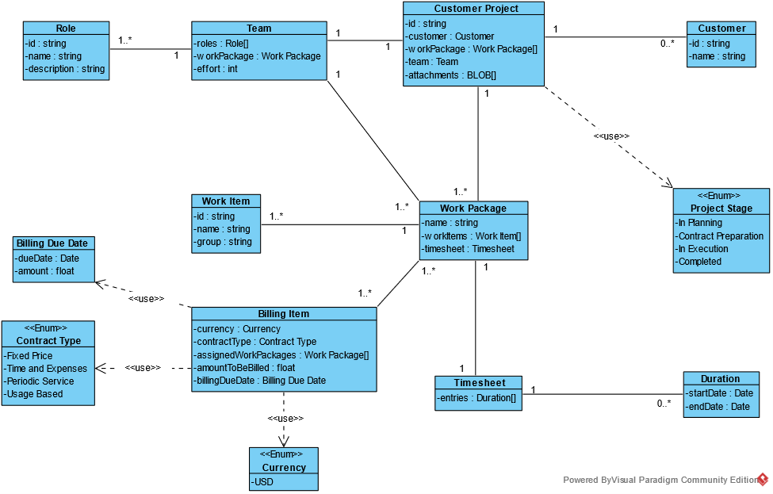
Class Diagram

Slide 19
Спасибо за внимание

