Slide 1




Mamdanistan breakout
A text adventure

Slide 2
Concept
Player wakes up in NYC
Gotta find way home
Some choices lead to player not getting home
  > being nice gets rewarded

Slide 3

Live Demo

Slide 4
Code Highlight
Your list (or other data structure) storing scenes, choices, or items.
One conditional that decides an outcome.
The loop driving your repeated scene structure.
One call to one of your functions.

Slide 5
Struggle
Understanding tables

Slide 6
Version 2
charmbracelet/bubbletea
Only gum: better css

Slide 7
Learnings
Lua
  Tables
  IO operations
  os.execute
Gum
  Styled Terminal output

Slide 8

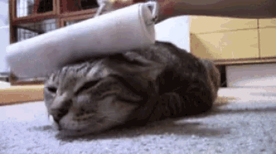
Thank Yoouuu ᜊ( ' ⩊ '𖦹)ᜊ
Questions ??

