Slide 1
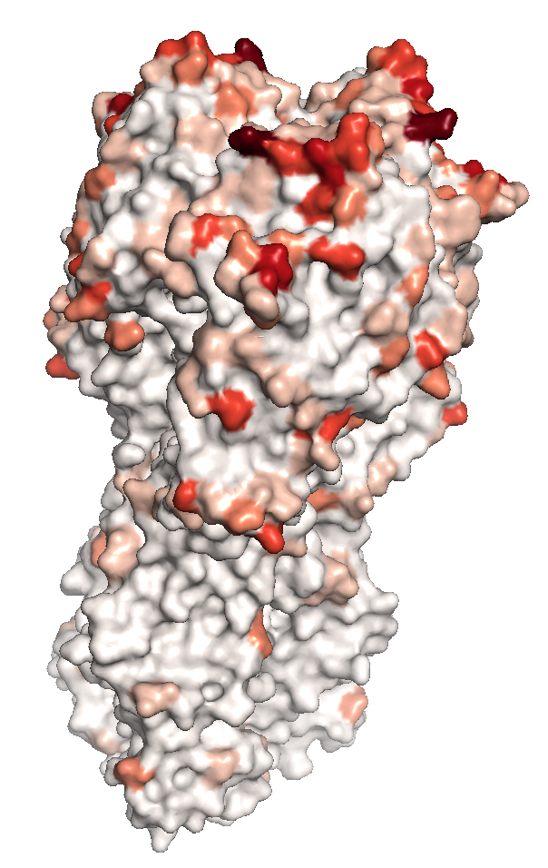
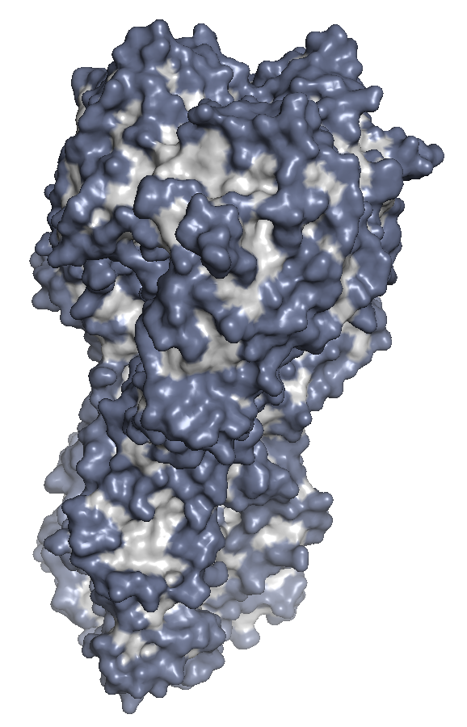
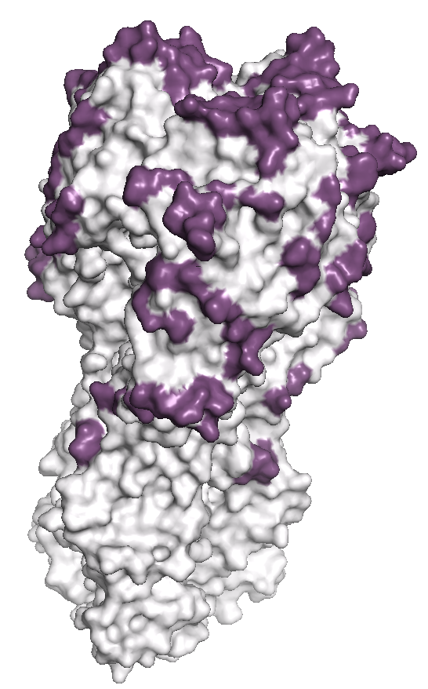
Fixations or near-fixations per codon
Surface-exposed residues
Clusters of surface-exposed residues where fixations have occurred
+

