Slide 1
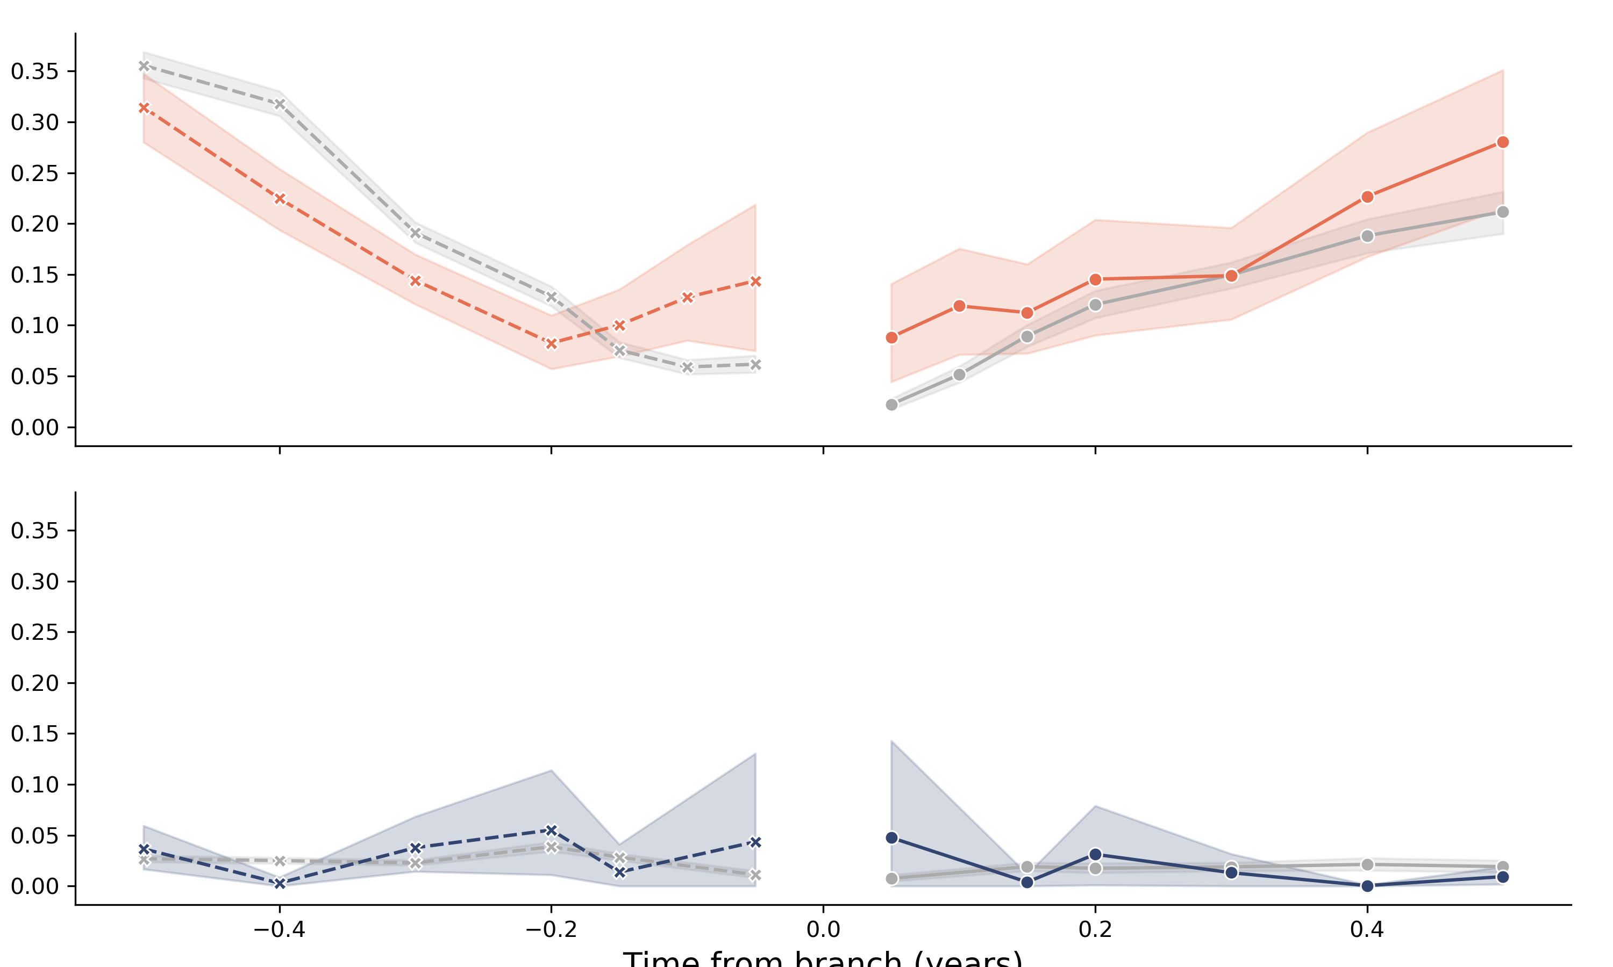
parents of branch
children of branch
Proportion of branches with
S1 mutation
Branch has S1 mutation
True
False
Proportion of branches with
Branch has RdRp mutation
True
False
RdRp mutation
Time from branch (years)

