Slide 1
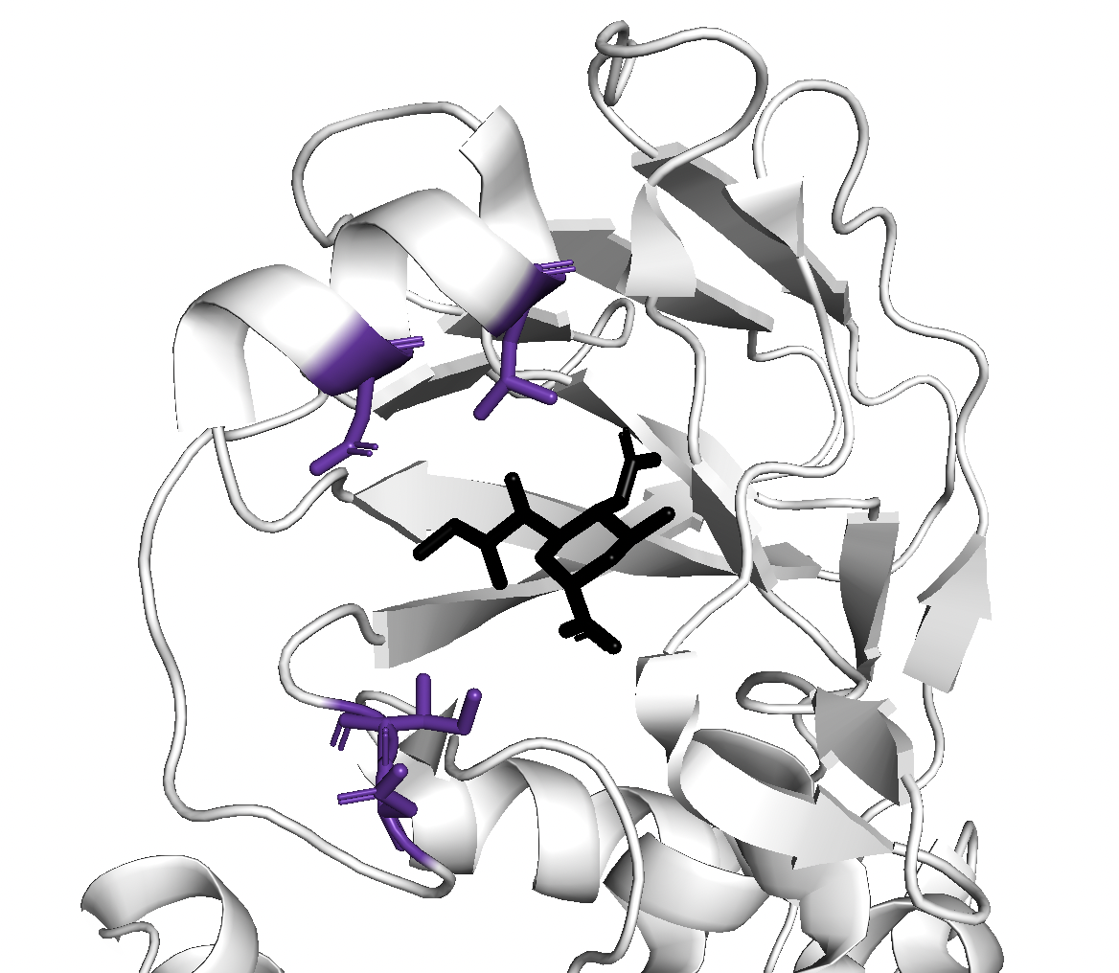
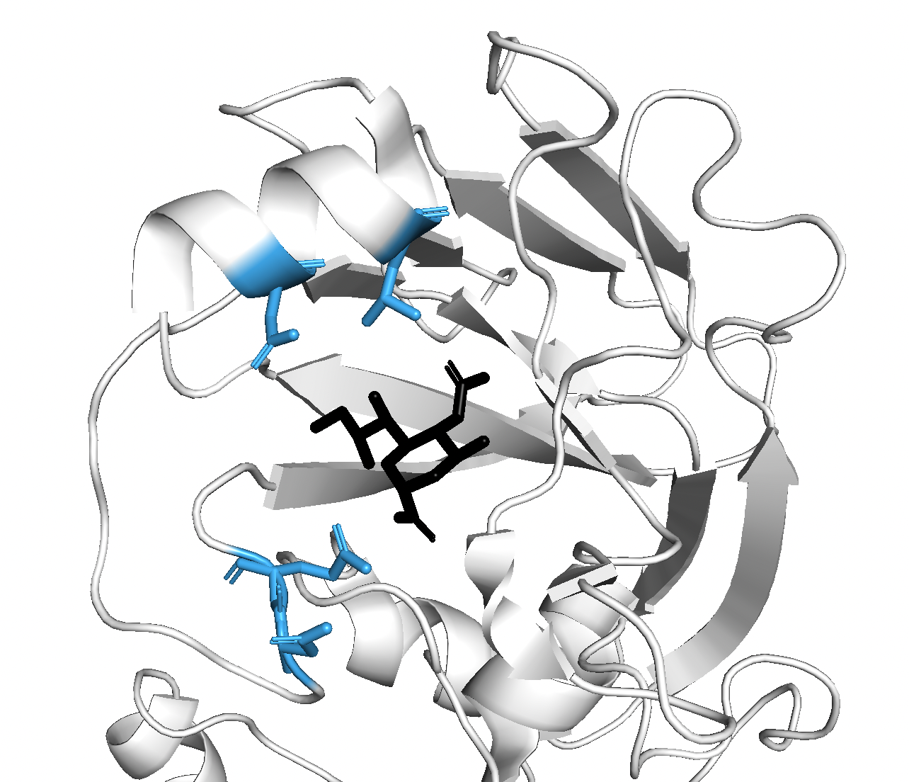
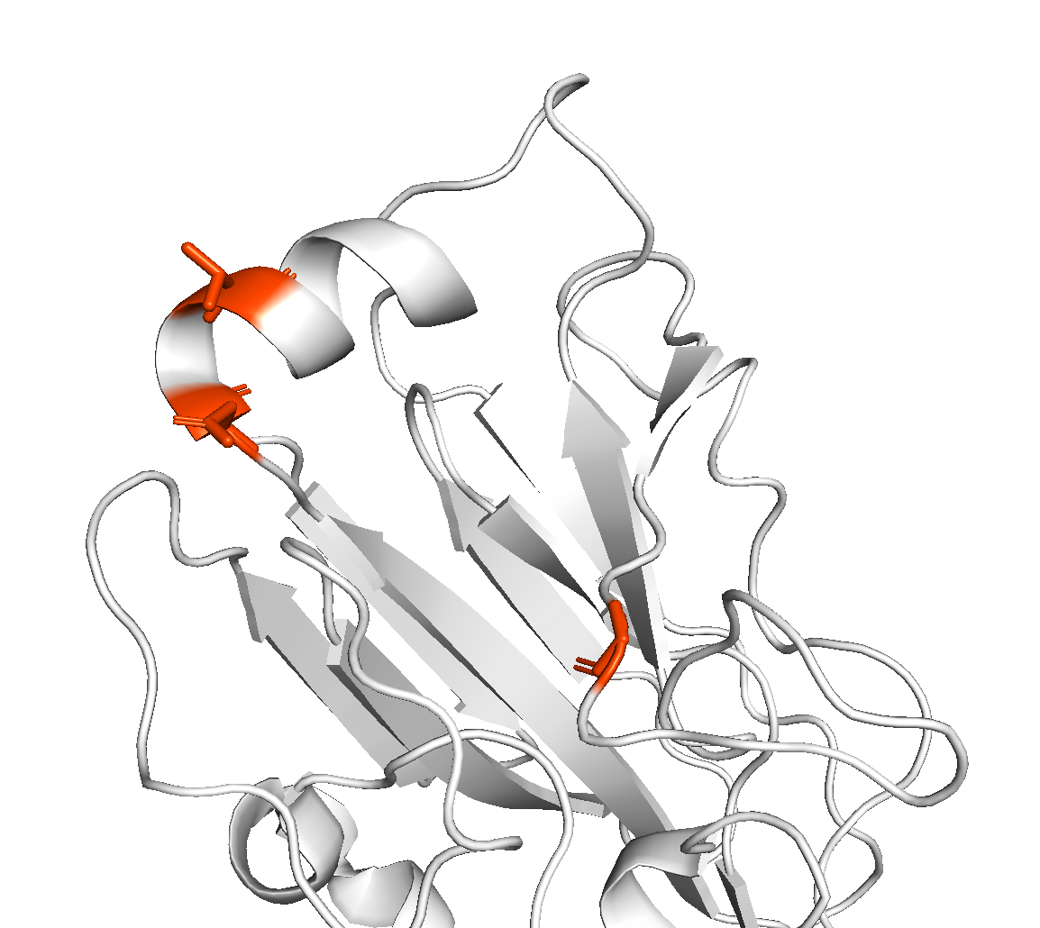
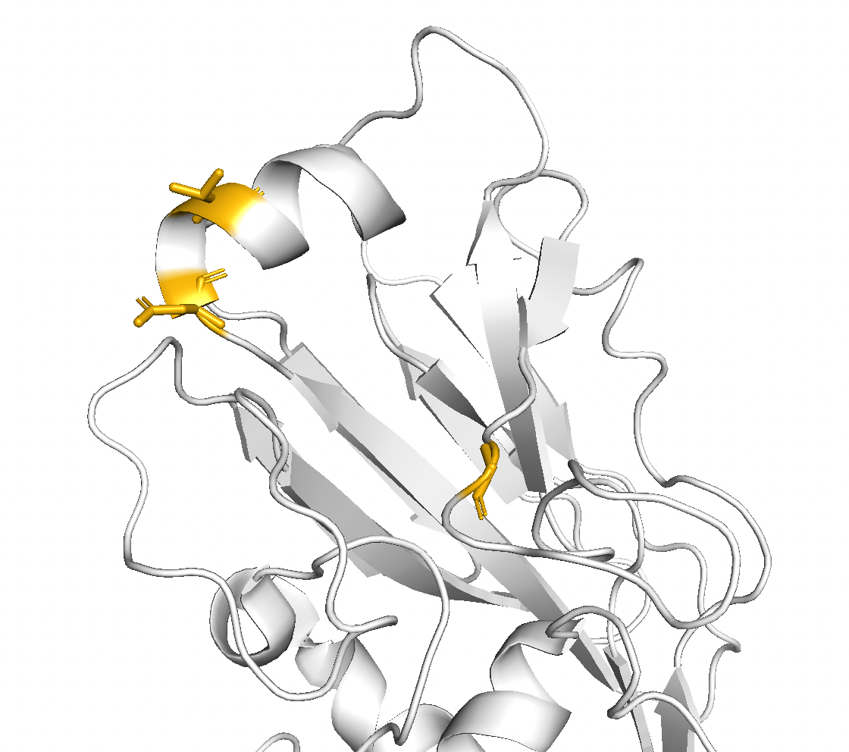
Influenza A
H1N1pdm
H3N2
Egg-adaptive aas
194
190 187 | VNG VNT
194 191 | IP I
225 222 | GN GN
226 223 | I R
191
187
190
226
223
225
222
Influenza B
Vic
Yam
198
197
Egg-adaptive aas
196
141 141 | R R
196 195 | SDKT SDK
198 197 | IAN IANP
195
141
141

