Slide 1
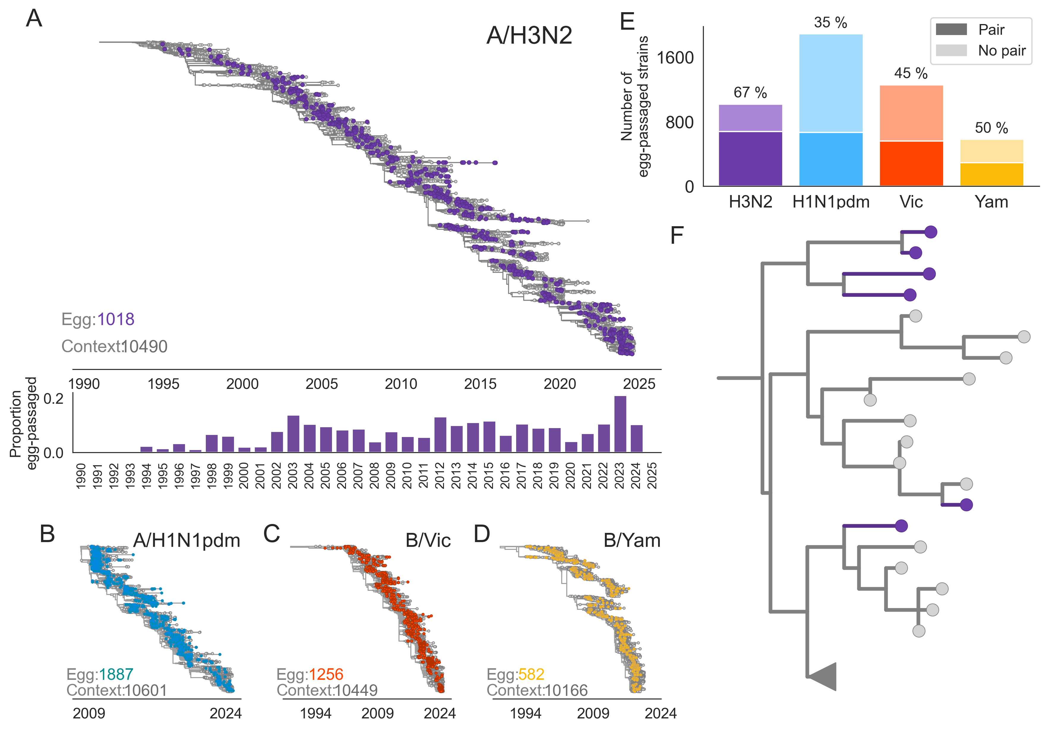

L194P
I140M
T160K
H156Q, G186V
1
H183L, D225G,
HA2: L102M
2
T160K, L194P, D225G
3
T160K, L194P
Strain Pair? Inferred egg-passaging mutations
1 No T160K, H156Q, G186V
2 Yes T160K, L194P
3 No T160K, L194P, D225G

