Slide 1
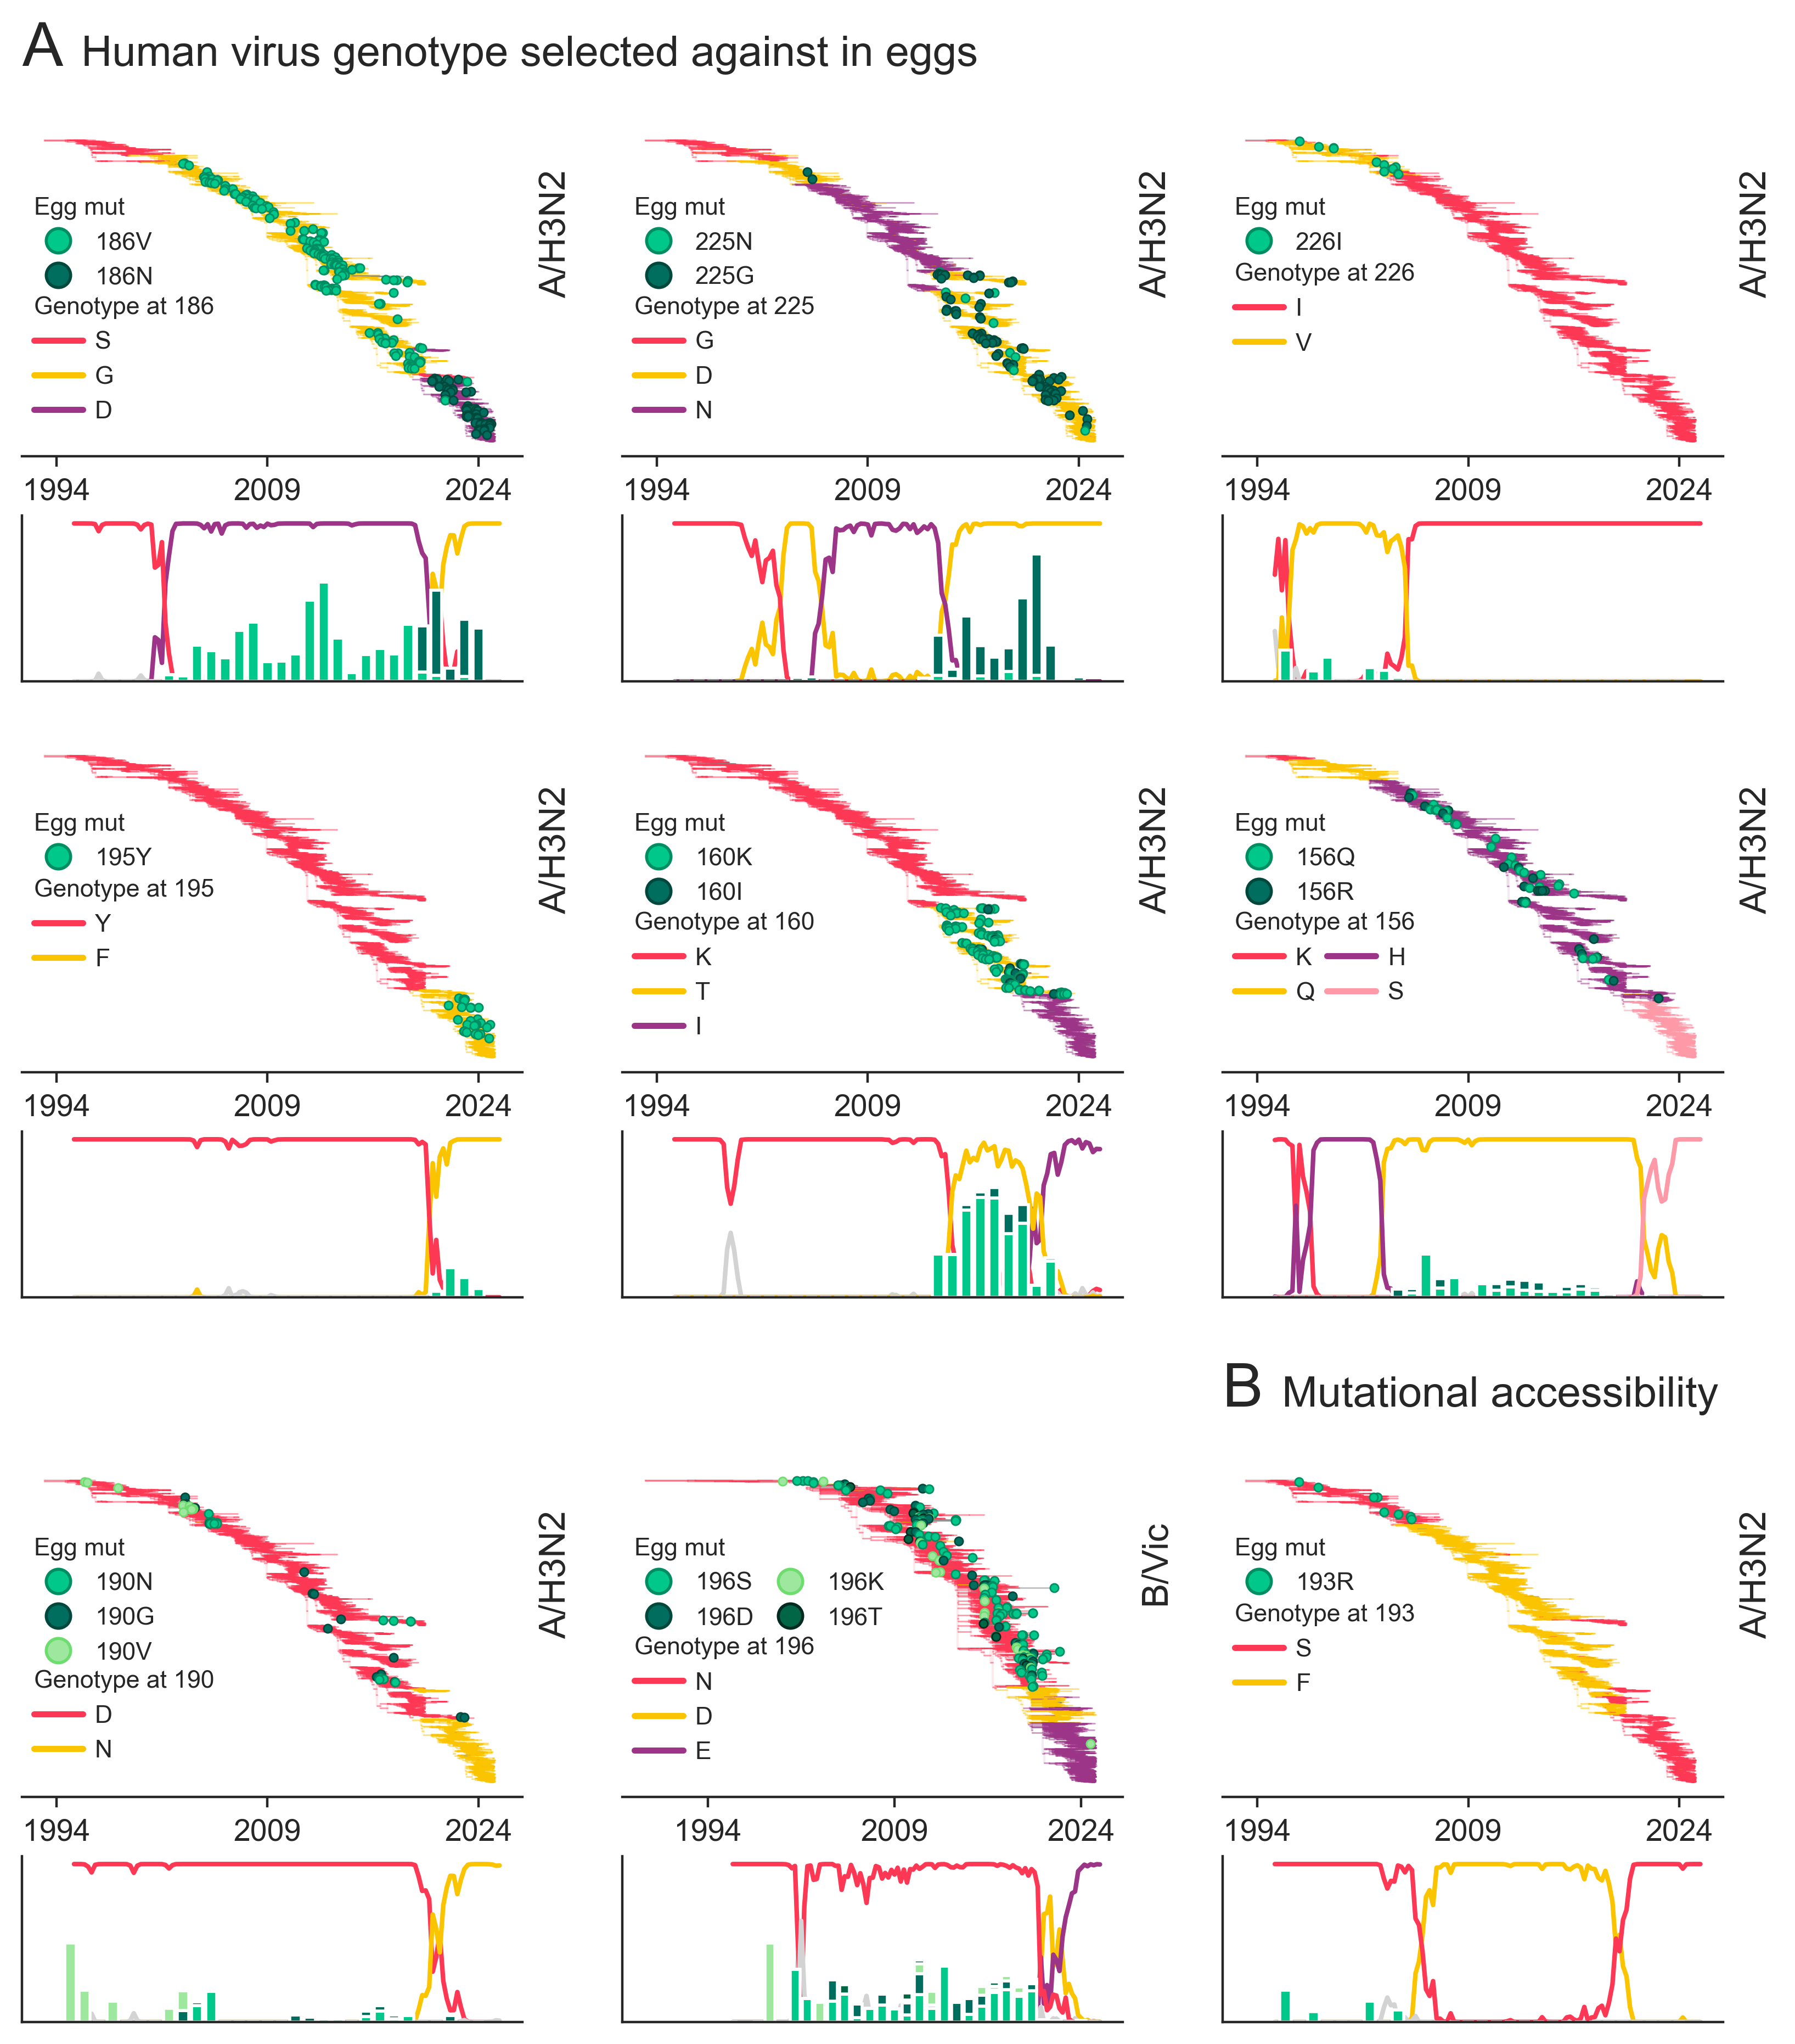
S = AGC
1 step to R
F = TTC
2 steps to R
S = TCC
2 steps to R

