Slide 1
190402 making disulfide mutant in Cal09 NA
Double mutant:
C318A, C335A

Slide 2
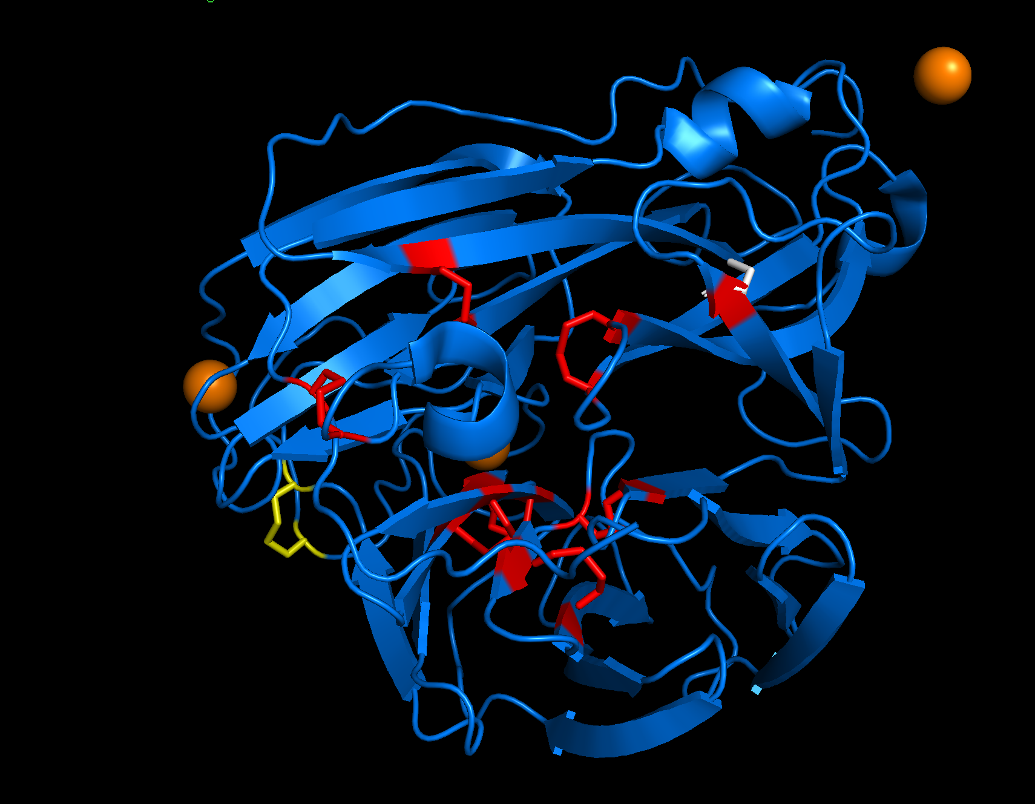
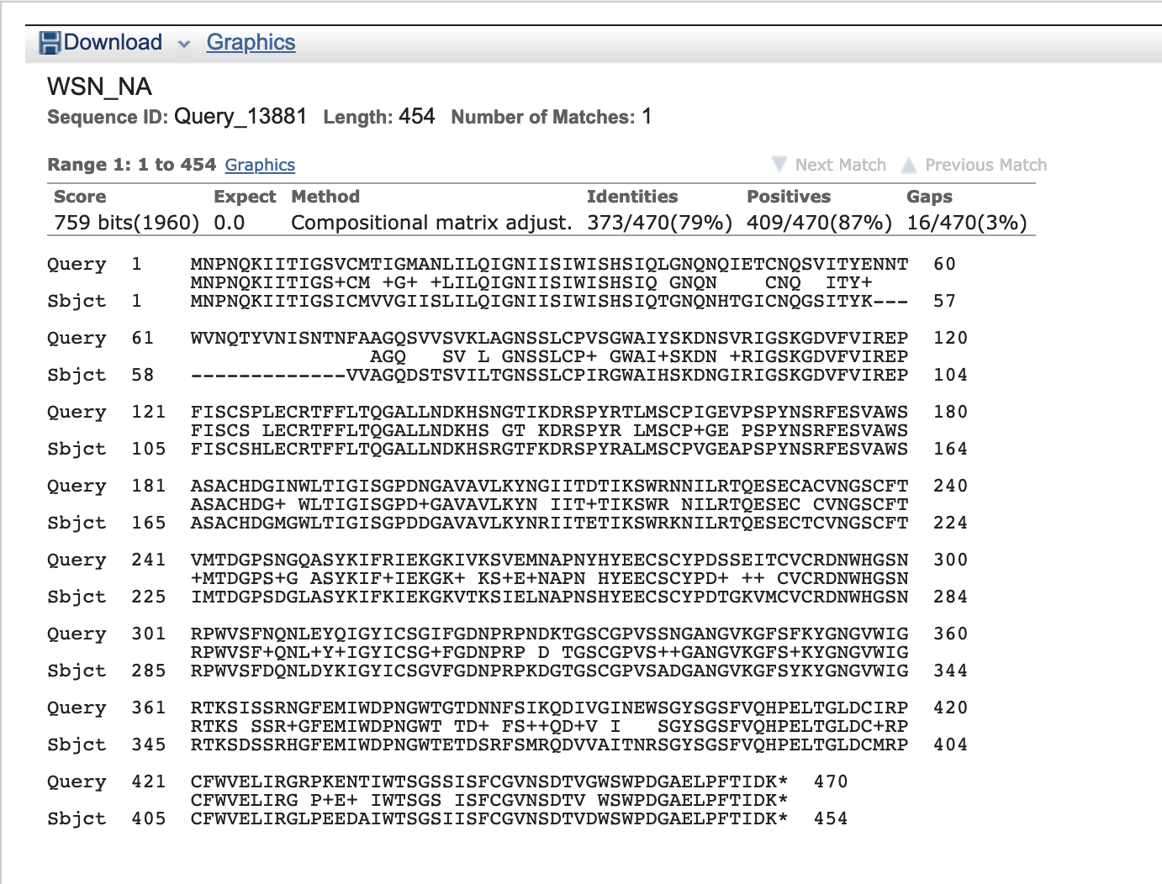
Background and overview
See this paper: https://www.ncbi.nlm.nih.gov/pmc/articles/PMC112825/
Also these:
https://www.molbiolcell.org/doi/full/10.1091/mbc.e07-12-1282
https://www.molbiolcell.org/doi/full/10.1091/mbc.e08-07-0670

Slide 4
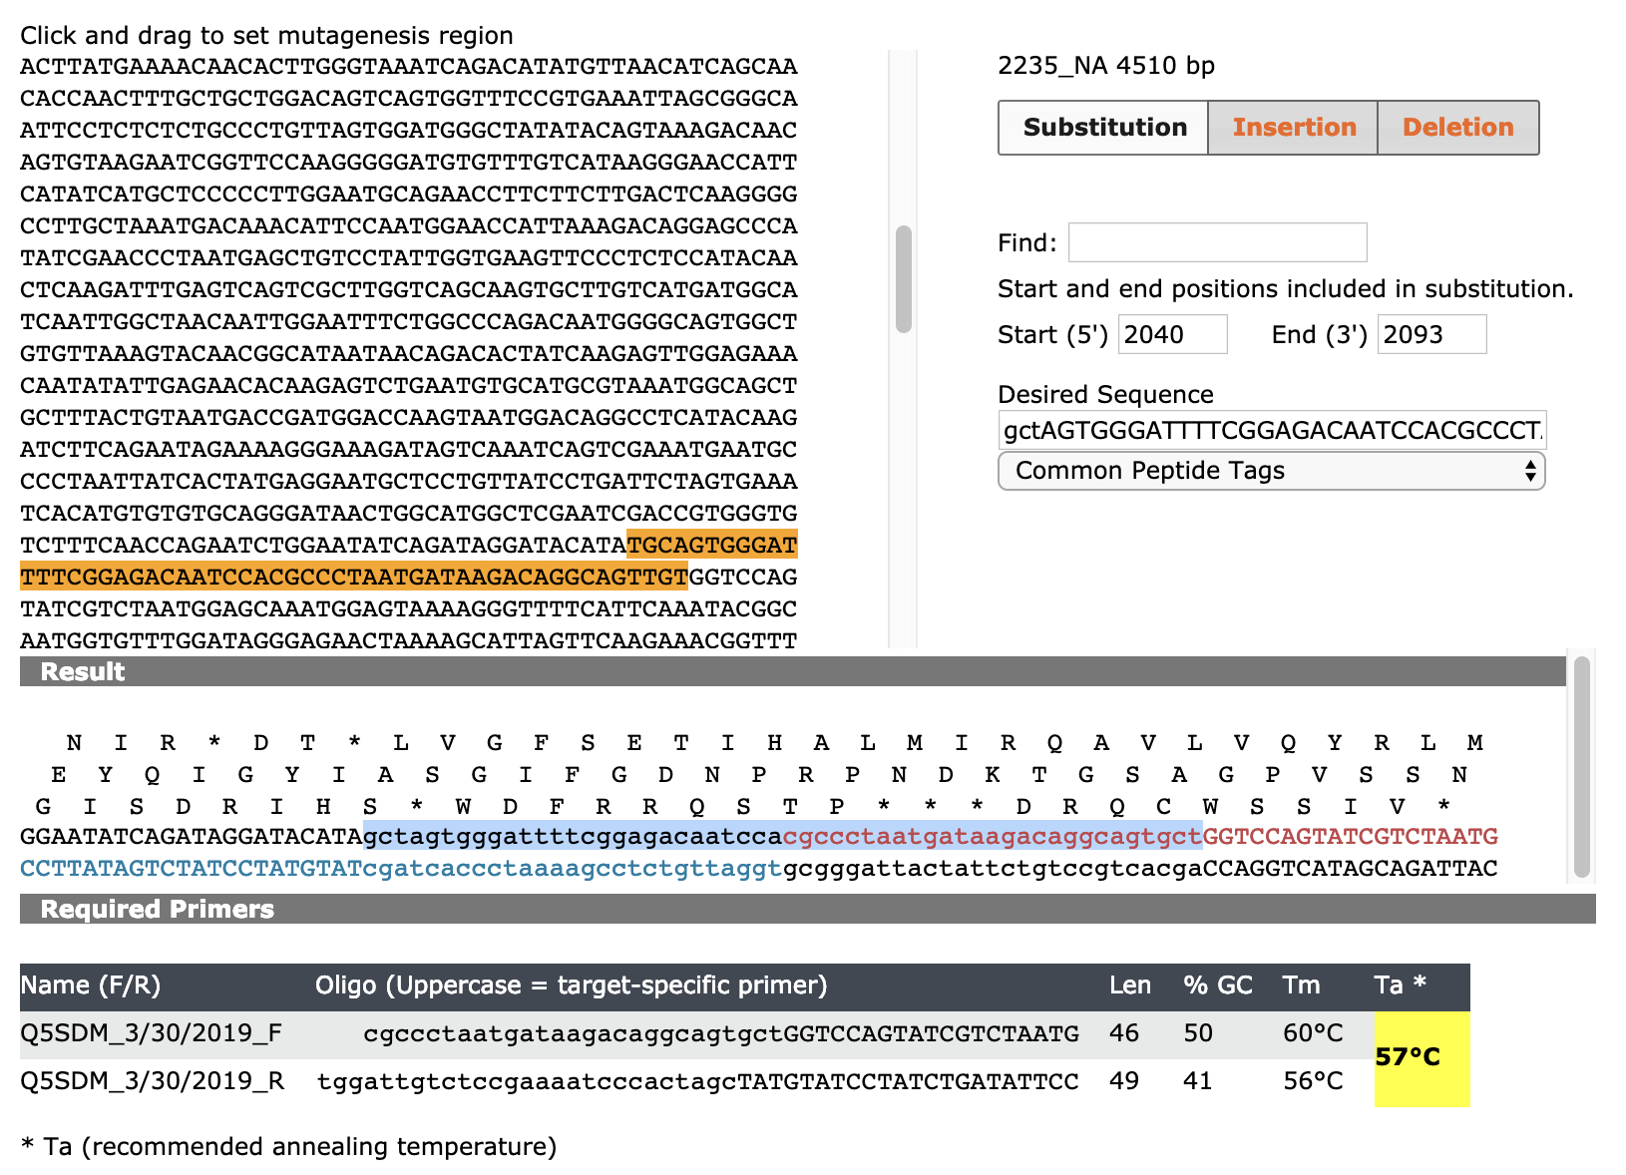
NEBaseChanger
Name (F/R) | Oligo (Uppercase = target-specific primer) | Len | % GC | Tm | Ta *
Q5SDM_3/30/2019_F | cgccctaatgataagacaggcagtgctGGTCCAGTATCGTCTAATG | 46 | 50 | 60°C | 57°C
Q5SDM_3/30/2019_R | tggattgtctccgaaaatcccactagcTATGTATCCTATCTGATATTCC | 49 | 41 | 56°C

Slide 5
190401: PCR for Q5 SDM with primers AG_96 and AG_97
P2235 is the template, at 1ng/uL, used 1uL = 1ng
Primers = AG96 and AG97
After PCR, ran 1uL on gel to confirm that there is product of desired size
190403: Picked 8 colonies
There were a lot of colonies on the plate! Even the 5uL plate had a lot of colonies!
Grew O/N in LB-Amp, 5mL
190404: Miniprepped and sent for sequencing
With primer AG_38
Clones 4 and 8 look good → chose clone 4 to be the real/permanent p2391 clone!
190408
Miniprepped and made glycerol stocks of clone 4!
Reagent | Vol. (uL)
Water | 9
F primer (10 uM) | 1.25
R primer (10 uM) | 1.25
1 ng DNA (2235) | 1
KOD 2x MM | 12.5
Total | 25
Step | 20-30s/kb
Pol activation | 98C for 30s
- Denature | 98C for 10s
- Anneal | 57C for 30s
- Extend | 72C for 2.5 min
Repeat | 25 cycles
Final extend | 5 min
190402: Step 2 = KLD reaction
Incubate for >5 minutes at room temperature
Reagent | Vol. (uL)
Water | 3
2X KLD buffer | 5
10X KLD Enzyme mix | 1
PCR product | 1
Total | 10
190402: Step 3 = Transformation
Add 5uL of KLD mix to 50uL of chemically competent cells
Incubate on ice for 30min
Heat shock at 42C for 30s
Incubate on ice for 5min
Skip outgrowth step
Spread 1:10 dilution and the remaining amount on LB-Amp plate, incubate O/N at 37C

Slide 6
Attempted reverse genetics rescue of mutant

Slide 7
33C:
No NA
2235
2391
No NA + 208
2235 + 208
2391 + 208
37C:
No NA
2235
2391
No NA + 208
2235 + 208
2391 + 208
190408: Plated cells
Plated 4e5 293T + 5e4 MDCK-SIAT1-TMPRSS2 cells in each well of 2x 6-well plate
Finished plating at 7:30pm
190409: Transfection (see right)
Finished transfections at 12:30pm
Will move one plate to 33C incubator ASAP
Harvested virus at 70hpt.

Slide 8
190412: set up TCID50
190412:
Set up TCID50; made sure to keep things separated according to temperature (33C viruses will be titered at 33, etc)
190415: Screened TCID50
The cells didn’t grow nearly as well at 33C, so it is difficult to score these plates. I will let them grow for another day or two, but will look at some preliminary data in the meantime.
37C plates were easy to score and the disulfide mutant didn’t fare as badly as I thought it would…
Retitered the 33C plates at 5d post-set up (bottom graph). The titers went up quite a bit at 33C by day 5.

Slide 9
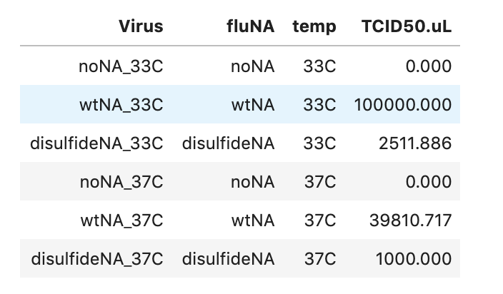
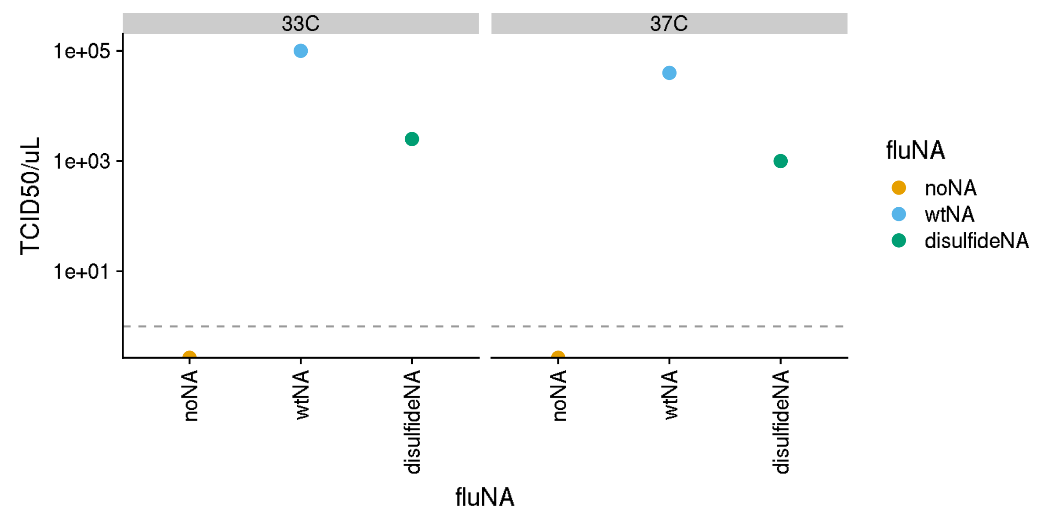
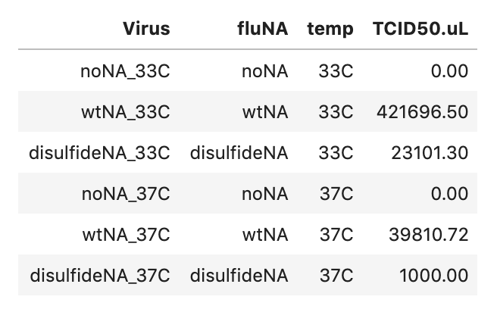
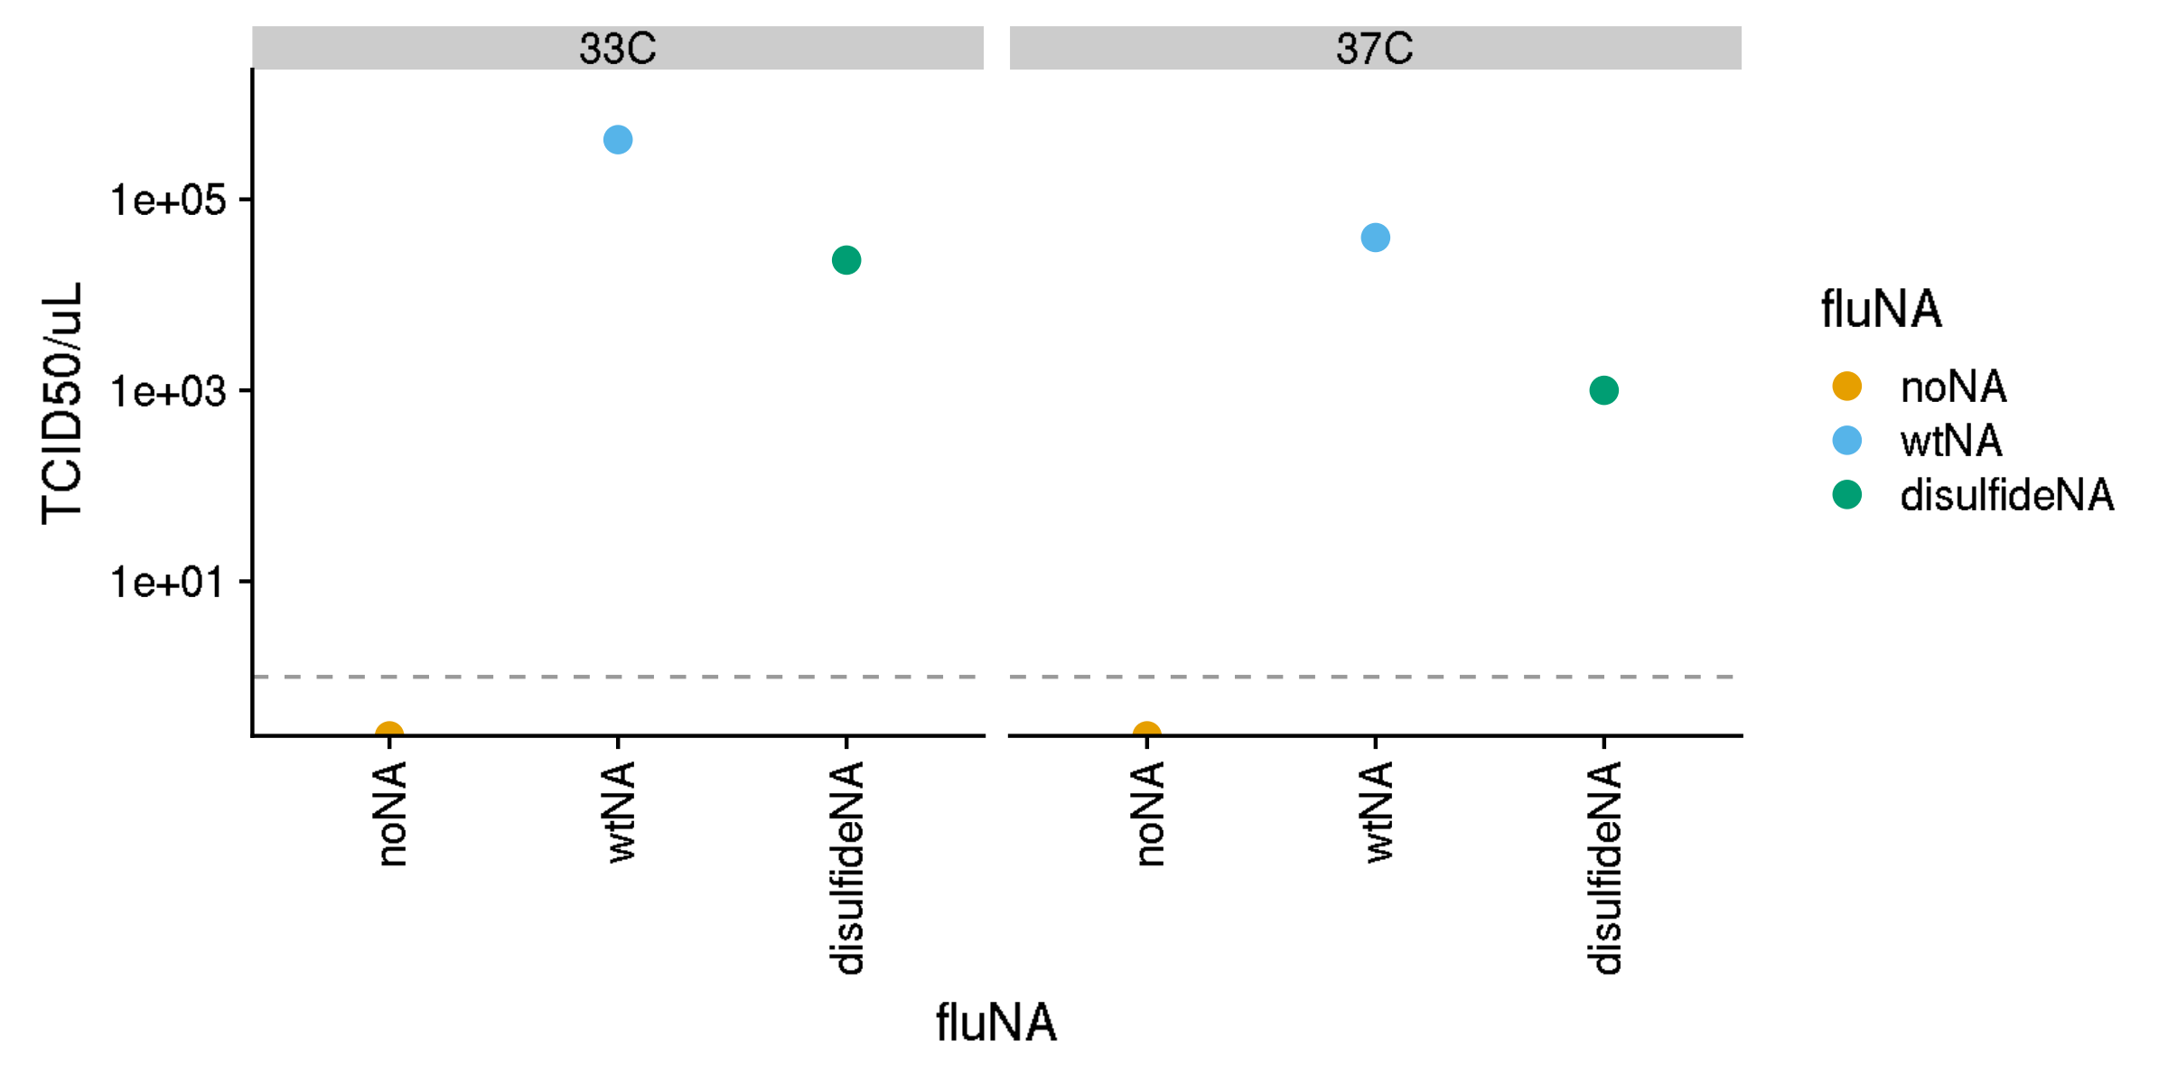
TCID50 of transfection sups
Screened at 72 hours
Screened at 72 hours
Screened at 120 hours
Screened at 120 hours

Slide 10
Passage viruses for growth curve at 33C and 37C (MOI 0.01)
190415:
3pm: plate MDCK-SIAT1-TMPRSS2 cells and 6e5 cells per well in 2mL D10 in 6well plate
I will do this in triplicate, so I need 2 6 well plates
Approx 3h later, infect at MOI 0.01 (that is, 6e3 IP/well)
First, dilute all viruses 1:10 by adding 100uL virus + 900 uL IGM
Then add the required amount (see spreadsheet) to 20mL IGM
Aspirate off D10. Probably don’t need to wash with PBS
Add 3mL of this virus mixture to cells
Save 0hpt aliquots for tittering
Took 2x150uL aliquots at 24hpi (6:30pm on Tuesday), 41hpi (11am Wednesday), and 72hpi (6pm Thursday)
No CPE visible at 24h
At 41hpi, the 37C cells (WT and mut) were totally shredded. There was very little CPE observed at 33C at this timepoint.
Cells were all totally shredded at 72h
190419: Set up 24 plates of TCID50s! That was 40 samples! That was a lot!
I didn’t have enough MDCK-SIAT1-TMPRSS2 cells, so I only plated cells at half the usual density (5e5 cells/mL, 50uL/well = 2.5e4/well)
190422: Screened TCID50s
Worked quite well – I should always use half the amount of cells!

Slide 11
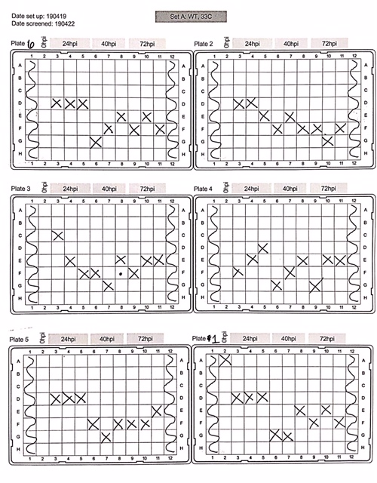
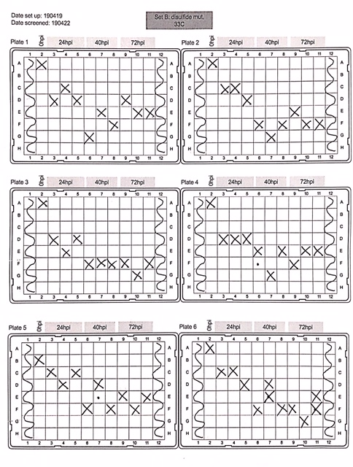

Slide 12
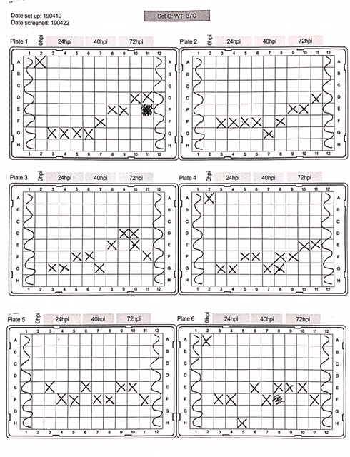
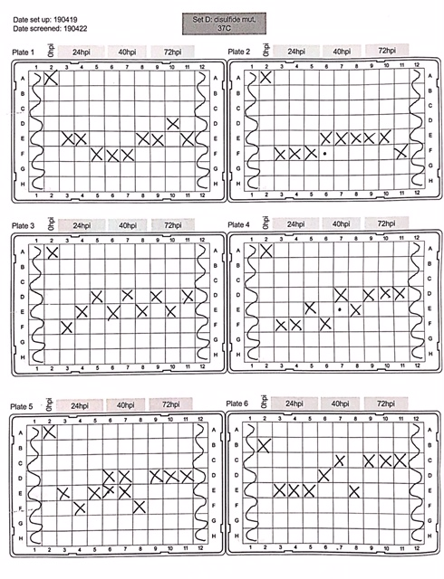

Slide 13
Raw data for p1 tcid50

Slide 14
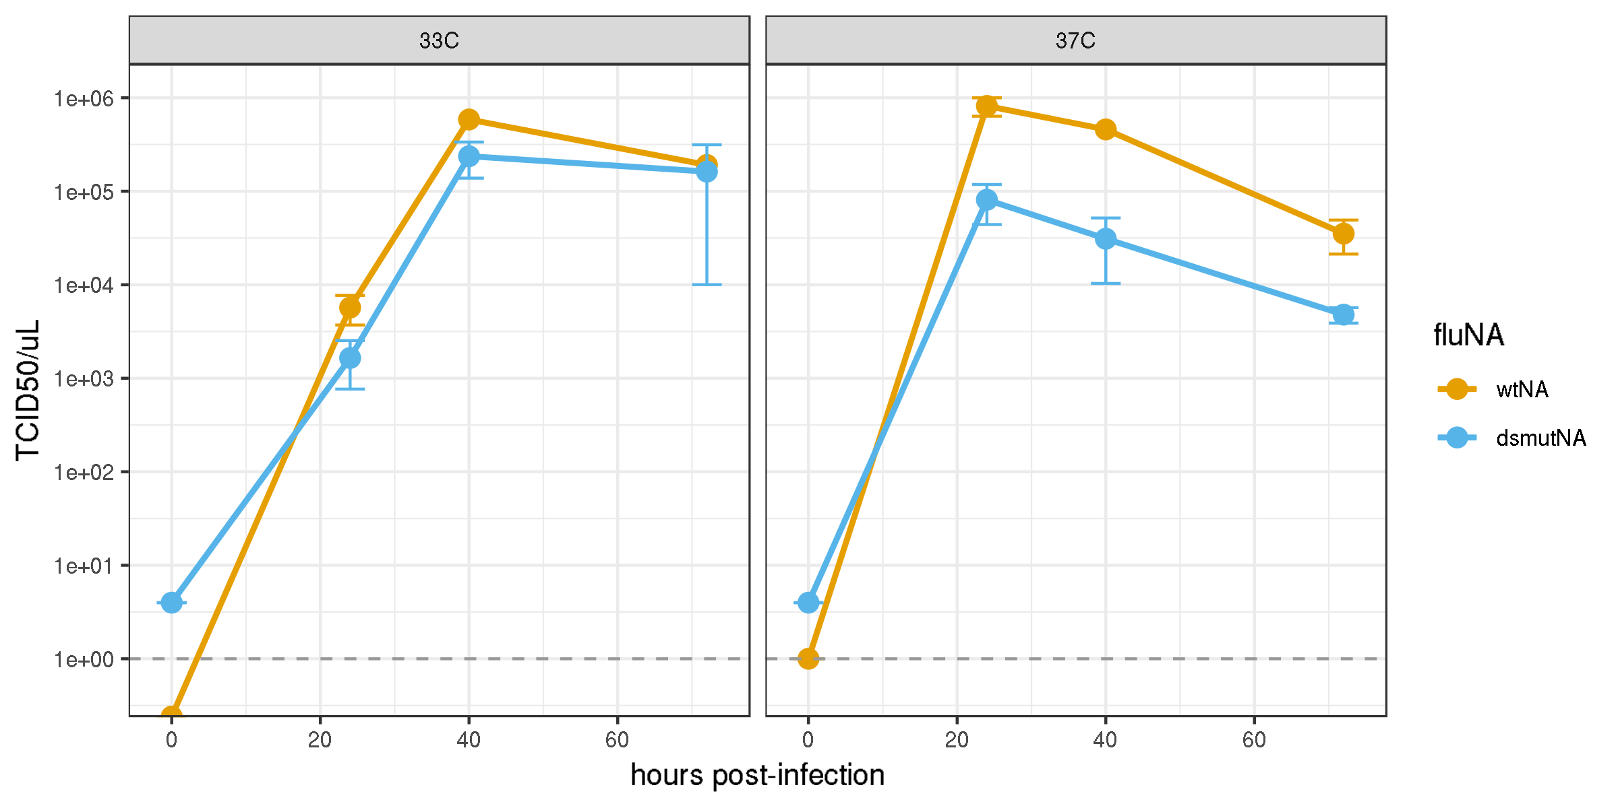
Mean and 95% CI (n=3)

Slide 15
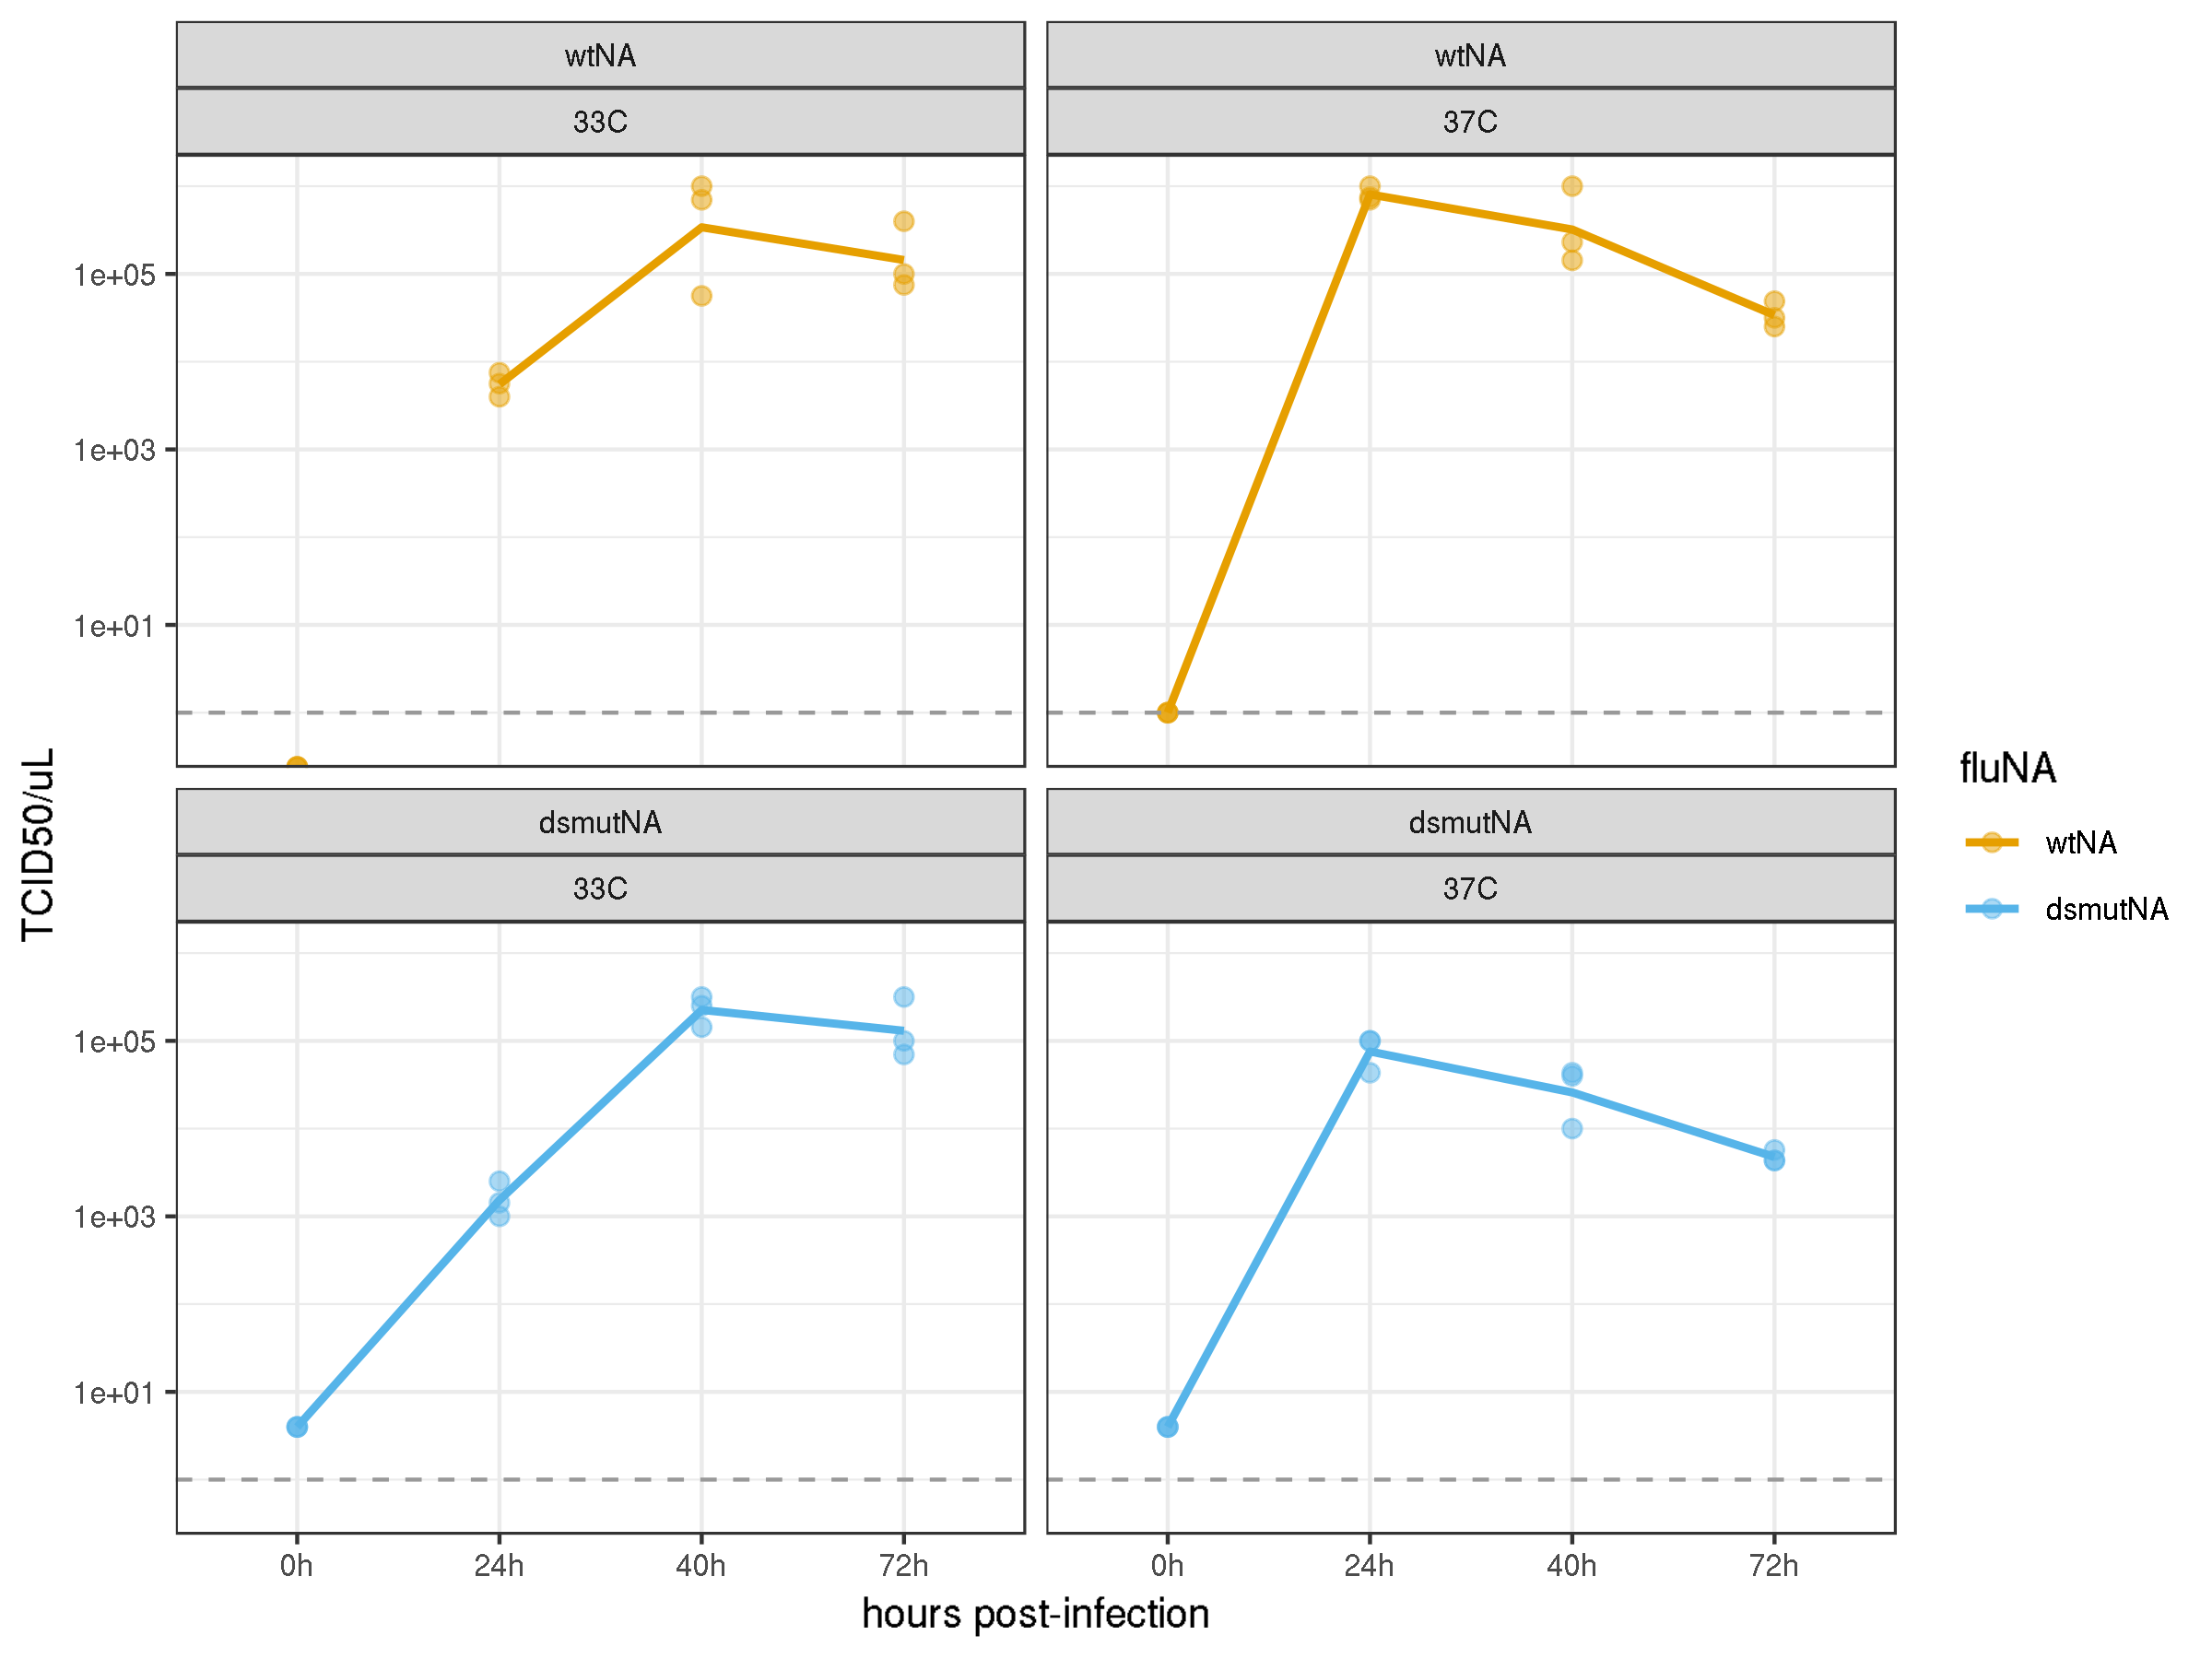
Individual points for 3 replicates and means.

