Slide 1
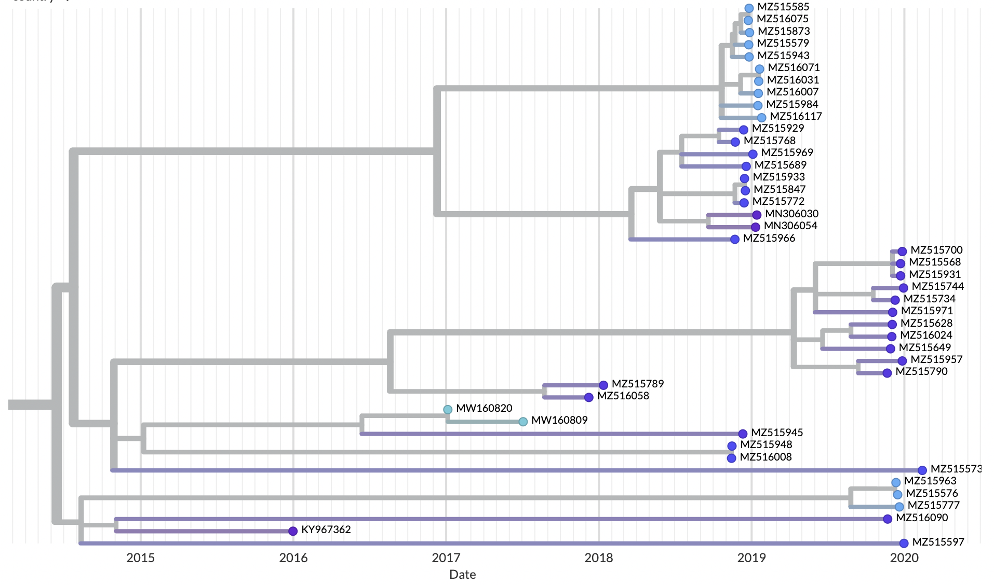
= large insertion at C-terminal end of G gene
= reversion -> insertion
= reversion of insertion
= no insertion

