Slide 1
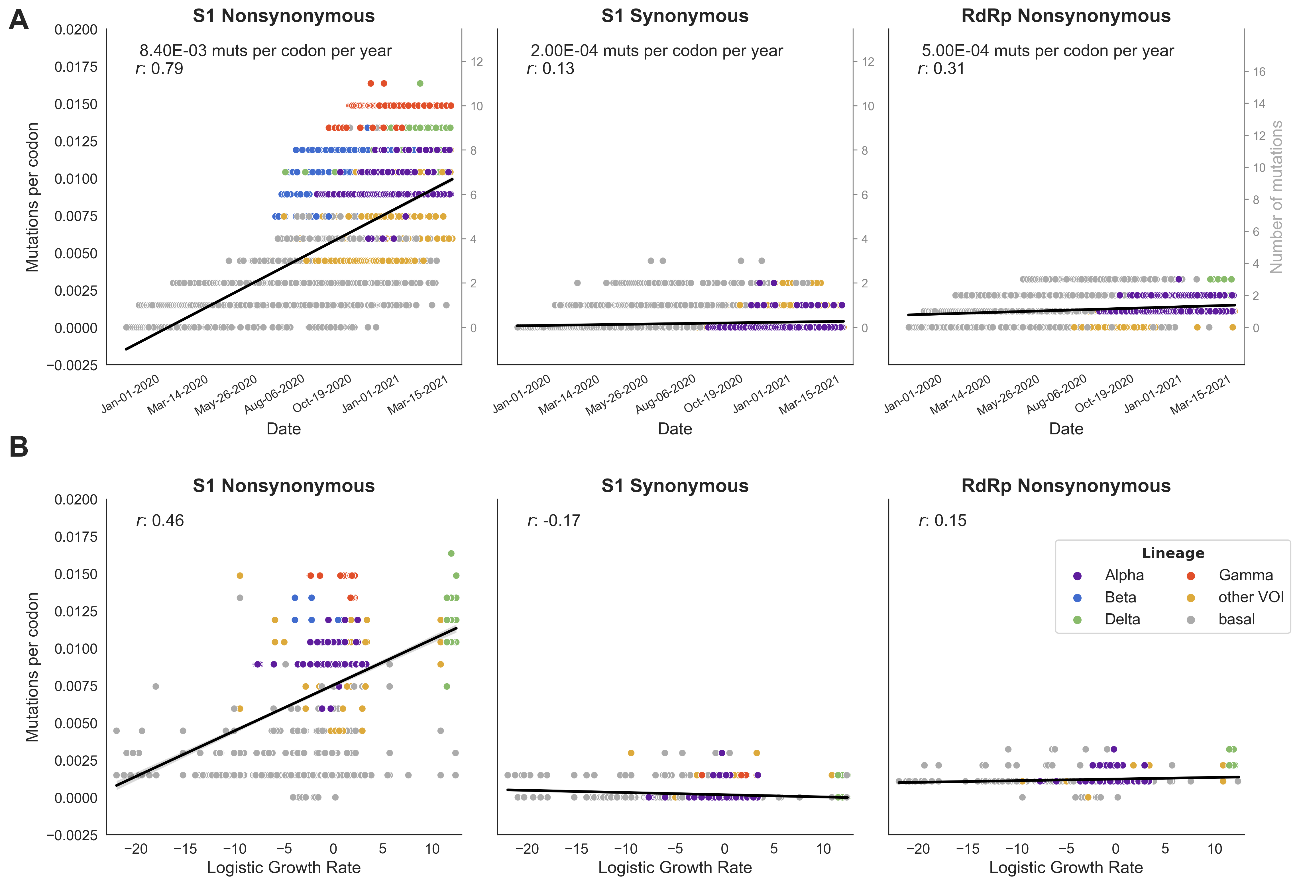
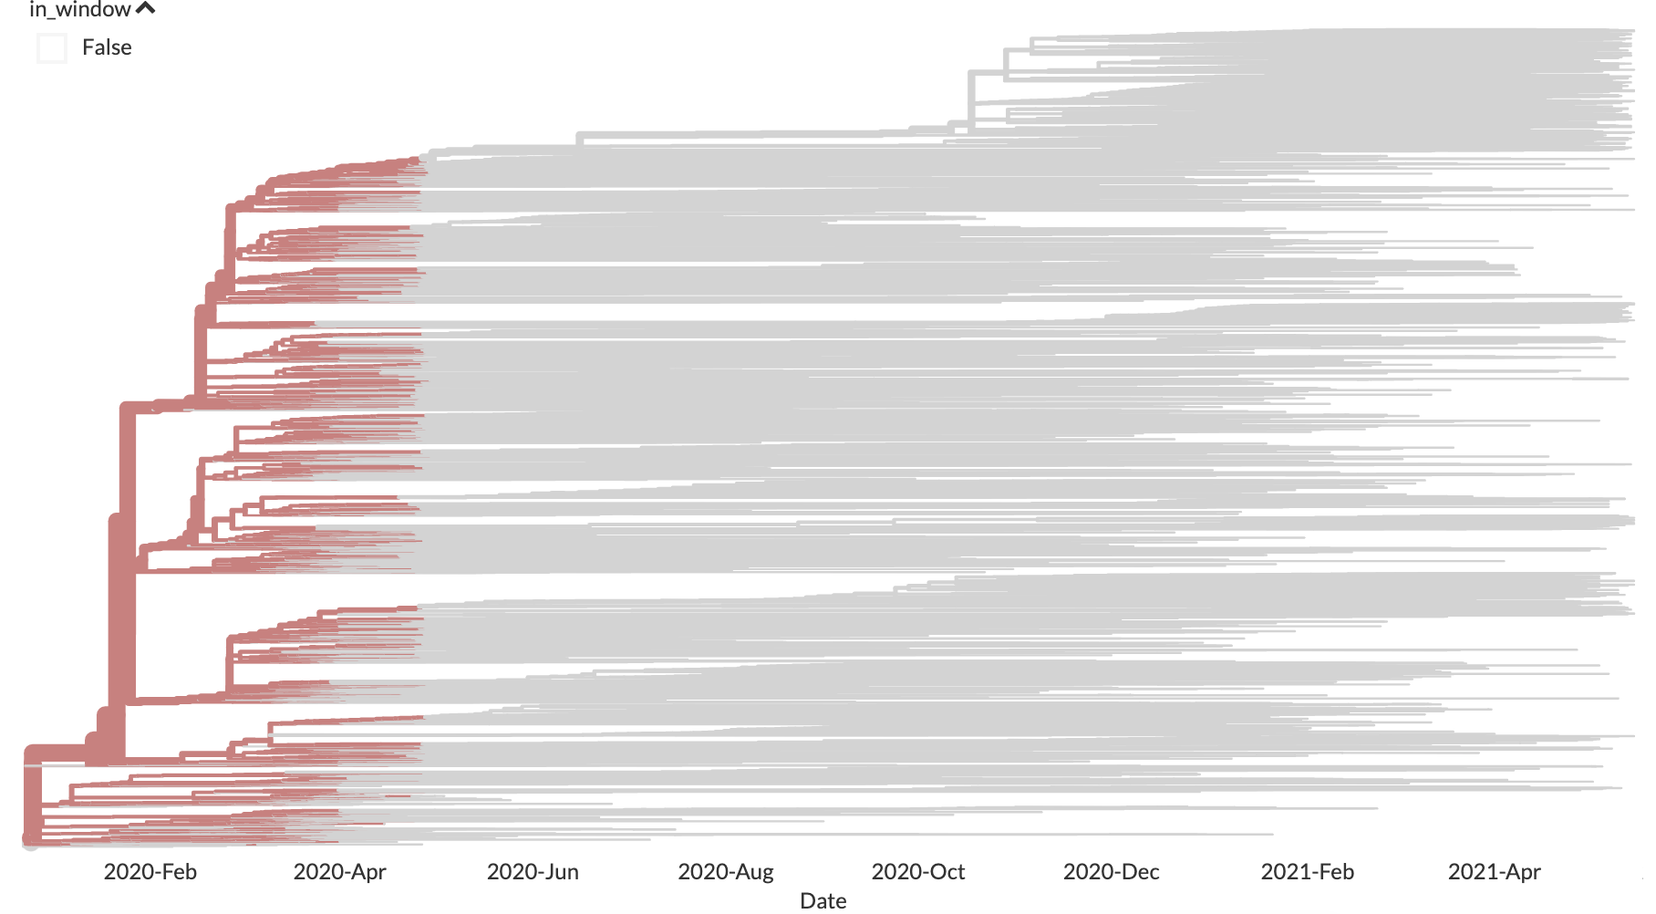
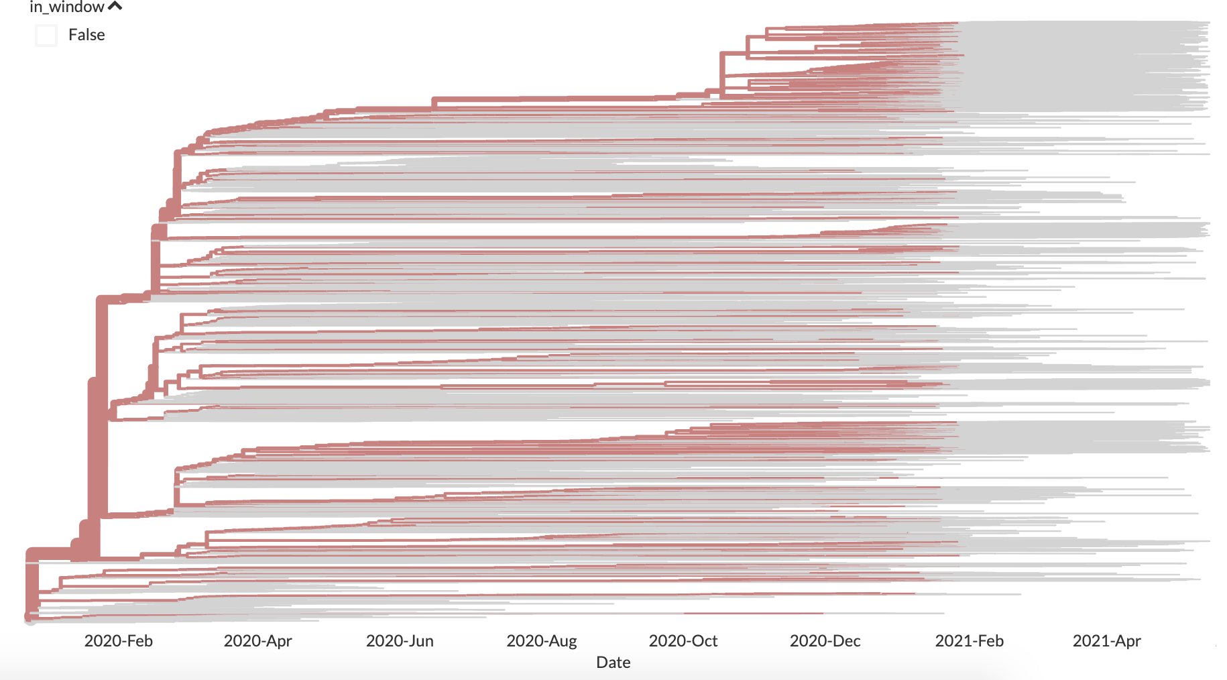
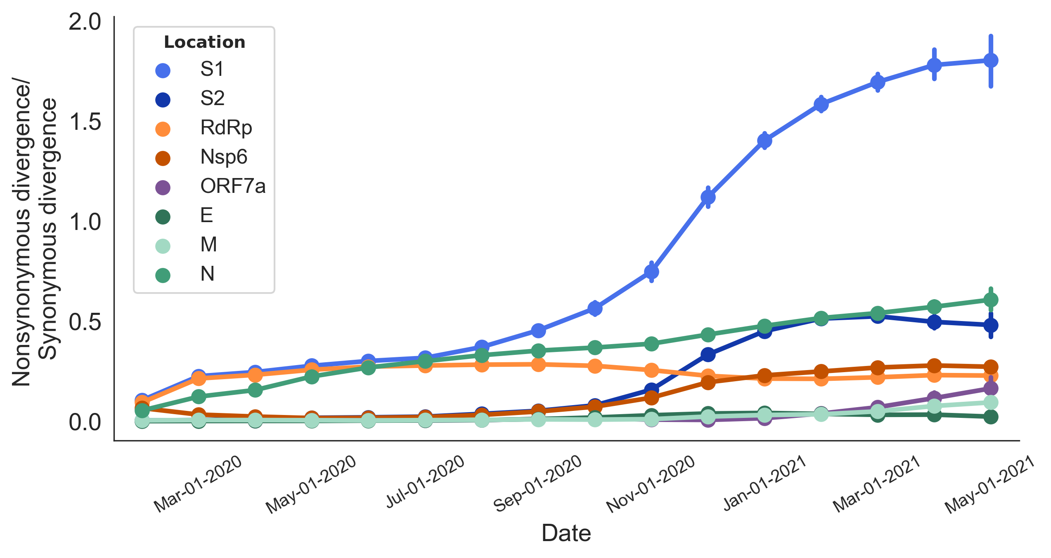
Accumulation of divergence calculated for internal branches in the window:
Apr-01-2020 (branches from Mar 1 to Apr 30)
Jan-01-2021 (branches from Dec 1 to Jan 31)

