Slide 1
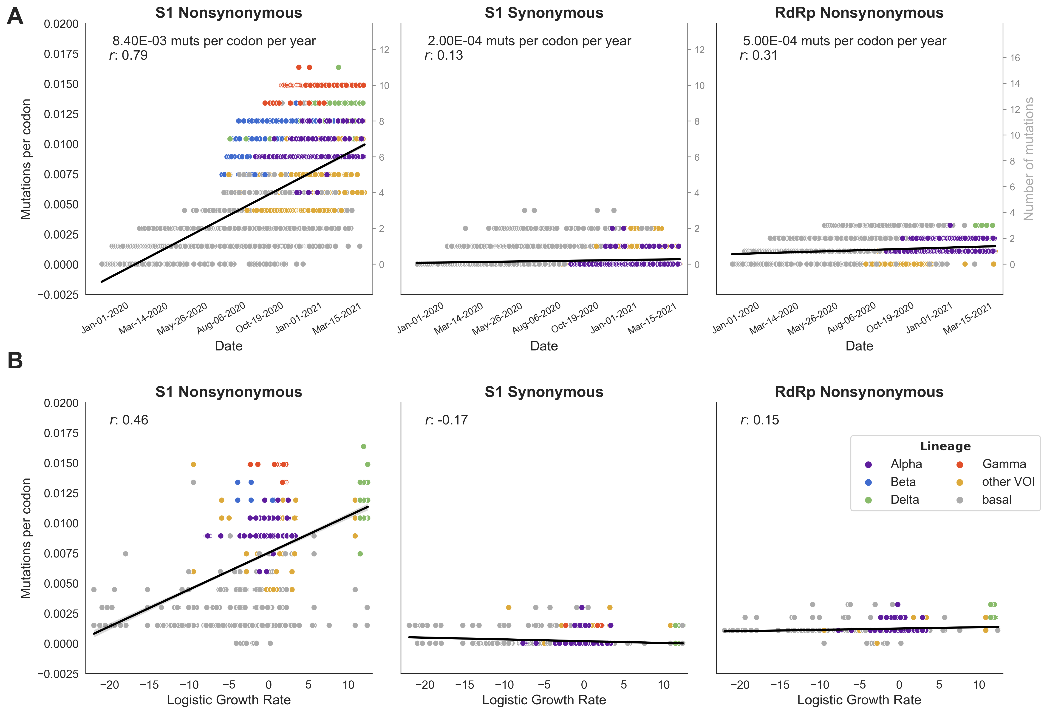
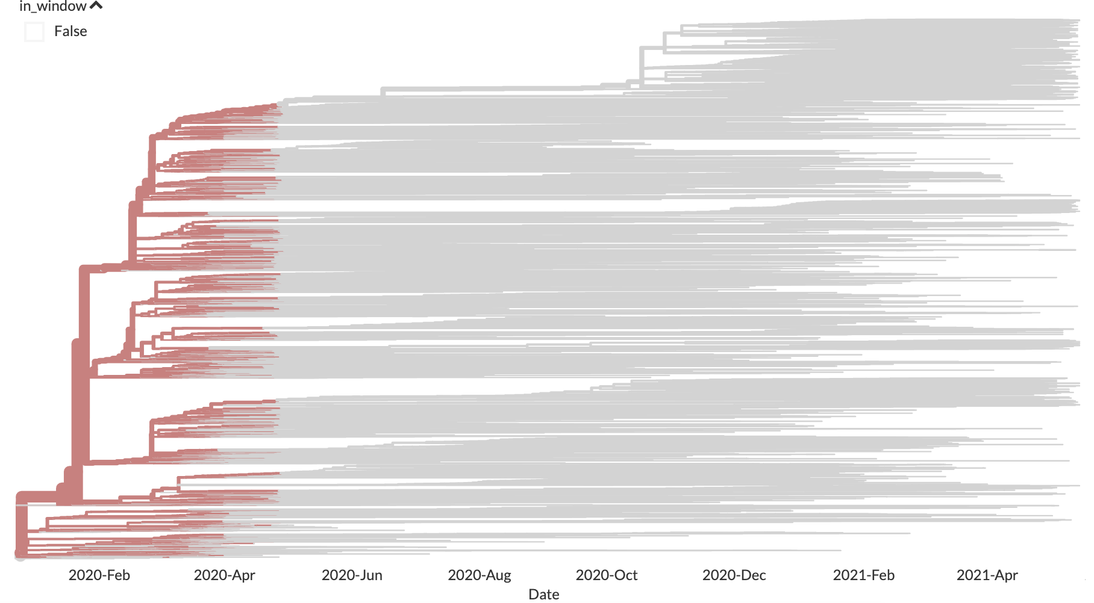
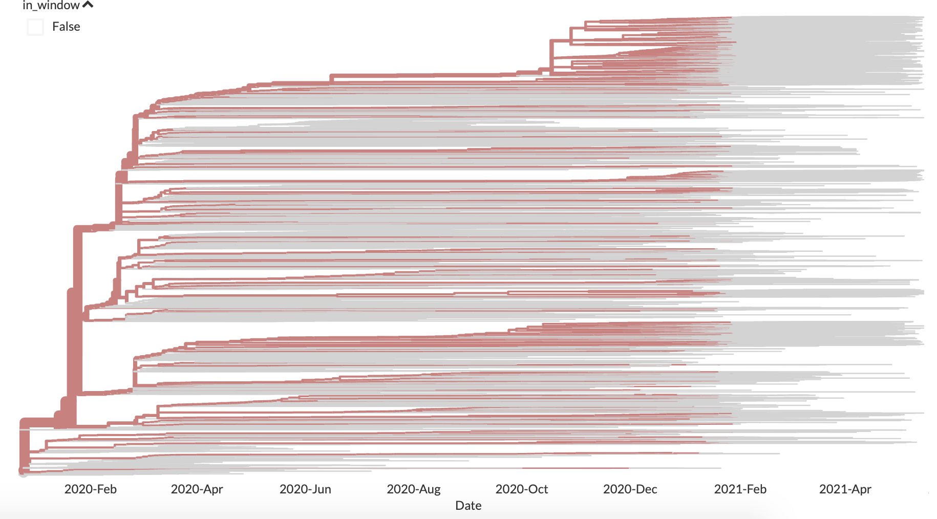
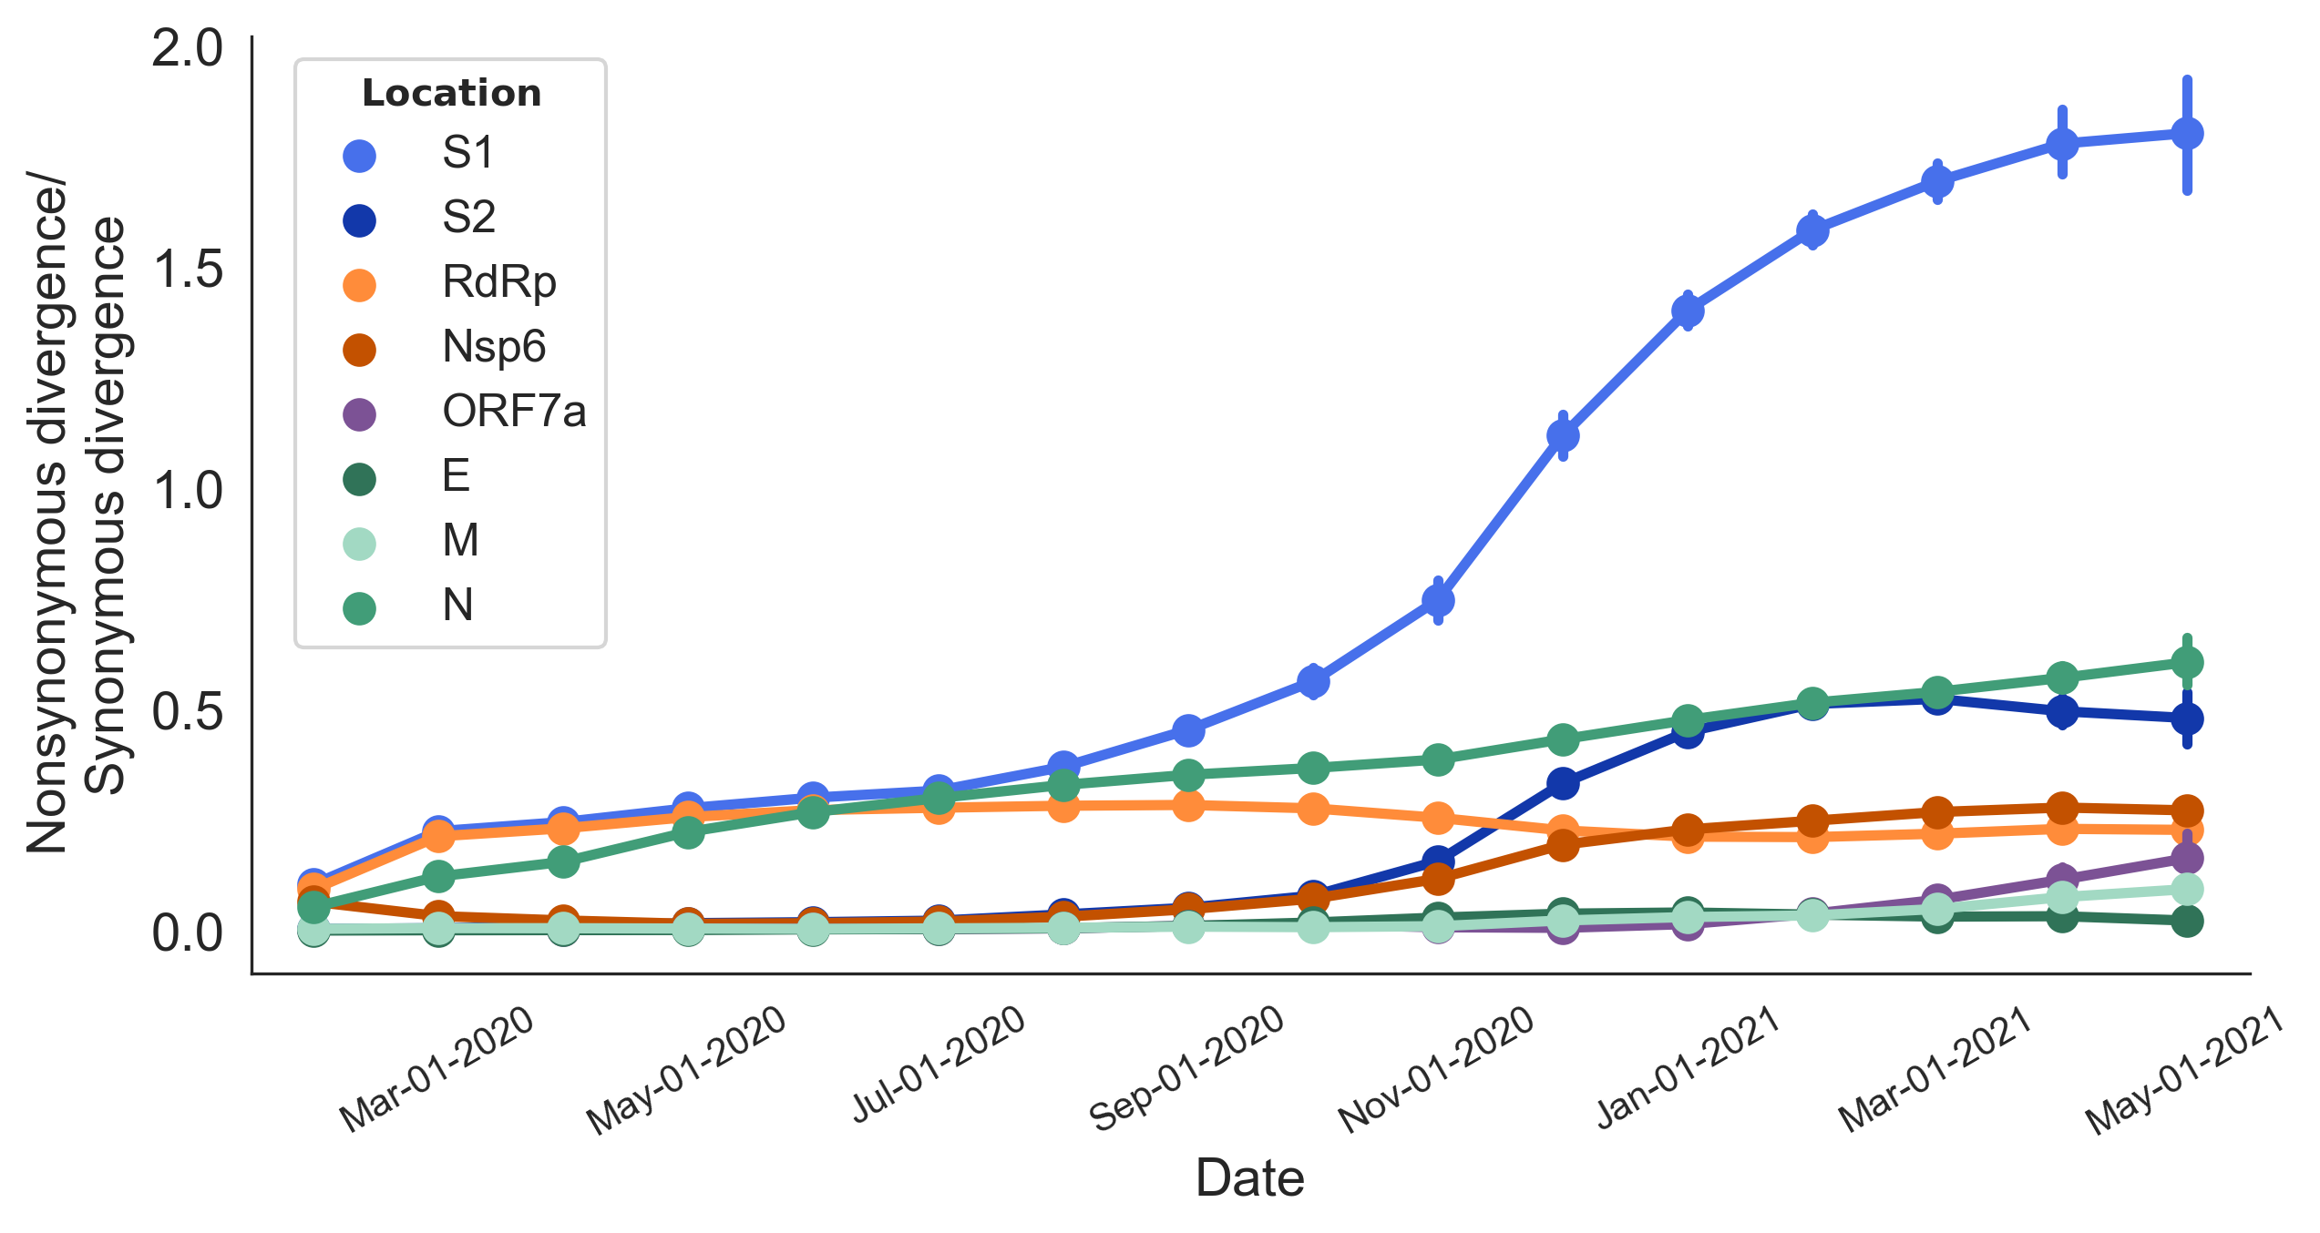
Accumulation of divergence calculated for internal branches in the window:
Apr-01-2020 (March 1 to April 30)
Jan-01-2021 (December 1 to January 31)

