Slide 1
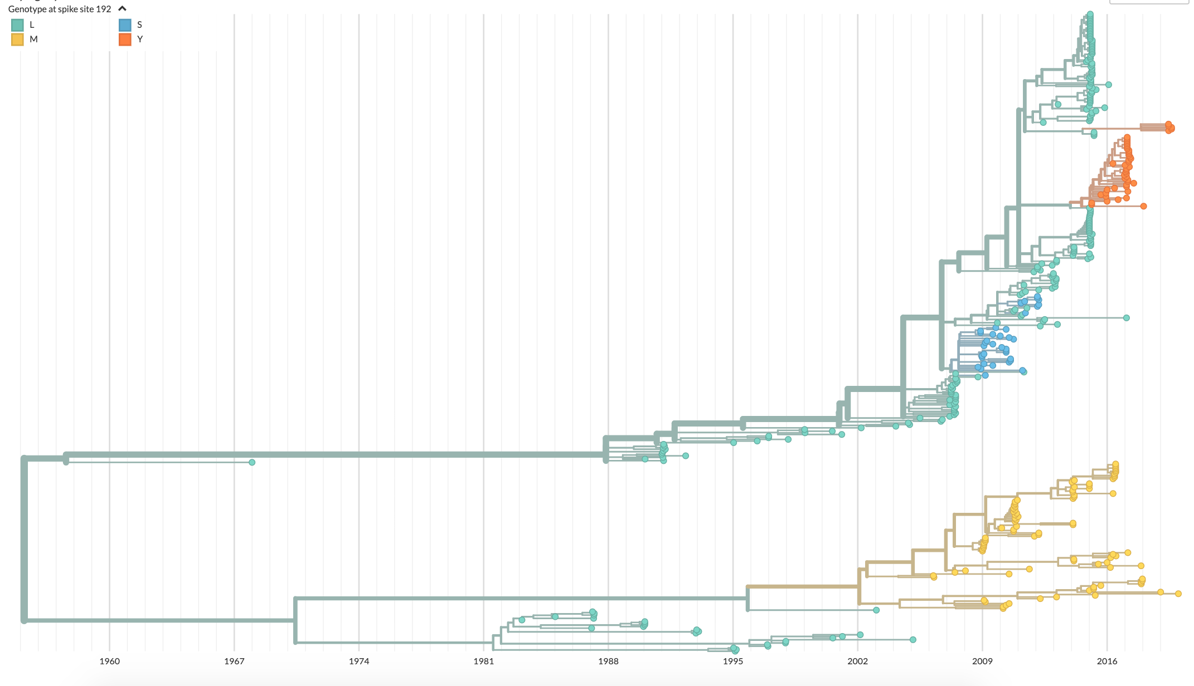
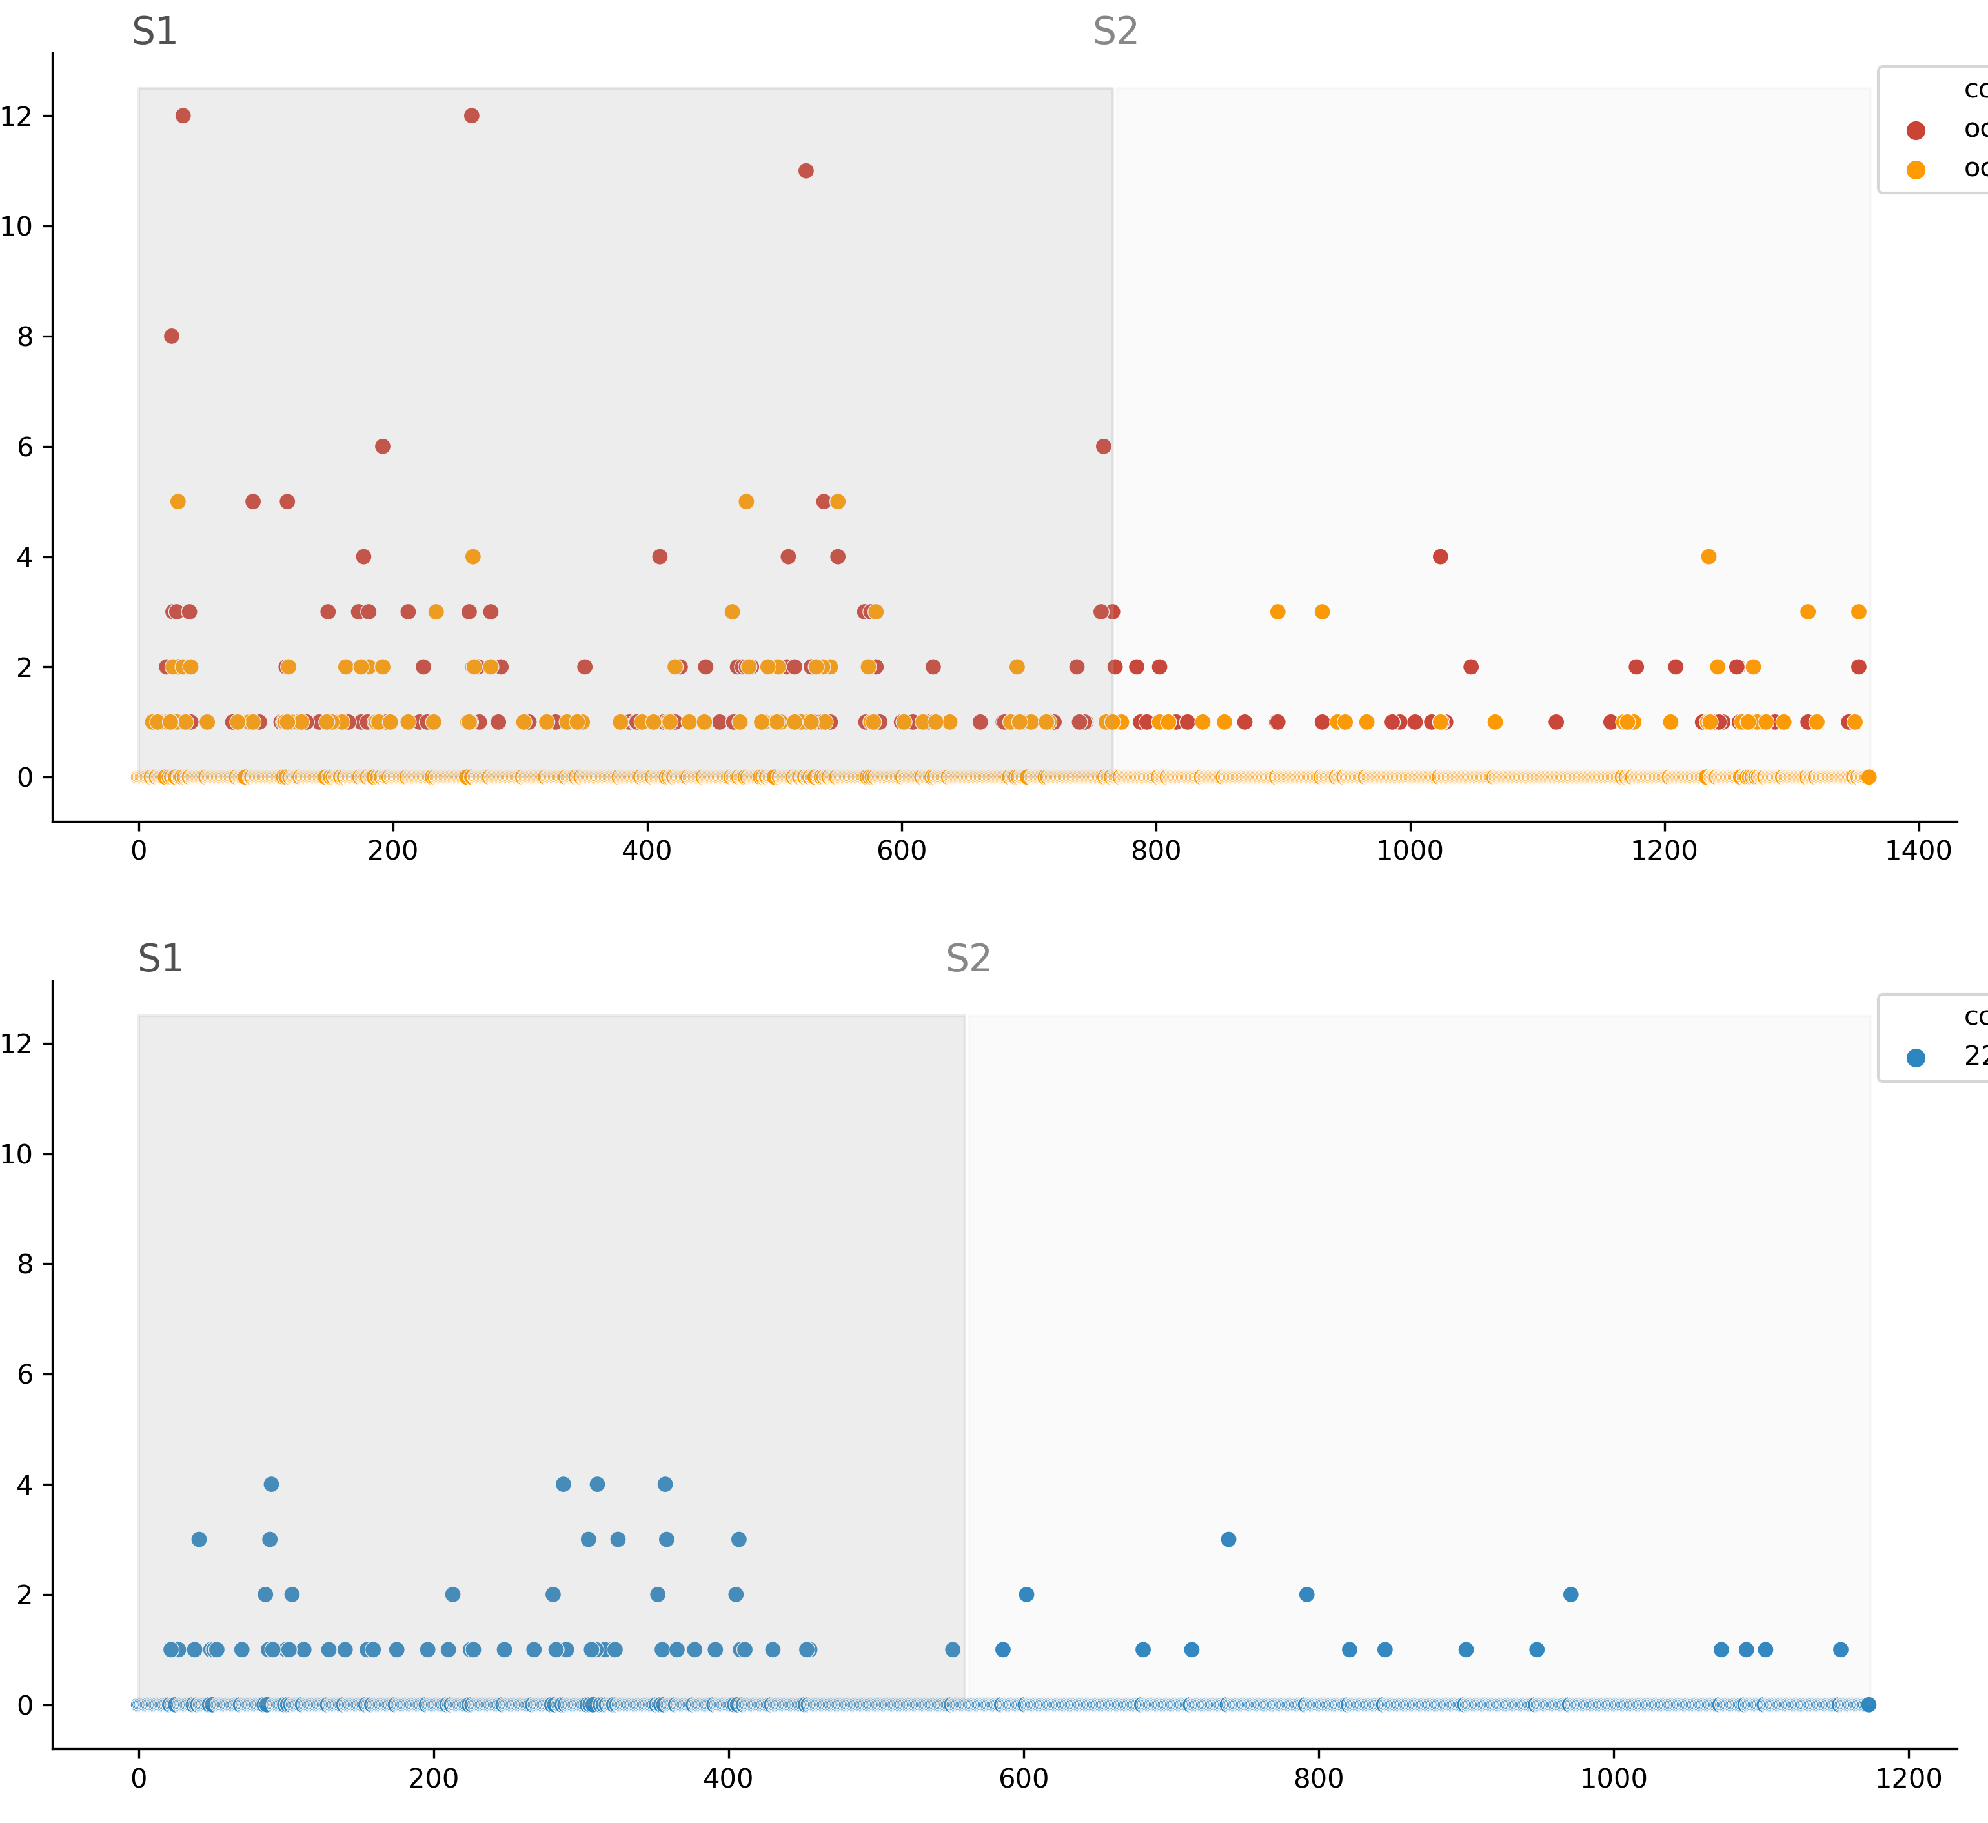
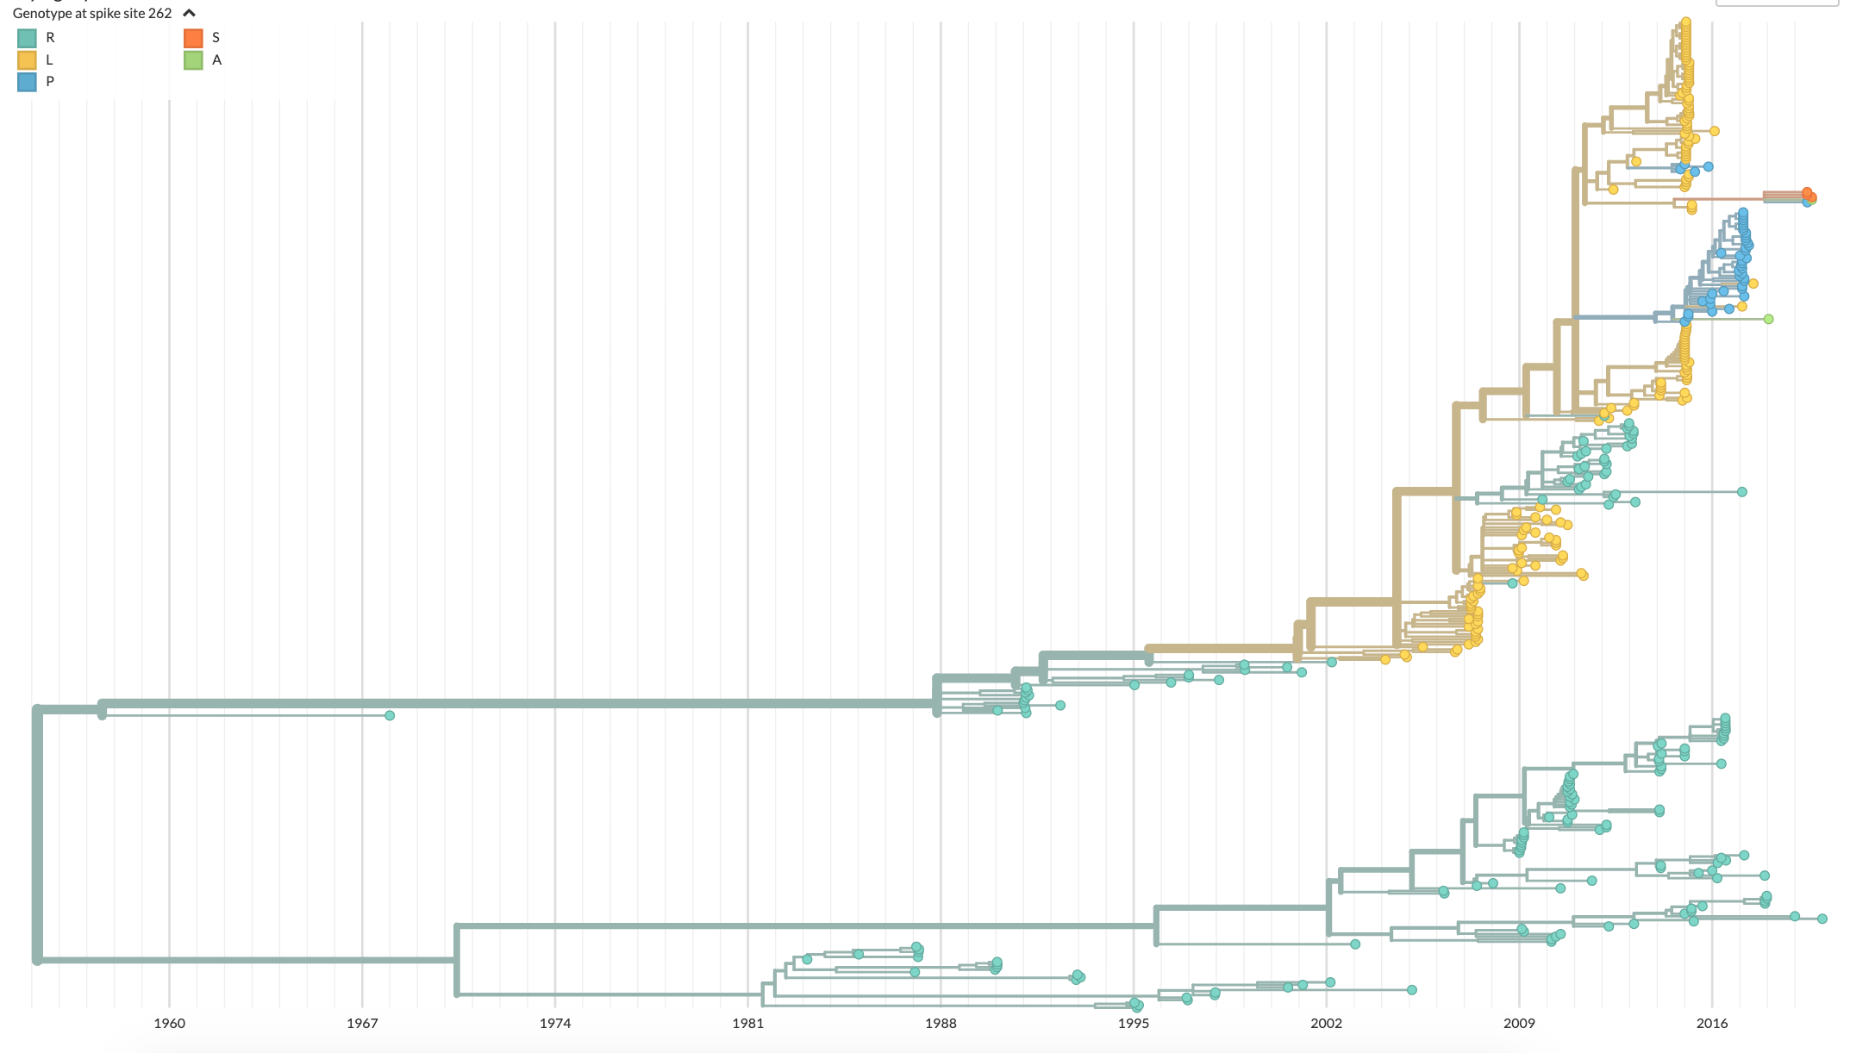
A
B
OC43 Spike 192 genotype
L
M
S
Y
OC43
lineage A
lineage B
Lineage A
Amino acid substitutions per site
Lineage B
C
1960 1967 1974 1981 1988 1995 2002 2009 2016
229E
OC43 Spike 262 genotype
R
L
P
S
A
Lineage A
Lineage B
Spike amino acid position
1960 1967 1974 1981 1988 1995 2002 2009 2016

