Slide 1
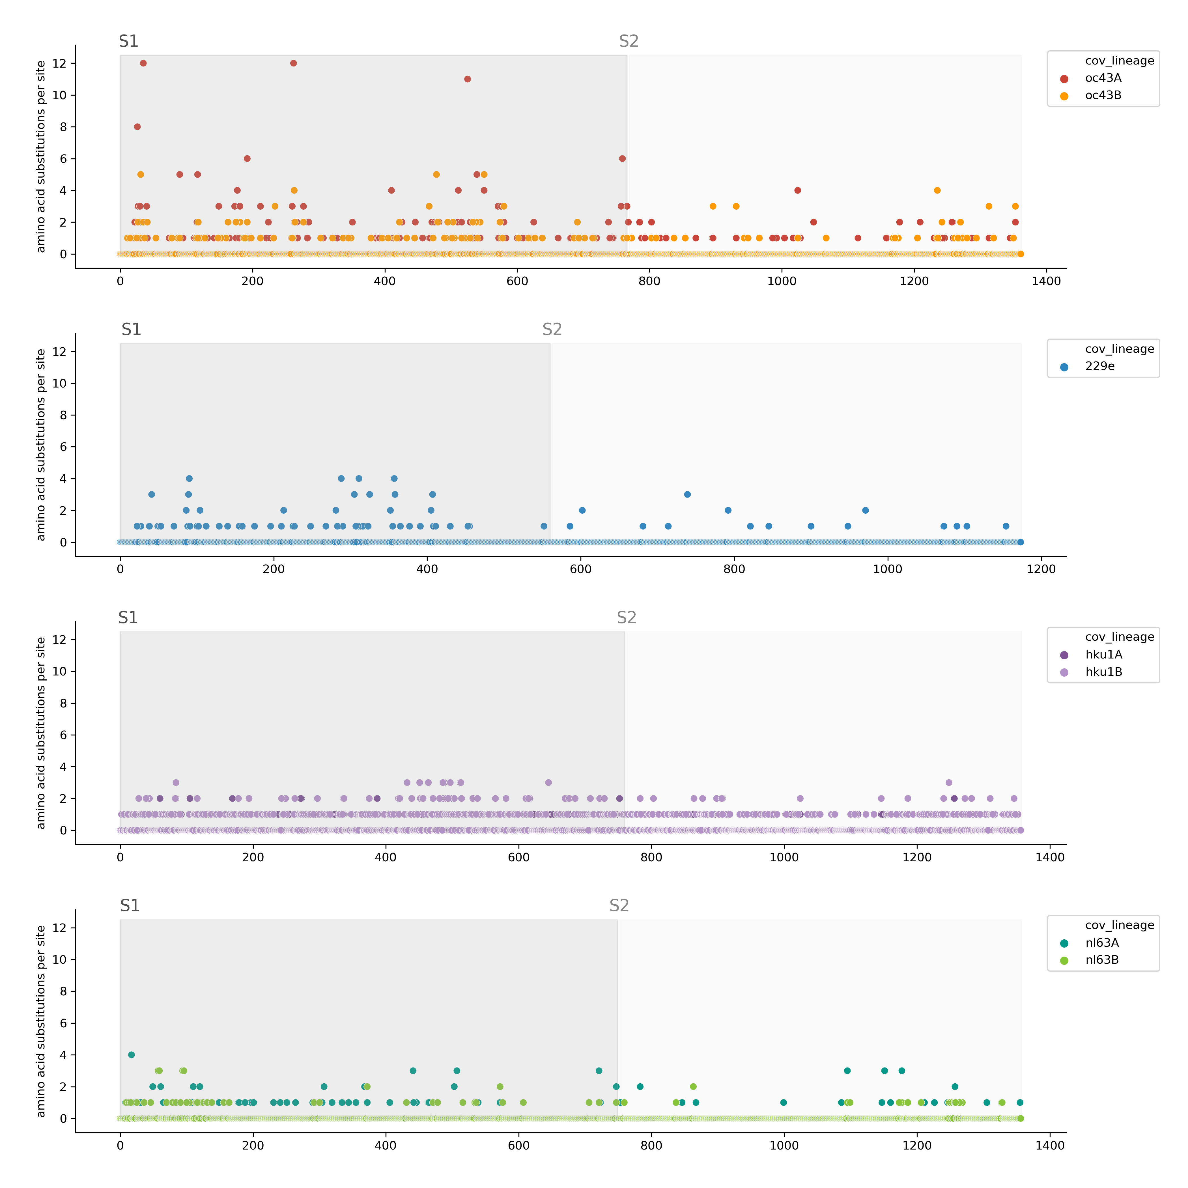
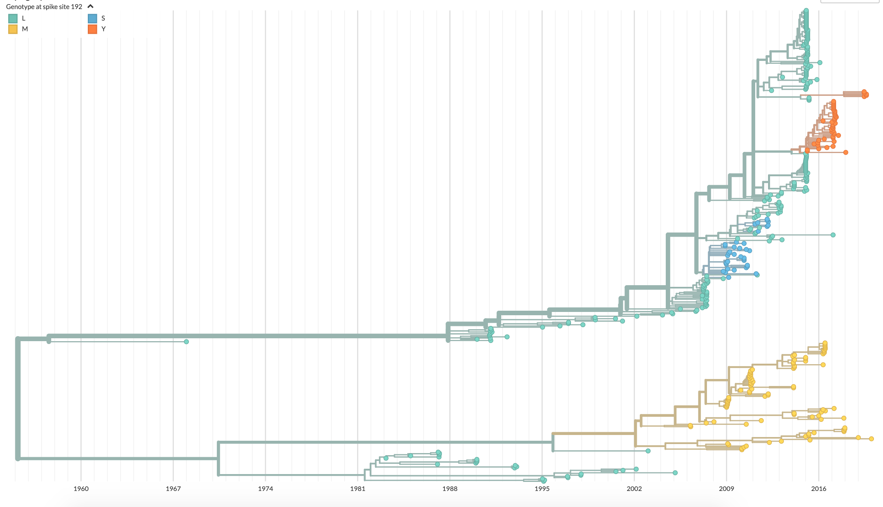
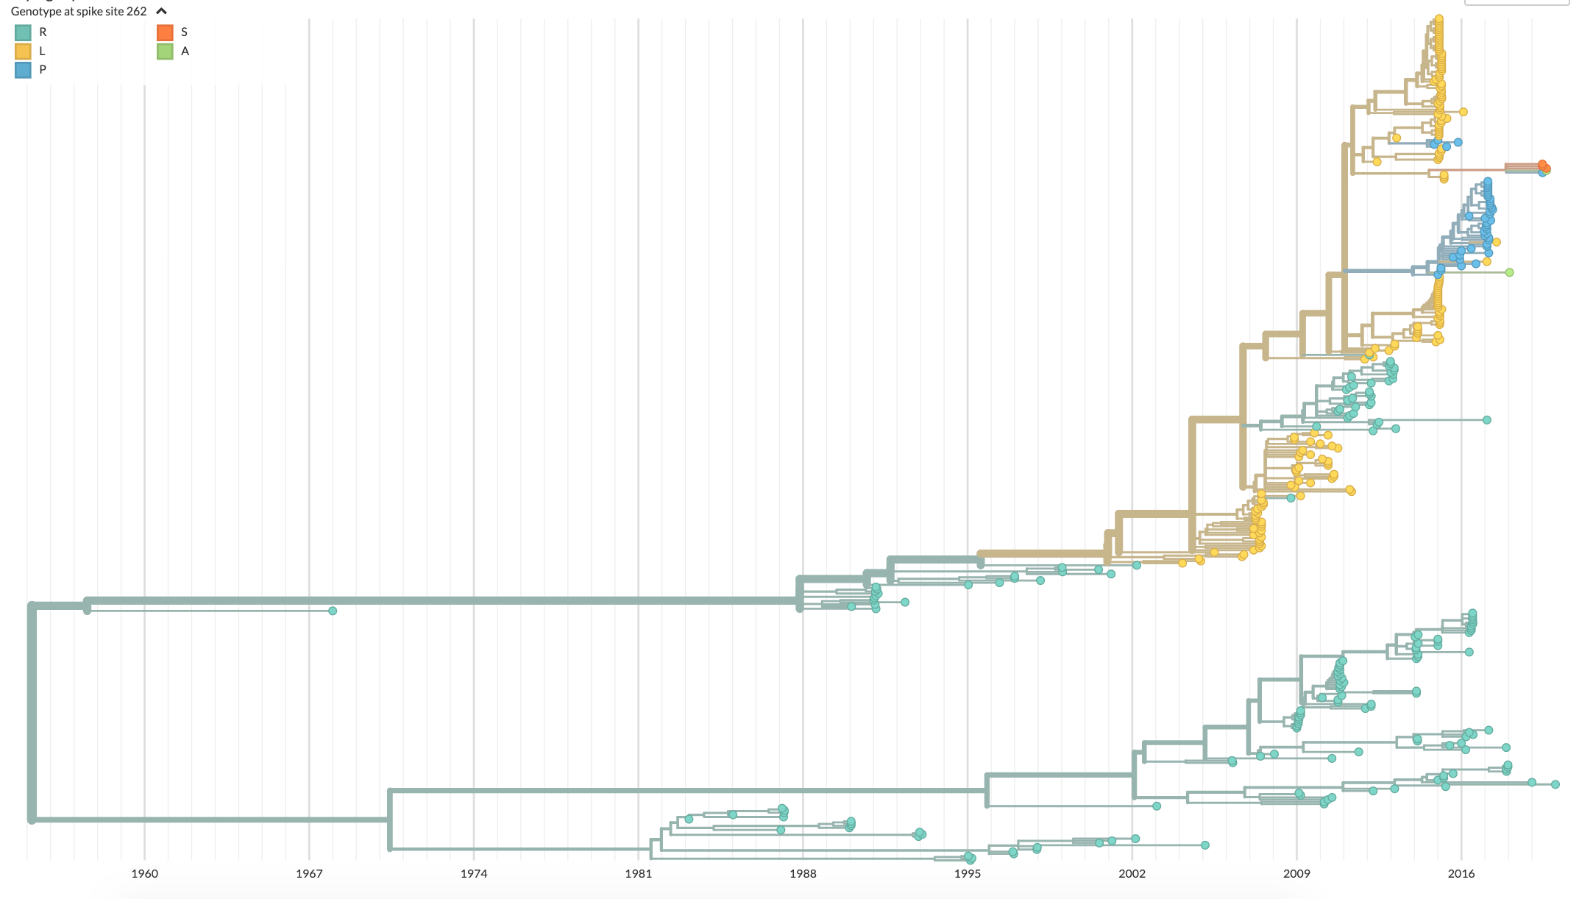
A
B
*
0.331
0.181
0.096
0.077
OC43
lineage A
lineage B
OC43 Spike 192 genotype
L
M
S
Y
*
0.170
0.033
229E
Lineage A
Lineage B
Amino acid substitutions per site
1960 1967 1974 1981 1988 1995 2002 2009 2016
HKU1
lineage A
lineage B
C
0.158
0.478
0.076
0.305
OC43 Spike 262 genotype
R
L
P
S
A
0.087
0.072
0.048
0.033
NL63
lineage A
lineage B
Lineage A
Lineage B
Spike amino acid position
1960 1967 1974 1981 1988 1995 2002 2009 2016

