Slide 1
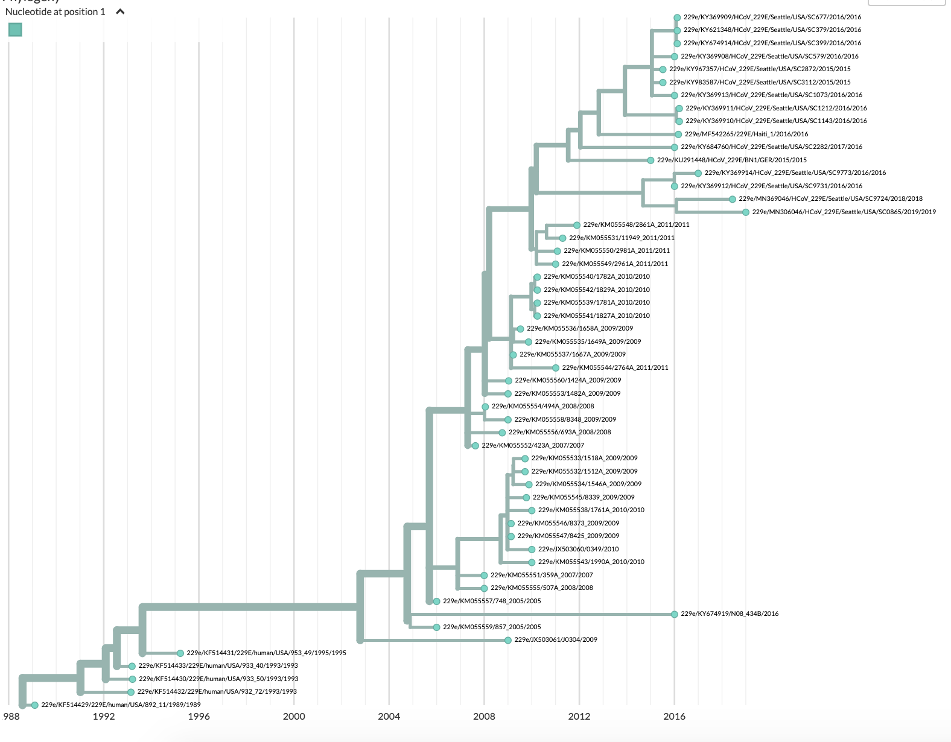
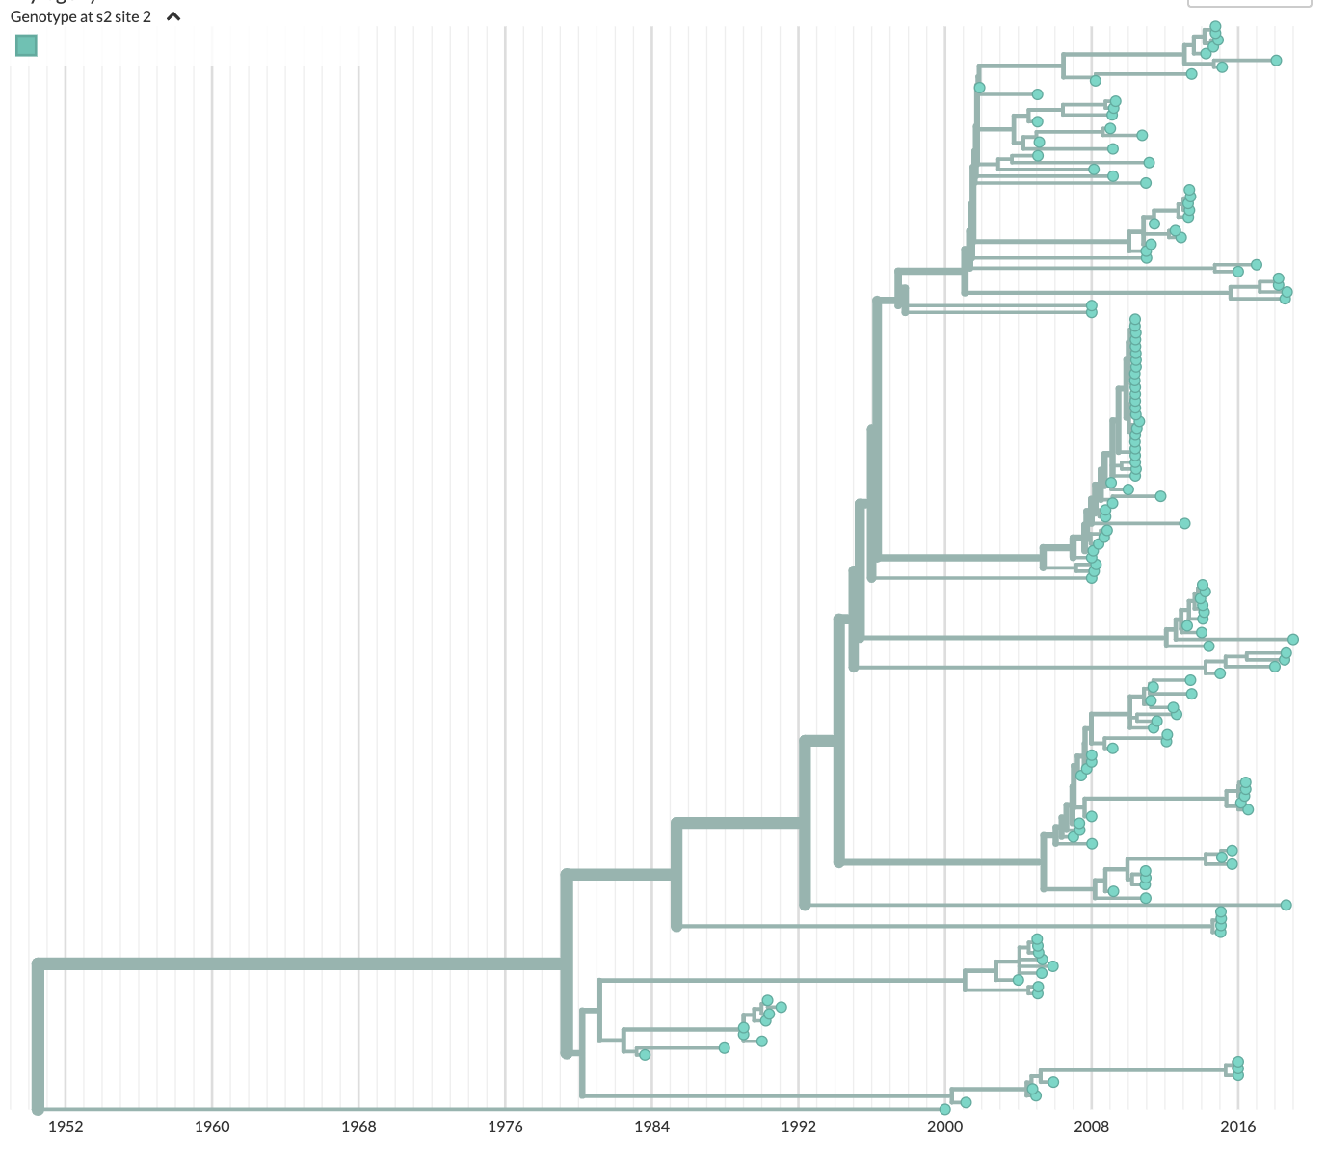
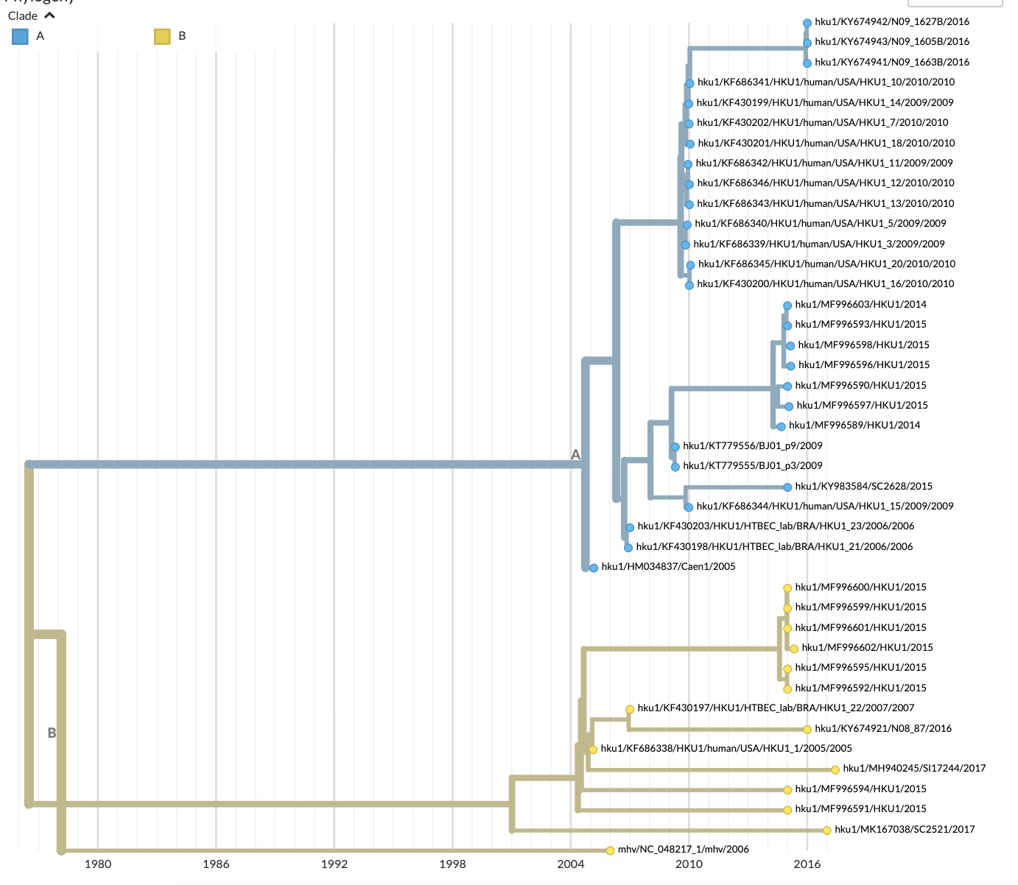
A
B
NL63
HKU1
1952 1960 1968 1976 1984 1992 2000 2008 2016
1980 1986 1992 1998 2004 2010 2016

