Slide 1
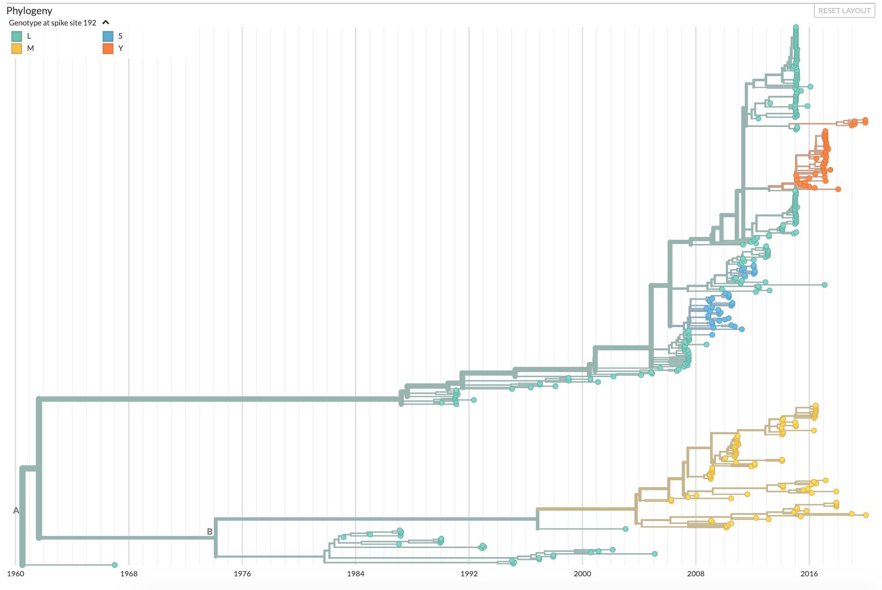
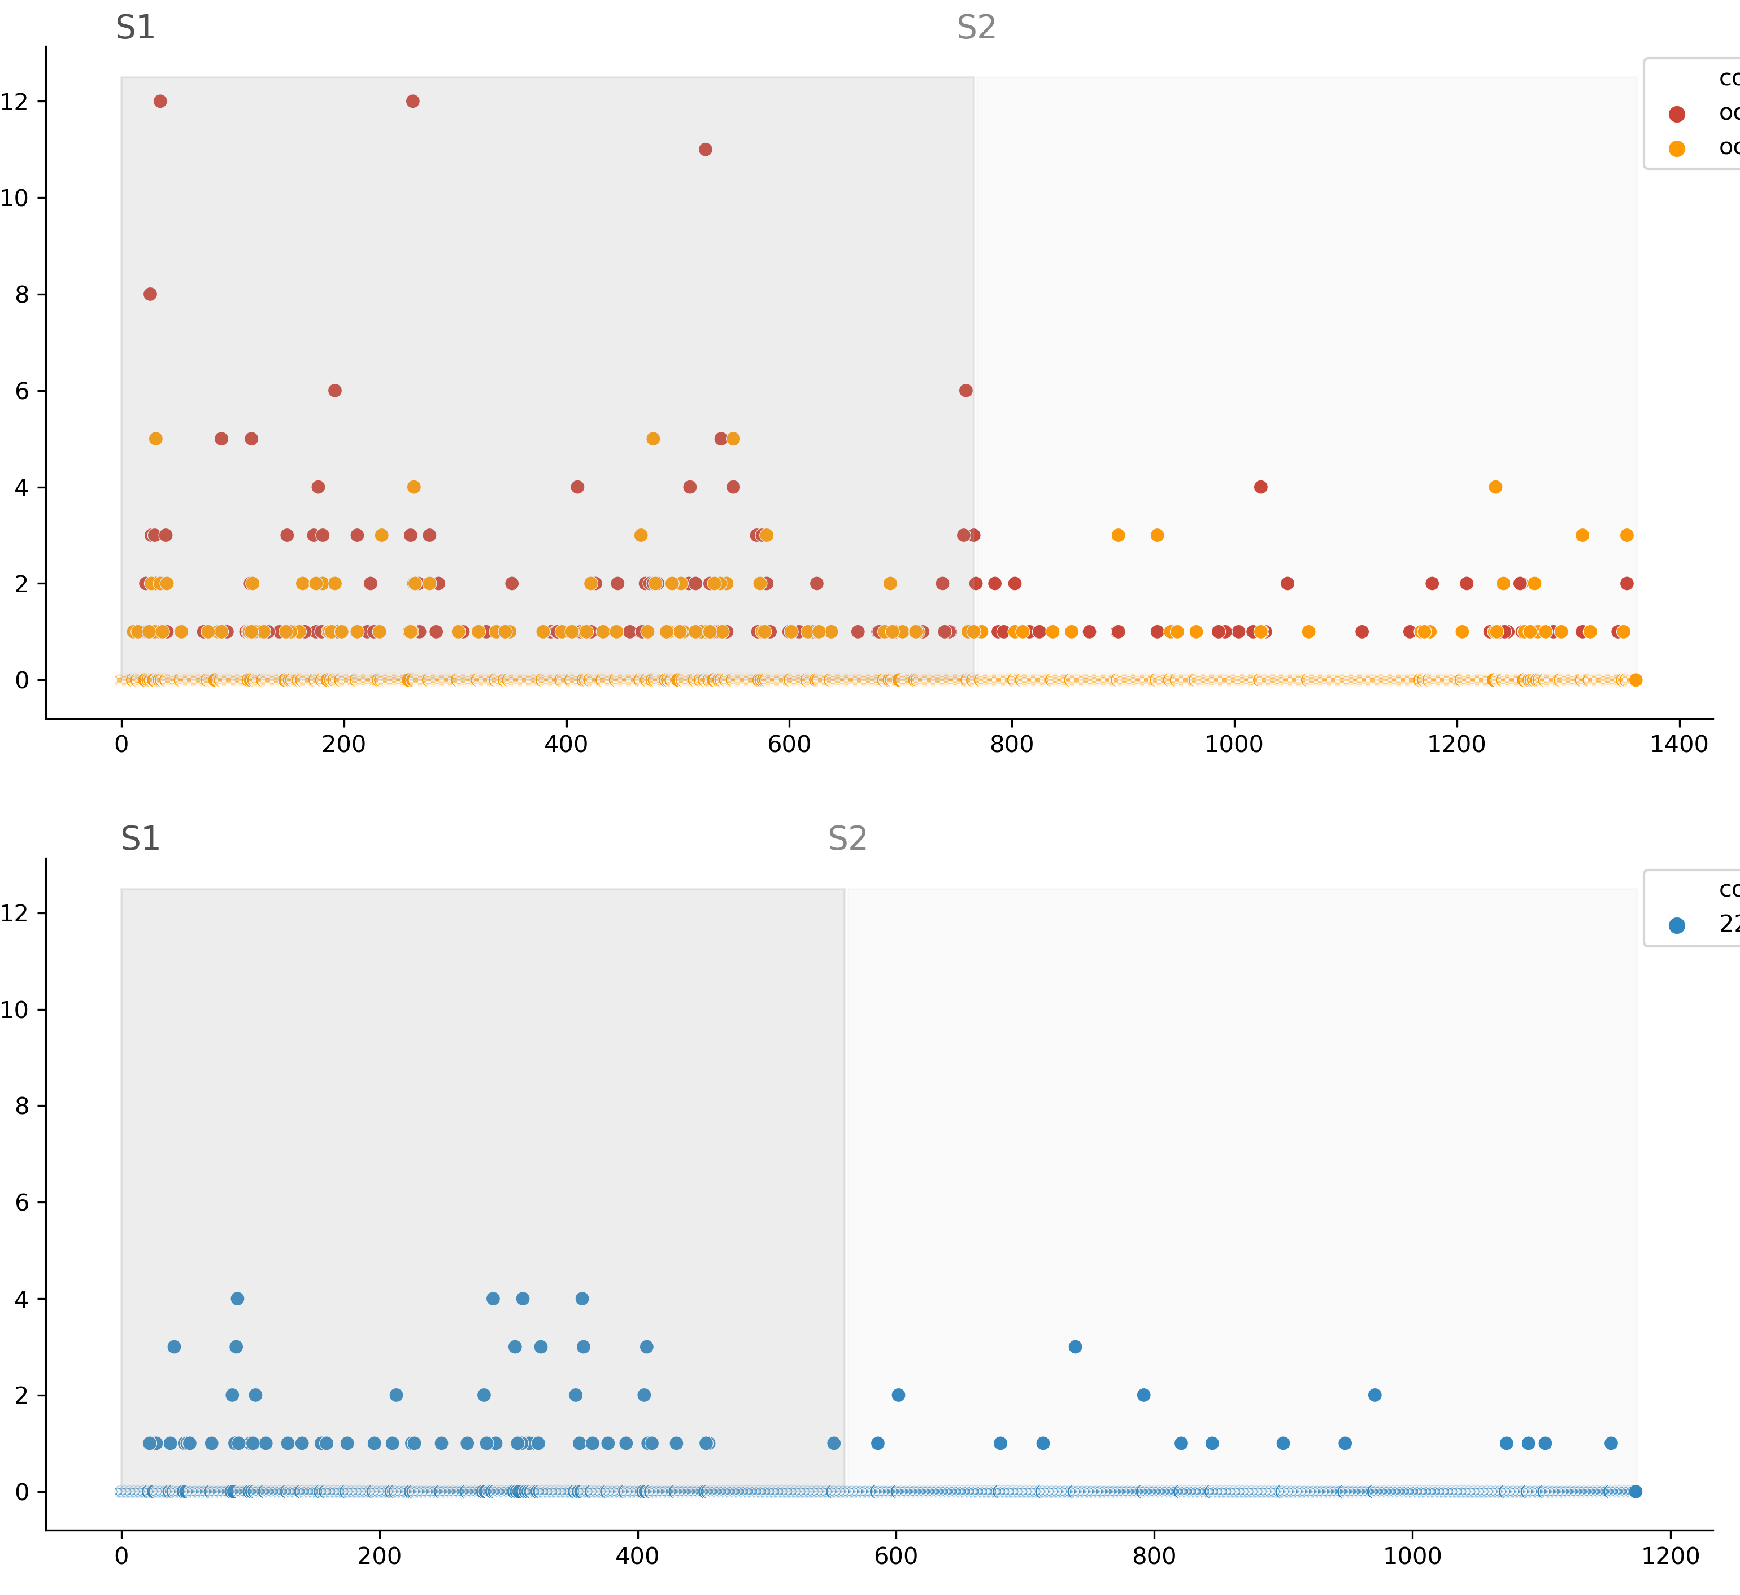
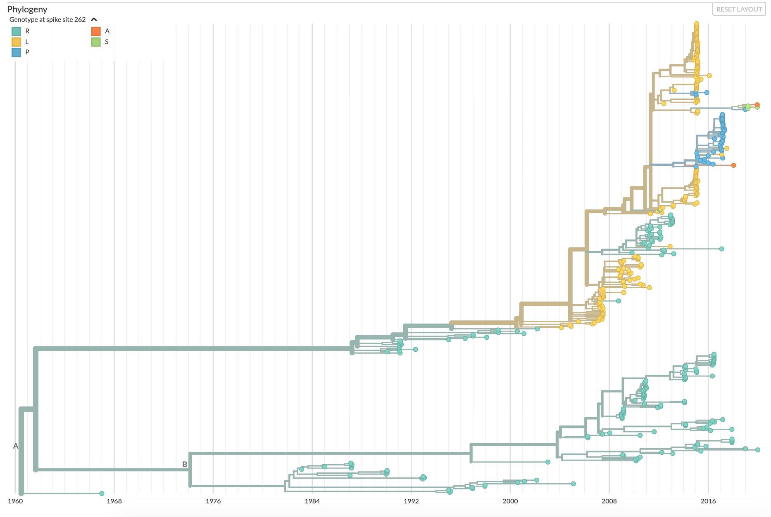
A
B
OC43 Spike 192 genotype
L
M
S
Y
*
OC43
lineage A
lineage B
*
Lineage A
Amino acid substitutions per site
Lineage B
1960 1968 1976 1984 1992 2000 2008 2016
C
229E
OC43 Spike 262 genotype
R
L
P
A
S
Lineage A
Lineage B
Spike amino acid position

