Slide 1
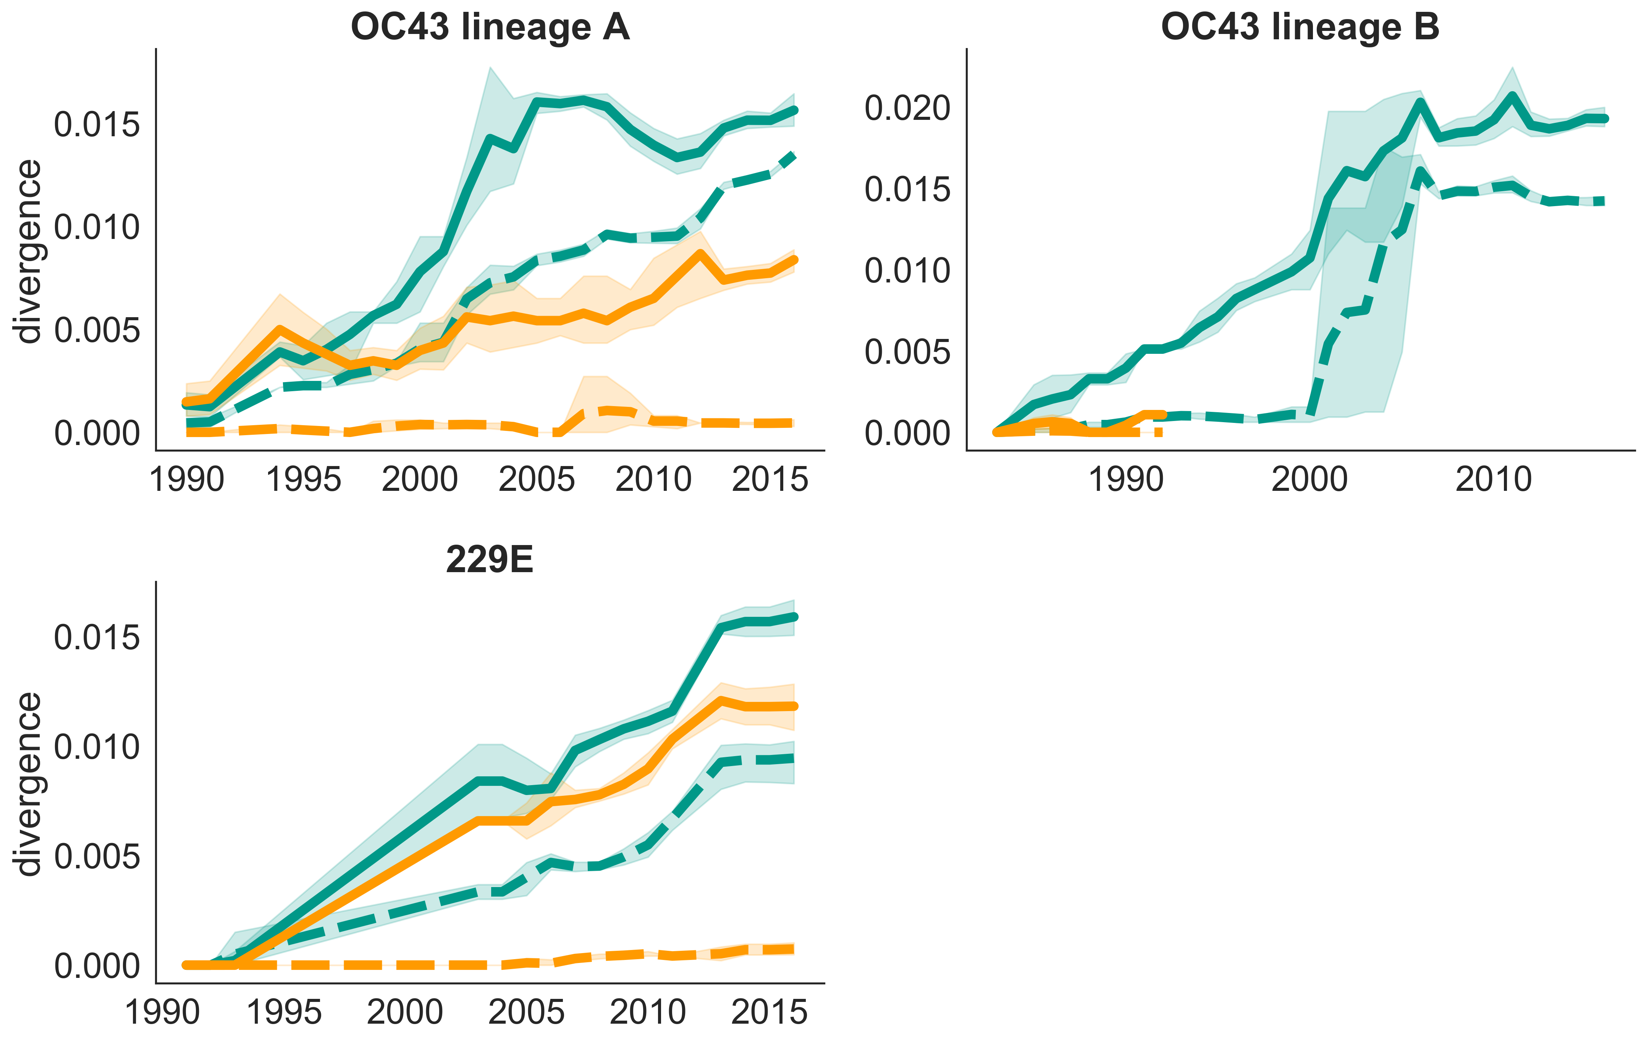
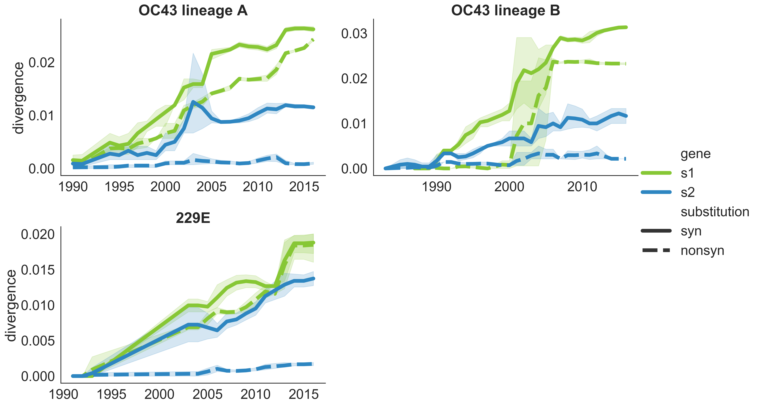
A
B
Gene
Spike
RdRp
S1
S2
Substitution
synonymous
nonsynonymous

