Slide 1
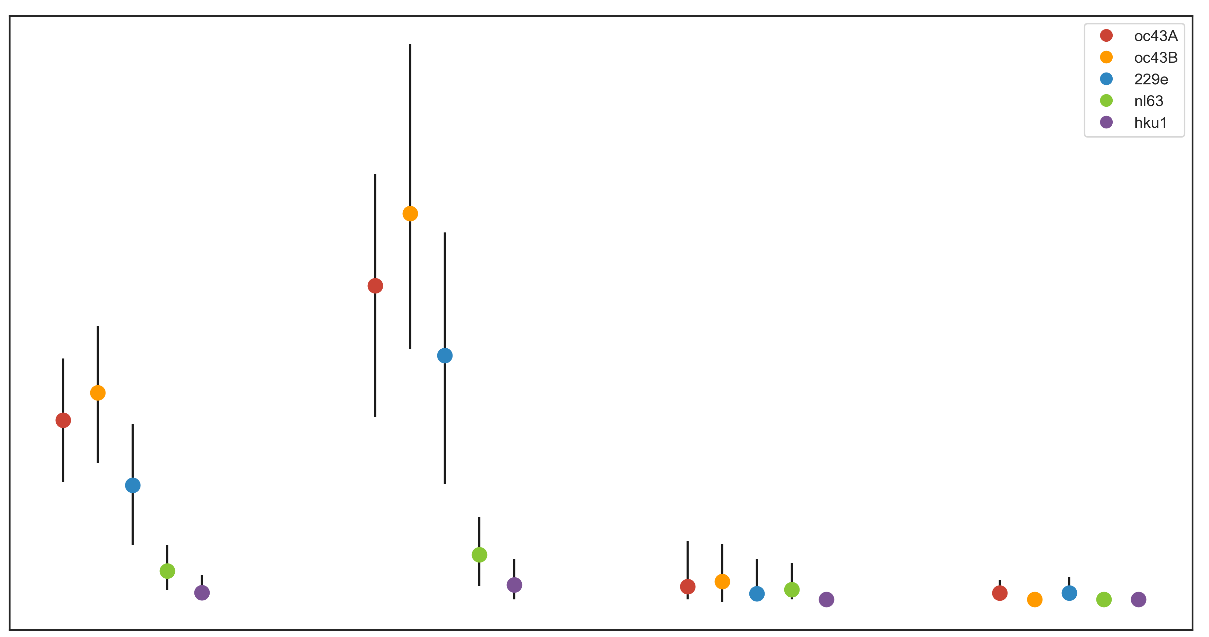
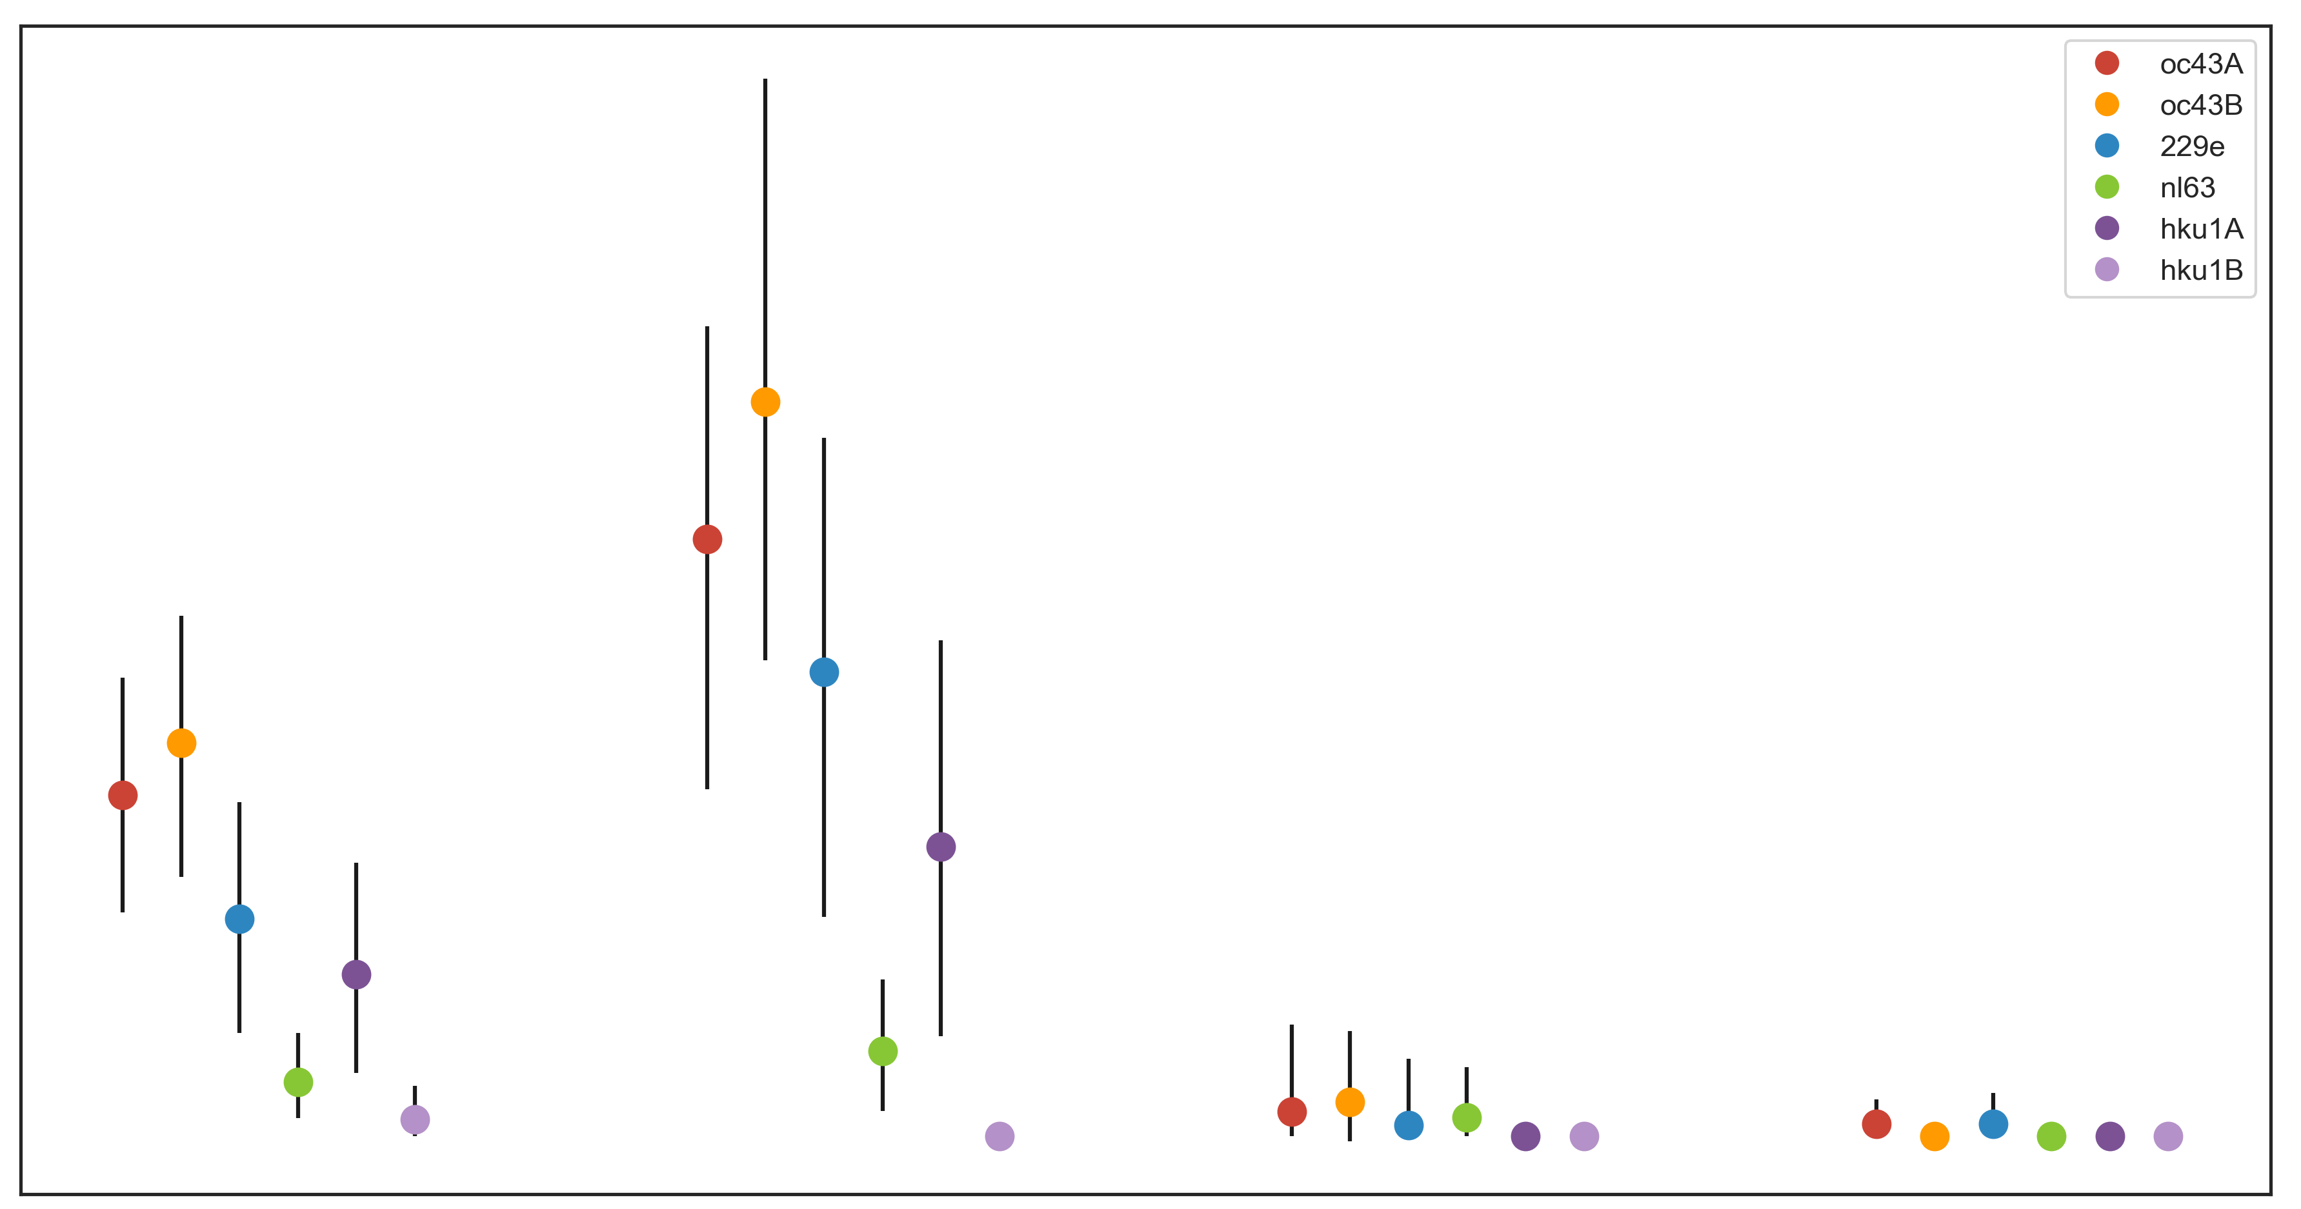
A
OC43 lineage A
OC43 lineage B
229E
NL63
HKU1
1.0
0.8
0.6
Adaptive Subs per Codon per Year (x10⁻³)
0.4
0.2
0.0
Spike
S1
S2
RdRp
B
OC43 lineage A
OC43 lineage B
229E
NL63
HKU1 lineage A
HKU1 lineage B
1.0
0.8
0.6
Adaptive Subs per Codon per Year (x10⁻³)
0.4
0.2
0.0
Spike
S1
S2
RdRp

